Slide 1
Welcome to Federally Qualified Health Centers (FQHCs) and FQHC Practitioners Enrollment Training

Slide 2
Topics
Primary topics:
Affordable Care Act Overview
FQHCs and FQHC Practitioners Enrollment Requirements
Accessing the Enrollment Application
Enrollment Portal
Enrolling a New Provider
Enrolling a New Service Location
Revalidation
Reactivation
Change Requests

Slide 3
Topics - continued
How to complete application
FQHC application
FQHC Practitioner application
Questions
Resources

Slide 4
ACA - Overview
The Federally mandated Affordable Care Act (ACA) requires that all states comply with the provider screening and enrollment regulations found at 42 Code of Regulations (CFR) 455, Subpart E – Provider Screening and Enrollment Requirements.
As required by the ACA, all practitioners, including those who order, refer or prescribe items or services for MA beneficiaries, must enroll in the MA Program.
The ACA and implementing regulations require states to revalidate the enrollment of providers every five years.

Slide 5
Provider Enrollment
Providers must revalidate their enrollment every 5 years
An application fee must be collected prior to executing a provider agreement except in the following instances:
Individual physicians or non-physician practitioners
Providers enrolled in Title XVIII of the ACT or another states title XIX or XXI plan
Providers that have paid the application fee to a Medicare contractor or another state

Slide 6
Types of Enrollment Applications
New application – brand new provider never enrolled with PA Medicaid
Revalidation application – provider currently enrolled with PA Medicaid
Reactivation application – provider re-enrolling with PA Medicaid
Change Request application – provider application for active providers who need to change specific enrollment information

Slide 7
Enrolling a New FQHC
FQHC newly enrolling in the MA Program (have never been enrolled)
Step 1:
Go to the Landing page of the PROMISe™ Portal
website: promise.dpw.state.pa.us
Step 2:
Select “New Application” from the Provider Enrollment Section of the Landing Page
Step 3:
Complete the application using the FQHC’s information and submit

Slide 8
Enrolling a New FQHC

Slide 9
FQHC - Adding a New Service Location
Enrolled FQHC adding a New Service Location
Step 1:
Logon to the PROMISe™ Portal using the FQHC’s logon credentials
website: promise.dpw.state.pa.us
Step 2:
From the Provider Services Section on the My Home Page select New Service Location
Step 3:
Complete the application using the FQHC’s information and submit

Slide 10
FQHC - Adding a New Service Location

Slide 11
FQHC – Revalidation Application
Enrolled FQHC needing to Revalidate an active Service Location
Step 1:
Logon to the PROMISe™ Portal using the FQHC’s logon credentials
website: promise.dpw.state.pa.us
Step 2:
From the Provider Services Section on the My Home Page select Revalidation
Step 3:
Complete the application using the FQHC’s information and submit
NOTE: Some fields may be prepopulated with the FQHC’s information

Slide 12
FQHC – Revalidation Application

Slide 13
FQHC – Reactivation - Service Location closed for more than 2 years
FQHC who wish to reactivate an existing service location that has been closed for more than 2 years
Step 1:
Go to the Landing page of the PROMISe™ Portal
website: promise.dpw.state.pa.us
Step 2:
Select “Reactivation” from the Provider Enrollment Section of the Landing Page
Step 3:
Complete the application using the FQHC’s information and submit

Slide 14
FQHC – Reactivation - Service Location closed for more than 2 years

Slide 15
FQHC – Reactivation - Service Location closed for less than 2 years
FQHC who wish to reactivate a service location that has been closed for less than 2 years
Step 1:
Logon to the PROMISe™ Portal using the FQHC’s logon credentials
website: promise.dpw.state.pa.us
Step 2:
From the Provider Services Section on the My Home Page select Reactivation
Step 3:
Complete the application using the FQHC’s information and submit
NOTE: Some fields may be prepopulated with the FQHC’s information

Slide 16
FQHC – Reactivation Application –Service Location closed less than 2 years

Slide 17
FQHC Practitioners Enrollment

Slide 18
Enrolling a New FQHC Practitioner
FQHC who are enrolling a new Practitioner in the MA Program (never been enrolled)
Step 1:
Go to the Landing page of the PROMISe™ Portal
website: promise.dpw.state.pa.us
Step 2:
Select “New Application” from the Provider Enrollment Section of the Landing Page
Step 3:
Complete the application using the Practitioner’s information and submit

Slide 19
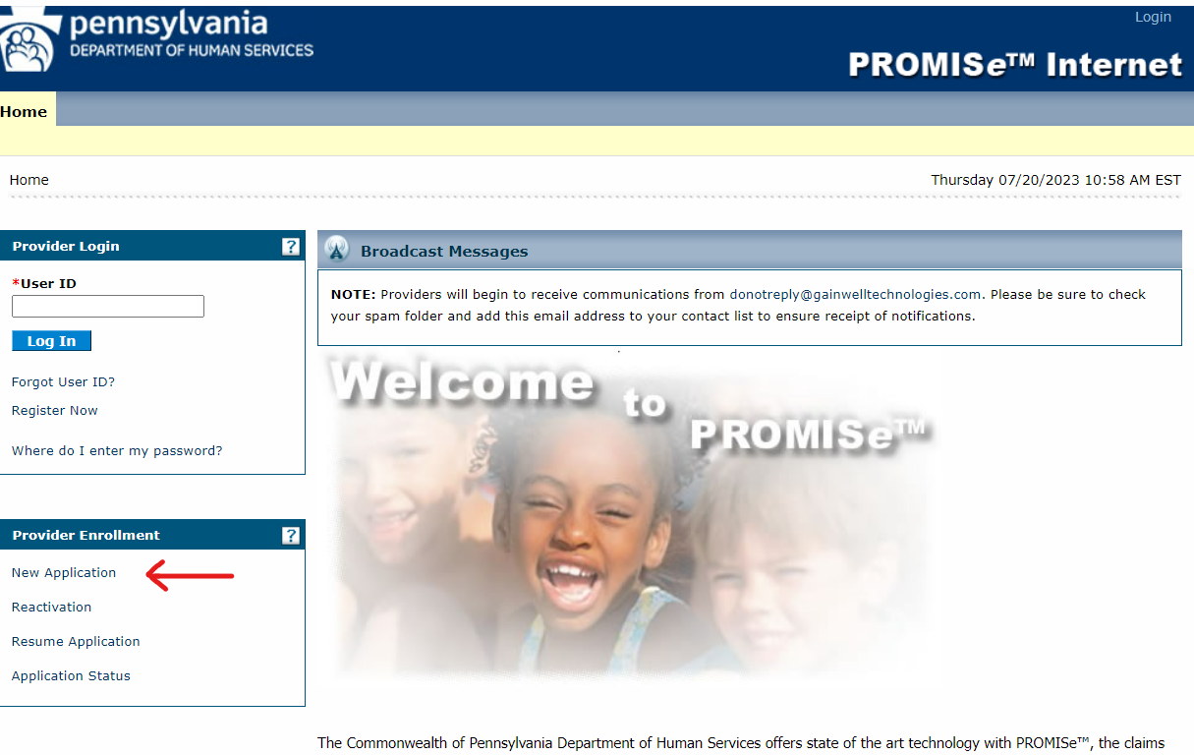
Enrolling a New FQHC Practitioner

Slide 20
FQHC Practitioner - Adding a New Service Location
Enrolled FQHC Practitioner adding a New Service Location
Step 1:
Logon to the PROMISe™ Portal using the Practitioner’s logon credentials
website: promise.dpw.state.pa.us
Step 2:
From the Provider Services Section on the My Home Page select New Service Location
Step 3:
Complete the application using the Practitioner’s information and submit

Slide 21
FQHC Practitioner- Adding a New Service Location

Slide 22
FQHC Practitioner – Revalidation Application
Enrolled FQHC Practitioner needing to Revalidate a Service Location
Step 1:
Logon to the PROMISe™ Portal using the Practitioner’s logon credentials
website: promise.dpw.state.pa.us
Step 2:
From the Provider Services Section on the My Home Page select Revalidation
Step 3:
Complete the application using the Practitioner’s information and submit
NOTE: Some fields may be prepopulated with the Practitioner’s information

Slide 23
FQHC Practitioner– Revalidation Application

Slide 24
FQHC Practitioner– Reactivation - Service Location closed for more than 2 years
FQHC Practitioner who wish to reactivate an existing service location that has been closed for more than 2 years
Step 1:
Go to the Landing page of the PROMISe™ Portal
website: promise.dpw.state.pa.us
Step 2:
Select “Reactivation” from the Provider Enrollment Section of the Landing Page
Step 3:
Complete the application using the Practitioner’s information and submit

Slide 25
FQHC Practitioner– Reactivation –Service Location closed for more than 2 years

Slide 26
FQHC Practitioner– Reactivation –Service Location closed less than 2 years
FQHC Practitioner who wish to reactivate a service location that has been closed for less than 2 years
Step 1:
Logon to the PROMISe™ Portal using the Practitioner’s logon credentials
website: promise.dpw.state.pa.us
Step 2:
From the Provider Services Section on the My Home Page select Reactivation
Step 3:
Complete the application using the Practitioner’s information and submit
NOTE: Some fields may be prepopulated with the Practitioner’s information

Slide 27
FQHC Practitioner– Reactivation Application –Service Location closed less than 2 years

Slide 28
Enrollment Application Walk Through
Presented By
Benita Bishop, Human Services Program Specialist Supervisor

Slide 29
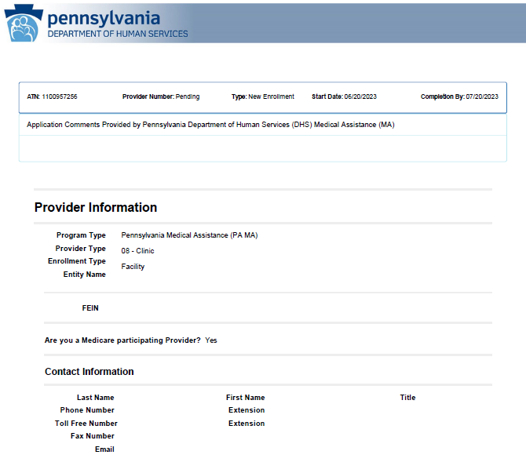

Slide 30
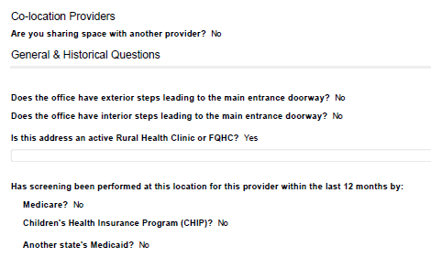
Notes:
Co Location question will be remove by Nov 1 . This regulation was repelled.

Slide 31
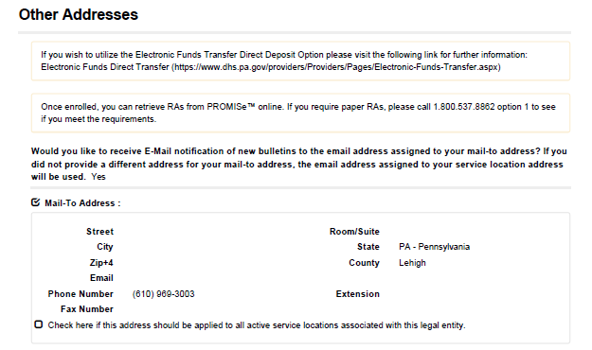
Notes:
There will be the option to make all address match the service location address, if that option is taken they will not see this section in this way. There will be a section for Mail-to, Pay-to and Home Office

Slide 32
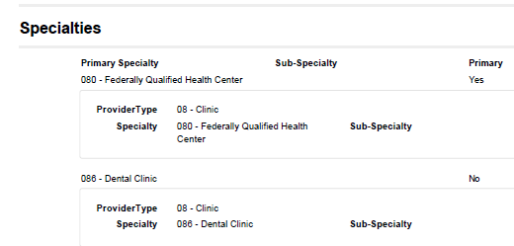
Notes:
Once they select the primary specialty they will have the question for additional specialties. In this case an additional specialty was selected.

Slide 33
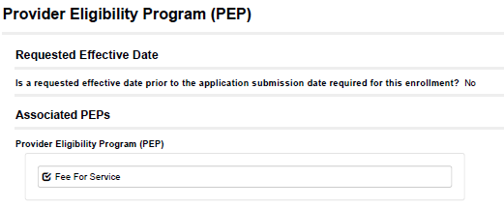

Slide 34
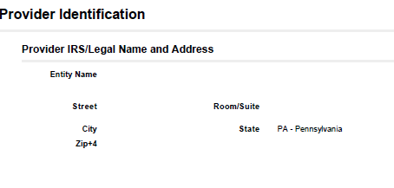
Name must match the IRS verification document
We DO NOT accept a W9 as verification of the Tax ID
Notes:
It will also ask for contact information for the IRS, this should be your individual that would receive the 1099 for this location.

Slide 35
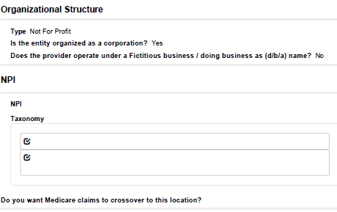
Notes:
The boxes with the check mark Discuss NPI, Taxonomy, Zip Code issue.
Cross over claims/MDX

Slide 36
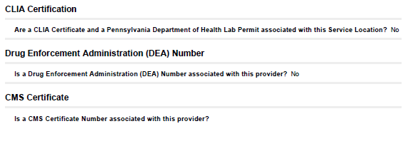
Notes:
These question will appear on the Provider Identification page with the previous slide.
CLIA should go on the Entity application and any individual provider that is performing the laboratory service. If the provider is only ordering or drawing the specimen they should not answer YES to the CLIA question.

Slide 37
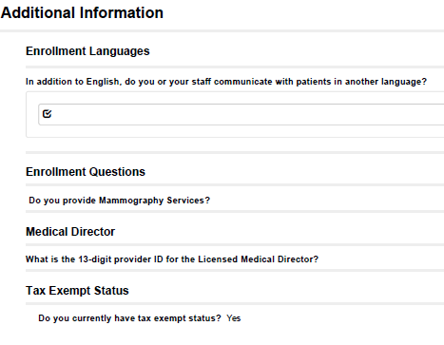
Notes:
Medical Director 13 digit id does not have to be for the same address as the Clinic. Must be a Physician and verification is in the form of a letter and their license.
Tax Exemption is for Federal Tax Exemption not State.

Slide 38
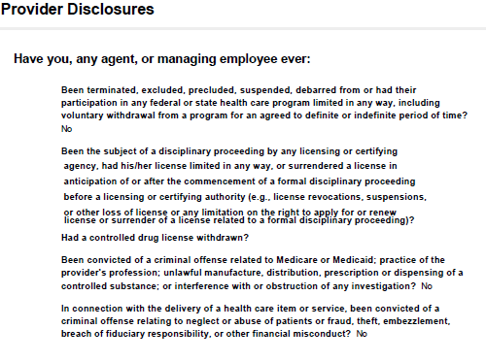

Slide 39
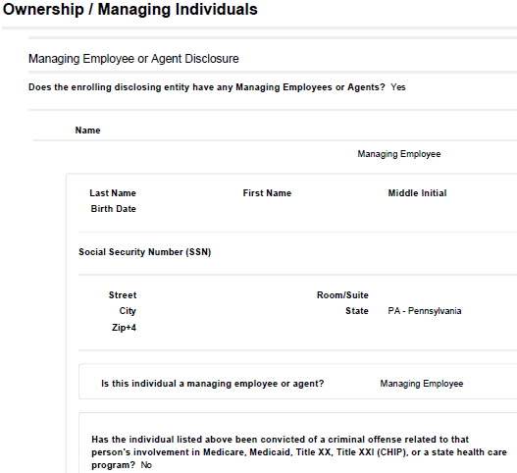
Notes:
Ownership information being reported must match what is reported to Medicare.
The Organization type selected previously will indicate what sections for owner ship need to be completed. All Organizational types must report at least one Managing Employee.

Slide 40
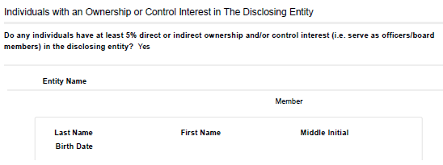
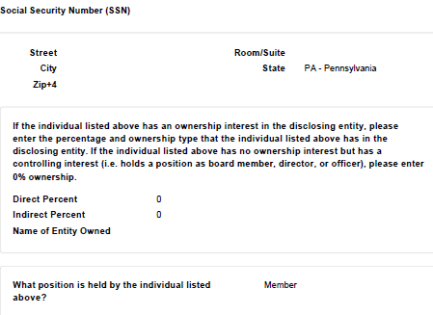
Notes:
For a Partnership, a Business Corporation that is owned by an individual or has board members and for Non Profit entity this question must be answered YES and the individuals must be disclosed.
Direct ownership is when the individual owns the tax id or a portion of the tax id that is being enrolled.
Indirect ownership is when the individual owns a corporation or a portion of the corporation that owns the tax id being enrolled.
There are additional questions in this section for each individual disclosed. CMS Verification

Slide 41
This question is followed by questions regarding Subcontractor ownership.
These questions are asking about the disclosed Corporate owner and if they own other entitles.
After this section is completed you will need to upload verification documentation
to be able to submit the application. Please note as you answer questions in the
portal any item that has a paperclip will require a document to be uploaded here.
All entity and individual provider applications will require signature of a provider
Agreement. This agreement must be signed by the individual or on an entity
application the signature must be from an individual in the organization that can make
Business decisions on behalf of the entity.
Notes:
The Corporate Entity Question must be YES if the individual ownership question is NO. This question is YES any time the tax id is owned by a corporate entity.

Slide 42
After the agreement and the application is signed you will have to review
all of the sections of the application prior to submitting it to the department.
Please note: All application pass through automated checks that can take
Up to 15 days prior to appearing in the departments work queues.
The Department cannot see an ATN prior to the ATN being completed and submitted.

Slide 43
Individual Application
for
FQHC / RHC

Slide 44
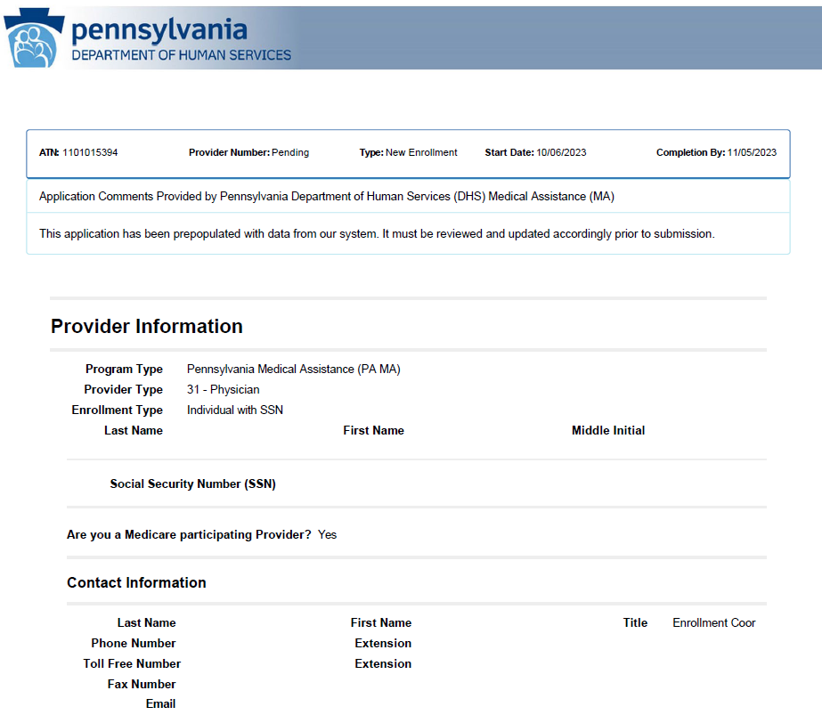

Slide 45
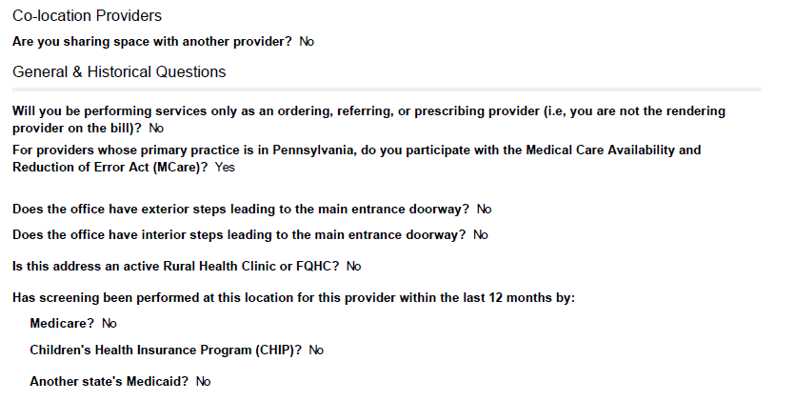
Notes:
A question was submitted to clarify the ORP. For individual FQHC providers they will never appear as the rendering provider on a claim and are only enrolled to be able to order, refer and prescribe services and medications for recipients so this question should always be answered YES. The only time this is answered no is when a provider will be a rendering provider on a claim.

Slide 46
Notes:
There will be the option to make all address match the service location address, if that option is taken they will not see this section in this way. There will be a section for Mail-to, Pay-to and Home Office

Slide 47
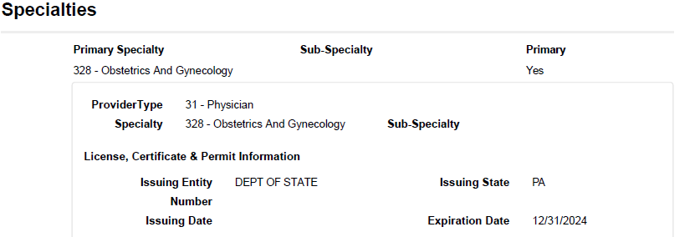
Notes:
When entering the State License, you must enter all letter and number associated with the license. When this is not done, it creates an error. Give example.

Slide 48
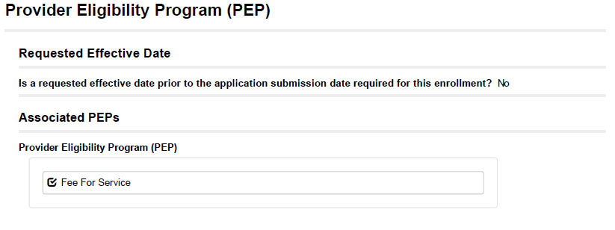

Slide 49
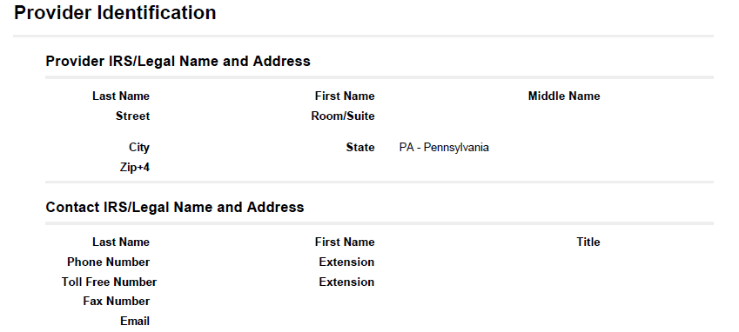

Slide 50
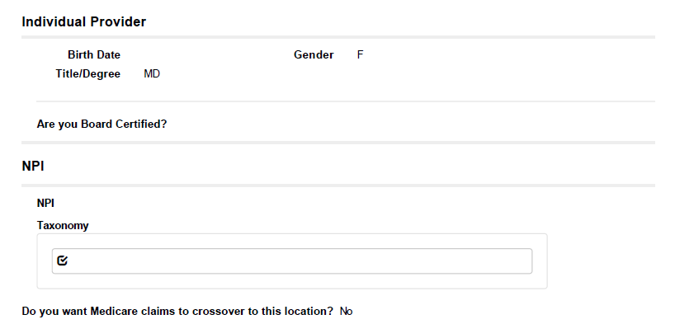
Notes:
Do not enter the group’s taxonomy for an individual. 193200000x, 193400000x. Do not select every taxonomy available. NPI, Taxonomy, Zip code issue.

Slide 51
Notes:
Only answer yes for CLIA/Lab Permit if the individual is the one performing the Laboratory test. It also must match the address of the service location including the suite.

Slide 52
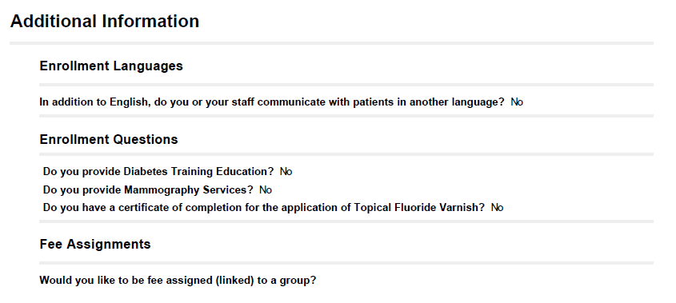

Slide 53
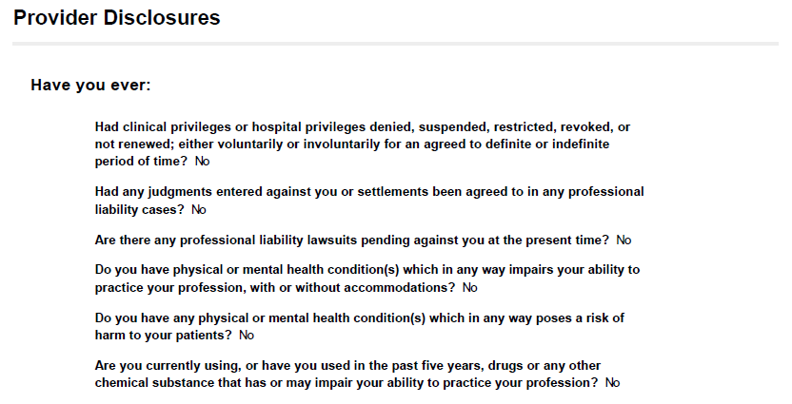

Slide 54
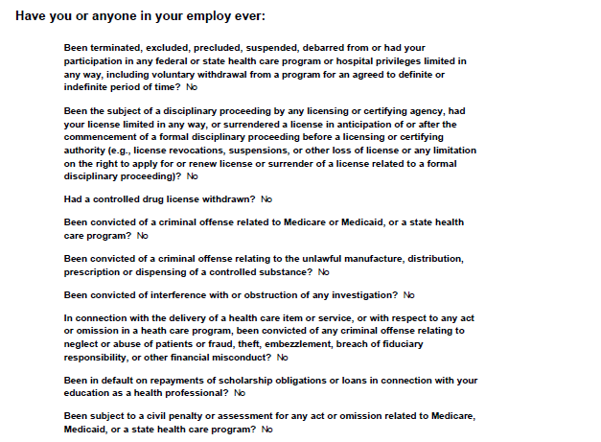

Slide 55
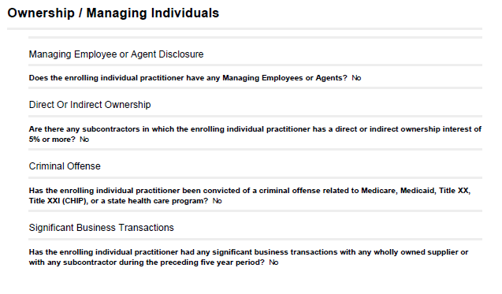
Notes:
Individuals do not need a managing employee. If you do elect to have a managing employee, information such as ssn, dob must be entered correctly or the application will be returned.

Slide 56
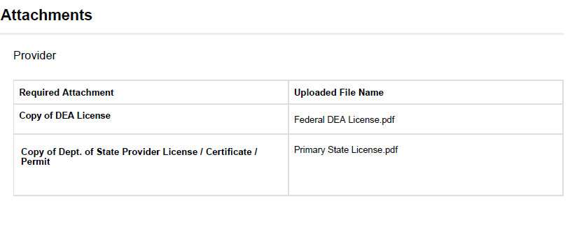
You will need to upload verification documentation to be able to submit the application. Please note as you answer questions in the portal any item that has a paperclip will require a document to be uploaded here.

Slide 57
SIGNATURE FOR INDIVIDUAL ENROLLMENT
The signatures on the application and the provider agreement must be the individual PROVIDER’S signature that is being enrolled.

Slide 58
After the agreement and the application is signed, you will have to review
all of the sections of the application prior to submitting it to the department.
Please note: All application pass through automated checks that can take
Up to 15 days prior to appearing in the departments work queues.
The Department cannot see an ATN prior to the ATN being completed and submitted.

Slide 59
Questions?

Slide 60
Questions Submitted Prior to Training

Slide 61
Is there a way to add/delete the medical director when provider changes happen instead of having to email RA-PROVAPP@pa.gov. When we email this mailbox, we do not receive communication back.
The ProvApp mailbox is set up to automatically send out a confirmation that the document was received. The provider will receive a change letter once the change is completed in the system. This information can also be completed electronically by submitting a Revalidation ATN for the FQHC service location and indicating a new Medical Director on the Medical Director question.

Slide 62
When we call in, is it possible to have an option to speak with a rep. who is familiar with FQHC enrollments?
All staff for provider enrollment can assist with questions regarding issues encountered during the entry of an application into the enrollment portal. Staff have the ability to reach out to specialized staff during a call and/or can take down information to have return calls completed for any items they cannot address during the call.

Slide 63
Can you please discuss how DHS is handling the enrollment of Mobile Health Units for FQHC’s?
Mobile Medical and Mobile Dental units are not separately enrolled. If an FQHC or RHC location has these units a special indicator of MMU (Mobile Medical Unit) or MDU (Mobile Dental Unit) is placed on the service location where the van is housed or dispatched from when it is not deployed.

Slide 64
Has there been any more discussion or progress on the following enhancements that were shared with the FQHC’s previously?
One application to revalidate up to 10 locations
This is slated to go into production on November 1st but will only be for individual and group locations that are limited risk.
b. One application per provider linked to multiple groups.
This is slated to go into production on November 1st but will only be for group locations that are limited risk.
c. Using a data compare from CMS to revalidate without application those providers who are enrolled in both Medicare and Medicaid.
Due to regulatory requirements within the Medicare Compendium, we are not able to automate this process.

Slide 65
If we do not need to add a CLIA or lab permit on individual provider enrollments, why are those sections there?
Individual providers can have the CLIA and Clinical Laboratory Permit applied if the individual is the one performing the laboratory testing. The individual application being used is not specific to individual providers at an FQHC, this application is for any individual provider that is enrolling.
Is it possible to remove those sections so they aren’t accidentally completed?
This is not possible at the current time as it requires significant system changes to program questions that sometimes apply and sometimes do not apply. For FQHC individual provider you will need to answer this question as NO.

Slide 66
When an add/change has been completed, why does the communication come back via mail stating that an add/change has been done, but doesn’t specify what that add/change was?
The provider letter does indicate the change that occurred on page two of the letter.

Slide 67
Can we get the approval letters digitally instead of through the mail?
State regulation requires approval letters to go out via postal mail. However, you can return to the portal to get a verification snapshot that confirms the enrollment.

Slide 68
Will you be providing an updated Electronic Provider Enrollment Application User Interface Provider Training documents for us?
We will be sharing a copy of today’s power point, and the recording of the meeting will be posted on the website. There is also a user manual on the website for the electronic enrollment portal.

Slide 69
Is there discussion about only having to register a provider once in PROMISe versus multiple times when they have more than one service location?
This cannot be accomplished in our current system but, is being looked at for future system development.

Slide 70
Can you tell us the correct procedure for enrollment for our LCSW’s/LPC’s/LMFT’s – The FQHC’s are having many issues with our behavioral health plans requiring a PA Medicaid (or a CHIP) number for our LCSW/LPC/LMFT providers.
LCSWs are enrolled for MA as well as for CHIP. Under the CHIP program they are enrolled as an 11-116 with the CHIP only PEP. LPCs are enrolled for the CHIP program as PT 11-117 with the CHIP only PEP. LMFTs are enrolled for the CHIP program as PT 11-122 with the CHIP only PEP.
For MA all these provider types are enrolled as an 11-112 with a BHHC PEP. To enroll, as MA with the 11-112 you must contact the BH MCO first to obtain the BH MCO Attestation as you will need this to upload in the application.

Slide 71
Resources
Electronic Provider Enrollment Application
https://promise.dpw.state.pa.us
Provider Enrollment Information
Enrollment Information (pa.gov)
Includes information regarding requirements for each Provider Type
Provider Enrollment and Screening Requirements of the Affordable Care Act
ACAforproviders (pa.gov)
Includes the most current information from the Department relating to the ACA federally mandated regulations
Medicaid Information
Medicaid | Medicaid
Provides information about the ACA federally mandated regulations and how they relate to the Medicaid program

Slide 72
Resources (continued)
Department of Human Services Website
http://www.dhs.pa.gov/
Provider Assistance Center - 800/248-2152
Obtain PROMISe™ Portal account information and portal password resets
Provider Quick Tip
#270 - Revalidation of Multiple Locations
#265 - How to Check the Status of Your Electronic Provider Enrollment Application/Actions to Take if Your Application Was Returned for Additional Information
#195 - Additional Information on the Provider Enrollment Application Fee
Quick Tips (pa.gov)
Medical Assistance Bulletins
MAB 99-16-10 – Revalidation of Medical Assistance (MA) Providers
MAB 99-16-07 – Enrollment of Ordering, Referring and Prescribing Providers
MAB 08-16-13 – ACA Enrollment Application Fee
Bulletin Search (pa.gov)
DHS Provider Services Center – 800/537-8862 option 2; option 4 for Enrollment

