Slide 1
Health and Human Services Delivery Center
[ARB Title]
[Work Order # and/or Initiative Name] [Release name & number (if this is a release ARB)]
[Department]
[ARB Date]

Slide 2
ARB Agenda
[Agenda Items]
See ARB Process for required items for ARB 1, 2, 3 and 4 meetings.

Slide 3
Background [ARB 1-3 ]
Provide a description of the purpose of the initiative

Slide 4
Initiative Overview
Initiative | Business Problem | Business Solution | Business Outcome
Initiative #1 | Business Problem #1 Business Problem #2 | Business Solution #1 | Outcome #1 Outcome #2 Outcome #3
Initiative #2 | Business Problem #3 Business Problem #4 | Business Solution #2 Business Solution #3 | Outcome #4.

Slide 5
Key System Requirements [ ARB 1 Only]
System requirement #1
System requirement #2
System requirement #3
System requirement #4
* Only capture system requirements that have architecturally significant impacts to any of the HHSDC domains”.

Slide 6
Architecture [ARB 2 and 3 Only]
*Note – for SaaS initiatives mark the section as N/A or No impacts if the scope of the change does not impact the area.
Database - changes to the OLTP DB (Oracle, SQL, Mainframe, etc.)
Data Warehouse - changes to the OLAP DB (Oracle DW, Cognos etc.)
Capacity - change to capacity including database, file storage, CPU / Memory, etc. (A Summary of the capacity plan that should have details)
Security - changes to security services and impacts (users, roles, SOA services, security role mapping to web pages, MFA (Multi Factor Authentication), PUM (Privileged User Management), increase/reduction in usage, etc.)
Middleware - changes to services or capabilities that leverage middleware
technologies and impacts (webMethods services, BizTalk services, OpenTI
services, increase/reduction in usage, execution timeline, etc.)

Slide 7
Architecture [ARB 2 and 3 Only]
Batch - changes to batch processes and impacts (batch schedule, processing volume, increase/reduction in usage, execution timeline, etc.)
Web Application – changes to the web application and impacts (screen changes, increase/reduction in usage, seasonal ups and downs, etc.)
Reporting – changes to reporting solutions and impacts (SSRS reports, data volume, increase/reduction in usage, execution timeline, etc.)
Correspondence - changes to correspondence generation processes and impacts (Adobe Experience Manager, PDF Templates, File Storage Service, Languages supported, increase/reduction in usage, execution timeline, etc.)
Conversion - impacts due to one-time conversation processes (data volume, run time, execution timeline, etc.)
Rules - changes to business rules engine and impacts (Corticon rules,
increase/reduction in usage, execution timeline, etc.)

Slide 8
Architecture [ARB 2 and 3 Only]
Disaster Recovery - changes to disaster recovery plan or processes
Services - changes to the application or enterprise SOA services (services changes, increase/reduction in usage, seasonal ups and downs, etc.)
Interface - other application(s) this solution connects to for data; changes to interfaces with applications external to HHSDC (seGov transfer schedules, increase/reduction in usage, file size, etc.)
Archive Purge Requirements - changes to / new data retention requirements; reference the General or Agency specific Records Retention and Disposition Schedule at https://pagov.sharepoint.com/sites/hhs-dc-it-solutions-management/SitePages/Business%20and%20Technical%20Standards/Data-Domain.aspx

Slide 9
Implementation Scope [ARB 2,3& 4]
Activity | Y / N / NA | Notes
Cross-Application Dependencies |  | Systems internal or external to Agency.
Deployment Expectations |  | Teams required to be in Saturday and Sunday to support deployment and validation.
Pre-Deployment Activities |  | Put up maintenance pages for multiple apps
Post-Deployment Activities |  | Execute specific batch jobs or data manipulation scripts
Post-Implementation Activities |  | X days after deployment, do Y

Slide 10
Key DSD Considerations [ARB 3 Only]
HHSDC Domain (see Business and Technical Standards (sharepoint.com) for what each domain entails | Key Considerations
Security
Network
Knowledge Management
Platform
Integration and Middleware
Data
Operations and Support
Application
Business
Procedures
Privacy
Access

Slide 11
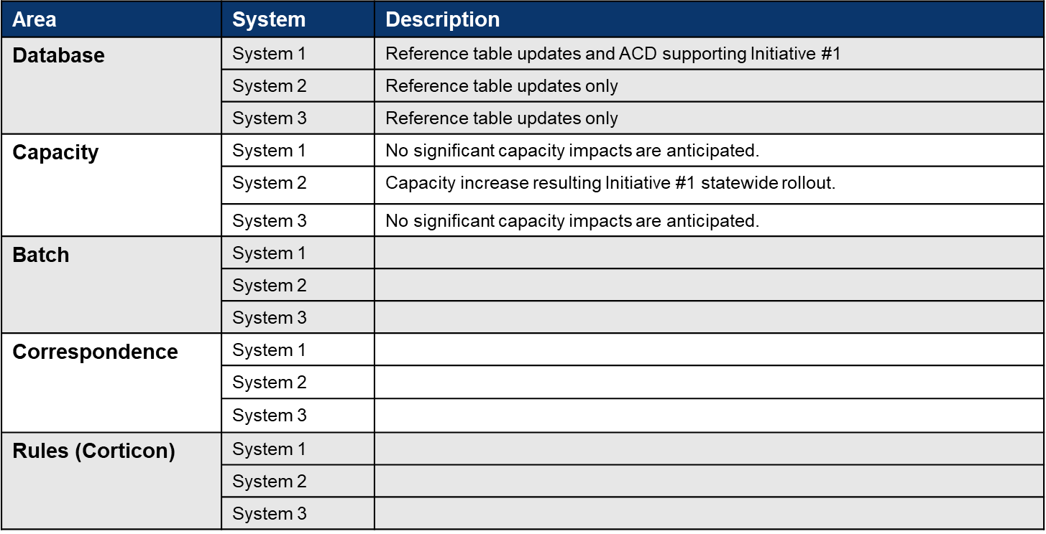
Deployment Scope [ARB 4 Only]

Slide 12
Deployment Scope [ARB 4 Only]
Area | System | Description
Web Application | System 1
 | System 2
 | System 3
Services | System 1
 | System 2
 | System 3
Security | System 1
 | System 2
 | System 3
Reporting | System 1
 | System 2
 | System 3
Data Warehouse | System 1
 | System 2
 | System 3

Slide 13
System Operational Readiness [ARB 4 Only]
 | Activity | Y / N / NA | Date | Notes
SAT | Performance Testing Completed
 | Vulnerability Testing Completed
UAT | User Acceptance Testing Completed
 | Conversion Testing Completed
 | Batch Testing Completed
 | Outstanding TFS Defects From Testing |  |  | [Functional and non-functional]
Deployment Readiness | Batch Schedule and Manual Updated
 | Playbook Reviews Scheduled
 | Final User Roles / Account Sign-Offs
 | Health Checks / Business Metrics Included
 | Operational Preparations Completed |  |  | [Field support, war rooms scheduled, etc.]

Slide 14
Business Operational Readiness Review [ARB 4]
 | Activity | Y/N/NA | Date | Notes
Project Management | Is the Integrated Work Plan Current?
 | Have the Business Requirements Document and Requirements Traceability Matrix been updated?
UAT | Is the UAT Test Plan Approved?
 | Is the Testing completed?
 | Has the testing Exit Criteria been met?
 | Has Requirements Traceability been established through identification of Testing Scenarios?
 | Is the completed UAT approved?
 | Have all defects been reviewed, and current status approved?
User Training & Materials | Has the Training Plan been approved?
 | Have Training Materials been approved?
 | Is User Reference Documentation approved and available?
 | Is the Training completed?

Slide 15
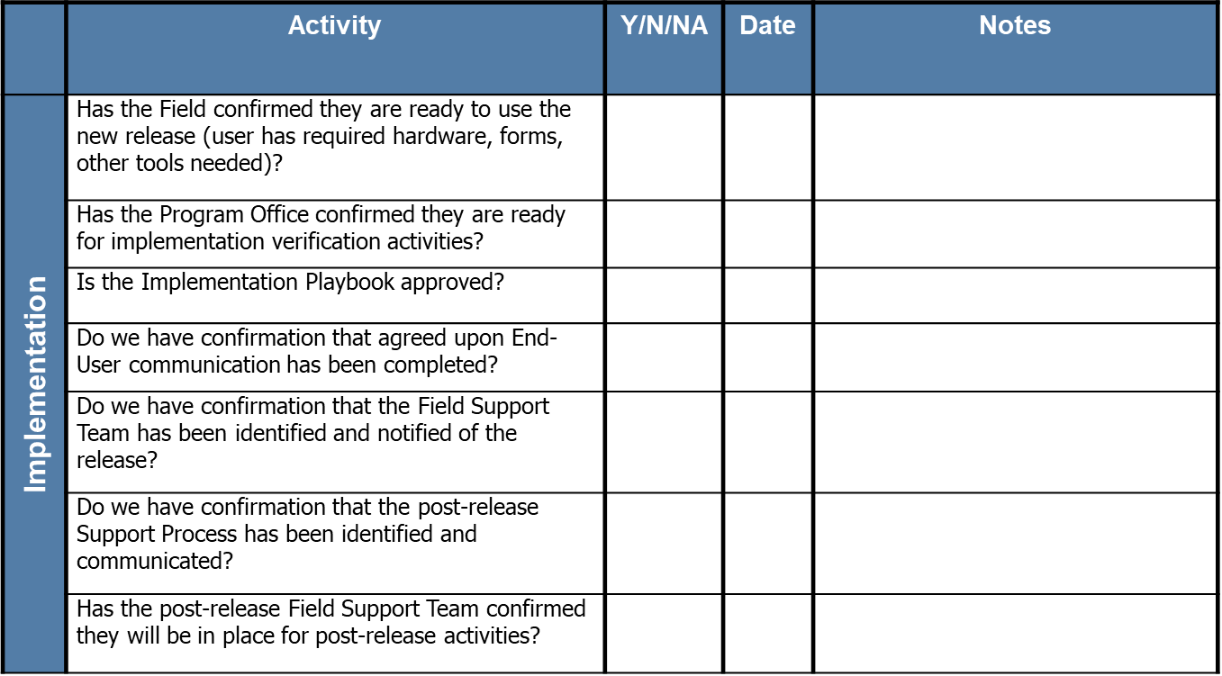
Business Operational Readiness Review Contd. [ARB 4 ]

Slide 16
Timeline & Testing Activities
Phase | Activities | Specific Provisions or Tools | Expected Timeframe
System Requirements |  | Team Foundation Server (TFS) | Complete
General System Design | General System Design | TFS, Erwin | <Enter Dates>
Detailed System Design | Detailed System Design | TFS, Erwin | <Enter Dates>
Development | Development, Unit Testing | Visual Studio, TFS, Cognos, Informatica, MBUnit, SoapUI | <Enter Dates>
Integration | Integration Testing, ADA Compliance, Security Testing | MTM, SoapUI, Compliance Sheriff, WebInspect, AppScan and Nessus | <Enter Dates>
System Acceptance Testing (SAT) | SAT Environment Readiness Testing, Performance Testing, Regression Testing | MTM, SoapUI, NeoLoad | <Enter Dates>
User Acceptance Testing (UAT) | Support Lot Vendor and Program Office as required |  | <Enter Dates>
Test for Production (TFP) | Production Readiness Testing | MTM | <Enter Dates>
Production | Deployment Testing | MTM | <Enter Dates>

