Slide 1
FMS Vendor Transition for Self-Directed Services
Community HealthChoices
October 1, 2021

Slide 2
Agenda
Today: FMS Transition
Presented by your Community HealthChoices MCOs: AmeriHealth Caritas Pennsylvania; Keystone First; PA Health & Wellness, Inc.; and UPMC
AND Tempus Unlimited
What to expect during Transition
​
Questions
2

Slide 3
What to Expect during Transition

Slide 4
What to Expect during Transition
Introductory letters and communication from Tempus
Common Law Employers will receive pre-populated transition packets from Tempus
Participant/Common Law Employer Transition Packet
Direct Care Worker Transition Packet
Attend Tempus Information and Training Sessions
Call-in/Online Webex
In-Person
Future Training
Introduction to Tempus EVV timesheet submission and approval process
Introduction to Tempus Enrollment Process
Tempus Informational Website updates

Slide 5
Tempus Communication
Introduction letter from Tempus
Communication to be mailed to the Common Law Employers and Direct Care Workers
Transition Packet mailing and follow-up
Participant/Common Law Employer and Direct Care Worker Information and Training Sessions
Tempus Informational Website
Emails, Text Messages and Voice Messages

Slide 6
Transition Packets for Common Law Employers and Direct Care Workers
Tempus will mail pre-populated Transition Packets with information received from Public Partnerships LLC.
Packets will be mailed to the Common Law Employer’s address on file.
Participant/Common Law Employer Transition Packets will include:
Common Law Employer Agreement
IRS Form 2678 - Employer/Payer Appointment of Agent
Direct Care Worker Transition Packets will include:
Direct Care Worker Agreement
Direct Care Worker Information and Acknowledgement Form

Slide 7
Transition Packet Mailing Schedule
Transition packets will be mailed in phases based on MCO regions
Southwest Region – week of 10/24/2021; expect to receive by 11/7/2021
Southeast Region – week of 10/31/2021; expect to receive by 11/14/2021
Northwest/Northeast Region – week of 11/7/2021; expect to receive by 11/21/2021
Lehigh/Capital Region– week of 11/14/2021; expect to receive by 11/28/2021
You should expect to receive your transition packet within two weeks of the scheduled mailing date. If you do not receive your packets, please contact Tempus.

Slide 8
How to Complete and Due Dates
Tempus will offer multiple training opportunities on how to complete the transition documents and answer questions
Instructions on how to complete the forms will be included in the packet
When packets are received, please review pre-populated information for accuracy and complete any required sections, sign and return to Tempus within 2-weeks of receipt
If anything is incorrect, please cross-off and make the correction then initial the change
If you are unsure on what to do, please attend an Information Session
Common Law Employer packets will require the signature of the Common Law Employer
Direct Care Worker packets will require the signature of both the Common Law Employer and the Direct Care Worker

Slide 9
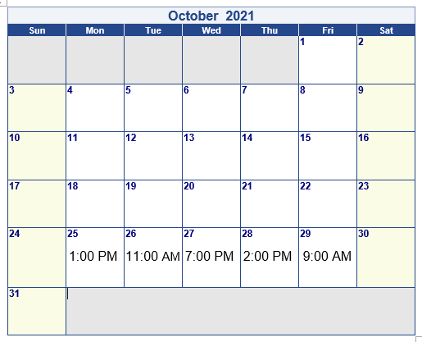
Call-in and Online Information Sessions
Tempus will host one-hour Call-in and Online WebEx sessions beginning in October
Login Information will be posted to the Tempus website

Slide 10
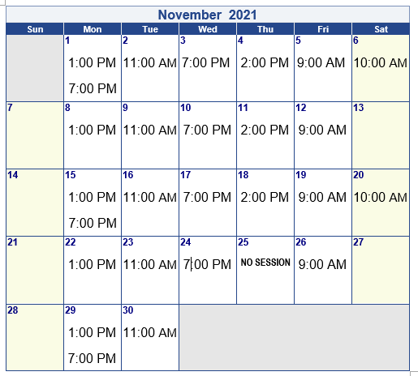
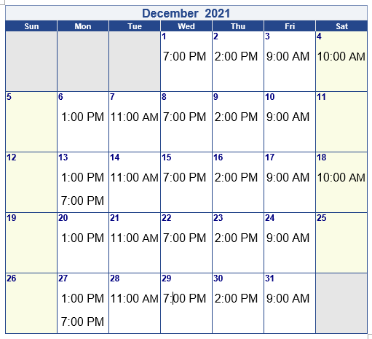
Call-in and Online Information Session Details

Slide 11
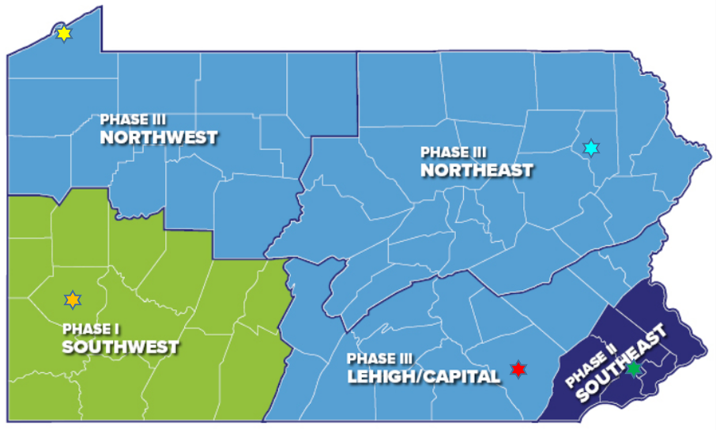
In-person Information Sessions
In-person Information Sessions for Common Law Employers and Direct Care Workers will be held in each region across the Commonwealth beginning in November
Schedule of dates and times will be posted on the Tempus website
Southwest – Pittsburgh
Southeast – King of Prussia
Northwest – Erie
Northeast – Clarks Summit
Lehigh/Capital – Lancaster
Notes:
Mention transportation benefit is available.

Slide 12
Future Training Sessions
Tempus will host training sessions for Participants, Common Law Employer and Direct Care Workers.
Topics for future training will include:
Introduction to Tempus EVV timesheet submission and approval process
Introduction to Tempus Online Tools and Self-Service Portal
Introduction to Tempus Enrollment Process
Every Common Law Employer and Direct Care Worker will need to be trained.
Training will be conducted through:
Call-in Sessions
Online Webex Sessions
In-person Sessions
How-to Guides and Videos posted to the Tempus website

Slide 13
Tempus Informational Website
Website address: https://pa.tempusunlimited.org
This can be one of your primary sources of information
Check Frequently: Information and updates from the MCOs and from Tempus will be posted to the Documentation section
Webinars and In-person sessions: Soon we’ll post the schedules for important webinars and in-person sessions to assist you with paperwork and to answer questions
The FAQs will be updated as we provide more information to Participants, Common Law Employers, and Direct Care Workers

Slide 14
Pennsylvania In-State Hiring Initiative
Tempus is looking to hire remote and in-office staff for Pennsylvania
Tempus is planning to open three offices in Pennsylvania
Pittsburgh Area
Central Pennsylvania
Philadelphia area
Individuals with lived experience or an understanding of self-direction would be valuable
Please check the Tempus website frequently for job openings:
Website: https://tempusunlimited.org

Slide 15
Questions?

