Slide 1
Financial Management Services (FMS) Stakeholder Meeting FMS Vendor Transition for Self-Directed Services
Community HealthChoices
February 18, 2022

Slide 2
Agenda
FMS Transition
Presented by your Community HealthChoices MCOs: AmeriHealth Caritas PA CHC, Keystone First CHC, PA Health & Wellness, Inc., UPMC
AND Tempus Unlimited
Transition Information
Tempus Call Center
EVV Training
Questions

Slide 3
Transition Information

Slide 4
Transition Packets
Transition Packet Statistics
52% of CLE packets and 46% of DCW packets were returned
Tempus re-mailed transition packets to all individuals who have not returned their packet
Tempus mailed transition packets to new CLEs and DCWs who recently became active
Tempus sent email, phone and text messages to CLEs and DCWs to advise:
Transition packet received and processed
Transition packet has not been received and was re-mailed
Transition packet mailed
Transition packets received and needing corrections will be addressed in the near future
Tempus is working on translating transition packets in other languages

Slide 5
Transition Timeline
Tempus will send the EVV enrollment (“Welcome!”) emails at the end of March 2022.
New Enrollments with Tempus will begin around May 20, 2022
Time Entry
First day for Payroll Schedule A to submit time to Tempus is June 5
First day for Payroll Schedule B to submit time to Tempus is June 12
Payroll: First payroll from Tempus for BOTH A and B schedules will be July 1
How will this extension be communicated to CLEs and DCWs?
Broadcast by email, text and voice message
Tempus communication letter to CLEs
Tempus will post notification on the PA website

Slide 6
Tempus Call Center

Slide 7
Tempus Call Center
Tempus call back feature is now live in the call center
Tempus is continuing to hire and train staff
Average time in queue is below 5 minutes
Goal is to get below 2 minute average queue time in 2-3 weeks
Eventual goal is 85% of calls answered in 30 seconds or less

Slide 8
EVV Training

Slide 9
Timesheet Submission & Approval Process
Electronic Visit Verification (EVV) requirements do not change. Changes to process include:
New app to clock in and clock out
New process for DCWs to review and submit time to CLE for approval
New approval process for CLEs
New phone system (“IVR”) option for DCWs and CLEs to record and approve time
Important information regarding Tempus user accounts:
All CLEs and DCWs must have a unique email address
CLEs and DCWs will need to provide Tempus their email address
To provide email address to Tempus, visit https://pa.tempusunlimited.org/ and click on the email survey link, answer the questions, and submit the form
“How to” videos explaining how to get free email accounts with Google, Microsoft and Yahoo! on Tempus website
Every Common Law Employer and Direct Care Worker will need to be trained on the EVV system!

Slide 10
Timesheet Submission & Approval Process
Tempus began to host multiple training sessions for CLEs and DCWs on January 10, 2022.
Training is conducted through:
Online WebEx Sessions
In-person Sessions will be scheduled closer to the new “go live”
NEW! Training Videos are now posted on the Tempus website
NEW! How-to Guides will be posted soon to the Tempus website
Training topics include:
How to obtain a user account to access the Tempus EVV app and Tempus portal
How to download and use the Tempus EVV app to clock in and clock out
How to use the Tempus portal to submit time worked, edit a shift and create a manual entry
How to use Tempus phone system to clock in and clock out
How to approve or reject a shift
How to use the Tempus portal to view timesheet and payment information

Slide 11
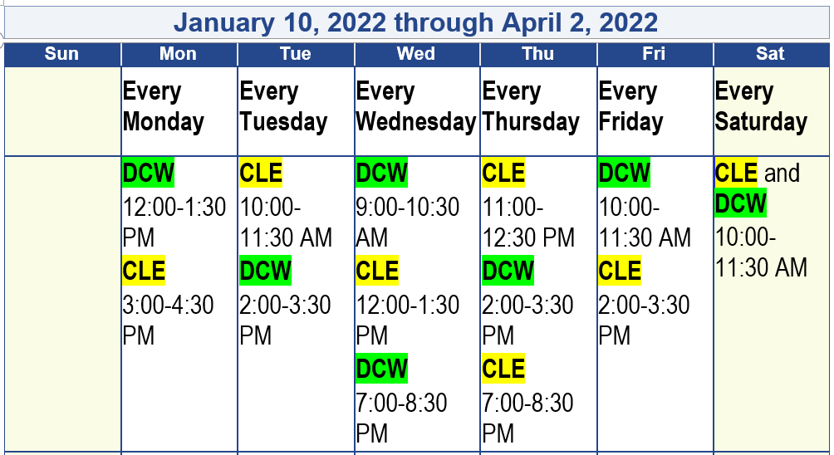
Timesheet Submission & Approval Process
Tempus is hosting 90-minute Online WebEx sessions through 4/2/2022 for CLEs and DCWs to learn how to submit and approve time worked. Tempus will post an updated schedule in March for additional sessions.
Login Information included in the monthly communication to CLEs and posted to the Tempus website at https://pa.tempusunlimited.org/.

Slide 12
Questions?

