Slide 1
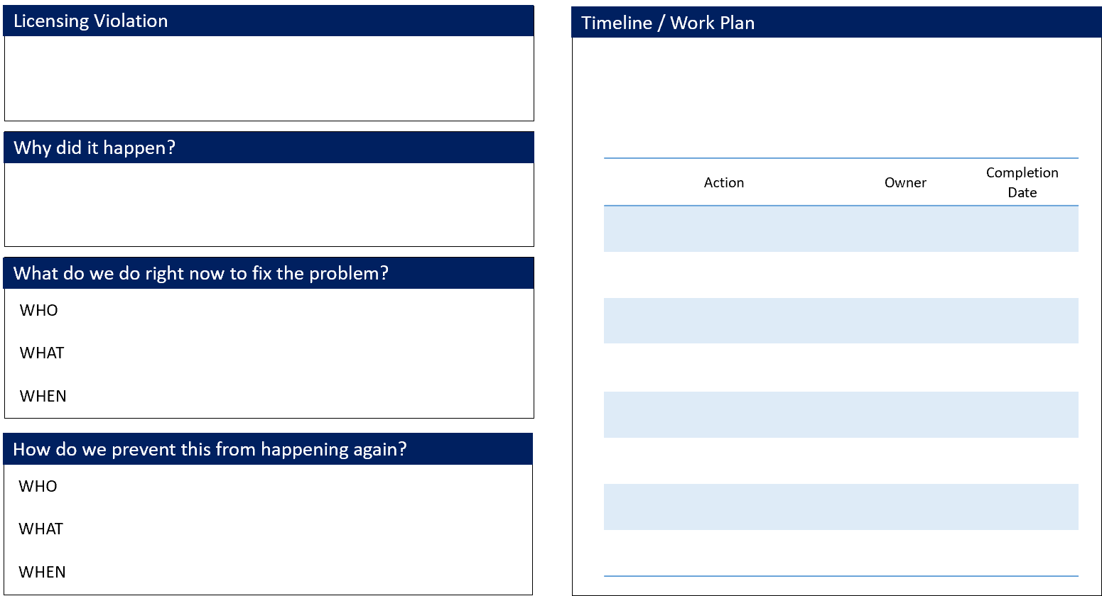
Licensing Plan of Correction (POC) Quick Reference Guide
To help provide all the elements needed in a Plan of Correction, the following Quick Reference Guide has been created to assist you as you write your POC. The Quick Reference Guide provides an overview of all the components needed in a POC.
POC Guide
Regulations are necessary to ensure the safety and well-being of those that we serve. It is important to keep this in mind as you write your POC.
This is a simple listing of actions that are needed to fix the violation and keep it from happening again. It lists the action item, the owner, and the date by which the action item will be completed.
When all steps have been completed in this plan, your solution should be implemented, the violation corrected, and reasonably prevented from happening in the future.
Understanding why the violation happened is critical to keep it from happening again. Sometimes the most easily identifiable cause may not be the real reason the violation occurred. One way you can identify the root cause of the problem is by asking yourself “Why” multiple times. This is a very simple approach for identifying each violation’s source.
When you write your immediate solution, it should address who is responsible for fixing the problem and monitoring compliance, what action that person will take, and when that action will happen. The solution needs to be realistic, sustainable, and specific.
IMPORTANT NOTE:
This guide is NOT intended to replace the LIS and POC forms that you currently use. The guide is a tool that can be referenced to ensure you include the key elements in your POC. You will continue to write your POC response in the approved format for each DHS Program Office.
The goal of the POC is not only to fix the violation, but make sure there is a sustainable plan in place to keep it from happening again. These long-term solutions should greatly reduce or eliminate the chances of the violation happening again and do it in a manner that is sustainable over time. The POC should detail specific, realistic, actionable steps that keep the violation from happening again.
Page 1 of 3

Slide 2
Licensing Plan of Correction (POC) Quick Reference Guide
Useful Evidence
Don’t Forget
Submitting useful evidence that a plan has been implemented can make it easier to verify compliance with the plan and may expedite the licensing process. Some DHS Program Offices require that useful evidence be submitted while others do not. Check with your DHS Program Office on the specifics of their requirements.
Sign and date your POC
As of October 1, 2019, all DHS Program Offices will verify all POCs 30 days after the last implementation date identified in the POC.
Complete POC in the correct POC section of your form
Useful evidence can fall into the following three categories:
Verify plan is realistic, specific, and sustainable
Internal documentation
Internal documentation is documents that you produce. These can include policies or procedures, documentation of staff specific training, updated assessments and support plans, maintenance logs, and any other internal documents.
Exclude names of residents
Verify writing is legible
External documentation
External documentation is generated by reliable third parties, such as bills or invoices for equipment, material, or labor. External documentation can also include letters or statements from professionals assisting in the implementation of the plan such as fire safety experts or outside training sources. External documents could also be confirming future commitments such as repair work or upcoming medical appointments.
Submit POC in a timely manner
Include persons and measurable steps for correction(s)
Photographic/Video
Attach supporting documentation*
Pictures and videos are excellent ways to verify that physical repairs to a setting have been made. If you are not sure about what useful evidence to submit, don’t hesitate to ask your Licensing Representative or his/her Supervisor about acceptable types of evidence to confirm compliance with a specific violation.
*For Sanswrite Users: Upon notification that your POC has been approved, you can submit your supporting documentation.
Page 2 of 3

Slide 3
Licensing Plan of Correction (POC) Quick Reference Guide
Need Help? Ask for Technical Assistance
For any questions on your Plan of Correction, reach out to your Licensing Representative.
BHSL
OCYF
OMHSAS
ODP
OCDEL
Western Region
11 Stanwix Street, Room 230
Pittsburgh, PA 15222 Phone: 412-565-5614, 412-565-5616 Toll Free: 1-888-464-6378,
1-888-322-3664 Fax: 412-565-2840, 412-565-5633 Email: ra-pwarlwest@pa.gov
Western Region
11 Stanwix Street, Room 260 Pittsburgh, PA 15222 Phone: 412-565-5777
Western Region
301 Fifth Avenue, Room 480
Pittsburgh, PA 15222
Phone: 412-565-5226
Fax: 412-565-5393
Western Region
301 Fifth Ave., Piatt Place Room 490 Pittsburgh, PA 15222
Phone: 412-565-5100
Toll Free: 1-800-565-9453
Fax: 412-565-5479
Email: Ra-odplicensing@pa.gov
Western Region
11 Stanwix Street, Room 240
Pittsburgh, PA 15222
Phone: 412-565-5183
Toll Free: 1-800-222-2149
Fax: 412-565-2658
Central Region
555 Walnut St., Forum Place, 6th Floor
P.O. Box 2675
Harrisburg, PA 17105
Phone: 717-772-7078
Toll Free: 1-800-222-2117
Fax: 717-705-8233
Central Region
625 Forster Street
Room 631 Health and Welfare Building Harrisburg, PA 17120 Phone: 717-772-4673 Toll Free: 1-800-882-1885 Fax: 717-783-3956 Email: ra-pwarlcentral@pa.gov
Central Region Hilltop Building 3 Ginko Drive, 2nd Floor Harrisburg, PA 17110 Phone: 717-772-7702
Central Region
PO Box 2675
Commonwealth Tower, 12th Floor
Harrisburg, PA 17105
Phone: 717-772-8395
Fax: 717-705-8386
Central Region
555 Walnut Street
Forum Place, 8th Floor
Harrisburg, PA 17101
Phone: 717-772-4673
Toll Free: 1-800-565-9435
Fax: 717-772-6483
Email: Ra-odplicensing@pa.gov
Northeast Region
100 Lackawanna Avenue
Scranton State Office Bldg.
Scranton, PA 18503
Phone: 570-963-4371
Toll Free: 1-800-222-2108
Fax: 570-963-3006
Northeast Region
330 Scranton State Office Building 100 Lackawanna Avenue
Scranton, PA, 18503-1923 Phone: 570-963-3209 Toll Free: 1-800-833-5095 Fax: 570-963-3018 Email: ra-pwarlnortheast@pa.gov
Northeast Region
Scranton State Office Building 100 Lackawanna Avenue, 3rd Floor Scranton, PA 18503 Phone: 570-963-4376
Northeast Region
100 Lackawanna Ave, Room 321
Scranton, PA 18503
Phone: 570-963-3040
Fax: 570-963-3050
Northeast Region
100 Lackawanna Ave, Rm 307
Scranton, PA 17101
Phone: 570-963-4749
Toll Free: 1-800-565-9435
Fax: 570-963-3177
Email: Ra-odplicensing@pa.gov
Southeast Region
801 Market Street, Suite 5132
Philadelphia, PA 19107-3126
Phone: 215-560-2541
Toll Free: 1-800-346-2929
Fax: 215-560-5139
Southeast Region
1001 Sterigere Street, Norristown State Hospital Building #2, Room 161 Norristown, PA 19401 Phone: 610-270-1137 Toll Free: 1-866-711-4115 Fax: 610-270-1147 Email: ra-pwarlsoutheast@pa.gov
Southeast Region 801 Market Street, 6th Floor Philadelphia, PA 19107 Phone: 215-560-2249
Southeast Region
1001 Sterigere Street Norristown State Hospital
Norristown, PA 19401
Phone: 610-313-5844
Fax: 610-313-5845
Southeast Region
801 Market Street, Suite 5071 Philadelphia, PA 19107
Phone: 215-560-2242
Toll Free:1-800-565-9453
Fax: 215-560-3043
Email: Ra-odplicensing@pa.gov
Note: OCDEL licensed facilities may receive a directed or tiered inspection summary. Contact your Licensing Representative as appropriate.
Page 3 of 3

