Slide 1
Office of Community Care and Mission Act Updates
Renee Williams RN, BSN
April 9, 2019

Slide 2
Overview
The Mission Act of 2018 is designed to improve Veteran access to VA Healthcare both within the VA and in the community

Slide 3
Overview
Improvements in:
Eligibility
Urgent Care Benefit
Improved Customer Service

Slide 4
Process Improvement
VA confirms eligibility
VA staff member performs or assists with scheduling
Veteran receives care from a community provider in the network
Community provider sends claim to a Third Party Administrator for payment

Slide 5
Single Community Care Program
Existing programs will be combined into one
Veterans Choice Program ending but some of its elements adopted into new program
Less complex decreasing the likelihood of errors

Slide 6
Improved Customer Service
Redesigned streamlined internal processes
Improved education
Improved communication resources for Veterans and VSO partners

Slide 7
New Urgent Care Benefit
Veterans will now have access to non-emergency care for certain conditions
Veterans will be able to go into any urgent care/walk in care in the VA’s network
Copayments may apply
*details are not yet final

Slide 8
New Community Care Network
VA establishing a new Community Care Network (CCN)
Administered through third party administrator
TPA’s will be required to make timely payments

Slide 9
Modern IT Systems
VA will modernize IT systems to replace old technology and manual processes
Speed up all aspects of community care including eligibility, authorizations, appointments, care coordination, claims, payments

Slide 10
General Eligibility
Service not available at VA
Veteran resides in a US state or territory without a full service VA
Veteran was eligible under previous distance criteria before mission act
Veteran meets specific access standards
Notes:
Alaska, Hawaii, NH and the US territories of Guam, American Samoa, Northern Mariana Islands, and the US Virgin Islands

Slide 11
Specific Eligibility
Average drive time
30 minutes for primary care, mental health, and non-institutional extended care svcs (incl adult day health)
60 minutes for specialty care
Appointment wait time at a VA
20 days for primary care, mental health, and non-institutional extended care services
28 days for specialty care from date of request
*Access standards not yet final
Notes:
(unless veteran wants a later date after consulting with provider)

Slide 12
Billing
Copayment are the same as for care at VA
Beneficiary travel expense eligibility remains the same
Generally VA pays Medicare Rates

Slide 13
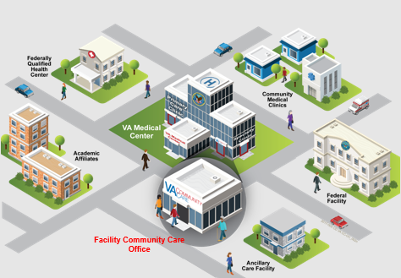
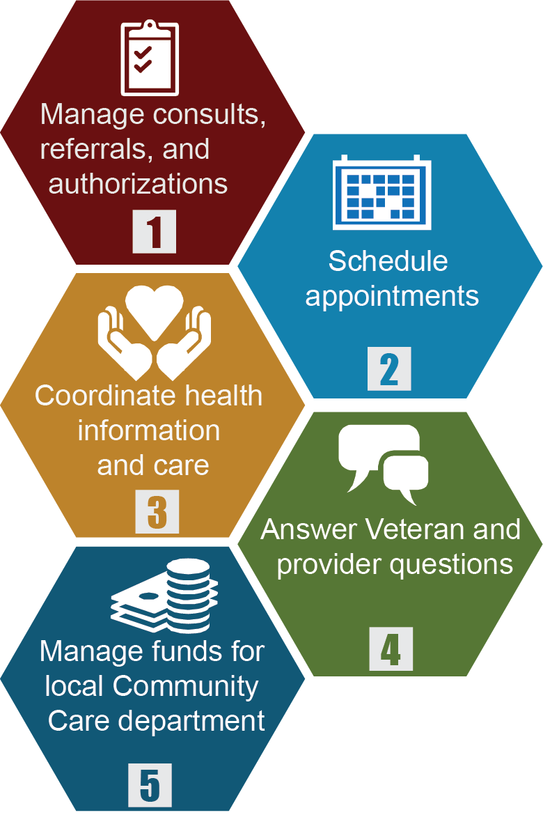
Facility Community Care Office Activities
The facility community care office is the “clinic” that coordinates all services for Veterans outside the VA healthcare system.
Activities of the facility community care office
Notes:
Hopefully this graphic looks familiar to most of the audience.
It depicts the future state of the Facility Community Care Office.
The duties of the local office of community care are listed on the left and include:
Managing consults, referrals and authorizations
Scheduling appointments
Coordinating health information and care
Answering Veteran and Provider questions
Managing funds for Facility Community Care Office.
On the right you see the facility community care office who may in fact collaborate with many partners in the community including:
Other VA Medical Centers-including our sister facilities
Academic Affiliates
Community Medical Offices
Community Facilities/Hospitals
Federally Qualified Health Centers or other Federal Facilities

Slide 14
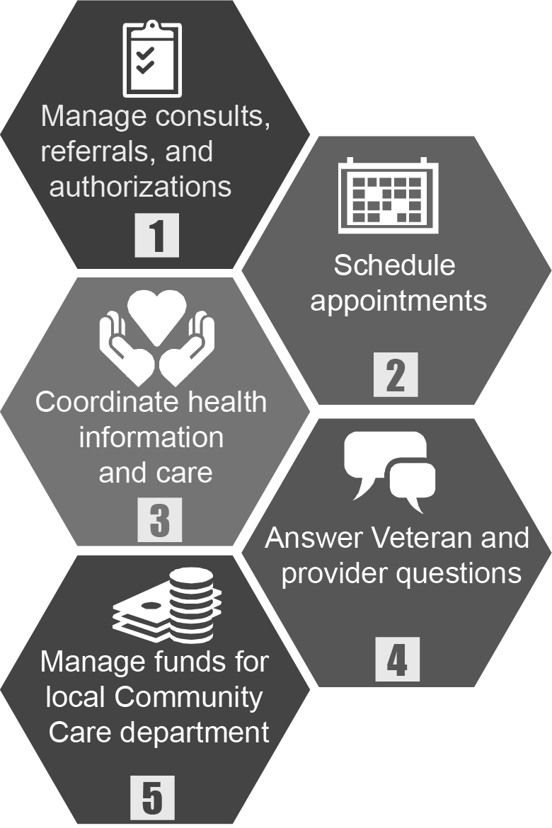
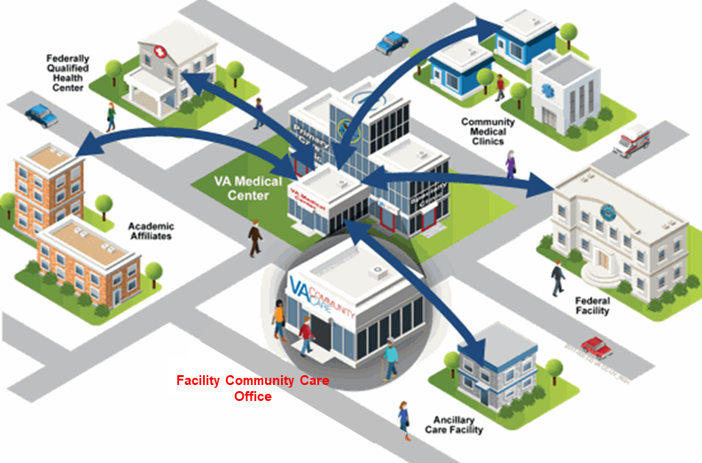
Facility Community Care Office Activities
This clinic enables a seamless experience for Veterans by coordinating health information and care across the VAMC and community partners.
Activities of the facility community care office
Integrated Care Coordination Team
Team-based approach integrating clinical and administrative
functions
Notes:
The future state vision for care coordination is for the facility community care office to function like a clinic within a clinic. The facility community care office will function as its own department, with its own management and will be responsible for facilitating care coordination. Because Care Coordination is a complex process involving administrative, clinical, and collaborative partnerships with the community, a Care Coordination model was developed with foundational elements and principals that address current state care coordination issues. The care coordination model gives a framework and outline for realizing the future state vision for care coordination. It outlines how the integrated care coordination team should function, what the standard care coordination process is, what their roles and responsibilities are, and what tools they should be using to accomplish their goals.
Note the arrows on the right are bidirectional, pointing out the importance of communicating with all parties including the Veteran to provide value added care coordination.

Slide 15
Questions
This Photo by Unknown Author is licensed under CC BY-SA

