Slide 1
OLTL Updates
April 9, 2019
Kevin Hancock Deputy Secretary
Office of Long-Term Living
Department of Human Services

Slide 2
AGENDA
CHC: WHERE IS IT NOW?
ELECTRONIC VISIT VERIFICATION (EVV)
FUNCTIONAL ELIGIBILITY DETERMINATION (FED) IMPLEMENTATION
ENROLLMENT SERVICES PROCUREMENT ACTIVITIES
ENROLLMENT DATA

Slide 3
CHC: WHERE IS IT NOW?

Slide 4
SOUTHEAST IMPLEMENTATION
Implemented CHC in the southeast on January 1, 2019
Approximately 127,000 Participants were transitioned to the CHC program
Based on lessons learned during the Southwest implementation, DHS was able to prevent or mitigate many of the issues seen in the Southwest during the Southeast implementation.
Lessons Learned (so far)
Earlier stakeholder engagement opportunities
Enhance communication materials and training regarding Medicare vs. CHC
More education and communication on continuity-of-care
MCO provider training and outreach to occur in the fall of 2019
Identify additional locations for participant information sessions
Schedule additional provider workshops in the fall of 2019

Slide 5
PRIORITIES THROUGH IMPLEMENTATION
ESSENTIAL PRIORITIES
No interruption in participant services
No interruption in provider payment
HOW WILL WE ENSURE NO INTERRUPTIONS?
The Department of Human Services (Department) is engaged with the MCOs in a rigorous readiness review process that looks at provider network adequacy and IT systems.
The Department of Health must also review and approve the MCOs to ensure they have adequate networks.

Slide 6
PHASE THREE IMPLEMENTATION PLANNING
Comprehensive participant communication
Robust readiness review
Provider communication and training
Pre-transition and plan selection for phase three participants
Incorporation of southwest and southeast implementation and launch lessons learned

Slide 7
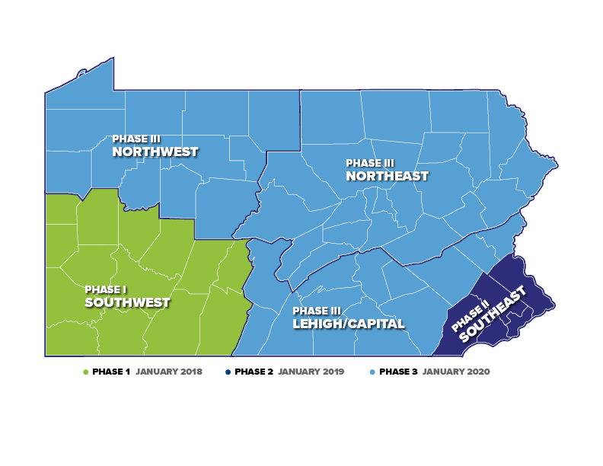

Slide 8
CHC PHASE 3 POPULATION
10%
14,609
Duals in Waivers
16%
23,323
Duals in Nursing Facilities
70%
99,887
NFI Duals
143,004
CHC POPULATION
3%
4,089
Non-duals in Waivers
13%
IN WAIVERS
17%
IN NURSING FACILITIES
96%
DUAL-ELIGIBLE
1%
1,096
Non-duals in Nursing Facilities

Slide 9
PHASE 3 ZONES: LEHIGH/CAPITAL
16%
10,861
Duals in Nursing Facilities
10%
6,269
Duals in Waivers
70%
46,411
NFI Duals
3%
1,996
Non-duals in Waivers
66,044
CHC POPULATION
LEHIGH/CAPITAL COUNTIES:
Adams, Berks, Cumberland,
Dauphin, Franklin, Fulton,
Huntingdon, Lancaster, Lebanon, Lehigh, Northampton, Perry, York
96%
DUAL-ELIGIBLE
1%
507
Non-Duals in Nursing Facilities

Slide 10
PHASE 3 ZONES: NORTHWEST
15%
4,053
Duals in Nursing Facilities
13%
3,671
Duals in Waivers
68%
18,737
NFI Duals
4%
1,080
Non-duals in Waivers
27,730
CHC POPULATION
95%
DUAL-ELIGIBLE
NORTHWEST COUNTIES:
Cameron, Clarion, Clearfield, Crawford, Elk, Erie, Forest, Jefferson, McKean, Mercer, Potter, Venango, Warren
<1%
189
Non-Duals in Nursing Facilities

Slide 11
PHASE 3 ZONES: NORTHEAST
17%
8,397
Duals in Nursing Facilities
9%
4,664
Duals in Waivers
71%
34,727
NFI Duals
2%
1,007
Non-Duals in Waivers
49,195
CHC POPULATION
NORTHEAST COUNTIES:
Bradford, Carbon, Centre, Clinton, Columbia, Juniata, Lackawanna,
Luzerne, Lycoming, Mifflin, Monroe, Montour, Northumberland, Pike, Schuylkill, Snyder, Sullivan, Susquehanna, Tioga, Union, Wayne, Wyoming
97%
DUAL-ELIGIBLE
1%
400
Non-Duals in Nursing Facilities

Slide 12
UPCOMING PROVIDER WORKSHOPS
Save the date for our upcoming provider summits in the Northeast, Northwest, and Lehigh/Capital zones. These summits are educational conferences specifically for providers to learn more about CHC. Lehigh/Capital Zone
Monday, May 13: Harrisburg Area Community College
Tuesday, May 14: Shippensburg University
Wednesday, May 15: Kutztown University
Thursday, May 16 (Transportation Session Only): Kutztown University
Northwest Zone
Monday, May 20: Edinboro University
Tuesday, May 21: Lock Haven University
Wednesday, May 22: University of Pittsburgh-Bradford
Thursday, May 23 (Transportation Session Only): University of Pittsburgh-Bradford
Northeast Zone
Tuesday, June 4: East Stroudsburg University
Wednesday, June 5: University of Scranton
Thursday, June 6: Bloomsburg University
Friday, June 7 (Transportation Session Only): Bloomsburg University

Slide 13
ELECTRONIC VISIT VERIFICATION (EVV)

Slide 14
WHEN WILL PENNSYLVANIA IMPLEMENT EVV?
April-May 2019 – Technical specifications and DHS Addendum to be distributed to providers.
July 2019 – Provider training to be offered with phased in system use. Training will continue to be offered through full implementation.
September 2019 – Soft launch of DHS EVV system.
January 2020 – Full implementation of system as required by Cures Act.
OLTL waiver services included in the initial implementation of EVV include:
Personal Assistance Services (Agency and Participant-Directed Model)
Respite (unlicensed settings only)
Implementation of EVV for home health services will also be required by January 1, 2023.

Slide 15
EVV PROVIDER TRAINING
DHS will offer training for providers choosing to utilize the DHS EVV system.
Train the Trainer Model
Two attendees from each provider agency (Owner, Administrator, Administrative staff)
Agencies will need to train caseworkers on the mobile application, telephony, and web portal processes
Training formats will include:
Classroom Training
Webinar Training
Self-paced Training
Additional resources
Locations, dates, times and registration instructions for the various trainings will be posted on the DHS EVV website: http://www.dhs.pa.gov/provider/billinginformation/electronicvisitverification/index.htm

Slide 16
CHC AND EVV
Providers Serving Participants in an Active CHC Zone (Southwest or Southeast)
Providers in CHC will have the option to use the MCO’s EVV system, HHAeXchange.
A CHC-participating provider with their own internal EVV system must work with each contracted MCO to ensure the provider’s system is able to send information to HHAeXchange.
Providers should begin discussing training and system options with their contracted MCO(s) in order to implement EVV by September 2019.
Providers Serving Participants in the Phase 3 Region of CHC (Lehigh/Capital, Northeast, and Northwest)
Includes providers currently serving participants in Aging, Attendant Care, and Independence waivers
Providers who will be participating in CHC will have the option to use the MCO’s EVV system, HHAeXchange.
A CHC-participating provider with their own internal EVV system must work with each contracted MCO to ensure the provider’s system is able to send information to HHAeXchange.
Providers currently serving participants in the Phase 3 region of CHC should begin discussing training and system options with the three MCOs to ensure that they will be able to use EVV when they transition to CHC on January 1, 2020.

Slide 17
FED IMPLEMENTATION

Slide 18
FED IMPLEMENTATION
Implementation Date: April 1, 2019
Publication of MA Bulletin: April 1, 2019

Slide 19
ENROLLMENT
SERVICES

Slide 20
ENROLLMENT SERVICES TIMELINE
Concept Paper Released for Public Comment
Released March 22, 2019 for a 30 day comment period.
Draft RFA Released for Public Comment - May 2019
RFA Publication
45 day response period

Slide 21
KEY ELEMENTS
Key elements:
Conflict-free enrollment and choice counseling
A regional presence
One in-home visit at the onset of the process (navigation)
Assistance with completing the LTSS application (navigation)
Efficient and effective operations
Consistency
Improved communications and follow-up
Better customer service and improved applicant experience
Enhanced accountability and quality control

Slide 22
ENROLLMENT
DATA

Slide 23
AGING WAIVER ENROLLMENT
Aging Waiver New Enrollment Volumes
Month | 2014 | 2015 | 2016 | 2017 | 2018
January | 346 | 474 | 477 | 774 | 867
February | 256 | 463 | 681 | 882 | 946
March | 589 | 628 | 946 | 1,003 | 1,094
April | 573 | 533 | 856 | 942 | 1,138
May | 389 | 402 | 814 | 893 | 1,170
June | 526 | 545 | 857 | 742 | 1,159
July | 484 | 644 | 285 | 789 | 992
August | 498 | 873 | 495 | 1,038 | 1252
September | 611 | 749 | 538 | 868 | 900
October | 594 | 654 | 730 | 1,090 | 899
November | 409 | 492 | 867 | 919 | 854
December | 483 | 556 | 1,207 | 839 | 832
Average | 480 | 584 | 729 | 898 | 1,043
Total | 5,758 | 7,013 | 8,753 | 10,779 | 5,215
Data Source: Maximus IEB

Slide 24
CHC WAIVER ENROLLMENT
CHC Waiver New Enrollments
Sept 18 | Oct 18 | Nov 18 | Dec 18 | Jan 18 | Feb 18 | Mar 18
256 | 298 | 257 | 303 | 1,207 | 1,183 | 1,098
Data Source: Maximus IEB

Slide 25
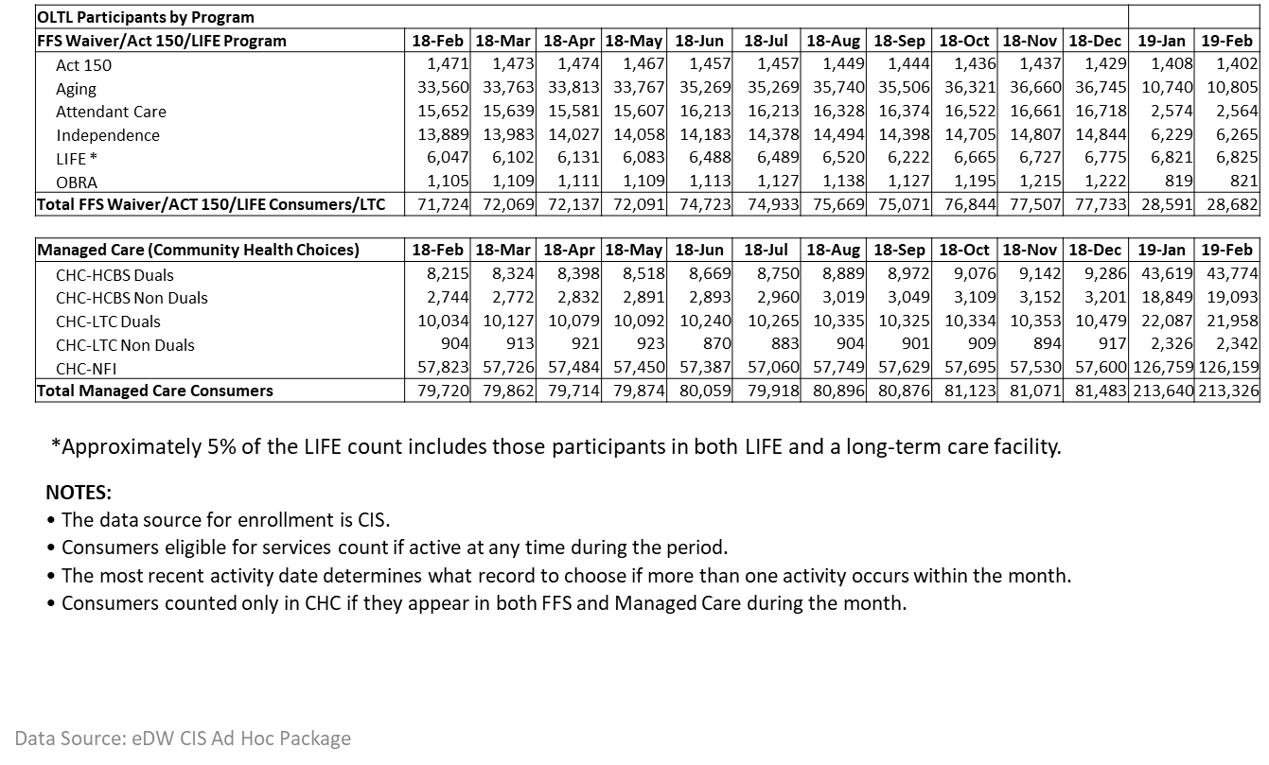
OLTL PARTICIPANTS BY PROGRAM

Slide 26
QUESTIONS

Slide 27
RESOURCE INFORMATION
CHC LISTSERV // STAY INFORMED: http://listserv.dpw.state.pa.us/oltl-community-healthchoices.html
COMMUNITY HEALTHCHOICES WEBSITE: www.healthchoices.pa.gov
MLTSS SUBMAAC WEBSITE: www.dhs.pa.gov/communitypartners/informationforadvocatesandstakeholders/mltss
EMAIL COMMENTS TO: RA-PWCHC@pa.gov
OLTL PROVIDER LINE: 1-800-932-0939
OLTL PARTICIPANT LINE: 1-800-757-5042
INDEPENDENT ENROLLMENT BROKER: 1-844-824-3655 or (TTY 1-833-254-0690)
or visit www.enrollchc.com

Slide 28
CHC MCO CONTACT INFORMATION
AmeriHealth Caritas/Keystone First | CHCProviders@amerihealthcaritas.com
www.amerihealthcaritaschc.com - 1-800-521-6007 (TTY 1-855-235-5112)
Pennsylvania Health and Wellness (Centene) | information@pahealthwellness.com
www.PAHealthWellness.com – 1-844-626-6813 (TTY 1-844-349-8916)
UPMC Community HealthChoices | CHCProviders@UPMC.edu
www.upmchealthplan.com/chc - 1-844-860-9303 (TTY 1-866-407-8762)

