Slide 1
Enrollment Updates and Data Review
LTSS Sub-MAAC
April 10, 2018 Updates

Slide 2
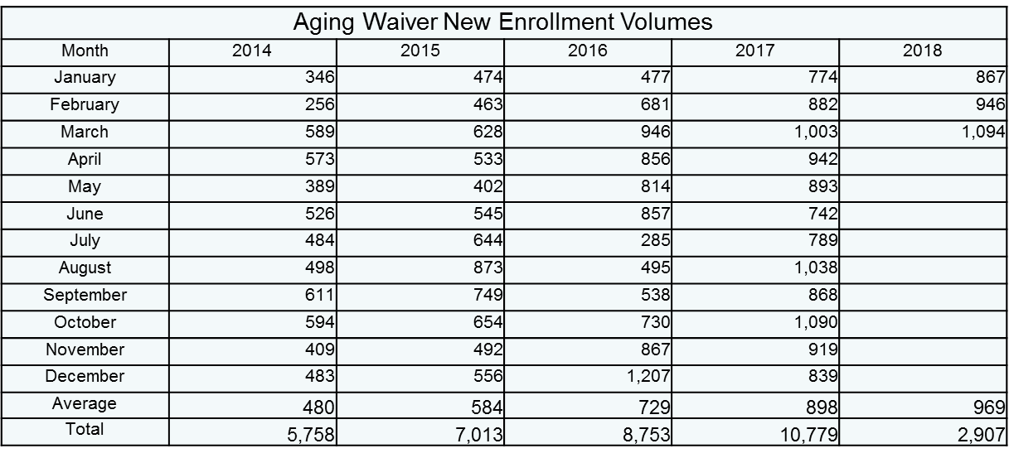
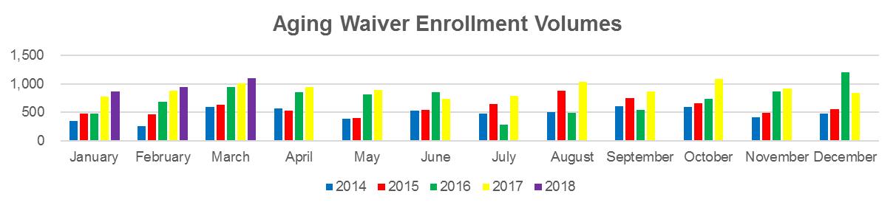
Aging Waiver Enrollment Volumes

Slide 3
Length of Time for Enrollment Status
2/28 Snapshot of Average length of time in status
  1768 Approval Issued to CAO : 39 days
  Pending review by OLTL : 17 days
  Waiting for In Home Visit to be Scheduled : 5 days
  In Home Visit Scheduled : 13 days
  PC and/or LCD Pending : 22 days

Slide 4
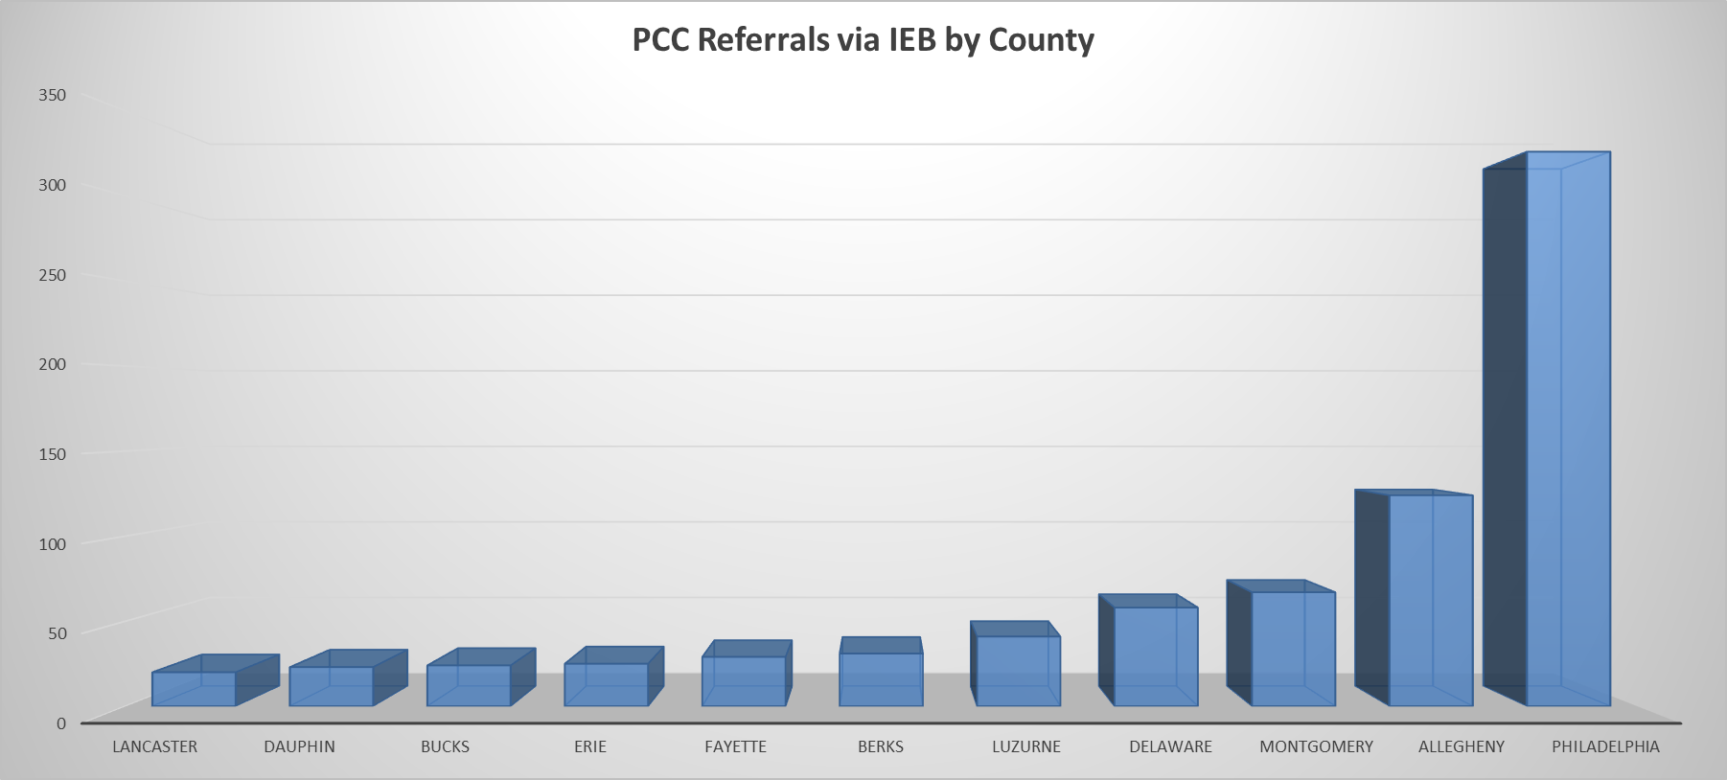
ADRC Involvement in the Application Process

Slide 5
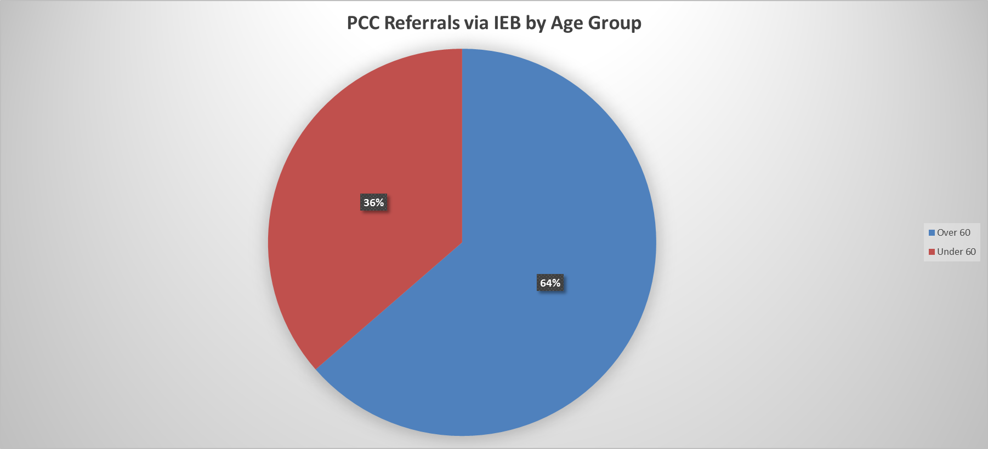
ADRC Involvement in the Application Process

Slide 6
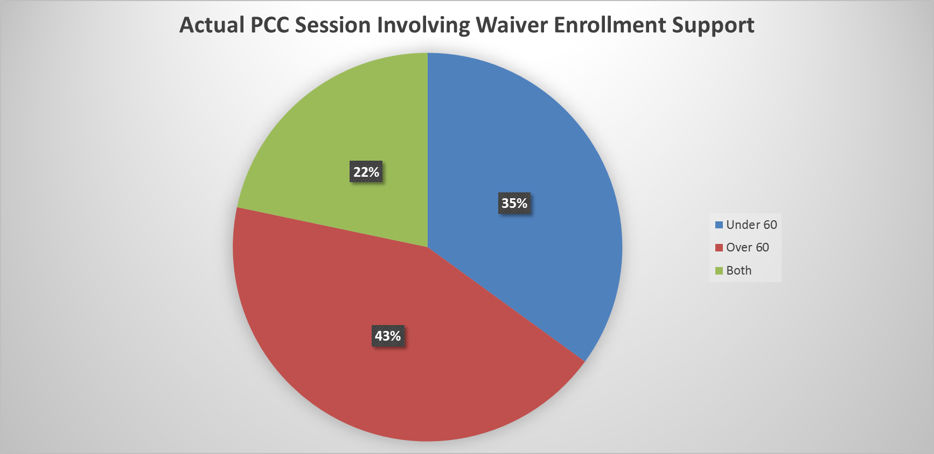
ADRC Involvement in the Application Process

Slide 7
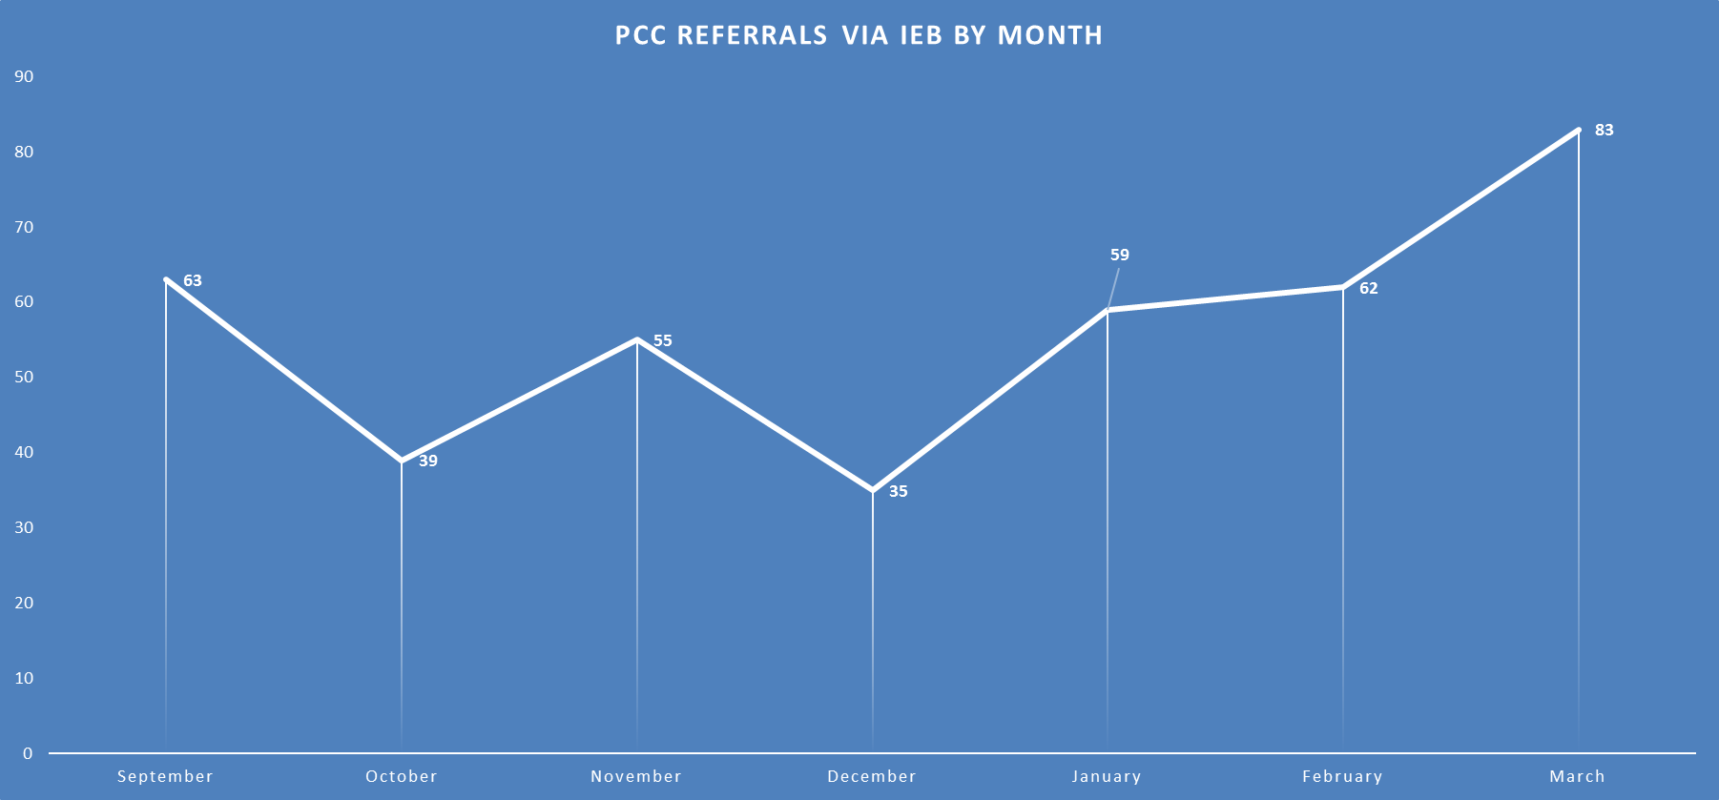
ADRC Involvement in the Application Process

Slide 8
Current IEB Report – Under 60
 | 2015 QTR2 | 2015 QTR3 | 2015 QTR4 | 2016 QTR1 | 2016 QTR2 | 2016 QTR3 | 2016 QTR4 | 2017 QTR1 | 2017 QTR2 | 2017 QTR3 | 2017 QTR4
Grand Total | 5,407 | 5,577 | 5,719 | 6,677 | 8,231 | 8,399 | 9,179 | 7,925 | 8,137 | 11,000 | 10,280
Complete | 2,944 | 3,020 | 3,254 | 3,215 | 5,872 | 4,452 | 6,149 | 5,066 | 4,081 | 6,626 | 6,781
Complete in 90 Days | 2,714 | 2,767 | 2,878 | 2,864 | 4,969 | 4,094 | 5,504 | 4,212 | 3,564 | 5,767 | 5,535
Complete > 90 Days With Excuse | 116 | 129 | 120 | 169 | 193 | 112 | 126 | 129 | 104 | 93 | 137
Compliance Percentage | 96% | 96% | 96% | 94% | 88% | 94% | 92% | 86% | 90% | 88% | 84%
Average Days To Complete | 62 | 66 | 71 | 66 | 55 | 41 | 45 | 54 | 53 | 63 | 58
All unduplicated applications in process this quarter
Total unduplicated applications completed this quarter
Total unduplicated applications completed during the quarter in 90 days
Total unduplicated applications completed during the quarter and over 90 days, but with excuse
Using the above fields = (row 3 + row 4)/ row 2
Average to complete excluding excused applications
Note: 2016 QTR 2 was revised to remove Aging waiver applications.
Note: Reapplications removed

Slide 9
Current IEB Report – Over 60
 | 2016 QTR4 | 2017 QTR1 | 2017 QTR2 | 2017 QTR3 | 2017 QTR4
Grand Total | 14,072 | 11,804 | 10,462 | 13,932 | 13,275
Complete | 9,802 | 7,495 | 5,654 | 8,457 | 8,555
Complete in 90 Days | 7,280 | 5,791 | 4,837 | 7,277 | 6,892
Complete > 90 Days With Excuse | 155 | 206 | 154 | 178 | 188
Compliance Percentage | 76% | 80% | 88% | 88% | 83%
Average Days To Complete | 64 | 62 | 59 | 60 | 59
All unduplicated applications in process this quarter
Total unduplicated applications completed this quarter
Total unduplicated applications completed during the quarter in 90 days
Total unduplicated applications completed during the quarter and over 90 days, but with excuse
Average to complete excluding excused applications

Slide 10
Consumer and Churn Reports – Snap Shot
Chart for 3rd Quarter SFY 2017-18 through February
 | Waiver/Act 150 Program Descriptions | Feb-17 | Mar-17 | Apr-17 | May-17 | Jun-17 | Jul-17 | Aug-17 | Sep-17 | Oct-17 | Nov-17 | Dec-17 | Jan-18 | Feb-18 | as a % | Budget
A | Active Consumers authorized for services at the end of the period
 | Act 150 | 1,680 | 1,671 | 1,651 | 1,643 | 1,631 | 1,608 | 1,602 | 1,576 | 1,558 | 1,551 | 1,549 | 1,525 | 1,515 | 2% | 1,575
 | Aging | 30,366 | 30,099 | 33,347 | 33,546 | 33,206 | 33,933 | 33,788 | 34,879 | 35,615 | 35,760 | 35,512 | 36,647 | 36,195 | 46% | 32,211
 | Attendant Care | 14,296 | 14,577 | 14,693 | 14,908 | 15,131 | 15,170 | 15,437 | 15,638 | 15,823 | 16,042 | 16,300 | 14,729 | 15,005 | 19% | 14,731
 | COMMCARE | 942 | 952 | 929 | 938 | 944 | 944 | 832 | 689 | 595 | 311 | 230 | 5,686 | 5,686 | 7% | 0
 | Independence | 14,799 | 15,038 | 15,073 | 15,245 | 15,401 | 15,496 | 15,894 | 16,221 | 16,710 | 17,028 | 17,316 | 13,784 | 14,015 | 18% | 15,951
 | OBRA | 1,465 | 1,470 | 1,469 | 1,479 | 1,482 | 1,484 | 1,483 | 1,504 | 1,506 | 1,516 | 1,518 | 1,104 | 1,108 | 1% | 1,374
 | LIFE | 5,485 | 5,492 | 5,574 | 5603 | 5,473 | 5,695 | 5,739 | 5,792 | 5,800 | 5,842 | 5,844 | 5,859 | 5,846 | 7% | 0
 | Total Active Authorized Consumers | 69,033 | 69,299 | 72,736 | 73,362 | 73,268 | 74,330 | 74,775 | 76,299 | 77,607 | 78,050 | 78,269 | 79,334 | 79,370 |  | 65,842
B | Consumers added
 | Act 150 | 7 | 2 | 5 | 6 | 1 | 5 | 2 | 3 | 11 | 7 | 1 | 5 | 7 | 0.6%
 | Aging | 609 | 326 | 820 | 727 | 291 | 568 | 454 | 679 | 942 | 663 | 362 | 623 | 394 | 34.5%
 | Attendant Care | 251 | 383 | 334 | 293 | 273 | 235 | 349 | 394 | 375 | 324 | 312 | 302 | 340 | 29.7%
 | COMMCARE | 9 | 13 | 8 | 12 | 7 | 8 | 10 | 9 | - | - | - | 5,691 | - | 0.0%
 | Independence | 188 | 280 | 278 | 213 | 187 | 256 | 421 | 408 | 650 | 368 | 314 | 214 | 262 | 22.9%
 | OBRA | 12 | 8 | 14 | 11 | 6 | 6 | 3 | 21 | 14 | 11 | 5 | 9 | 8 | 0.7%
 | LIFE | 137 | 139 | 175 | 130 | 141 | 156 | 157 | 138 | 128 | 171 | 169 | 136 | 132 | 11.5%
 | Total Consumers added | 1,213 | 1,151 | 1,634 | 1,392 | 906 | 1,234 | 1,396 | 1,652 | 2,120 | 1,544 | 1,163 | 6,980 | 1,143
C | Consumers that left
 | Act 150 | 11 | 7 | 3 | 14 | 6 | 8 | 6 | 9 | 14 | 81 | 10 | 16 | 8 | 1%
 | Aging | 592 | 831 | 519 | 626 | 984 | 590 | 862 | 592 | 504 | 616 | 962 | 841 | 1,367 | 86%
 | Attendant Care | 104 | 79 | 84 | 48 | 33 | 91 | 42 | 73 | 107 | 54 | 1,684 | 63 | 54 | 3%
 | COMMCARE | 2 | 1 | 13 | 1 | - | 100 | 125 | 89 | 285 | 3 | 230 | 5 | - | 0%
 | Independence | 43 | 18 | 45 | 29 | 23 | 25 | 8 | 22 | 51 | 3 | 3,623 | 31 | 9 | 1%
 | OBRA | 3 | - | 1 | 3 | 1 | 4 | 1 | 6 | 1 | 24 | 420 | 3 | 1 | 0%
 | LIFE | 119 | 135 | 136 | 100 | 119 | 153 | 114 | 141 | 124 | 135 | 159 | 146 | 147 | 9%
 | Total Consumers that left | 874 | 1,071 | 801 | 821 | 1,166 | 971 | 1,158 | 932 | 1,086 | 916 | 7,088 | 1,105 | 1,586
D | Transfers from ACW to Independence | 57 | 47 | 57 | 26 | 15 | 38 | 37 | 28 | 71 | 44 | 25 | 15 | 52
 | Transfers from Independence to ACW | -- | -- | -- | -- | -- | -- | -- | -- | -- | -- | -- | 2 | --
Notes:
Note: The three categories A, B and C cannot be reconciled. (It can be done however because the members did not understand why the numbers didn’t add up. I reconciled every month when the program first started in July 2015 but the process was cumbersome, tedious and time-consuming so the need to reconcile was dropped as an issue.
The most recent month is the only calculated table column. All others are “hold overs” and “unaltered”. The numbers for prior months would be quite different otherwise.
The enrollment data uses the standard definition of an enrolled person:
Funding Source Name(s)
'ACT 150', 'Aging', 'Attendant Care', 'COMMCARE', 'Independence', 'OBRA'
In waiver/Act 150 anytime in period
[Waiver Eligibility Begin Date] <=?Report end date? [Waiver Eligibility End Date] is null or [Waiver Eligibility End Date] >?Report start date?
Newly enrolled in period
[Waiver Eligibility Begin Date] between ?Report start date? and ?Report end date?
“Disenrolled” in period
[Waiver Eligibility End Date] between ?Report start date? and ?Report end date?
Transfers: For September 2017 the only transfers were from Attendant Care to Independence and COMMCARE to Independence.
Facility Fact table data identifies any participant with a change to her or his service plan in the current month as indicated.

Slide 11
Employment
Note: This is the total number of waiver/program participants employed (Source: CIS employment data)
Notes:
This CIS custom report provides employment and income information for waiver recipients.
The report matches MCI information from the CIS and waiver Data for a given month.
The report also includes the recipient’s waiver and enrollment as well as the employment and income details.
The categories identify by waiver the number of participants with CIS employment data.
The table does not include the “Sheltered workshop” and “Room and board” employment categories.

Slide 12
NHT and MFP Transitions
Month | NHT02 Service Deliveries Count | Number of those who were also MFP * | Participants who were MFP only ** | % NHT Transitions who also had MFP
2017
March | 144 | 29 | 11 | 20.1%
April | 98 | 17 | 33 | 17.3%
May | 124 | 27 | 16 | 21.8%
June | 129 | 19 | 26 | 14.7%
July | 101 | 13 | 24 | 12.9%
August | 93 | 6 | 16 | 6.5%
September | 95 | 9 | 16 | 9.5%
October | 103 | 8 | 21 | 7.8%
November | 81 | 7 | 19 | 8.6%
December | 75 | 3 | 13 | 4.0%
2018
January | 62 | 5 | 9 | 8.1%
February | 59 | 2 | 12 | 3.4%
TOTAL for Period | 1164 | 145 | 216 | 12.5%
* Based on MFP anytime around NHT completion
** Based on MFP Facility Begin Date
Notes:
% NHT Transitions who also had MFP data for the last three months looks low. This is due to using two data sources to capture the data and therefore a maturation process will lead to higher percentages over time.

Slide 13
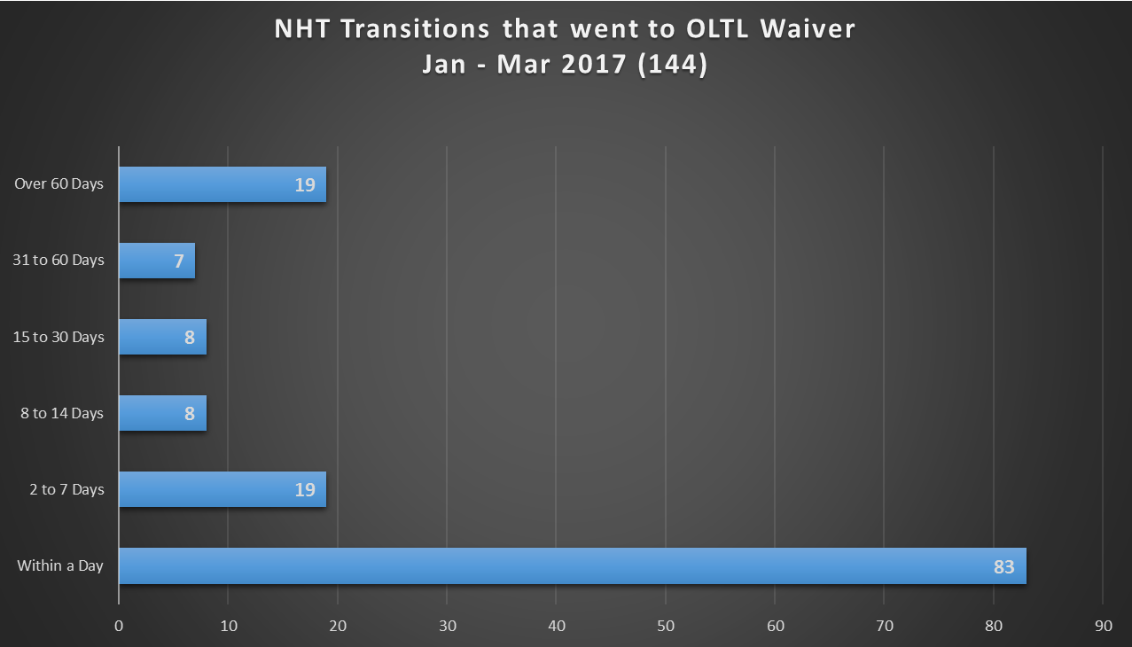
NHT Transitions to First Date of Service

