Slide 1
DIRECT CARE WORKER POLICY CLARIFICATION & GUIDANCE
PA Homecare Association Conference
May 3, 2017
Jennifer Burnett, Deputy Secretary, Office of Long-Term Living, DHS
Susan Coble, Director, Bureau of Community Program and Licensure, DOH
Linda Chamberlin, Chief, Division of Home Health, DOH

Slide 2
Background on Direct Care Worker (DCW) Policy
Many individuals, families, DCWs, advocates, and other members of the stakeholder community have expressed a strong desire for the commonwealth to adopt a policy that would clarify the types of non-skilled home care services/activities DCWs can perform in HCBS settings to enable individuals with disabilities to live independently.
The Pennsylvania Long-Term Care Commission (“LTCC”) Final Report, recommended the commonwealth explore “enabl[ing] DCWs to provide additional services for long term services and supports (“LTSS”) consumers.” ADAPT, a national disability rights grassroots organization, has also recognized the need for DCWs to provide individuals with assistance concerning activities that individuals could perform themselves, but for their disability.
Notes:
Jen’s Slide

Slide 3
Background Continued
November 14, 2016 the Wolf Administration issued a policy clarification through the departments of Health, Human Services, and State that clarifies the types of non-skilled services/activities that can be performed by DCWs to assist individuals with disabilities with activities of daily living that could be performed independently but for their disability.
Notes:
Jen’s Slide

Slide 4
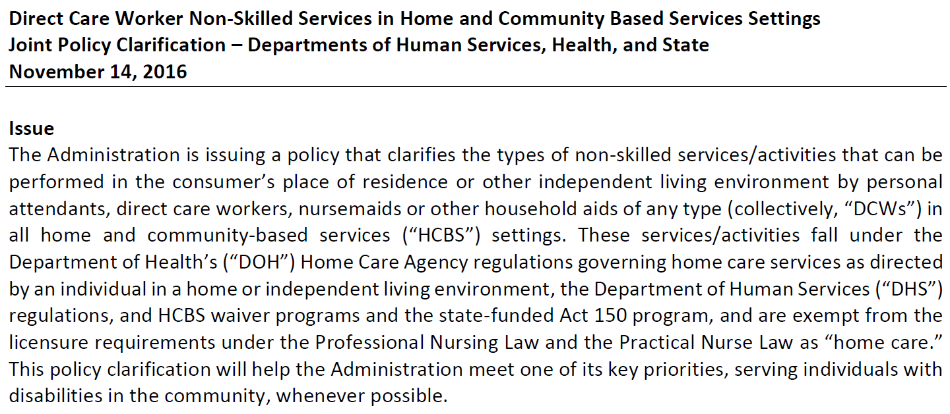
November 14, 2016 Policy Clarification

Slide 5
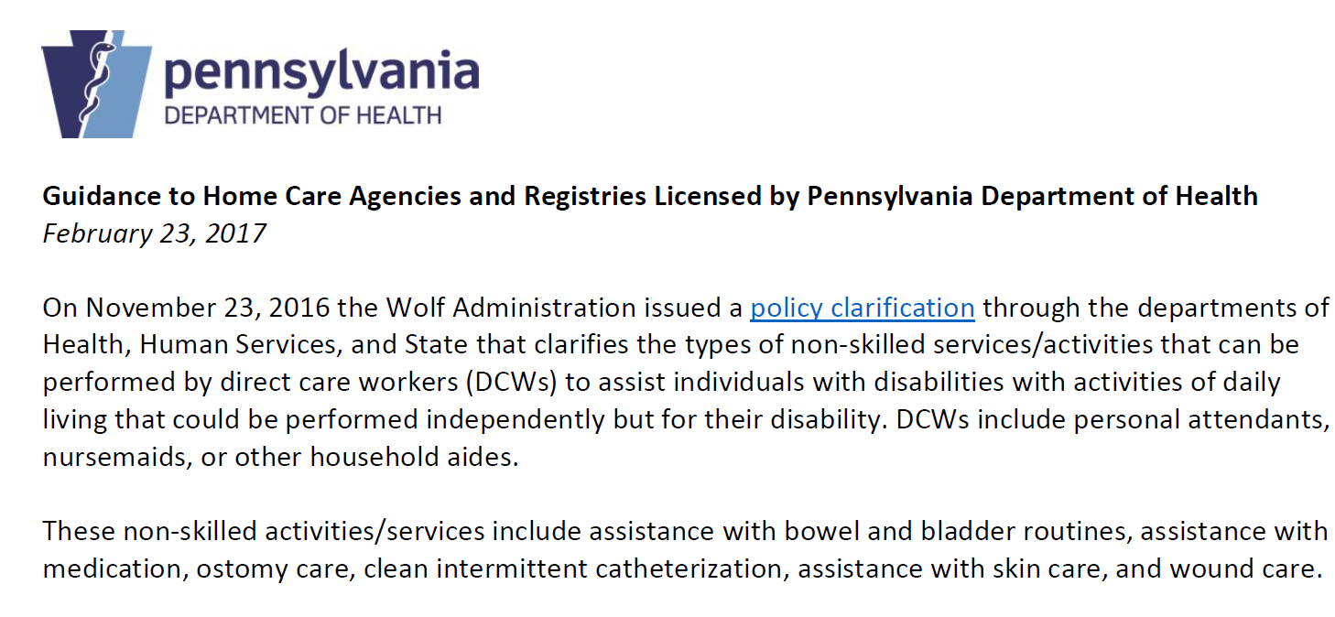
February 23, 2017 Department of Health Policy Guidance
Notes:
An In-service educational session was held with all DOH Surveyors to educate them on implementing the new guidance.
Susan’s Slide

Slide 6
Definitions – Ch. 611 Home Care Regulations
Direct Care Worker – individual employed by a home care agency or referred by a home care registry to provide home care services to a consumer.
Home Care Services – encompass the following activities:
Personal care services
Assistance with instrumental activities of daily living
Companionship services
Respite care
Specialized care
Non-skilled services/activities unique to the consumer’s care needs that facilitate the consumer’s health, safety and welfare, and ability to live independently.
Notes:
Susan’s Slide

Slide 7
Specialized Care
The non-skilled activities/services are specialized care that are unique to the individual consumer’s care needs that facilitate the consumer’s health, safety and welfare, and ability to live independently. This applies to consumers regardless of age or nature of disability. These services include:
Assistance with bowel and bladder routines
Assistance with medication
Ostomy care
Clean intermittent catheterization
Assistance with skin care
Wound care
Notes:
Susan’s Slide

Slide 8
Consumer Characteristics – Department of Health
A DCW may perform the non-skilled activities/services included in this policy for a consumer whose characteristics meet all of the following guidelines:
The consumer is capable of directing his or her own care or has a health care representative or agent who is capable to make choices for the consumer about home care services, understands the impact of these choices, and assumes responsibility for the results of the choices.
The specific non-skilled activity/service provided is of a nature that the consumer would be able to perform independently but for his/her disability.
Notes:
Susan’s Slide

Slide 9
Consumer Characteristics – DOH Continued
The consumer’s service plan documents that the consumer has a need for assistance with the non-skilled activity/service to facilitate the ability to live independently while maintaining his or her health, safety, and welfare, as defined by the consumer, the consumer’s health care representative, or the consumer’s agent.
The consumer has an order from a health care practitioner, service authorization form, or service plan/agreement that authorizes the home care agency/registry to provide the non-skilled service/activity. The order, service authorization form, or service plan/agreement is renewed yearly or when a significant change in condition occurs.
The consumer’s health conditions, care needs, and the outcomes of the non-skilled service/activity are generally predictable to the consumer.

Slide 10
Home Care Agency/Registry Responsibility
Prior to assigning a DCW employee to provide the non-skilled activities/services included in the policy, the home care agency/registry must evaluate the DCW and document that the DCW has received training and demonstrated competency in any specialized care activities/services that the DCW will provide to the consumer, per 28.PA.Code Section 611.55
Training and demonstrated competency must:
Be individualized for each consumer;
Take into consideration the service delivery preferences of the consumer; and
Emphasize delivery methods that ensure the safety and maintain the dignity of the consumer.
The home care agency or registry should ensure a consumer meets the consumer characteristics defined above after initial assessment.
Notes:
Susan’s Slide

Slide 11
Important to Note
In addition to the Department of Health’s clarification relating to competency requirements, Home Care agencies must also be in compliance with any other licensing or Medicaid participation requirements.
Notes:
Susan’s Slide

Slide 12
OLTL Waivers
The service definition of Personal Assistance Services is broad enough in the OLTL Waivers (including Community HealthChoices) that no changes are required to allow DCWs to provide non-skilled activities/services.
It will be up to each consumer or health care representative or agent under the participant-directed model or home care agency under the agency-directed model to decide if and when they want to use DCWs for non-skilled activities/services.
Notes:
Jen’s Slide

Slide 13
Next Steps
DHS is currently developing a frequently asked questions resource that will be distributed to service coordinators and posted to the OLTL website at www.dhs.pa.gov/provider/longtermcareprov/
DOH will continue to monitor home care agencies’ and registries’ compliance with Chapter 611 Home Care Agency and Registry regulations relative to the provision of specialized care to consumers and DCW competency requirements through surveys and complaint investigations.
Notes:
Jen’s Slide

