Slide 1
Data Review
LTC Sub-MAAC
June 13, 2017 Updates

Slide 2
Consumer and Churn Reports – Snap Shot
 | Waiver/Act 150 Program Descriptions | Mar-16 | Sep-16 | Oct-16 | Nov-16 | Dec-16 | Jan-17 | Feb-17 | Mar-17 | as a % | Budget
A | Active Consumers authorized for services at the end of the period
 | Act 150 | 1,749 | 1,703 | 1,708 | 1,707 | 1,705 | 1,687 | 1,680 | 1,671 | 2% | 1,705
 | Aging | 27,889 | 29,571 | 29,442 | 29,410 | 29,194 | 30,305 | 30,366 | 30,099 | 43% | 36,421
 | Attendant Care | 12,899 | 13,642 | 13,847 | 13,964 | 14,093 | 14,131 | 14,296 | 14,577 | 21% | 12,892
 | COMMCARE | 877 | 915 | 923 | 928 | 934 | 937 | 942 | 952 | 1% | 884
 | Independence | 13,415 | 14,123 | 14,405 | 14,529 | 14,658 | 14,673 | 14,799 | 15,038 | 22% | 13,309
 | OBRA | 1,396 | 1,439 | 1,446 | 1,452 | 1,456 | 1,458 | 1,465 | 1,470 | 2% | 1,694
 | LIFE | 5,468 | 5,377 | 5,417 | 5,412 | 5,451 | 5,468 | 5485 | 5,492 | 8%
 | Total Active Authorized Consumers | 63,693 | 66,770 | 67,188 | 67,402 | 67,491 | 68,659 | 69,033 | 69,299 | 100% | 66,905
B | Consumers added
 | Act 150 | 4 | 9 | 9 | 9 | 6 | 6 | 7 | 2 | 0%
 | Aging | 789 | 528 | 528 | 529 | 312 | 577 | 609 | 326 | 48%
 | Attendant Care | 369 | 234 | 234 | 207 | 220 | 261 | 251 | 383 | 22%
 | COMMCARE | 16 | 10 | 10 | 8 | 7 | 11 | 9 | 13 | 1%
 | Independence | 307 | 238 | 238 | 187 | 173 | 207 | 188 | 280 | 17%
 | OBRA | 8 | 11 | 11 | 9 | 7 | 10 | 12 | 8 | 1%
 | LIFE | 130 | 166 | 138 | 138 | 133 | 133 | 137 | 139 | 11%
 | Total Consumers added | 1,623 | 1,196 | 1,168 | 1,087 | 858 | 1,205 | 1,213 | 1,151 | 100%
C | Consumers that left
 | Act 150 | 20 | 5 | 3 | 1 | 3 | 14 | 11 | 7 | 2%
 | Aging | 632 | 436 | 554 | 531 | 687 | 549 | 592 | 831 | 65%
 | Attendant Care | 101 | 334 | 95 | 91 | 45 | 86 | 104 | 79 | 10%
 | COMMCARE | 3 | 10 | 8 | 10 | 0 | 5 | 2 | 1 | 1%
 | Independence | 95 | 306 | 62 | 45 | 13 | 64 | 43 | 18 | 8%
 | OBRA | 6 | 18 | 2 | 4 | 1 | 6 | 3 | - | 1%
 | LIFE | 82 | 80 | 103 | 141 | 96 | 117 | 119 | 135 | 14%
 | Total Consumers that left | 939 | 1,189 | 827 | 823 | 845 | 841 | 874 | 1,071 | 100%
D | Transfers from Attendant Care to Independence | 48 | 58 | 47 | 44 | 34 | 53 | 57 | 47
Notes:
As requested at the last meeting we have added the % column

Slide 3
Employment
Note: This is the total number of waiver/program participants employed (Source: CIS employment data)
 | 2016 |  |  |  |  |  |  | 2017
Waiver/Employment | Mar | Jul | Aug | Sep | Oct | Nov | Dec | Jan | Feb | Mar
ACT 150
Full Time Employment | 10 | 11 | 12 | 10 | 12 | 11 | 12 | 12 | 12 | 11
Part Time Employment | 17 | 15 | 18 | 17 | 19 | 15 | 19 | 18 | 17 | 18
Self Employment | 7 | 1 | 1 | 1 | 8 | 8 | 9 | 8 | 9 | 9
Total | 34 | 27 | 31 | 28 | 39 | 34 | 40 | 38 | 38 | 38
Attendant Care
Full Time Employment | 22 | 23 | 29 | 28 | 29 | 34 | 33 | 34 | 33 | 36
Part Time Employment | 129 | 126 | 130 | 137 | 142 | 144 | 154 | 158 | 152 | 150
Self Employment | 53 | 31 | 31 | 33 | 57 | 53 | 57 | 58 | 57 | 61
Total | 204 | 180 | 190 | 198 | 228 | 231 | 244 | 250 | 242 | 247
COMMCARE
Full Time Employment | 3 | 3 | 3 | 2 | 2 | 2 | 2 | 3 | 3 | 3
Part Time Employment | 49 | 44 | 49 | 52 | 56 | 54 | 57 | 57 | 57 | 59
Self Employment | 2 | 0 | 0 | 0 | 4 | 4 | 4 | 6 | 5 | 5
Total | 54 | 47 | 52 | 54 | 62 | 60 | 63 | 66 | 65 | 67
Independence
Full Time Employment | 44 | 37 | 37 | 36 | 38 | 38 | 41 | 47 | 48 | 53
Part Time Employment | 167 | 176 | 175 | 175 | 188 | 186 | 192 | 199 | 197 | 193
Self Employment | 55 | 19 | 18 | 16 | 61 | 60 | 59 | 61 | 59 | 61
Total | 266 | 232 | 230 | 227 | 287 | 284 | 292 | 307 | 304 | 307
OBRA
Full Time Employment | 14 | 14 | 14 | 13 | 15 | 16 | 16 | 15 | 16 | 16
Part Time Employment | 89 | 89 | 89 | 91 | 94 | 93 | 101 | 102 | 106 | 108
Self Employment | 2 | 0 | 0 | 0 | 5 | 3 | 5 | 5 | 4 | 4
Total | 105 | 103 | 103 | 104 | 114 | 112 | 122 | 122 | 126 | 128
All Waivers | 663 | 589 | 606 | 611 | 730 | 721 | 761 | 783 | 775 | 787

Slide 4
NHT and MFP Transitions
Month | NHT02 Service Deliveries Count | Number of those who were also MFP* | Participants who were MFP only** | % NHT Transitions who also had MFP
2016
June | 99 | 29 | 42 | 29.3%
July | 104 | 26 | 39 | 25.0%
August | 142 | 27 | 35 | 19.0%
September | 133 | 18 | 41 | 13.5%
October | 121 | 28 | 27 | 23.1%
November | 94 | 15 | 24 | 16.0%
December | 94 | 12 | 10 | 12.8%
2017
January | 73 | 15 | 12 | 20.5%
February | 76 | 13 | 13 | 17.1%
March | 88 | 13 | 6 | 14.8%
TOTAL for Period | 1024 | 196 | 249 | 19.1%

Slide 5
Updated Participant Data Flow Chart by System
*There is not always a referral
1A. IEB receives referral (IEB System)* Facility Begin Date (CIS)
4. Financial Eligibility approved and 162 Issued(CIS) – Eligibility Run (Data Load Date)
5. Participant entered into HCSIS (under 60) and file to SC
5. Participant entered into SAMS (over 60) and file to SC
6. SC starts plan in HCSIS
6. SC starts plan in SAMS
2. AAA conducts LCD (SAMS)
3. IEB sends 1768 & 600L to CAO with Waiver Program
7. Service Plan Approved HCSIS
7. SP Approved SAMS
8. Service Performed / Billed (PROMISe)
1B. IEB sends PA600 (non-MA) and Freedom of Choice (already MA and non-MA)
Notes:
Notes: Step 2 can be done before or after step one – therefore not reliable.

Slide 6
Aging Milestones with Dates
Process Points | Systems / Tools | Fields | Availability | Allowable Time
Referral | IEB / Excel Report | Referral Date | Weekly | Variable
Application Starts | SAMS / Crystal Reports | Application Start Date | SAMS WH Weekly | Day 1
Eligibility Starts | SAMS / Crystal Reports | Care Plan Start Date | SAMS WH Weekly | By Day 90
Care Plan Approved | HCSIS / DW | Initial Service Plan Start* | HCSIS | Within 30 days
First Date of Service | PROMISe / DW | FDOS | Weekly | Any time after initial CP
*SAMS gives new SP date each month; initial plan date must be determined
Notes:
NOTE: HCSIS Data Warehouse and PROMISe Data Warehouse do NOT talk to one another – these have to be extracted and matched by hand
Remember: (HCSIS DW 1.5 months old)
We are doing an exercise now to improve our approach to measuring this information. We have pulled a small sample which we are validating and figuring out how we will aggregate it (average days, snapshot counts, etc.)
The sample showed we are taking longer than expected between Care Plan Start and Initial Service Plan start and also the SP start and FDOS

Slide 7
Aging Waiver Utilization
First Time Utilizers – PAS for Aging Waiver only
Calendar Year 2016
Jan | Feb | Mar | Apr | May | June | July | Aug | Sep | Oct | Nov | Dec
619 | 594 | 700 | 779 | 759 | 584 | 667 | 676 | 609 | 536 | 578 | 692
Notes:
This report identifies those that had an Aging PAS claim that report month that also did not have an Aging PAS claim from Jan 1 2015 to the month prior to the report month. Example: for March 2016, Aging PAS claims sometime in Mar 2016 but no Aging PAS claims Jan 2015 – Feb 2016

Slide 8
Current IEB Report – Under 60
 | 2015 QTR1 | 2015QTR2 | 2015 QTR3 | 2015 QTR4 | 2016 QTR1 | 2016 QTR2 | 2016 QTR3 | 2016 QTR4 | 2017 QTR1
Grand Total | 5041 | 5407 | 5577 | 5719 | 6677 | 7191 | 6688 | 8476 | 7264
Complete | 2867 | 2944 | 3020 | 3150 | 3198 | 5068 | 3957 | 5635 | 4407
Complete in 90 Days | 2351 | 2645 | 2702 | 2788 | 2850 | 4258 | 3631 | 5007 | 3605
Complete > 90 Days With Excuse | 161 | 116 | 129 | 119 | 169 | 162 | 95 | 120 | 112
Compliance Percentage | 88% | 94% | 94% | 94% | 94% | 87% | 94% | 91% | 84%
Average Days To Complete | 73 | 62 | 65 | 72 | 66 | 56 | 41 | 48 | 56
All unduplicated applications in process this quarter
Total unduplicated applications completed this quarter
Total unduplicated applications completed during the quarter in 90 days
Total unduplicated applications completed during the quarter and over 90 days, but with excuse
Using the above fields = (row 3 + row 4)/ row 2
Average to complete excluding excused applications
Note: 2016 QTR 2 was revised to remove Aging waiver applications.
Note: Reapplications removed

Slide 9
Current IEB Report – Over 60
 | 2016 QTR 4 | 2017 QTR 1
Grand Total | 12624 | 10705
Complete | 8358 | 6409
Complete in 90 Days | 5907 | 4824
Complete > 90 Days With Excuse | 146 | 145
Compliance Percentage | 72% | 78%
Average Days To Complete | 67 | 64
Question from last meeting: What does “Complete mean?”
Answer: The date the 162 is received.
Question: Do any OLTL waivers have a waiting list?
Answer: No.

Slide 10
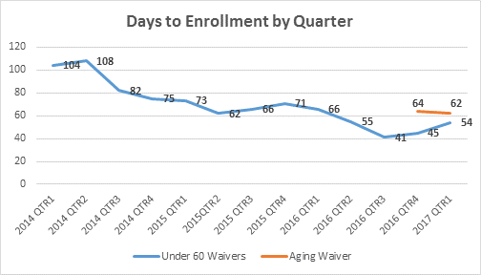
IEB Report with Reapplications Included
Reapplications included

Slide 11
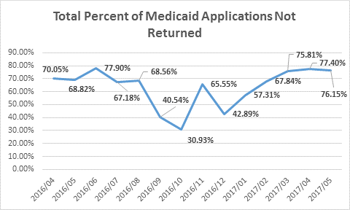
IEB Questions

Slide 12
IEB Questions
Number over 60 mailed applications:
Measure >60 | April2016 | May 2016 | June 2016 | July 2016 | Aug 2016 | Sept 2016 | Oct 2016 | Nov 2016 | Dec 2016 | Jan 2017 | Feb 2017 | Mar 2017 | April 2017 | May 2017 | Total April 2016 - March 2017
PA 600 Sent to recipients over the age of 60 | 716 | 2038 | 2634 | 1839 | 2306 | 997 | 654 | 1351 | 608 | 378 | 1989 | 1804 | 1363 | 1121 | 19798
PA 600 Sent to recipients over the age of 60 Not Returned | 517 | 1416 | 2059 | 1247 | 1608 | 381 | 161 | 871 | 222 | 175 | 1444 | 1402 | 1076 | 867 | 13446
% Not Returned | 72% | 69% | 78% | 68% | 70% | 38% | 25% | 64% | 37% | 46% | 73% | 78% | 79% | 77% | 68%
Notes:
Monthly average 62%

Slide 13
IEB Questions
Number under 60 mailed applications:
Measure < 60 | April2016 | May 2016 | June 2016 | July 2016 | Aug 2016 | Sept 2016 | Oct 2016 | Nov 2016 | Dec 2016 | Jan 2017 | Feb 2017 | Mar 2017 | April 2017 | May 2017 | Total April 2016 - March 2017
PA 600 Sent to recipients under the age of 60 | 359 | 480 | 588 | 498 | 464 | 293 | 235 | 443 | 285 | 238 | 539 | 424 | 252 | 225 | 4422
PA 600 Sent to recipients under the age of 60 Not Returned | 236 | 317 | 451 | 323 | 291 | 142 | 114 | 305 | 161 | 178 | 271 | 287 | 174 | 158 | 2789
% Not Returned | 66% | 66% | 77% | 65% | 63% | 48% | 49% | 69% | 56% | 75% | 50% | 68% | 69% | 70% | 63%
Notes:
Monthly average = 64%

Slide 14
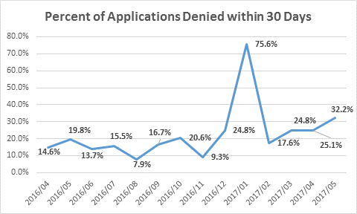
IEB Questions

Slide 15
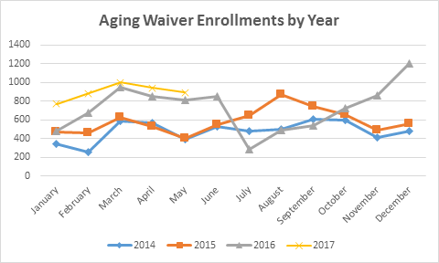
IEB Questions

Slide 16
IEB Questions
Month | 2014 | 2015 | 2016 | 2017
January | 346 | 474 | 477 | 774
February | 256 | 463 | 681 | 882
March | 589 | 628 | 946 | 1003
April | 573 | 533 | 856 | 942
May | 389 | 402 | 814 | 893
June | 526 | 545 | 857
July | 484 | 644 | 285
August | 498 | 873 | 495
September | 611 | 749 | 538
October | 594 | 654 | 730
November | 409 | 492 | 867
December | 483 | 556 | 1207

