Slide 1
LTSS SUBMAAC UPDATES
December 11, 2017

Slide 2
LTSS SubMAAC Updates - Agenda
Long-term Care Enrollment Updates
IEB Performance Updates
Participant ‘Churn’ Reports
Aging Waiver Service Coordination Plan Management
Nursing Home Transition

Slide 3
Aging Waiver Enrollment Volumes
Aging Waiver Enrollment Volumes
Month | 2014 | 2015 | 2016 | 2017
January | 346 | 474 | 477 | 774
February | 256 | 463 | 681 | 882
March | 589 | 628 | 946 | 1003
April | 573 | 533 | 856 | 942
May | 389 | 402 | 814 | 893
June | 526 | 545 | 857 | 742
July | 484 | 644 | 285 | 789
August | 498 | 873 | 495 | 1038
September | 611 | 749 | 538 | 868
October | 594 | 654 | 730 | 1090
November | 409 | 492 | 867 | 919
December | 483 | 556 | 1207

Slide 4
Enrollment Application Processing
Wavier Applications Average Days to Complete | 2014 QTR1 | 2014 QTR2 | 2014 QTR3 | 2014 QTR4 | 2015 QTR1 | 2015QTR2 | 2015 QTR3 | 2015 QTR4 | 2016 QTR1 | 2016 QTR2 | 2016 QTR3 | 2016 QTR4 | 2017 QTR1 | 2017 QTR 2 | 2017 QTR3
Under 60 | 104 | 108 | 82 | 75 | 73 | 62 | 65 | 72 | 66 | 56 | 41 | 48 | 56 | 55 | 65
Over 60 |  |  |  |  |  |  |  |  |  |  |  | 67 | 64 | 57 | 62

Slide 5
Applications Completed < 90 Days
Wavier Applications Average Days to Complete | 2014 QTR1 | 2014 QTR2 | 2014 QTR3 | 2014 QTR4 | 2015 QTR1 | 2015QTR2 | 2015 QTR3 | 2015 QTR4 | 2016 QTR1 | 2016 QTR2 | 2016 QTR3 | 2016 QTR4 | 2017 QTR1 | 2017 QTR 2 | 2017 QTR3
Under 60 Compliance percentage | 57% | 60% | 71% | 83% | 88% | 94% | 94% | 94% | 94% | 87% | 94% | 91% | 84% | 89% | 88%
Over 60 Compliance Percentage |  |  |  |  |  |  |  |  |  |  |  | 72% | 78% | 87% | 88%

Slide 6
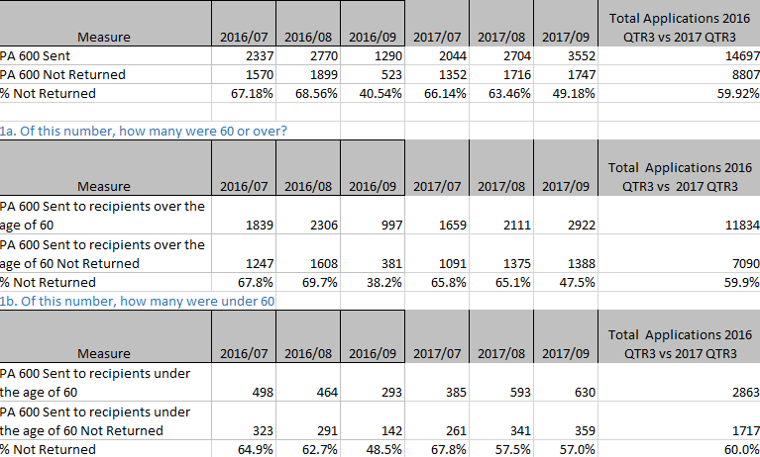
Referrals 3rd Quarter Comparisons
Referrals 3rd Quarter in 2016 and 2017
  2017 - 23918
  2016 - 19404
Not return application by month
  3rd Quarter

Slide 7
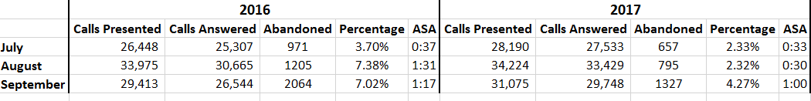
Call Center Request – 3rd Quarter Comparison
IEB Call Center Request 3rd Quarter in 2016 and 2017

Slide 8
OLTL Complaint Tracking
September, 2017 = 140
October, 2017 = 19
November, 2017 = 20
Indicate About | Numbers
Status Update | 51
SCA Inquiry/Issue | 5
Referrals | 1
PC | 6
PA600 | 6
Costumer Service | 2
1768 | 10
Data Entry Issue | 3
LCD | 5
Final Mailings | 3
Internal Escalation | 30
Ineligible Closed | 1
General Inquiry | 17
Indicate About | Numbers
Client | 1
Internal Escalation | 13
Violation Rights | 1
PC | 1
SCA Inquiry Issue | 1
Status Update | 2
Indicate About | Numbers
1768 | 5
Internal Escalation | 13
Customer Service | 1
Referrals | 1

Slide 9
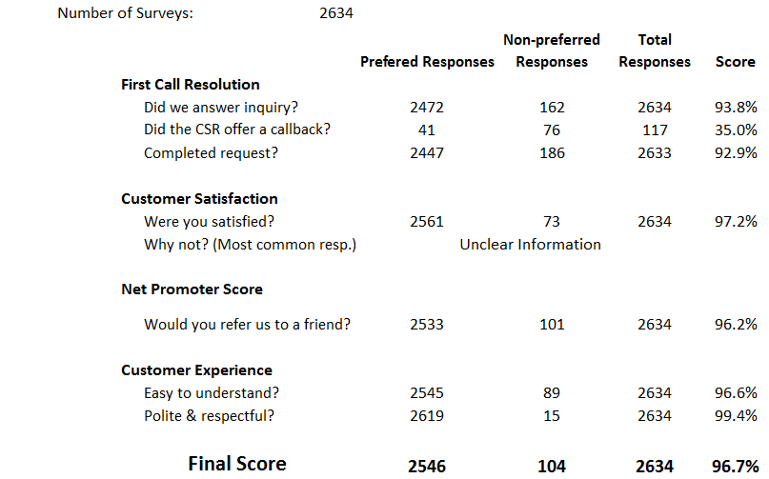
Caller Survey 3rd Quarter in 2017

Slide 10
Outbound Dialer
Total number of calls by Outbound Dialer in
  3 months in 2017
Calls Offered Connected and Calls Routed to Agent
Months | Outbound Dialers
September | 6781
October | 8473
November | 14,920
Months | Calls Offered Connected | Calls Routed to Agent
September | 965 | 948
October | 1354 | 1324
November | 2244 | 2109

Slide 11
Procurement Updates
IEB Procurement Update
  In formal blackout
  Final Scoring
FMS Procurement
  In formal blackout
  Contract Negotiations

Slide 12
Consumer and Churn Reports – Snap Shot
Chart for 1st Quarter SFY 2017-18 through September
 | Waiver/Act 150 Program Descriptions | Oct-16 | Dec-16 | Jan-17 | Feb-17 | Mar-17 | Apr-17 | May-17 | Jun-17 | Jul-17 | Aug-17 | Sep-17 | as a % | Budget *
A | Active Consumers authorized for services at the end of the period
 | Act 150 | 1,708 | 1,705 | 1,687 | 1,680 | 1,671 | 1,651 | 1,643 | 1,631 | 1,608 | 1,602 | 1,576 | 2% | 1,575
 | Aging | 29,442 | 29,194 | 30,305 | 30,366 | 30,099 | 33,347 | 33,546 | 33,206 | 33,933 | 33,788 | 34,879 | 46% | 32,211
 | Attendant Care | 13,847 | 14,093 | 14,131 | 14,296 | 14,577 | 14,693 | 14,908 | 15,131 | 15,170 | 15,437 | 15,638 | 20% | 14,731
 | COMMCARE | 923 | 934 | 937 | 942 | 952 | 929 | 938 | 944 | 944 | 832 | 689 | 1% | 0
 | Independence | 14,405 | 14,658 | 14,673 | 14,799 | 15,038 | 15,073 | 15,245 | 15,401 | 15,496 | 15,894 | 16,221 | 21% | 15,951
 | OBRA | 1,446 | 1,456 | 1,458 | 1,465 | 1,470 | 1,469 | 1,479 | 1,482 | 1,484 | 1,483 | 1,504 | 2% | 1,374
 | LIFE | 5,417 | 5,451 | 5,468 | 5,485 | 5,492 | 5,574 | 5603 | 5,473 | 5,695 | 5,739 | 5,792 | 8%
 | Total Active Authorized Consumers | 67,188 | 67,491 | 68,659 | 69,033 | 69,299 | 72,736 | 73,362 | 73,268 | 74,330 | 74,775 | 76,299 |  | 65,842
B | Consumers added
 | Act 150 | 9 | 6 | 6 | 7 | 2 | 5 | 6 | 1 | 5 | 2 | 3 | 0.2%
 | Aging | 528 | 312 | 577 | 609 | 326 | 820 | 727 | 291 | 568 | 454 | 679 | 41.1%
 | Attendant Care | 234 | 220 | 261 | 251 | 383 | 334 | 293 | 273 | 235 | 349 | 394 | 23.8%
 | COMMCARE | 10 | 7 | 11 | 9 | 13 | 8 | 12 | 7 | 8 | 10 | 9 | 0.5%
 | Independence | 238 | 173 | 207 | 188 | 280 | 278 | 213 | 187 | 256 | 421 | 408 | 24.7%
 | OBRA | 11 | 7 | 10 | 12 | 8 | 14 | 11 | 6 | 6 | 3 | 21 | 1.3%
 | LIFE | 138 | 133 | 133 | 137 | 139 | 175 | 130 | 141 | 156 | 157 | 138 | 8.4%
 | Total Consumers added | 1,168 | 858 | 1,205 | 1,213 | 1,151 | 1,634 | 1,392 | 906 | 1,234 | 1,396 | 1,652
C | Consumers that left
 | Act 150 | 3 | 3 | 14 | 11 | 7 | 3 | 14 | 6 | 8 | 6 | 9 | 1%
 | Aging | 554 | 687 | 549 | 592 | 831 | 519 | 626 | 984 | 590 | 862 | 592 | 64%
 | Attendant Care | 95 | 45 | 86 | 104 | 79 | 84 | 48 | 33 | 91 | 42 | 73 | 8%
 | COMMCARE | 8 | 0 | 5 | 2 | 1 | 13 | 1 | - | 100 | 125 | 89 | 10%
 | Independence | 62 | 13 | 64 | 43 | 18 | 45 | 29 | 23 | 25 | 8 | 22 | 2%
 | OBRA | 2 | 1 | 6 | 3 | - | 1 | 3 | 1 | 4 | 1 | 6 | 1%
 | LIFE | 103 | 96 | 117 | 119 | 135 | 136 | 100 | 119 | 153 | 114 | 141 | 15%
 | Total Consumers that left | 827 | 845 | 841 | 874 | 1,071 | 801 | 821 | 1,166 | 971 | 1,158 | 932
D | Transfers from ACW to Independence | 47 | 34 | 53 | 57 | 47 | 57 | 26 | 15 | 38 | 37 | 28
 | Transfers from COMMCARE to Independence | -- | -- | -- | -- | -- | -- | -- | -- | 57 | 196 | 78

Slide 13
Employment
Note: This is the total number of waiver/program participants employed (Source: CIS employment data)
Using CIS Employment Data (most recent 1st Quarter SFY 2017-18)
eDW Data Source:
Public Folders ‎> * Group Folders * ‎> Commonly Used OLTL Reports ‎> SubMACC for Long-Term Care Comm > Employ and Income Infor for Waiver Recipients
 | Sep | 2016 | 2017
Waiver/Employment |  | Dec | Jan | Feb | Mar | Apr | May | Jun | Jul | Aug | Sep
ACT 150
Full Time Employment | 10 | 12 | 12 | 12 | 11 | 12 | 13 | 13 | 12 | 12 | 10
Part Time Employment | 17 | 19 | 18 | 17 | 18 | 16 | 18 | 19 | 17 | 15 | 15
Self Employment | 1 | 9 | 8 | 9 | 9 | 9 | 9 | 9 | 9 | 9 | 9
Total | 28 | 40 | 38 | 38 | 38 | 37 | 40 | 41 | 38 | 36 | 34
Attendant Care
Full Time Employment | 28 | 33 | 34 | 33 | 36 | 36 | 34 | 35 | 32 | 32 | 32
Part Time Employment | 137 | 154 | 158 | 152 | 150 | 151 | 159 | 152 | 154 | 157 | 160
Self Employment | 33 | 57 | 58 | 57 | 61 | 53 | 57 | 57 | 59 | 59 | 60
Total | 198 | 244 | 250 | 242 | 247 | 240 | 250 | 244 | 245 | 248 | 252
COMMCARE
Full Time Employment | 2 | 2 | 3 | 3 | 3 | 2 | 2 | 2 | 2 | 2 | 1
Part Time Employment | 52 | 57 | 57 | 57 | 59 | 57 | 58 | 57 | 55 | 49 | 47
Self Employment | 0 | 4 | 6 | 5 | 5 | 5 | 4 | 4 | 3 | 3 | 3
Total | 54 | 63 | 66 | 65 | 67 | 64 | 64 | 63 | 60 | 54 | 51
Independence
Full Time Employment | 36 | 41 | 47 | 48 | 53 | 44 | 42 | 41 | 46 | 46 | 47
Part Time Employment | 175 | 192 | 199 | 197 | 193 | 195 | 203 | 206 | 195 | 203 | 218
Self Employment | 16 | 59 | 61 | 59 | 61 | 64 | 62 | 58 | 48 | 54 | 56
Total | 227 | 292 | 307 | 304 | 307 | 303 | 307 | 305 | 289 | 303 | 321
OBRA
Full Time Employment | 13 | 16 | 15 | 16 | 16 | 17 | 17 | 16 | 18 | 19 | 19
Part Time Employment | 91 | 101 | 102 | 106 | 108 | 110 | 110 | 108 | 110 | 110 | 112
Self Employment | 0 | 5 | 5 | 4 | 4 | 3 | 3 | 3 | 3 | 3 | 3
Total | 104 | 122 | 122 | 126 | 128 | 130 | 130 | 127 | 131 | 132 | 134
All Waivers | 611 | 761 | 783 | 775 | 787 | 774 | 791 | 780 | 763 | 773 | 792

Slide 14
NHT and MFP Transitions
Month | NHT02 Service Deliveries Count | Number of those who were also MFP * | Participants who were MFP only ** | % NHT Transitions who also had MFP
2016
December | 94 | 13 | 16 | 13.8%
2017
January | 92 | 22 | 21 | 23.9%
February | 109 | 21 | 12 | 19.3%
March | 144 | 29 | 11 | 20.1%
April | 98 | 17 | 33 | 17.3%
May | 124 | 27 | 16 | 21.8%
June | 129 | 19 | 26 | 14.7%
July | 101 | 13 | 24 | 12.9%
August | 90 | 6 | 13 | 6.7%
September | 93 | 7 | 17 | 7.5%
October | 101 | 6 | 14 | 5.9%
TOTAL for Period | 1175 | 180 | 203 | 15.3%
* Based on MFP anytime around NHT completion
** Based on MFP Facility Begin Date

Slide 15
NHT Transitions to First Date of Service
NHT Transition during January – March
Went to OLTL Waiver
Non Service Coordination First Paid Date of Service

Slide 16

Questions

