Slide 1
Enrollment Updates and Data Review
LTSS Sub-MAAC
February 13, 2018 Updates

Slide 2
Forth Quarter 2017 Data and Other Updates
Forth Quarter 2017 Data is not available yet and will be provided in the April, 2018 Meeting.
Special needs unit information
PAIEBSupport@maximus.com
Contact
Meeshaun Beattie – MeeshaunBeattie@maximus.com

Slide 3
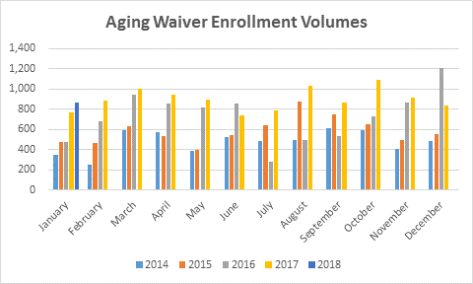
Aging Waiver Enrollment Volumes
Aging Waiver New Enrollment Volumes
Month | 2014 | 2015 | 2016 | 2017 | 2018
January | 346 | 474 | 477 | 774 | 867
February | 256 | 463 | 681 | 882
March | 589 | 628 | 946 | 1,003
April | 573 | 533 | 856 | 942
May | 389 | 402 | 814 | 893
June | 526 | 545 | 857 | 742
July | 484 | 644 | 285 | 789
August | 498 | 873 | 495 | 1,038
September | 611 | 749 | 538 | 868
October | 594 | 654 | 730 | 1,090
November | 409 | 492 | 867 | 919
December | 483 | 556 | 1,207 | 839
Average | 480 | 584 | 729 | 898
Total | 5,758 | 7,013 | 8,753 | 10,779

Slide 4
Length of Time for Enrollment Status
9/29 Snapshot of Average length of time in status
1768 Approval Issued to CAO : 25 days
Pending review by OLTL : 2 days
Waiting for In Home Visit to be Scheduled : 7 days
In Home Visit Scheduled : 14 days
PC and/or LCD Pending : 25 days

Slide 5
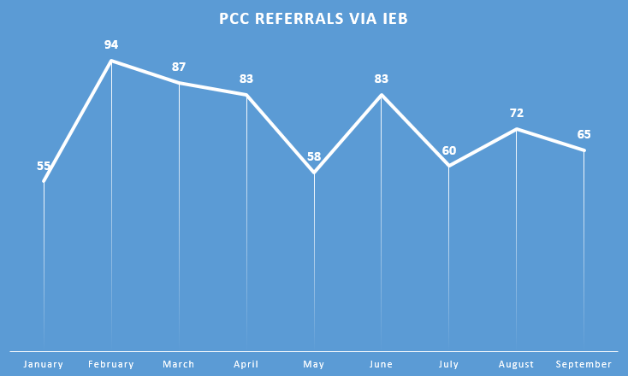
ADRC Involvement in the Application Process

Slide 6
IEB Complaint Tracking December/January
Total reported =36
Incident reasons:
CSR Rudeness: Lack of Professionalism
Customer Service: Service Coordinator Complaint
EB In-Home Visit Related: Lack of Professionalism During Visit in Home
Eligibility: AAA didn’t Have Demographic Information
Non OLTL Transfer : Case Monitoring
Special Protection – Expediate Case: An Adult Protective Services Case
Violation of Rights: AAA Rudeness and Lack of Professionalism
Other (Liaison-State Escalations): PA600 issues, 1768, Case Status Updates

Slide 7
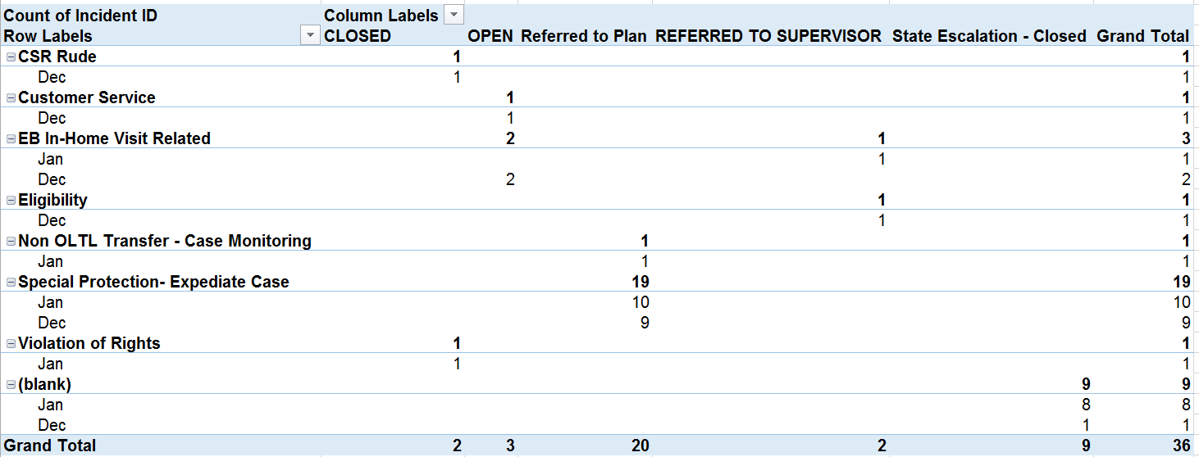
IEB Complaint Tracking December/January

Slide 8
Current IEB Report – Under 60
 | 2015 QTR2 | 2015 QTR3 | 2015 QTR4 | 2016 QTR1 | 2016 QTR2 | 2016 QTR3 | 2016 QTR4 | 2017 QTR1 | 2017 QTR2 | 2017 QTR3
Grand Total | 5,407 | 5,577 | 5,719 | 6,677 | 8,231 | 8,399 | 9,179 | 7,925 | 8,137 | 11,000
Complete | 2,944 | 3,020 | 3,254 | 3,215 | 5,872 | 4,452 | 6,149 | 5,066 | 4,081 | 6,626
Complete in 90 Days | 2,714 | 2,767 | 2,878 | 2,864 | 4,969 | 4,094 | 5,504 | 4,212 | 3,564 | 5,767
Complete > 90 Days With Excuse | 116 | 129 | 120 | 169 | 193 | 112 | 126 | 129 | 104 | 93
Compliance Percentage | 96% | 96% | 96% | 94% | 88% | 94% | 92% | 86% | 90% | 88%
Average Days To Complete | 62 | 66 | 71 | 66 | 55 | 41 | 45 | 54 | 53 | 63
All unduplicated applications in process this quarter
Total unduplicated applications completed this quarter
Total unduplicated applications completed during the quarter in 90 days
Total unduplicated applications completed during the quarter and over 90 days, but with excuse
Using the above fields = (row 3 + row 4)/ row 2
Average to complete excluding excused applications
Note: 2016 QTR 2 was revised to remove Aging waiver applications.
Note: Reapplications removed

Slide 9
Current IEB Report – Over 60
 | 2016 QTR4 | 2017 QTR1 | 2017 QTR2 | 2017 QTR3
Grand Total | 14,072 | 11,804 | 10,462 | 13,932
Complete | 9,802 | 7,495 | 5,654 | 8,457
Complete in 90 Days | 7,280 | 5,791 | 4,837 | 7,277
Complete > 90 Days With Excuse | 155 | 206 | 154 | 178
Compliance Percentage | 76% | 80% | 88% | 88%
Average Days To Complete | 64 | 62 | 59 | 60
All unduplicated applications in process this quarter
Total unduplicated applications completed this quarter
Total unduplicated applications completed during the quarter in 90 days
Total unduplicated applications completed during the quarter and over 90 days, but with excuse
Average to complete excluding excused applications

Slide 10
Consumer and Churn Reports – Snap Shot
Chart for 1st Quarter SFY 2017-18 through September
 | Waiver/Act 150 Program Descriptions | Oct-16 | Dec-16 | Jan-17 | Feb-17 | Mar-17 | Apr-17 | May-17 | Jun-17 | Jul-17 | Aug-17 | Sep-17 | Oct-17 | Nov-17 | Dec-17 | as a % | Budget
A | Active Consumers authorized for services at the end of the period
 | Act 150 | 1,708 | 1,705 | 1,687 | 1,680 | 1,671 | 1,651 | 1,643 | 1,631 | 1,608 | 1,602 | 1,576 | 1,558 | 1,551 | 1,549 | 2% | 1,575
 | Aging | 29,442 | 29,194 | 30,305 | 30,366 | 30,099 | 33,347 | 33,546 | 33,206 | 33,933 | 33,788 | 34,879 | 35,615 | 35,760 | 35,512 | 45% | 32,211
 | Attendant Care | 13,847 | 14,093 | 14,131 | 14,296 | 14,577 | 14,693 | 14,908 | 15,131 | 15,170 | 15,437 | 15,638 | 15,823 | 16,042 | 16,300 | 21% | 14,731
 | COMMCARE | 923 | 934 | 937 | 942 | 952 | 929 | 938 | 944 | 944 | 832 | 689 | 595 | 311 | 230 | 0% | 0
 | Independence | 14,405 | 14,658 | 14,673 | 14,799 | 15,038 | 15,073 | 15,245 | 15,401 | 15,496 | 15,894 | 16,221 | 16,710 | 17,028 | 17,316 | 22% | 15,951
 | OBRA | 1,446 | 1,456 | 1,458 | 1,465 | 1,470 | 1,469 | 1,479 | 1,482 | 1,484 | 1,483 | 1,504 | 1,506 | 1,516 | 1,518 | 2% | 1,374
 | LIFE | 5,417 | 5,451 | 5,468 | 5,485 | 5,492 | 5,574 | 5603 | 5,473 | 5,695 | 5,739 | 5,792 | 5,800 | 5,842 | 5,844 | 7% | 0
 | Total Active Authorized Consumers | 67,188 | 67,491 | 68,659 | 69,033 | 69,299 | 72,736 | 73,362 | 73,268 | 74,330 | 74,775 | 76,299 | 77,607 | 78,050 | 78,269 |  | 65,842
B | Consumers added
 | Act 150 | 9 | 6 | 6 | 7 | 2 | 5 | 6 | 1 | 5 | 2 | 3 | 11 | 7 | 1 | 0.1%
 | Aging | 528 | 312 | 577 | 609 | 326 | 820 | 727 | 291 | 568 | 454 | 679 | 942 | 663 | 362 | 31.1%
 | Attendant Care | 234 | 220 | 261 | 251 | 383 | 334 | 293 | 273 | 235 | 349 | 394 | 375 | 324 | 312 | 26.8%
 | COMMCARE | 10 | 7 | 11 | 9 | 13 | 8 | 12 | 7 | 8 | 10 | 9 | - | - | - | 0.0%
 | Independence | 238 | 173 | 207 | 188 | 280 | 278 | 213 | 187 | 256 | 421 | 408 | 650 | 368 | 314 | 27.0%
 | OBRA | 11 | 7 | 10 | 12 | 8 | 14 | 11 | 6 | 6 | 3 | 21 | 14 | 11 | 5 | 0.4%
 | LIFE | 138 | 133 | 133 | 137 | 139 | 175 | 130 | 141 | 156 | 157 | 138 | 128 | 171 | 169 | 14.5%
 | Total Consumers added | 1,168 | 858 | 1,205 | 1,213 | 1,151 | 1,634 | 1,392 | 906 | 1,234 | 1,396 | 1,652 | 2,120 | 1,544 | 1,163
C | Consumers that left
 | Act 150 | 3 | 3 | 14 | 11 | 7 | 3 | 14 | 6 | 8 | 6 | 9 | 14 | 81 | 10 | 0%
 | Aging | 554 | 687 | 549 | 592 | 831 | 519 | 626 | 984 | 590 | 862 | 592 | 504 | 616 | 962 | 14%
 | Attendant Care | 95 | 45 | 86 | 104 | 79 | 84 | 48 | 33 | 91 | 42 | 73 | 107 | 54 | 1,684 | 24%
 | COMMCARE | 8 | 0 | 5 | 2 | 1 | 13 | 1 | - | 100 | 125 | 89 | 285 | 3 | 230 | 3%
 | Independence | 62 | 13 | 64 | 43 | 18 | 45 | 29 | 23 | 25 | 8 | 22 | 51 | 3 | 3,623 | 51%
 | OBRA | 2 | 1 | 6 | 3 | - | 1 | 3 | 1 | 4 | 1 | 6 | 1 | 24 | 420 | 6%
 | LIFE | 103 | 96 | 117 | 119 | 135 | 136 | 100 | 119 | 153 | 114 | 141 | 124 | 135 | 159 | 2%
 | Total Consumers that left | 827 | 845 | 841 | 874 | 1,071 | 801 | 821 | 1,166 | 971 | 1,158 | 932 | 1,086 | 916 | 7,088
D | Transfers from ACW to Independence | 47 | 34 | 53 | 57 | 47 | 57 | 26 | 15 | 38 | 37 | 28 | 71 | 44 | 25
 | Transfers from COMMCARE to Independence ** | -- | -- | -- | -- | -- | -- | -- | -- | 57 | 196 | 78 | 287 | 80 | 20
Notes:
Note: The three categories A, B and C cannot be reconciled. (It can be done however because the members did not understand why the numbers didn’t add up. I reconciled every month when the program first started in July 2015 but the process was cumbersome, tedious and time-consuming so the need to reconcile was dropped as an issue.
The most recent month is the only calculated table column. All others are “hold overs” and “unaltered”. The numbers for prior months would be quite different otherwise.
The enrollment data uses the standard definition of an enrolled person:
Funding Source Name(s)
'ACT 150', 'Aging', 'Attendant Care', 'COMMCARE', 'Independence', 'OBRA'
In waiver/Act 150 anytime in period
[Waiver Eligibility Begin Date] <=?Report end date? [Waiver Eligibility End Date] is null or [Waiver Eligibility End Date] >?Report start date?
Newly enrolled in period
[Waiver Eligibility Begin Date] between ?Report start date? and ?Report end date?
“Disenrolled” in period
[Waiver Eligibility End Date] between ?Report start date? and ?Report end date?
Transfers: For September 2017 the only transfers were from Attendant Care to Independence and COMMCARE to Independence.
Facility Fact table data identifies any participant with a change to her or his service plan in the current month as indicated.

Slide 11
Employment
Note: This is the total number of waiver/program participants employed (Source: CIS employment data)
Using CIS Employment Data (most recent 2nd Quarter SFY 2017-18)
eDW Data Source:
Public Folders ‎> * Group Folders * ‎> Commonly Used OLTL Reports ‎> SubMACC for Long-Term Care Comm > Employ and Income Infor for Waiver Recipients
 | 2016 | 2017
Waiver/Employment | Dec | Jan | Feb | Mar | Apr | May | Jun | Jul | Aug | Sep | Oct | Nov | Dec
ACT 150
Full Time Employment | 12 | 12 | 12 | 11 | 12 | 13 | 13 | 12 | 12 | 10 | 13 | 11 | 11
Part Time Employment | 19 | 18 | 17 | 18 | 16 | 18 | 19 | 17 | 15 | 15 | 12 | 13 | 14
Self Employment | 9 | 8 | 9 | 9 | 9 | 9 | 9 | 9 | 9 | 9 | 10 | 10 | 8
Total | 40 | 38 | 38 | 38 | 37 | 40 | 41 | 38 | 36 | 34 | 35 | 34 | 33
Attendant Care
Full Time Employment | 33 | 34 | 33 | 36 | 36 | 34 | 35 | 32 | 32 | 32 | 33 | 43 | 42
Part Time Employment | 154 | 158 | 152 | 150 | 151 | 159 | 152 | 154 | 157 | 160 | 149 | 157 | 161
Self Employment | 57 | 58 | 57 | 61 | 53 | 57 | 57 | 59 | 59 | 60 | 62 | 58 | 58
Total | 244 | 250 | 242 | 247 | 240 | 250 | 244 | 245 | 248 | 252 | 244 | 258 | 261
COMMCARE
Full Time Employment | 2 | 3 | 3 | 3 | 2 | 2 | 2 | 2 | 2 | 1 | 0 | 0 | 0
Part Time Employment | 57 | 57 | 57 | 59 | 57 | 58 | 57 | 55 | 49 | 47 | 11 | 10 | 9
Self Employment | 4 | 6 | 5 | 5 | 5 | 4 | 4 | 3 | 3 | 3 | 2 | 1 | 1
Total | 63 | 66 | 65 | 67 | 64 | 64 | 63 | 60 | 54 | 51 | 13 | 11 | 10
Independence
Full Time Employment | 41 | 47 | 48 | 53 | 44 | 42 | 41 | 46 | 46 | 47 | 48 | 48 | 48
Part Time Employment | 192 | 199 | 197 | 193 | 195 | 203 | 206 | 195 | 203 | 218 | 243 | 243 | 251
Self Employment | 59 | 61 | 59 | 61 | 64 | 62 | 58 | 48 | 54 | 56 | 60 | 60 | 57
Total | 292 | 307 | 304 | 307 | 303 | 307 | 305 | 289 | 303 | 321 | 351 | 351 | 356
OBRA
Full Time Employment | 16 | 15 | 16 | 16 | 17 | 17 | 16 | 18 | 19 | 19 | 18 | 17 | 17
Part Time Employment | 101 | 102 | 106 | 108 | 110 | 110 | 108 | 110 | 110 | 112 | 109 | 109 | 110
Self Employment | 5 | 5 | 4 | 4 | 3 | 3 | 3 | 3 | 3 | 3 | 3 | 3 | 4
Total | 122 | 122 | 126 | 128 | 130 | 130 | 127 | 131 | 132 | 134 | 130 | 129 | 131
All Waivers | 761 | 783 | 775 | 787 | 774 | 791 | 780 | 763 | 773 | 792 | 773 | 783 | 791
Notes:
This CIS custom report provides employment and income information for waiver recipients.
The report matches MCI information from the CIS and waiver Data for a given month.
The report also includes the recipient’s waiver and enrollment as well as the employment and income details.
The categories identify by waiver the number of participants with CIS employment data.
The table does not include the “Sheltered workshop” and “Room and board” employment categories.

Slide 12
NHT and MFP Transitions
Month | NHT02 Service Deliveries Count | Number of those who were also MFP * | Participants who were MFP only ** | % NHT Transitions who also had MFP
2017
January | 92 | 22 | 21 | 23.9%
February | 109 | 21 | 12 | 19.3%
March | 144 | 29 | 11 | 20.1%
April | 98 | 17 | 33 | 17.3%
May | 124 | 27 | 16 | 21.8%
June | 129 | 19 | 26 | 14.7%
July | 101 | 13 | 24 | 12.9%
August | 92 | 6 | 14 | 6.5%
September | 95 | 9 | 16 | 9.5%
October | 103 | 7 | 20 | 6.8%
November | 80 | 3 | 15 | 3.8%
December | 68 | 2 | 12 | 2.9%
TOTAL for Period | 1235 | 175 | 220 | 14.2%
* Based on MFP anytime around NHT completion
** Based on MFP Facility Begin Date
Notes:
% NHT Transitions who also had MFP data for the last three months looks low. This is due to using two data sources to capture the data and therefore a maturation process will lead to higher percentages over time.

