Slide 1
http://starproviders.org/

Slide 6
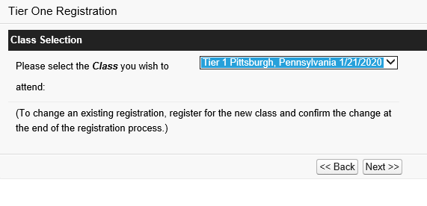

Slide 7
