Slide 1
CWIS Citizen Account User Guide
Revised July 28, 2021
Copyright© 2015 by the Commonwealth of Pennsylvania. All Rights Reserved.

Slide 2
Background
The instructions in this document provide guidance to individuals who need to create an account to use CWIS to obtain a child abuse clearance, or to submit a child abuse or neglect referral (for mandated reporters only). This instruction guide covers the following scenarios:
Create a CWIS Citizen Account (for mandated reporters or users seeking a child abuse history clearance)
Recover a Forgotten User ID (for a user who forgot their User ID)
Reset a Citizen Account Password (for a user who has locked their account by trying to login with the incorrect password 3 or more times; and for users who have forgotten their password)
NOTE: PA CITIZEN USER ACCOUNTS MAY LINKED TO ONLY ONE EMAIL ADDRESS. THIS RESTRICTION APPLIES TO ALL CITIZEN ACCOUNTS ACROSS ALL PROGRAMS/APPLICATIONS (NOT JUST CWIS).

Slide 3
Create a CWIS Citizen Account
Scenario:
An individual needs to create a CWIS citizen account to apply for a child abuse clearance; a mandated reporter needs to create a CWIS citizen account in order to submit a child abuse or neglect referral.

Slide 4
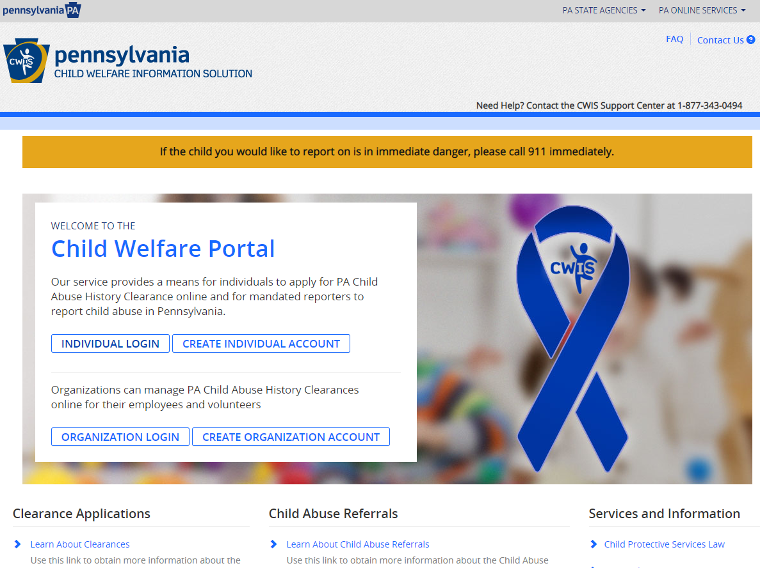
Create a CWIS Citizen Account: Step 1
Navigate to the CWIS Child Welfare portal (also referred to as the self-service portal) by entering the following URL in your browser
https://www.compass.state.pa.us/cwis
Click CREATE INDIVIDUAL ACCOUNT

Slide 5
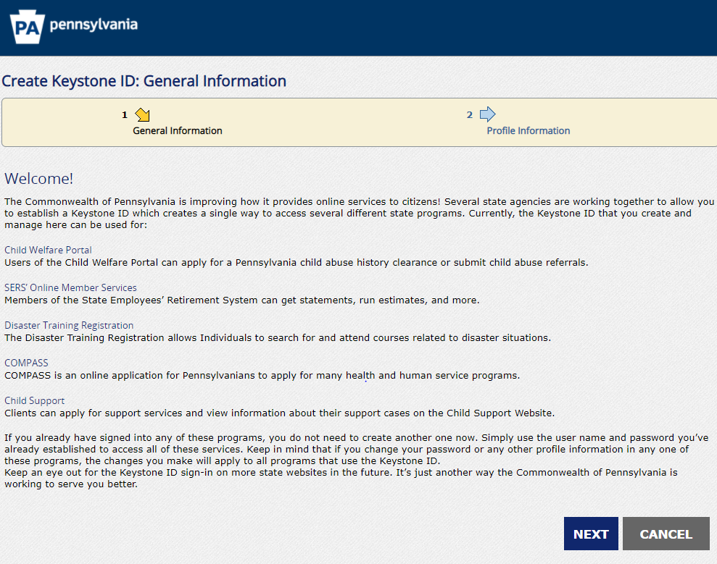
Create a CWIS Citizen Account: Step 2
On the General Information screen, scroll down and click NEXT (do not click on any of the links)

Slide 6
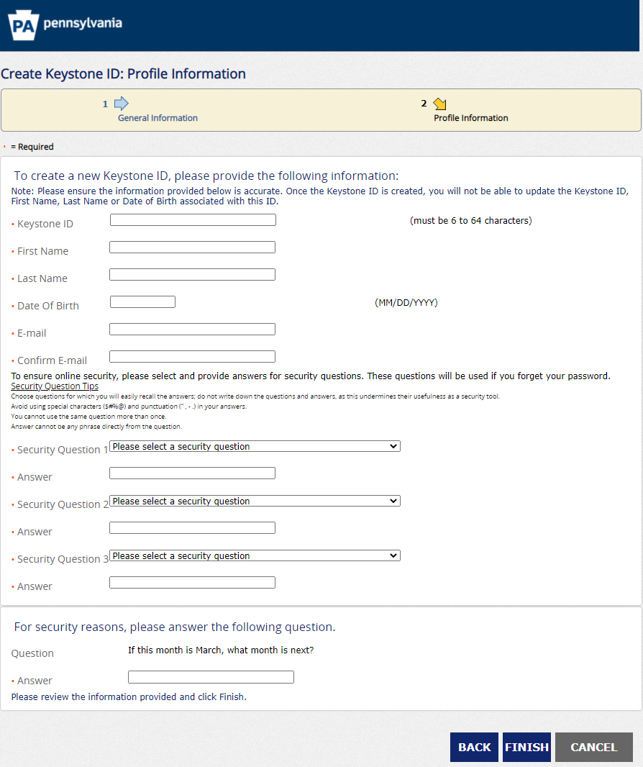
Create a CWIS Citizen Account: Step 3
On the Profile Information screen, enter the requested information:
Pick a unique ID for your Keystone ID (Note: if you pick a generic user ID, i.e., JohnSmith, it will likely already be in use)
Be sure to enter a valid email address; this is where the temporary password and Keystone ID confirmation emails will be sent.
Click FINISH.

Slide 7
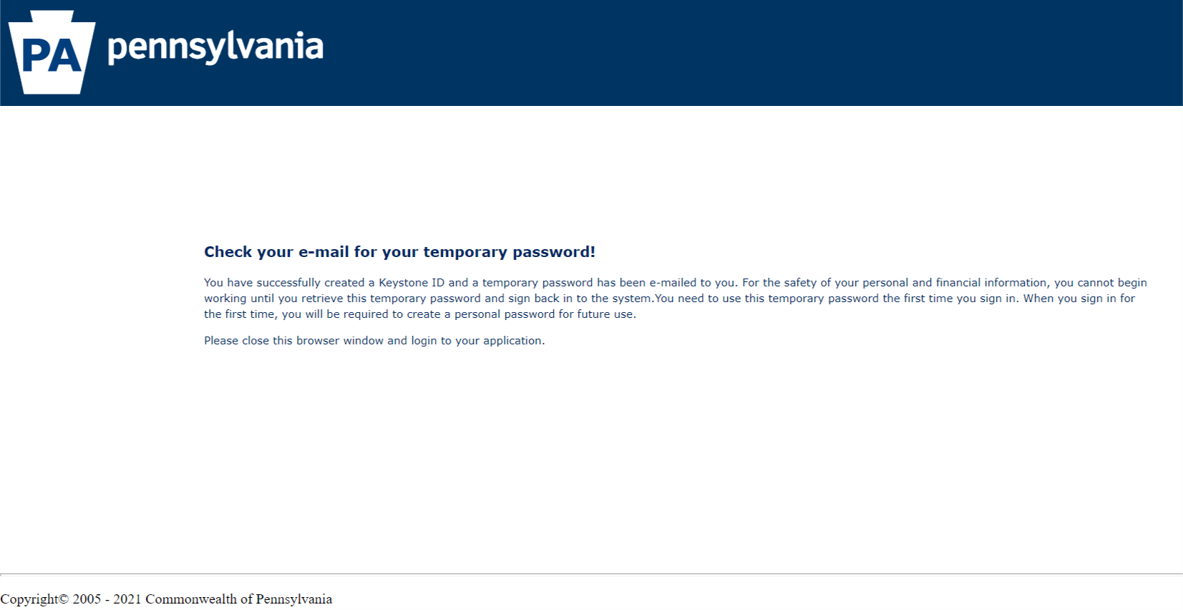
Create a CWIS Citizen Account: Step 4
Close the window and check your email for the temporary password.

Slide 8
Create a CWIS Citizen Account: Step 5
You will receive an email with your userID.
You will also receive an email with a temporary password.

Slide 9
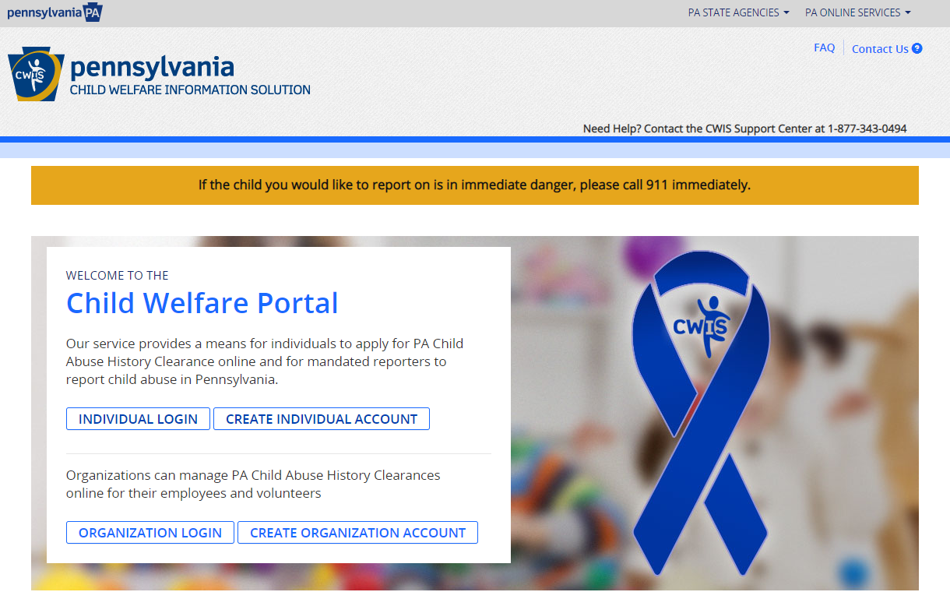
Create a CWIS Citizen Account: Step 6
Navigate to the CWIS Child Welfare portal (also referred to as the self-service portal) or enter the following URL in your browser:
https://www.compass.state.pa.us/cwis
Click INDIVIDUAL LOGIN

Slide 10
Create a CWIS Citizen Account: Step 7
In order to proceed to the next screen, you will need to click either ACCESS MY CLEARANCES or ACCESS MY REFERRALS.

Slide 11
Create a CWIS Citizen Account: Step 8
On the Learn More screen, scroll to the bottom and click CONTINUE.
(Note: the Learn More screen will appear differently, depending on if you clicked ACCESS MY CLEARANCES or ACCESS MY REFERRALS on the previous screen.)

Slide 12
Create a CWIS Citizen Account: Step 9
On the Keystone Key screen, enter the user ID and temporary password you received in the emails in the Username and Password fields. Remember to copy and paste the temporary password from the email to avoid typographic errors that would cause your login to fail.
Click LOGIN.

Slide 13
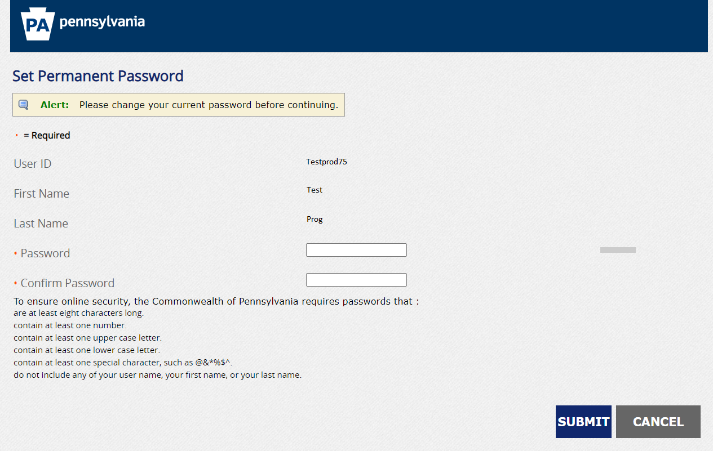
Create a CWIS Citizen Account: Step 10
On the Set Permanent Password screen, enter a new password (note: be sure to follow the password requirements listed below the fields on the screen).
Click SUBMIT.

Slide 14
Create a CWIS Citizen Account: Step 11
Click CLOSE WINDOW.

Slide 15
Create a CWIS Citizen Account: Step 12
On the Keystone Key screen, enter your Username and (permanent) Password.
Click LOGIN.
Note: Be sure to use the permanent password you created in previous steps. If you login five times incorrectly, your account will be locked. If locked, click the FORGOT PASSWORD button and follow the reset/unlock password procedures contained later in this document; alternatively, you may wait 30 minutes and your account will unlock.

Slide 16
Create a CWIS Citizen Account: Step 13
On the My Child Welfare Terms and Conditions screen, read the terms and conditions and click the “I have read, fully understand and….” radio button to confirm acceptance.
Click NEXT.

Slide 17
Create a CWIS Citizen Account: Step 14
On the Learn More screen, scroll to the bottom and click CONTINUE.
(Note: the Learn More screen will appear differently, depending on if you clicked ACCESS MY CLEARANCES or ACCESS MY REFERRALS on the previous screen.)

Slide 18
Create a CWIS Citizen Account: Next Steps
You will now be able to login to the Child Welfare Portal.
SCENARIO COMPLETE

Slide 19
Recover a Forgotten User ID
Scenario:
The citizen account user has forgotten their user ID associated with their citizen account.

Slide 20
Recover a Forgotten User ID: Step 1
Navigate to the CWIS Child Welfare portal (also referred to as the self-service portal) or enter the following URL in your browser:
https://www.compass.state.pa.us/cwis
Click INDIVIDUAL LOGIN

Slide 21
Recover a Forgotten User ID: Step 2
In order to proceed to the next screen, you will need to click either ACCESS MY CLEARANCES or ACCESS MY REFERRALS.

Slide 22
Recover a Forgotten User ID: Step 3
On the Learn More screen, scroll to the bottom and click CONTINUE.
(Note: the Learn More screen will appear differently, depending on whether you clicked ACCESS MY CLEARANCES or ACCESS MY REFERRALS on the previous screen.)

Slide 23
Recover a Forgotten User ID: Step 4
On the Keystone Key screen, click the Forgot User ID button.

Slide 24
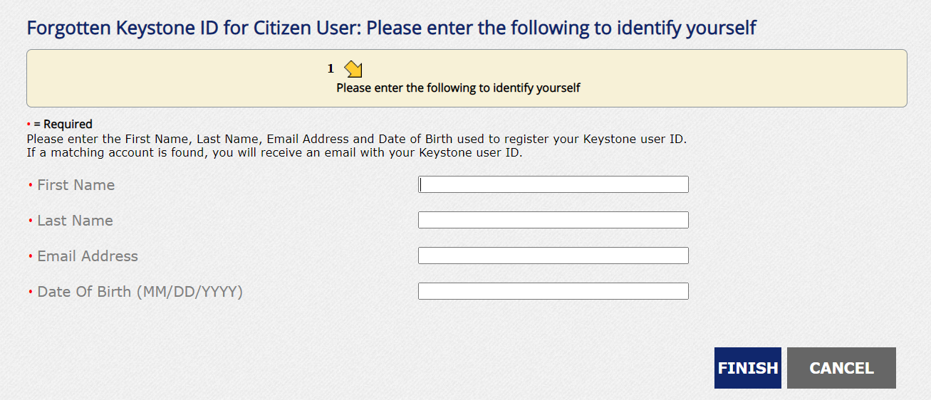
Recover a Forgotten User ID: Step 5
On the Forgotten Keystone ID for Citizen User screen, enter the First Name, Last Name, Email Address, and Date of Birth associated with the account.
Click FINISH.
The User ID will be sent to the Email Address provided.
Note: If multiple accounts are associated with the information provided during the retrieval process, all of the associated User IDs will be sent to the user.

Slide 25
Recover a Forgotten User ID: Step 6
Navigate back to the Keystone Key screen.
Using the User ID provided in the email, enter the User ID and password.
Click LOGIN
SCENARIO COMPLETE

Slide 26
Reset a Citizen Account Password
Scenario:
The citizen account user has attempted to login five or more times incorrectly, or they have forgotten their password.
Note: Locked citizen accounts will unlock after 30 minutes; users may want to wait and try to login again instead of attempting a password reset.

Slide 27
Reset a Citizen Account Password: Step 1
Note: Locked accounts will unlock after 30 minutes, so the following steps may not be needed. Users may want to wait and try to login again before attempting a password reset.
Navigate to the CWIS Child Welfare portal (also referred to as the self-service portal) or enter the following URL in your browser:
https://www.compass.state.pa.us/cwis
Click INDIVIDUAL LOGIN.

Slide 28
Reset a Citizen Account Password: Step 2
In order to proceed to the next screen, you will need to click either ACCESS MY CLEARANCES or ACCESS MY REFERRALS.

Slide 29
Reset a Citizen Account Password: Step 3
On the Learn More screen, scroll to the bottom and click CONTINUE.
(Note: the Learn More screen will appear differently, depending on whether you clicked ACCESS MY CLEARANCES or ACCESS MY REFERRALS on the previous screen.)

Slide 30
Reset a Citizen Account Password: Step 4
On the Keystone Key screen, click the Forgot Password button.

Slide 31
Reset a Citizen Account Password: Step 5
On the first Forgotten Password Reset via One-Time Password (OTP) screen, enter the user ID associated with the citizen account in the Keystone ID field, then complete the First Name, Last Name, and Email Address fields.
Click OK.

Slide 32
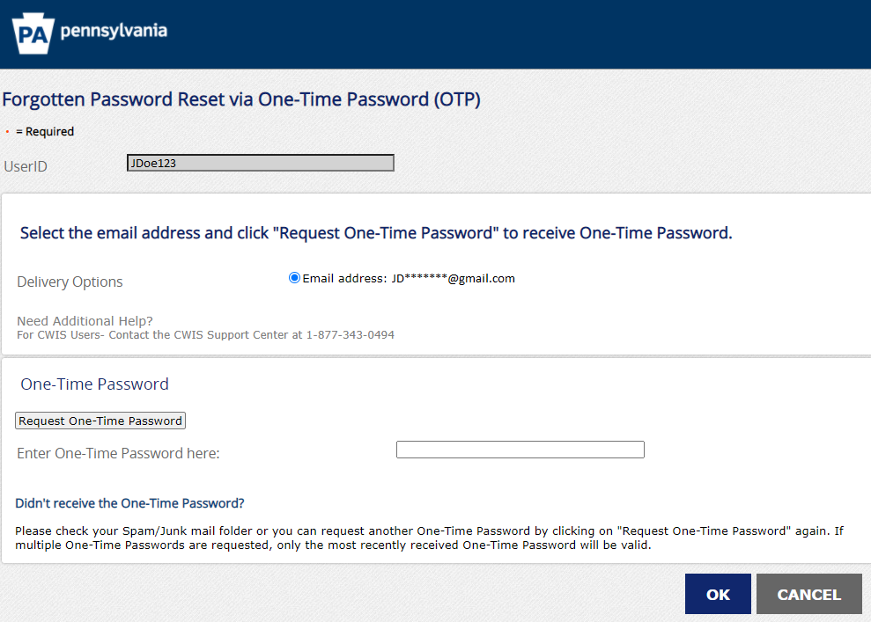
Reset a Citizen Account Password: Step 6
On the second Forgotten Password Reset via One-Time Password (OTP) screen, check the Email Address box and then click the Request One-Time Password button.
Retrieve the one-time password that was sent to the email address associated with the account.
Enter the one-time password and click OK.

Slide 33
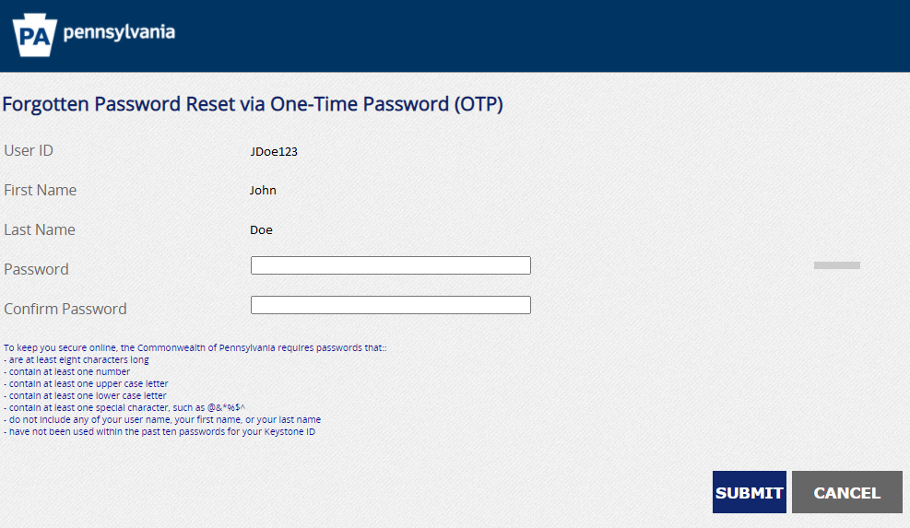
Reset a Citizen Account Password: Step 7
On the third Forgotten Password Reset via One-Time Password (OTP) screen, enter a new password in the Password field, and repeat the password in the Confirm Password field. Then click the SUBMIT button.
Note: Be sure to follow the password guidance listed below the fields on the screen.

Slide 34
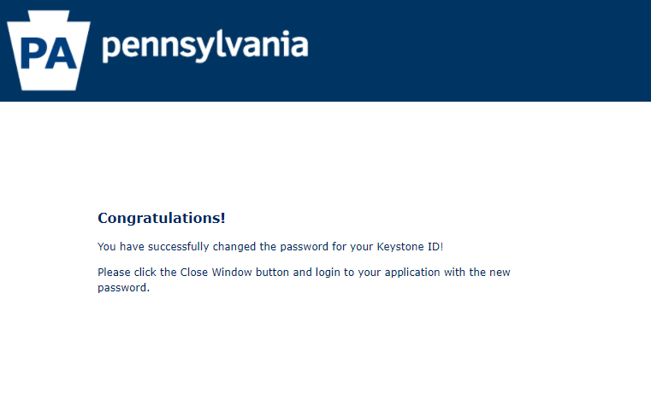
Reset a Citizen Account Password: Step 8
The Congratulations screen will appear once your password is successfully reset.
You can now log in to the Child Welfare Portal.

Slide 35
Reset a Citizen Account Password: Step 9
Navigate back to the Keystone Key screen.
Enter the User ID and new password.
Click LOGIN
SCENARIO COMPLETE

Slide 36
Reset (Unlock) a Citizen Account Password: Step 9
If for some reason the password reset fails, you can create a new citizen account using the same email address (but not the same user ID).
Propose removing slide and ending scenario at step 9 on previous slide.
SCENARIO COMPLETE

