Slide 1
CHC Third Thursday Webinar
September 19, 2019
Kevin Hancock/Deputy Secretary
Office of Long-Term Living
Department of Human Services

Slide 2
AGENDA
CHC Phase 3 Implementation Updates
Electronic Visit Verification (EVV) Updates

Slide 3
PHASE 3 IMPLEMENTATION

Slide 4
CHC PHASE 3 POPULATION
10%
14,609
Duals in Waivers
16%
23,323
Duals in Nursing Facilities
70%
99,887
NFI Duals
143,004
CHC POPULATION
3%
4,089
Non-duals in Waivers
13%
IN WAIVERS
17%
IN NURSING FACILITIES
96%
DUAL-ELIGIBLE
1%
1,096
Non-duals in Nursing Facilities

Slide 5
PHASE THREE IMPLEMENTATION
OBJECTIVES
Comprehensive participant communication
Robust readiness review
Provider communication and training
Pre-transition and plan selection for phase three participants
Incorporation of southwest, southeast implementation and launch lessons learned
CHALLENGES
Transportation
Geography
Participant Outreach
Electronic Visit Verification (EVV) Implementation

Slide 6
PHASE THREE PROVIDER NETWORKS
Nursing Facilities (318 Total)
Amerihealth Caritas – 215
PA Health & Wellness – 127
UPMC – 240
Hospitals (93 Total)
Amerihealth Caritas – 78
PA Health & Wellness – 57
UPMC – 61
All other Nursing Facility and Hospital contracts are in process.
All MCOs continue to submit weekly provider network reports for network adequacy monitoring.

Slide 7
PHASE THREE PROVIDER NETWORKS
Each of the MCOs will conduct various trainings for providers enrolling in the Phase 3 zones.
Examples of training topics include:
Working with the MCO
Billing and Invoicing
Person-Centered Service Plans
Electronic Visit Verification

Slide 8
CHC PROVIDER SUMMITS
Registration is now open for the CHC provider workshops in October.
Northwest Zone: October 8th at Clarion University
Northeast Zone: October 21st at Marywood University
Lehigh/Capital Zone: October 28th at Kutztown University
Agenda:
An overview of CHC will be provided in the morning.
Breakout sessions will be offered in the afternoon and will cover the following topics:
Home and Community-Based Services
Service Coordination
Nursing Facilities
Behavioral Health
Physical Health
Transportation

Slide 9
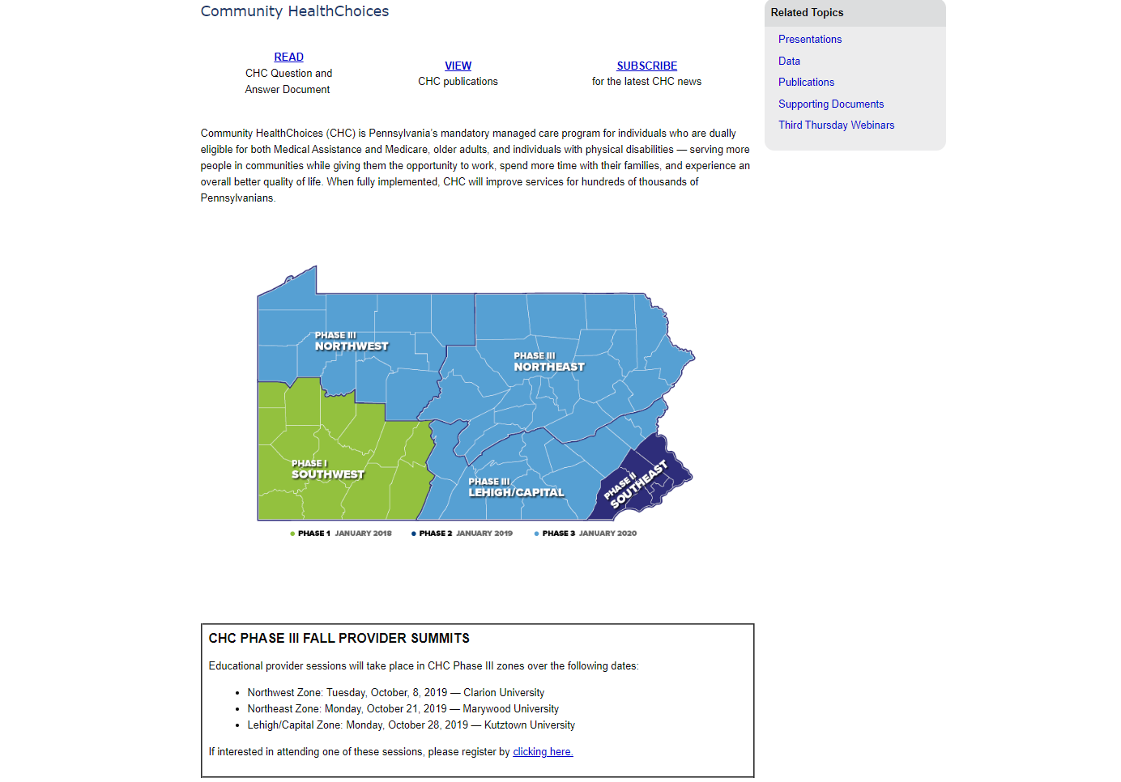

Slide 10
PARTICIPANT OUTREACH ACTIVITIES
July-August
July 15: Initial Participant Touchpoint Flyer and LIFE Program Flyer
August 1: Aging Well Participant Information Session Mailer
August 19-30: First Mailing of Pre-Transition Notices
Meaningful Contact Activities Begin
September-October
72 Participant Information Sessions
Participant Enrollment Packet Mailings
Participant Outreach Calls from Maximus
Ongoing Meaningful Contact Activities
November-December
November 13 Last Day for Plan Selection Before Auto-Assignment
December 20 Last Day for Plan Selection Effective January 1

Slide 11
MEANINGFUL CONTACT ACTIVITIES
OLTL has an agreement in place with Aging Well PA (AWP) to provide outreach and education activities in each region of the Commonwealth as CHC is implemented in three phases.
Part of the outreach and education effort for each region is making sure that all participants who will be effected have been contacted and given information regarding what the change to CHC will mean to them.
OLTL has determined that service coordinators (SCs) are responsible for making these contacts with their participants. These contacts must meet specific criteria and are referred to as “meaningful contact.”
OLTL is asking that SCs be aware of the requirements outlined in the memo that was previously sent in March by AWP, and in the follow-up email they will be receiving from AWP, and respond accordingly.

Slide 12
MEANINGFUL CONTACT ACTIVITIES
Each Service Coordination Entity (SCE) must send Aging Well PA a list of their service coordinators so that they can be registered in Aging Well PA’s learning management system.
Once registered, each SC Will be given access to the OLTL approved online training for SCs. Once the SC has completed this training, he or she may begin making meaningful contacts.
In order to accurately track the meaningful contacts made by each SC, the SCE must enter each contact in AWP’s Outreach and Education online database (O&E DB).
The data entered into the O&E DB will be used by OLTL to verify billing from SCEs for meaningful contacts.

Slide 13
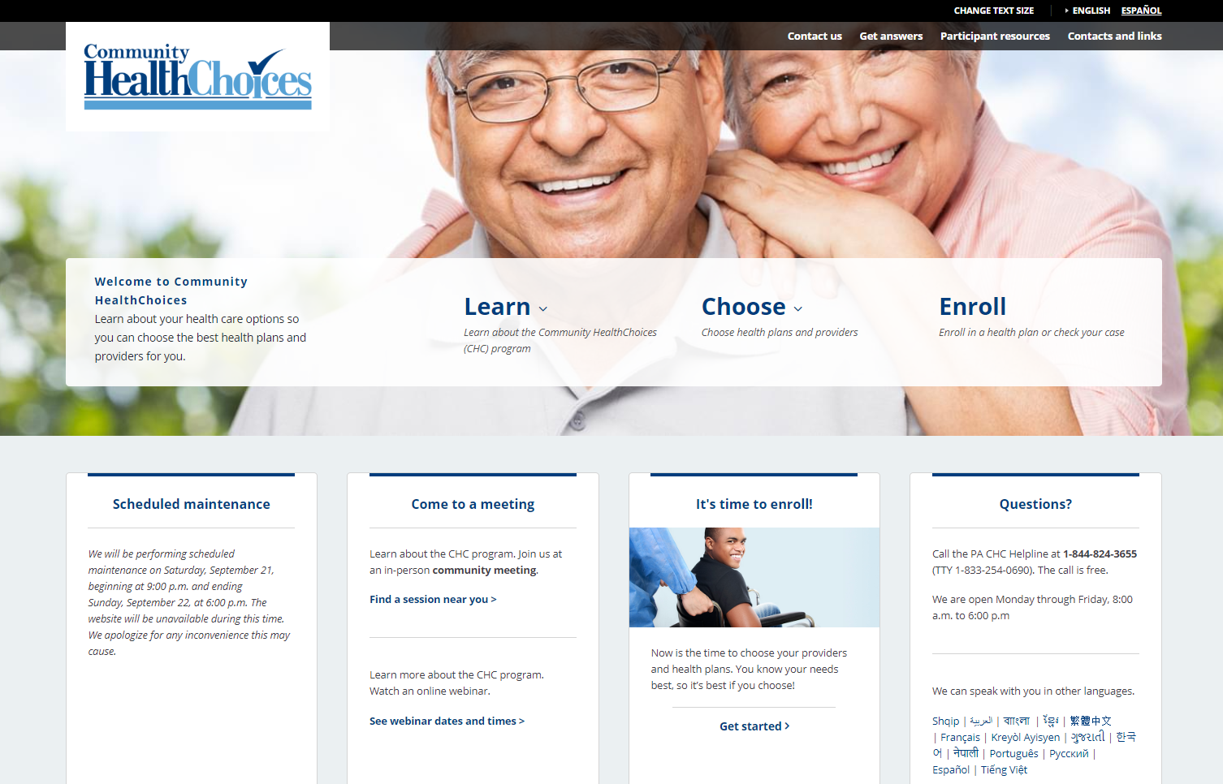
Participant Plan Selection Resources:
Enrollment Packets
www.enrollCHC.com
Maximus: 1-844-824-3655
Meaningful Contacts
Participant Information Sessions
Online Participant Modules
NFI Dual Training
HCBS Training
Nursing Facility Training
www.enrollCHC.com

Slide 15
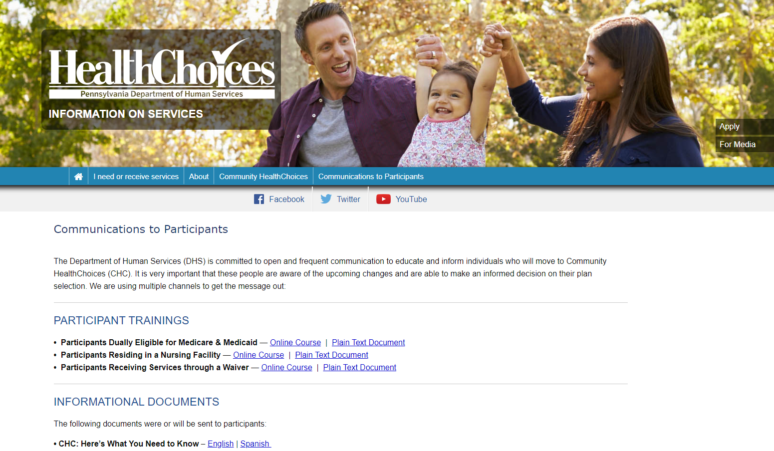

Slide 16
ELECTRONIC VISIT VERIFICATION (EVV)

Slide 17
EVV REQUIREMENTS
Section 12006 of the 21st Century Cures Act requires all states to implement the use of EVV for Medicaid-funded personal care and home health care services. EVV must be implemented for personal care services by January 1, 2020 and for home health care services by January 1, 2023.
OLTL waiver services included in the initial implementation of EVV include:
Personal Assistance Services (Agency and Participant-Directed Model)
Participant-Directed Community Supports
Respite (unlicensed settings only)

Slide 18
OPEN VENDOR MODEL
DHS is working with DXC and Sandata to develop an EVV system that will integrate with PROMISe, our existing Medicaid Management Information System.
Providers may use other EVV vendors/systems (Alternate EVV).
Alternate EVV systems will need to capture the six required items under the Cures Act and will need to meet DHS system data requirements outlined in the technical specification documents.

Slide 19
EVV NEXT STEPS FOR PROVIDERS
PROVIDERS USING THE DHS EVV SYSTEM OR CHC-MCO System
Fee-For-Service Providers (OBRA Waiver and Act 150 Program)
The DHS Sandata system training registration is now open for providers electing to use the DHS Sandata system for the OBRA waiver and Act 150 program. Providers using the DHS system must complete this training in order to begin setting up their agency accounts and security permissions. The DHS Sandata system is only available for Fee-For-Service providers.
Three types of training will be available:
in-person, class-room style training offered at regional locations
instructor-led webinars
self-paced on-line training
Current CHC Providers and Aging, Attendant Care, and Independence Waiver Providers
If providers are electing to use the HHAeXchange EVV system offered by the MCOs, providers must work with the MCOs to complete training and other onboarding requirements.

Slide 20
NEXT STEPS FOR PROVIDERS
PROVIDERS USING AN ALTERNATE System
Fee-For-Service (OBRA Waiver and Act 150 Program)
The DHS Aggregator will receive information from Alternate EVV systems being used by providers in fee-for-service programs.
Providers should contact Sandata at 1-855-705-2407 to complete third party system integration activities for fee-for-service programs.
Current CHC Providers and Aging, Attendant Care, and Independence Waiver Providers
Providers using Alternate EVV systems in CHC will need to send their EVV data the CHC-MCOs.
Providers should contact HHAeXchange at EDIsupport@hhaexchange.com to complete third party system integration activities for CHC.

Slide 21
EVV RESOURCES
FAQs, technical specifications, and other resources are available at: http://www.dhs.pa.gov/provider/billinginformation/electronicvisitverification/
For specific questions regarding EVV and to subscribe to the EVV listserv, please contact: RA-PWEVVNotice@pa.gov
Upcoming EVV Public Meetings:
Tuesday September 23, 2019 from 1:00 to 3:00PM
Tuesday October 22, 2019 from 1:00 to 3:30PM

Slide 22
QUESTIONS

Slide 23
CHC RESOURCE INFORMATION
CHC LISTSERV // STAY INFORMED: http://listserv.dpw.state.pa.us/oltl-community-healthchoices.html
COMMUNITY HEALTHCHOICES WEBSITE: www.healthchoices.pa.gov
MLTSS SUBMAAC WEBSITE: www.dhs.pa.gov/communitypartners/informationforadvocatesandstakeholders/mltss
EMAIL COMMENTS TO: RA-PWCHC@pa.gov
OLTL PROVIDER LINE: 1-800-932-0939
OLTL PARTICIPANT LINE: 1-800-757-5042
INDEPENDENT ENROLLMENT BROKER: 1-844-824-3655 or (TTY 1-833-254-0690)
or visit www.enrollchc.com

Slide 24
CHC MCO CONTACT INFORMATION
AmeriHealth Caritas/Keystone First | CHCProviders@amerihealthcaritas.com
www.amerihealthcaritaschc.com - 1-800-521-6007 (TTY 1-855-235-5112)
Pennsylvania Health and Wellness (Centene) | information@pahealthwellness.com
www.PAHealthWellness.com – 1-844-626-6813 (TTY 1-844-349-8916)
UPMC Community HealthChoices | CHCProviders@UPMC.edu
www.upmchealthplan.com/chc - 1-844-860-9303 (TTY 1-866-407-8762)

