Slide 1
CHC Third Thursday Webinar
November 21, 2019

Slide 2
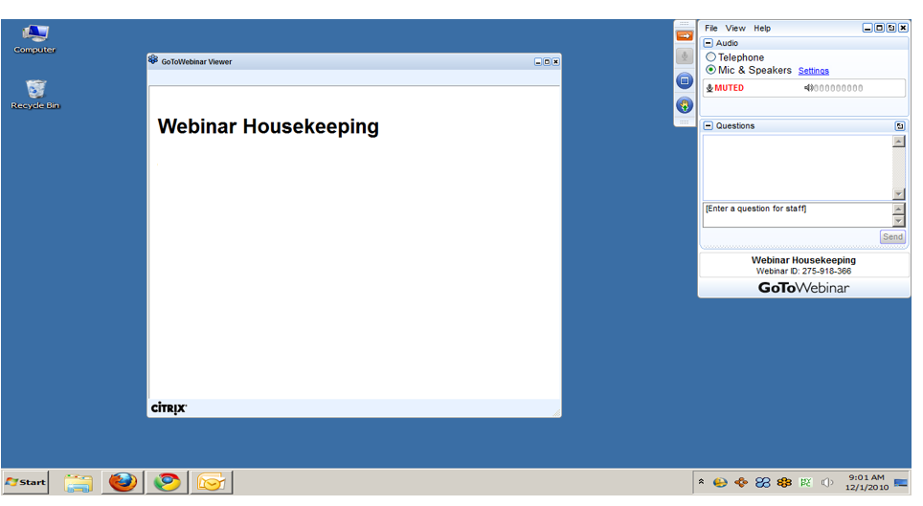
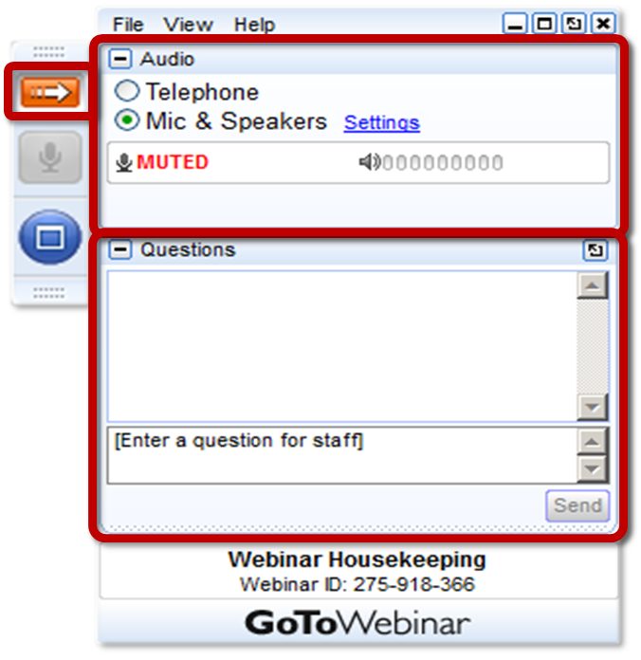
GoToWEBINAR HOUSEKEEPING: What Attendees See
Notes:
Before we get started, I’d like to go over a few items so you know how to participate in today’s event:
Here is a screen shot of the Attendee interface. This is what you should see on your desktop.
In the center of the screen is the GoToWebinar Viewer where you will see the presentation.
In the upper right hand corner is the GoToWebinar control panel where you can ask questions and select audio mode.
If the Control Panel is closed you will see a slim red rectangle. Click on the red arrow to expand the Control Panel.
5. You will be listening to the presentation via your computer's speaker system by default. If you prefer to join by phone, select the “Telephone” button in the audio pane and the dial-in information will be displayed. This will place you in the “listen only” mode to hear the presentation.
You may submit questions (via text) by typing your questions into the “Questions” pane of the control panel. You may send in your questions at any time during the presentation.
Note: The attendee control panel will collapse automatically when not in use. To keep it open, click the “View”, menu, and uncheck “Auto-hide Control Panel”.

Slide 3
AGENDA
Community HealthChoices (CHC) Phase 3 Updates
Electronic Visit Verification (EVV) Updates

Slide 4
PHASE 3 IMPLEMENTATION

Slide 5
PARTICIPANT INFORMATION SESSIONS
Aging Well completed 72 Participant Information Sessions across 43 different sites with over 3,000 attendees.
Stakeholder Participation Played a Key Role
92 individuals volunteered and served as meeting facilitators. 64 were from AAAs, 16 from non-AAA Service Coordination Entities and 12 from Centers for Independent Living.
The Apprise Program served as an important resource for individuals to discuss how Medicare would coordinate with their CHC plan.
The assistance from Maximus representatives also allowed participants to receive one-on-one enrollment support during the events.
11 additional Information Sessions were offered in partnership with the PA Centers for Independent Living with over 600 attendees.

Slide 6
PARTICIPANT OUTREACH ACTIVITIES
DHS is collaborating with the Mendoza Group to conduct additional grassroots outreach activities throughout November and December.
The outreach activities are focused on enhanced communications in alternative languages and other community engagement opportunities to reach various populations.
Activities include:
Community outreach events across the Phase 3 zones
Stakeholder roundtables
Marketing and communication campaigns

Slide 7
PHASE THREE PLAN SELECTION
System transition activities were conducted over the weekend of November 16th.
These transition activities resulted in CHC plan auto-assignment if a participant had not yet made an advanced plan selection.
Participants will receive a notice identifying the plan they were assigned to and a postcard reminder that plan changes can be made until December 20th.
As of November 16th, 39% of participants transitioning to CHC have made an advanced plan selection.

Slide 8
PROVIDER WORKSHOPS
Three provider workshops were offered in October to augment the 12 workshops held in May and June.
Northwest Zone: October 8th at Clarion University
Northeast Zone: October 21st at Marywood University
Lehigh/Capital Zone: October 28th at Kutztown University
Approximately 1,950 attendees participated in the workshops held in the spring and fall.
Notes:
SPRING
Lehigh/Capital zone – 600
Northwest zone – 420
Northeast zone – 520
FALL – Total = 415

Slide 9
PHASE THREE PROVIDER NETWORKS
Nursing Facilities (318 Total)
Amerihealth Caritas – 256
PA Health & Wellness – 241
UPMC – 268
Hospitals (93 Total)
Amerihealth Caritas – 85
PA Health & Wellness – 60
UPMC – 69
All other Nursing Facility and Hospital contracts are in process.
All MCOs continue to submit weekly provider network reports for network adequacy monitoring.

Slide 10
PHASE 3 DATA CLEAN-UP
Several listservs have been sent to Service Coordination Entities regarding the SAMS Aging Waiver Data Clean-Up to support CHC.
If the CHC Managed Care Organizations are unable to successfully transition service authorizations due to inaccurate data elements, continuity of care and provider payment could be impacted as a result.
OLTL has been engaging in regular follow up with SCEs regarding 6 priority data fields (Care Plan Manager, Diagnosis Code, Medicaid ID, Client Phone, Consumer Provider, and Service Order) It is important for SCEs to make sure these fields in particular are entered correctly.
Notes:
To ensure a smooth transition, it is crucial that all Service Coordination Entities (SCEs) review and make the necessary corrections to affected plans.
We have seen some improvement in the number of errors, but there are still plan errors in SAMS that require attention as soon as possible.

Slide 11
SERVICE PLANNING TRANSITION REMINDER
SCEs serving participants in the Phase 3 zones will continue to receive FFS waiver enrollments from the IEB through December.
It is strongly encouraged that SCs complete service plan development and submit initial service plans as soon as possible to facilitate a smooth transition for continuity of care.

Slide 12
ELECTRONIC VISIT VERIFICATION (EVV)

Slide 13
EVV REQUIREMENTS
Section 12006 of the 21st Century Cures Act requires all states to implement the use of EVV for Medicaid-funded personal care and home health care services.
States that do not comply with the 21st Century Cures Act will have their Federal Medical Assistance Percentage (FMAP) reduced.
EVV must be implemented for personal care services by January 1, 2020 and for home health care services by January 1, 2023.
OLTL waiver services included in the 2020 implementation of EVV include:
Personal Assistance Services (Agency and Participant-Directed Model)
Participant-Directed Community Supports
Respite (unlicensed settings only)

Slide 14
EVV IMPLEMENTATION UPDATES
DHS Sandata System
The DHS Sandata system went live on October 7th as planned.
Providers who completed the DHS Sandata system training should have received welcome packets to begin using the system and training their staff.
Public Partnerships LLC. (PPL)
In October, PPL conducted several webinar trainings and in-person trainings in the Southwest, Northwest, Northeast, and Lehigh/Capital regions.
Throughout November, PPL will be conducting additional webinar trainings and in-person trainings in the Southeast region.

Slide 15
EVV IMPLEMENTATION UPDATES
DHS is in the process of applying for a Good Faith Effort Exemption through the Centers for Medicare and Medicaid Services (CMS)
If approved, the Good Faith Effort Exemption will allow DHS to extend the soft launch period so that provider payments are not impacted.
Providers are still expected to implement an EVV system by January 1, 2020

Slide 16
EVV IMPLEMENTATION UPDATES
EVV compliance policies will be released through a joint OLTL/ODP Bulletin once finalized.
IVR technology clarification from CMS
Telephonic verification must include validation through a GPS or location system
Cell phones are not acceptable for telephonic verification unless a location device code is included
There are no additional changes to DHS EVV implementation due to recent CMS guidance

Slide 17
EVV NEXT STEPS FOR PROVIDERS
Current CHC Providers and Aging, Attendant Care, and Independence Waiver Providers
If providers are electing to use the HHAeXchange EVV system offered by the MCOs, providers must work with the MCOs to complete training and other onboarding requirements.
Providers using Alternate EVV systems in CHC will need to send their EVV data the CHC-MCOs.
Providers should contact HHAeXchange at EDIsupport@hhaexchange.com to complete third party system integration activities for CHC.

Slide 18
EVV NEXT STEPS FOR PROVIDERS
Fee-For-Service (OBRA Waiver and Act 150 Program)
The DHS Sandata system training is available for providers electing to use the DHS Sandata system for the OBRA waiver, Act 150 program, and ODP waiver programs.
Providers using the DHS system must complete this training in order to begin setting up their agency accounts and security permissions.
The DHS Sandata system is only available for Fee-For-Service providers.
The DHS Aggregator will receive information from Alternate EVV systems being used by providers in fee-for-service programs.
Providers must contact Sandata at 1-855-705-2407 to complete Alternate EVV system integration activities for fee-for-service programs.

Slide 19
EVV RESOURCES
The next EVV Webinar is scheduled for December 18th from 1-3pm . A link to register can be found on the DHS EVV website.
Website: http://www.dhs.pa.gov/providers/Billing-Info/Pages/EVV.aspx
For specific questions regarding EVV and to subscribe to the EVV listserv, please contact RA-PWEVVNotice@pa.gov

Slide 20
CHC RESOURCE INFORMATION
CHC LISTSERV // STAY INFORMED: http://listserv.dpw.state.pa.us/oltl-community-healthchoices.html
COMMUNITY HEALTHCHOICES WEBSITE: www.healthchoices.pa.gov
MLTSS SUBMAAC WEBSITE: www.dhs.pa.gov/communitypartners/informationforadvocatesandstakeholders/mltss
EMAIL COMMENTS TO: RA-PWCHC@pa.gov
OLTL PROVIDER LINE: 1-800-932-0939
OLTL PARTICIPANT LINE: 1-800-757-5042
INDEPENDENT ENROLLMENT BROKER: 1-844-824-3655 or (TTY 1-833-254-0690)
or visit www.enrollchc.com

Slide 21
QUESTIONS

