Slide 1
Third Thursday Webinar
Pennsylvania Individualized Assessments Overview
March 21, 2019
Mike Hale/Bureau Director
Tyrone Williams/Operations Manager
Office of Long-Term Living
Department of Human Services

Slide 2
PIA Effective Date
April 1, 2019
DHS will go-live with its
Pennsylvania Individualized Assessments (PIA)
system

Slide 3
PIA Purpose and Scope
To introduce OLTL’s new level of care assessment tool and new process used to determine functional eligibility for Medical Assistance (MA) funded long term services and supports (LTSS).
Applies to OLTL staff, the Independent Enrollment Broker (IEB), the Independent Assessment Entity (IAE), and Community HealthChoices-Managed Care Organizations (CHC-MCO) responsible for either performing or facilitating level of care assessments or redeterminations.

Slide 4
PIA Goals
Enhance access to and improve coordination of medical care
Create a person-driven, long-term support system in which people have choice, control, and access to a full array of quality services that provide independence, health, and quality of life

Slide 5
PIA-MA-Funded LTSS Eligibility
Eligibility for MA-funded LTSS require individuals seeking and continuing to receive these services to meet financial and functional eligibility standards.
To be functionally eligible, an individual must be evaluated and determined to require the level of care provided in a nursing facility through a level of care assessment (NFCE).

Slide 6
PIA Overview
https://youtu.be/AWsJvgtYTK4

Slide 7
PIA Overview

Slide 8
PIA Workflow
IEB (Maximus)
IEB creates/updates applicant profiles
Functional Eligibility Determination Requests
Functional Eligibility Determination Results
Pennsylvania Individualized Assessments (PIA)
Used by independent assessors through AWP to create applicant profiles and do FED assessments
interRAI HCTM Assessment Results
UPMC
AmeriHealth Caritas
PA Health and Wellness
MCOs do interRAI HCTM assessments

Slide 9
FED Overview

Slide 10
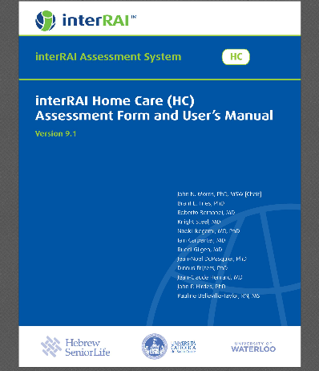
Functional Eligibility Determination Instrument
Basis: InterRAI Home Care (interRAI HCTM) instrument
Comprised of a subset of questions from the interRAI HCTM
The interRAI HCTM is a broadly used, standardized tool
Designed to be a user-friendly, reliable, person-centered assessment that informs and guides comprehensive care and service planning in community-based settings.

Slide 11
Functional Eligibility Determination Instrument
Purpose: MA-LTSS Functional Eligibility Determination
Successor to current LCD used in PA today
Must be administered within 10 business days of a request for service
Administered to applicants by FED assessors, contracted with Aging Well PA, to determine:
NFI – Nursing Facility Ineligible
NFCE – Nursing Facility Clinically Eligible

Slide 12
Functional Eligibility Determination Instrument
The FED tool uses item responses, probes, and scoring to provide a recommendation that the applicant is considered to be either NFCE or NFI.

Slide 13
Functional Eligibility Determination Instrument
The FED tool has six sections:
Demographic information;
Cognition;
Mood and Behavior;
Functional Status;
Continence; and
Treatments and Procedures.

Slide 14
Functional Eligibility Determination Instrument

Slide 15
Functional Eligibility Determination Instrument FED Scoring Matrix Translator:
The matrix places the attributes into eight groups (Columns A through H) and classifies the scores in those groups into three possible levels:
Little or no deficit;
Partial Deficit; and
Full Deficit.
If the individual’s scores translate into at least three Partial Deficits or into at least one Full Deficit, then the individual will be NFCE. Otherwise, the individual is NFI.

Slide 16
Functional Eligibility Determination Instrument FED Scoring-Matrix Translator

Slide 17
Functional Eligibility Determination Instrument
Nursing Facility Clinically Eligible (NFCE)
IEB continues CHC eligibility using FED determination as one part of the eligibility criteria
IEB provides critical profile and enrollment updates to PIA throughout the eligibility determination process
Nursing Facility Ineligible (NFI)
Applicant may be eligible for other types of county or state Aging assistance programs
FED results sent to IEB for non-CHC benefits consideration or appropriate program
Potential Medical Director review

Slide 18
FED Assessment Workflow
IEB
Create Profile, Request Asmnt.
AAA Sup.
(Alert)
Assign Assessor
(Alert)
Conduct FED
AAA
Create Profile, Request Asmnt.
Conduct FED
*May or may not send to IEB
Assign Assessor

Slide 19
Medical Director Review

Slide 20
DHS Medical Director Review
All NFCE determinations must be certified by a physician.
In instances where the certification of the applicant’s physician and the recommendation of the assessor differ on functional eligibility determination, OLTL’s Medical Director will review the collected documentation and make the final determination.

Slide 21
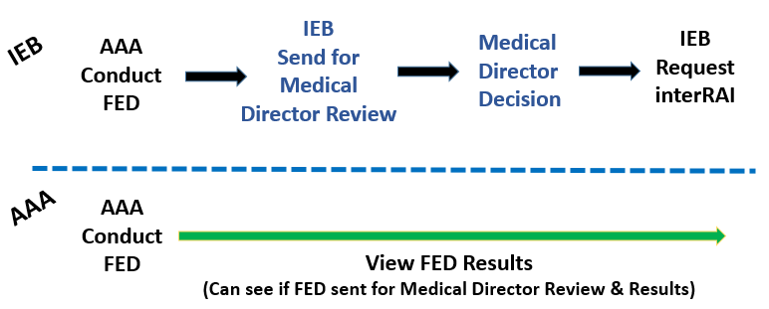
Workflow – DHS Medical Director Review

Slide 22
MCO Assessments
And Reassessments

Slide 23
MCO InterRAI Home Care Assessment
Post-FED Determination
For CHC applicants determined to be NFCE
IEB continues CHC eligibility determination
IEB provides critical profile and enrollment updates to PIA throughout the eligibility process
Upon CHC benefits approval
IEB contacts enrollee to determine choice of MCO
IEB updates PIA with enrollee’s MCO choice and MA number

Slide 24
MCO InterRAI Home Care Assessment
Purpose: Needs assessment post-eligibility determination to inform and guide subsequent care and service planning
Process:
Assessment required to be completed within 5 business days of MCO assignment
Selected MCO’s assessor schedules appointment with enrollee
Administers interRAI HCTM assessment using the M O’s application
Receives determination of care needs
Develops service plan for enrollee
interRAI HCTM assessment data flows back into PIA that night for long-term storage

Slide 25
MCO InterRAI Home Care Assessment
Re-Assessments
MCO is responsible for annual interRAI HCTM re-assessments and change in condition assessments
PIA extracts FED-related weighted question responses from interRAI HCTM assessment and re-calculates FED recommendation
Aging Well PA compares current FED recommendation with last one done to determine appropriateness of benefit continuation

Slide 26
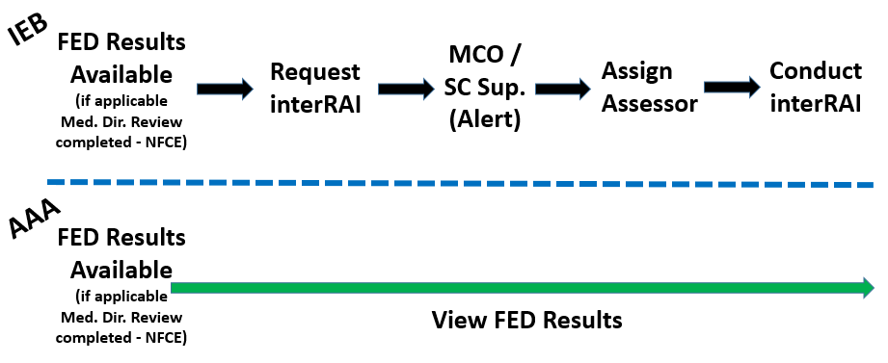
Workflow - interRAI HC Assessment

Slide 27
QUESTIONS

