Slide 1
Third Thursday Webinar
June 20, 2019

Slide 2
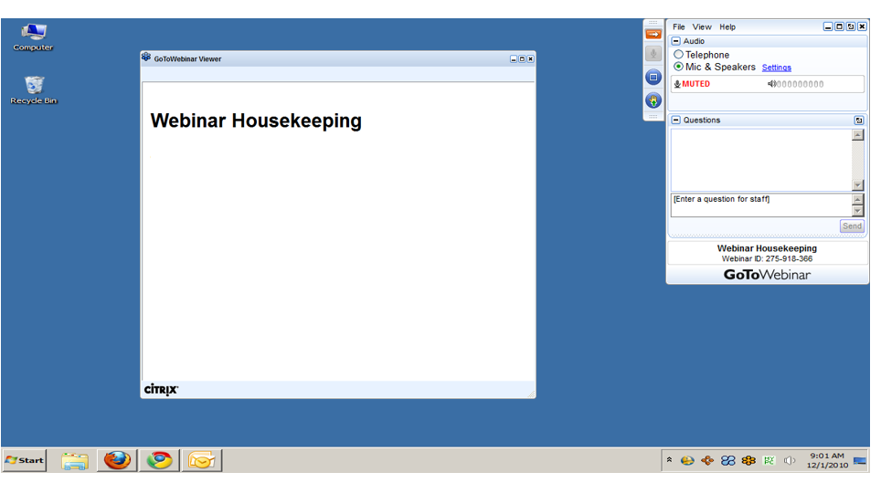
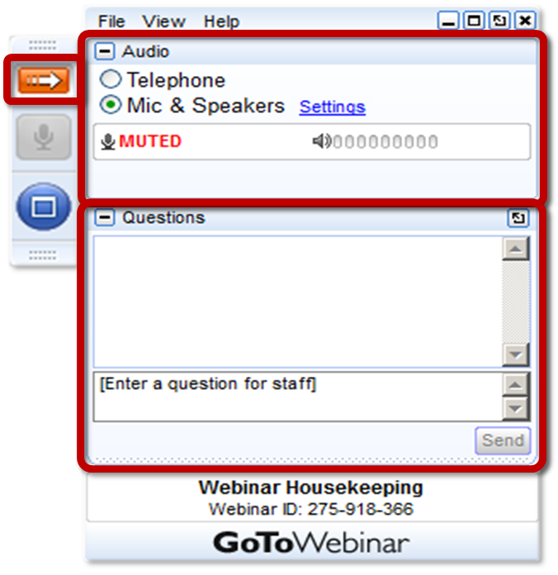
GoToWEBINAR HOUSEKEEPING: What Attendees See
Notes:
Before we get started, I’d like to go over a few items so you know how to participate in today’s event:
Here is a screen shot of the Attendee interface. This is what you should see on your desktop.
In the center of the screen is the GoToWebinar Viewer where you will see the presentation.
In the upper right hand corner is the GoToWebinar control panel where you can ask questions and select audio mode.
If the Control Panel is closed you will see a slim red rectangle. Click on the red arrow to expand the Control Panel.
5. You will be listening to the presentation via your computer's speaker system by default. If you prefer to join by phone, select the “Telephone” button in the audio pane and the dial-in information will be displayed. This will place you in the “listen only” mode to hear the presentation.
You may submit questions (via text) by typing your questions into the “Questions” pane of the control panel. You may send in your questions at any time during the presentation.
Note: The attendee control panel will collapse automatically when not in use. To keep it open, click the “View”, menu, and uncheck “Auto-hide Control Panel”.

Slide 3
AGENDA
Community HealthChoices (CHC) Updates
Functional Eligibility Determination (FED) Updates

Slide 4
CHC UPDATES

Slide 5
SOUTHWEST AND SOUTHEAST OPERATIONS
Southwest Operations
Southeast Continuity of Care
The Continuity of Care period ends in the Southeast zone of CHC on June 30th.
What can participants expect at the end of the continuity of care period?
A comprehensive needs assessment
Person-centered service planning
A revised person-centered service plan

Slide 6
PHASE 3 IMPLEMENTATION

Slide 7
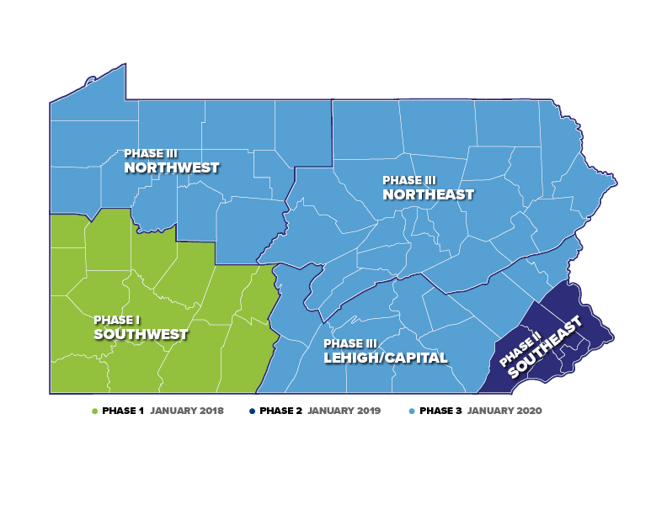

Slide 8
CHC PHASE 3 POPULATION
10%
14,609
Duals in Waivers
16%
23,323
Duals in Nursing Facilities
70%
99,887
NFI Duals
143,004
CHC POPULATION
3%
4,089
Non-duals in Waivers
13%
IN WAIVERS
17%
IN NURSING FACILITIES
96%
DUAL-ELIGIBLE
1%
1,096
Non-duals in Nursing Facilities

Slide 9
PHASE 3 ZONES: LEHIGH/CAPITAL
16%
10,861
Duals in Nursing Facilities
10%
6,269
Duals in Waivers
70%
46,411
NFI Duals
3%
1,996
Non-duals in Waivers
66,044
CHC POPULATION
LEHIGH/CAPITAL COUNTIES:
Adams, Berks, Cumberland,
Dauphin, Franklin, Fulton,
Huntingdon, Lancaster, Lebanon, Lehigh, Northampton, Perry, York
1%
507
Non-Duals in Nursing Facilities

Slide 10
PHASE 3 ZONES: NORTHWEST
15%
4,053
Duals in Nursing Facilities
13%
3,671
Duals in Waivers
68%
18,737
NFI Duals
4%
1,080
Non-duals in Waivers
27,730
CHC POPULATION
NORTHWEST COUNTIES:
Cameron, Clarion, Clearfield, Crawford, Elk, Erie, Forest, Jefferson, McKean, Mercer, Potter, Venango, Warren
<1%
189
Non-Duals in Nursing Facilities

Slide 11
PHASE 3 ZONES: NORTHEAST
17%
8,397
Duals in Nursing Facilities
9%
4,664
Duals in Waivers
71%
34,727
NFI Duals
2%
1,007
Non-duals in Waivers
49,195
CHC POPULATION
NORTHEAST COUNTIES:
Bradford, Carbon, Centre, Clinton, Columbia, Juniata, Lackawanna,
Luzerne, Lycoming, Mifflin, Monroe, Montour, Northumberland, Pike, Schuylkill, Snyder, Sullivan, Susquehanna, Tioga, Union, Wayne, Wyoming
1%
400
Non-Duals in Nursing Facilities

Slide 12
PHASE 3 PROVIDER SESSIONS
Lehigh/Capital Zone:
OLTL conducted Provider Workshops in Harrisburg, Shippensburg, and Kutztown.
A Transportation Summit was also held in Kutztown.
Approximately 600 people attended.
Northwest Zone:
OLTL conducted Provider Workshops in Edinboro, Lock Haven, and Bradford.
A Transportation Summit was also held in Bradford.
Approximately 420 people attended.
Northeast Zone
OLTL conducted Provider Workshops in East Stroudsburg, Scranton, and Bloomsburg.
A Transportation Summit was also held in Bloomsburg.
Approximately 520 people attended.

Slide 13
TRANSPORTATION SUMMITS
Key Takeaways
Evaluate potential areas for innovation to support the informal transportation supports currently being provided by direct care workers.
Continue to facilitate discussion to ensure MCOs, providers, and other stakeholders understand the various transportation resources offered through Commonwealth programs.
Increase communication to service coordinators regarding the role of the transportation brokers in CHC.

Slide 14
PHASE 3 TIMELINE
July-August
July 15: Initial Participant Touchpoint Flyer and LIFE Program Flyer
August 1: Aging Well Mailer
August 19-30: Round 1 Pre-Transition Notices
September-October
Participant Information Sessions
Provider Sessions
Round 1, 2, & 3 Enrollment Packets
Round 2 & 3 Pre-Transition Notices

Slide 15
PHASE 3 TIMELINE
November-December
Phase 3
November 13 Last Day for Plan Selection Before Auto-Assignment
December 20 Last Day for Plan Selection Effective January 1
January 1, 2020 – CHC Phase 3 Implementation

Slide 16
www.HealthChoices.pa.gov

Slide 17
FED UPDATES

Slide 18
COMPLETED FED ASSESSMENTS

Slide 19
INITIAL FED RESULTS
The Number of FEDS with an Initial Recommendation of NFCE or NFI

Slide 20
INITIAL FED RESULTS
The Percentage of FEDS with an Initial Recommendation of NFCE or NFI

Slide 21
FED MEDICAL REVIEW
The Number of Requested Medical Reviews

Slide 22
QUESTIONS

Slide 23
RESOURCE INFORMATION
CHC LISTSERV // STAY INFORMED: http://listserv.dpw.state.pa.us/oltl-community-healthchoices.html
COMMUNITY HEALTHCHOICES WEBSITE: www.healthchoices.pa.gov
MLTSS SUBMAAC WEBSITE: www.dhs.pa.gov/communitypartners/informationforadvocatesandstakeholders/mltss
EMAIL COMMENTS TO: RA-PWCHC@pa.gov
OLTL PROVIDER LINE: 1-800-932-0939
OLTL PARTICIPANT LINE: 1-800-757-5042
INDEPENDENT ENROLLMENT BROKER: 1-844-824-3655 or (TTY 1-833-254-0690)
or visit www.enrollchc.com

