Slide 1
CHC Third Thursday Webinar
January 16, 2020

Slide 2
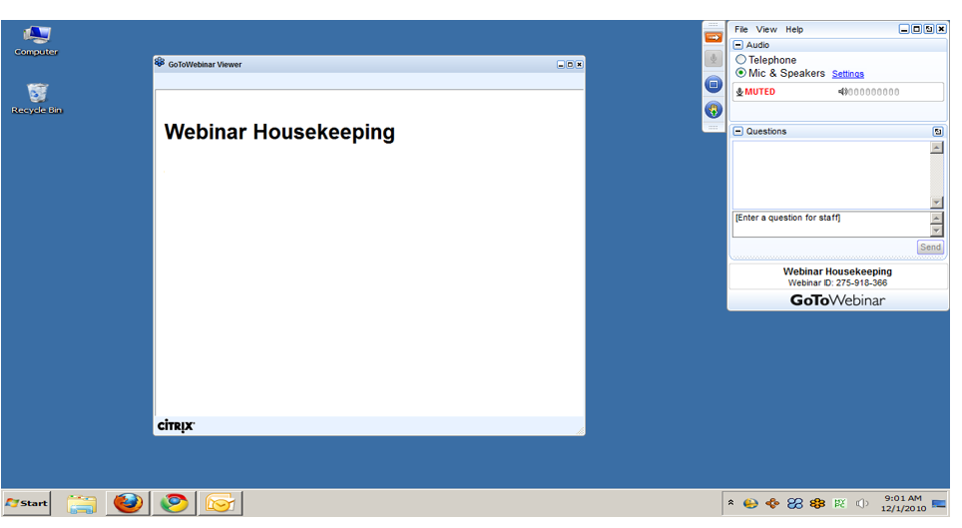
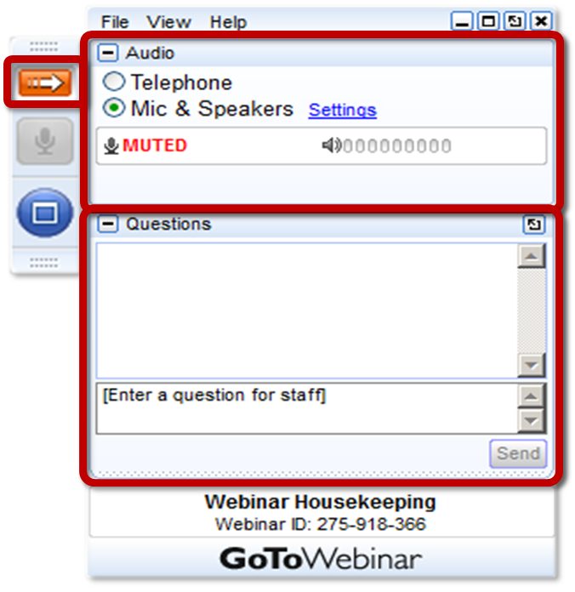
GoToWEBINAR HOUSEKEEPING: What Attendees See
Notes:
Before we get started, I’d like to go over a few items so you know how to participate in today’s event:
Here is a screen shot of the Attendee interface. This is what you should see on your desktop.
In the center of the screen is the GoToWebinar Viewer where you will see the presentation.
In the upper right hand corner is the GoToWebinar control panel where you can ask questions and select audio mode.
If the Control Panel is closed you will see a slim red rectangle. Click on the red arrow to expand the Control Panel.
5. You will be listening to the presentation via your computer's speaker system by default. If you prefer to join by phone, select the “Telephone” button in the audio pane and the dial-in information will be displayed. This will place you in the “listen only” mode to hear the presentation.
You may submit questions (via text) by typing your questions into the “Questions” pane of the control panel. You may send in your questions at any time during the presentation.
Note: The attendee control panel will collapse automatically when not in use. To keep it open, click the “View”, menu, and uncheck “Auto-hide Control Panel”.

Slide 3
AGENDA
Community HealthChoices (CHC) Implementation Updates
CHC Waiver Renewal
Electronic Visit Verification (EVV) Update

Slide 4
CHC UPDATES

Slide 5
PRIORITIES THROUGH IMPLEMENTATION
ESSENTIAL PRIORITIES
No interruption in participant services
No interruption in provider payment
HOW WILL WE ENSURE NO INTERRUPTIONS?
Launch Indicators
Daily Managed Care Organization (MCO) Huddles
Ongoing Monitoring Reports

Slide 6
PHASE THREE PLAN SELECTION
Region | Population | Recipients who Selected a Plan | Total Recipients Transitioning to CHC | % of Recipients Selecting a Plan
Northeast | NFI Dual | 13,149 | 34,682 | 37.9%
 | HCBS Dual | 3,194 | 5,004 | 63.8%
 | HCBS Non-Dual | 818 | 1,131 | 72.3%
 | LTC Dual | 3,230 | 8,306 | 38.8%
 | LTC Non-Dual | 109 | 414 | 26.3%
 | Total | 20,500 | 49,537 | 41.4%

Slide 7
PHASE THREE PLAN SELECTION
Region | Population | Recipients who Selected a Plan | Total Recipients Transitioning to CHC | % of Recipients Selecting a Plan
Northwest | NFI Dual | 8,878 | 18,610 | 47.8%
 | HCBS Dual | 2,534 | 3,795 | 66.8%
 | HCBS Non-Dual | 987 | 1,235 | 79.9%
 | LTC Dual | 1,630 | 3,972 | 41%
 | LTC Non-Dual | 45 | 186 | 24.2%
 | Total | 14,074 | 27,798 | 50.6%

Slide 8
PHASE THREE PLAN SELECTION
Region | Population | Recipients who Selected a Plan | Total Recipients Transitioning to CHC | % of Recipients Selecting a Plan
Lehigh/ Capital | NFI Dual | 16,750 | 46,039 | 36.4%
 | HCBS Dual | 4,519 | 7,392 | 61.1%
 | HCBS Non Dual | 1,961 | 2,705 | 72.5%
 | LTC Dual | 3,761 | 10,805 | 34.8%
 | LTC Non Dual | 167 | 584 | 28.6%
 | Total | 27,158 | 67,525 | 40.2%

Slide 9
PHASE THREE POPULATION
Lehigh Capital Zone
AmeriHealth Caritas | 26,802 | 40%
UPMC | 22,166 | 33%
PA Health & Wellness | 18,565 | 27%
Northeast Zone
AmeriHealth Caritas | 20,830 | 42%
UPMC | 15,159 | 31%
PA Health & Wellness | 13,550 | 27%
Northwest Zone
UPMC | 14,945 | 54%
PA Health & Wellness | 6,495 | 23%
AmeriHealth Caritas | 6.370 | 23%

Slide 10
CHC PHASE THREE POPULATION
Phase 3 Population | Count
NFI Duals | 99,331
HCBS Duals | 16,192
HCBS Non-Duals | 5,087
LTC Duals | 23,088
LTC Non-Duals | 1,184
Grand Total | 144,882

Slide 11
CHC WAIVER RENEWAL

Slide 12
CHC 1915c WAIVER RENEWAL
Changes in the approved renewal include:
Revised the Residential Habilitation service definition by modifying the number of hours that are defined as a day unit from a minimum of 12 hours to a minimum of 8 hours.
Modified the qualifications for Service Coordinators and Service Coordinator supervisors.

Slide 13
CHC 1915c WAIVER RENEWAL
Changes in the approved renewal (continued):
Revised the service definitions of Job Finding, Job Coaching, Employment Skills Development, Career Assessment and Benefits Counseling.
Added language that Office of Vocational Rehabilitation (OVR) services are considered to not be available if OVR has not made an eligibility determination within 120 days
Also added language to address when employment services through the CHC waiver can be provided should OVR close the order of selection, thereby creating a waiting list for OVR services.

Slide 14
ELECTRONIC VISIT VERIFICATION (EVV)

Slide 15
EVV IMPLEMENTATION UPDATES
Pennsylvania’s Good Faith Effort Exemption Application was approved by the Centers for Medicare and Medicaid Services (CMS).
2020 EVV Implementation Timeline:
January 1, 2020: All Providers must begin using EVV for Personal Care Services (PCS).
January 2020 – March 2020: All Providers must complete system integration activities with the DHS Aggregator for fee-for-service programs or HHAeXchange in CHC.
Providers who cannot complete integration activities by March 31, 2020 must submit an extension request documenting the reasons for delay no later than February 1, 2020.
Providers will need to complete the extension form found on the EVV website and email the completed form to RA-PWEVVNOTICE@pa.gov.
Starting July 1, 2020: Claims submitted for Personal Care Services without a matching EVV visit will be denied.

Slide 16
CHC RESOURCE INFORMATION
CHC LISTSERV // STAY INFORMED: http://listserv.dpw.state.pa.us/oltl-community-healthchoices.html
COMMUNITY HEALTHCHOICES WEBSITE: www.healthchoices.pa.gov
MLTSS SUBMAAC WEBSITE: www.dhs.pa.gov/communitypartners/informationforadvocatesandstakeholders/mltss
EMAIL COMMENTS TO: RA-PWCHC@pa.gov
OLTL PROVIDER LINE: 1-800-932-0939
OLTL PARTICIPANT LINE: 1-800-757-5042
INDEPENDENT ENROLLMENT BROKER: 1-844-824-3655 or (TTY 1-833-254-0690)
or visit www.enrollchc.com

Slide 17
QUESTIONS

