Slide 1

Pennsylvania eHealth Partnership
Advisory Board
Meeting
November 13, 2020

Slide 2

Agenda
10 a.m. Welcome and Introductions
10:05 Minutes of August 14, 2020 Meeting
10:10 PA eHealth Partnership Program Updates
10:25 Learnings from Allegheny County Population Health Analysis of
Resident EHR Data
10:55 COVID-19 Public Health Emergency
11:15 HIE Trust Community Committee Updates
11:25 Mount Nittany Exchange Overview
11:40 PA eHealth Draft Annual Report
11:50 Vice Chair Election
11:55 Public Comment
12 p.m. Adjournment
2021 Meeting Dates

Slide 3
Welcome and Introductions
  David F. Simon, JD
  Consumer Representative
  and
  PA eHealth Advisory Board Chair

Slide 4
PA eHealth Advisory Board
  Mr. MARTIN CICCOCIOPPO, Director, PA eHealth Partnership Program
  Pennsylvania Department of Human Services (Secretary of DHS Designee)
  Ms. PAMELA E. CLARKE, Senior Director, Quality, Health Promotion Council (House Appointed HIO Representative)
  Mr. JOSEPH FISNE, Associate Chief Information Officer
  Geisinger Health System (Senate Appointed HIO Representative)
  Mr. SCOTT FRANK, Chief Information Officer
  Capital Blue Cross (Insurer Representative)
  Dr. BRIAN HANNAH, Vice President, Chief Medical Information Officer
  Mercy Health (Hospital Representative)
  Dr. TIMOTHY HEILMANN, Chief Medical Information Officer
  UPMC Susquehanna (Physician or Nurse Representative)
  Ms. TERI L. HENNING, Chief Executive Officer
  Pennsylvania Homecare Association (Home Care or Hospice Representative)

Slide 5
PA eHealth Advisory Board continued
  Mr. MICHAEL HUMPFREYS, Chief of Staff
  Pennsylvania Insurance Department (Insurance Commissioner Designee)
  Ms. JULIE KORICK, Director of Finance & Business Development
  Pennsylvania Association of Community Health Centers (Underserved Representative)
  Ms. MINTA LIVENGOOD, Vice Chair, Consumer Subcommittee of the MAAC
  (Consumer Representative)
  Mr. PAUL MCGUIRE (Vice Chair), Chief Operating Officer, Quality Life Services
  (Post-Acute Care Facility Representative)
  Ms. MEGHNA PATEL, Deputy Secretary for Health Innovation, PA Department of Health
  (Secretary of Health Designee)
  Dr. MICHAEL A. SHEINBERG, Chief Medical Information Officer
  Penn Medicine Lancaster General Health (House Appointed HIO Representative)
  Mr. DAVID F. SIMON (Chair), Chief Legal Affairs Officer
  Philadelphia College of Osteopathic Medicine (Consumer Representative)

Slide 6
Ex Officio Members
  Ms. PHYLLIS SZYMANSKI, Director
  ClinicalConnect HIE (Nominated as Senate HIO Appointee)
  Mr. DON REED, Chief Operating Officer
  HealthShare Exchange (Nominated as House HIO Appointee)

Slide 7
Pennsylvania eHealth Program Updates
  Martin Ciccocioppo, MBA MHA
  Director
  Pennsylvania eHealth Partnership Program
  Office of Medical Assistance Programs
  Pennsylvania Department of Human Services

Slide 8
PA eHealth Staff Changes
  Debra Kochel, joined PA eHealth as a Human Services Program Specialist on September 14, 2020
  Terri Lynn Brown, PA eHealth Administrative Officer, will be transferring to the Office of Administration, Office of Chief Counsel on November 27, 2020

Slide 9
Recent PA eHealth Accomplishments
  In FFY2020, four HIOs onboarded 42 hospitals and nursing homes and 33 ambulatory providers with HIE Onboarding Grant.
  HIOs also made 10 additional grant-funded Public Health Gateway provider onboardings.
  Established additional PHG connections to RxCheck PDMP gateway.
  CMS approved our FFY2021 HIT IAPD for $11.2 million in interoperability projects.
  Expanded P3N ADT Statewide Notification Service to include107 emergency departments in production and 35 inpatient ADT feeds; anticipate more than 110 ED and IP ADT feeds by 1Q2021.
  More than 1.77 million documents were retrieved across the P3N in October 2020.
  Submitted P3N MMIS APD to CMS for review/approval.
  P3N RFP in internal review; expect to release in January 2021 after CMS approval.

Slide 10
FFY 2020 HIT IAPD Projects
HIE Onboarding Grants – Paid $2.8 million in grant achievement
Health Plan Onboarding Grants – Unable to issue RFA in FFY2020
PHG Onboarding Grants – Paid $50,000 in grant achievement
Radiology Image Sharing – KeyHIE completed second-year of project
Care Plan Document Registry – IBM unable to complete in FFY2020
PHG Utilization – PHG working well and hired new PHG Coordinator
Case Reporting – Capacity building for eCR work continues
Immunization Registry Interoperability – IAPD funding not used
Education and Outreach – Quality Insights worked with MA providers
Allegheny County Population Health – ACHD completed second-year
Total Approved FFY 2020 IAPD Funding = $11.7 million
(DHS provides the 10% state matching funds.)

Slide 11
FFY 2021 HIT IAPD Projects
Total CMS Approved FFY 2021 IAPD Funding = $11.2 million
(DHS provides the 10% state matching funds.)
Note: FFY 2021 is the last year for HITECH project funding.
No. | Project | Contracting Mechanism | Status
1 | HIE Onboarding Grants | RFA 11-20 | 10/9/2020 - RFA posted on eMarketplace
2 | PHG Grants | RFA 10-20 | 10/9/2020 - RFA posted on eMarketplace
3 | PHG Utilization | MOU | Staffing resources in place
4 | Case Reporting | MOU | DOH is meeting with CDC, AIMS, and Digital Bridge to develop architecture and onboarding plan
5 | Education and Outreach | RFQ | PO issued to Quality Insights
6 | Immunization Registry Interoperability | MOU | Active recruitment for staffing resources
7 | HIE Onboarding Grants for Payors | RFA 09-20 | 10/13/2020 - RFA posted on eMarketplace
8 | Patient Matching Improvement | RFA 08-20 | RFA in final internal review

Slide 12
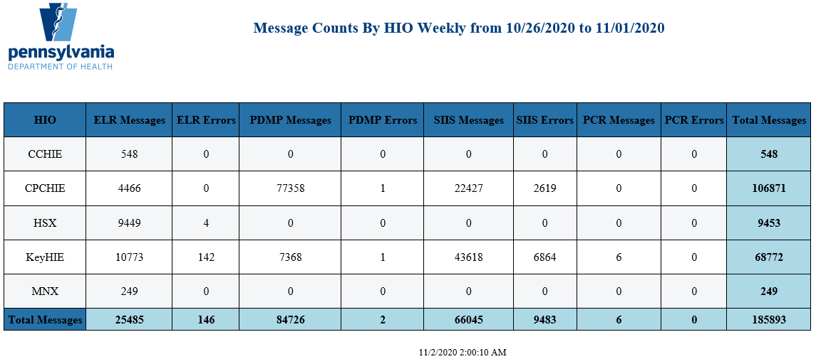
Public Health Gateway Activity

Slide 13
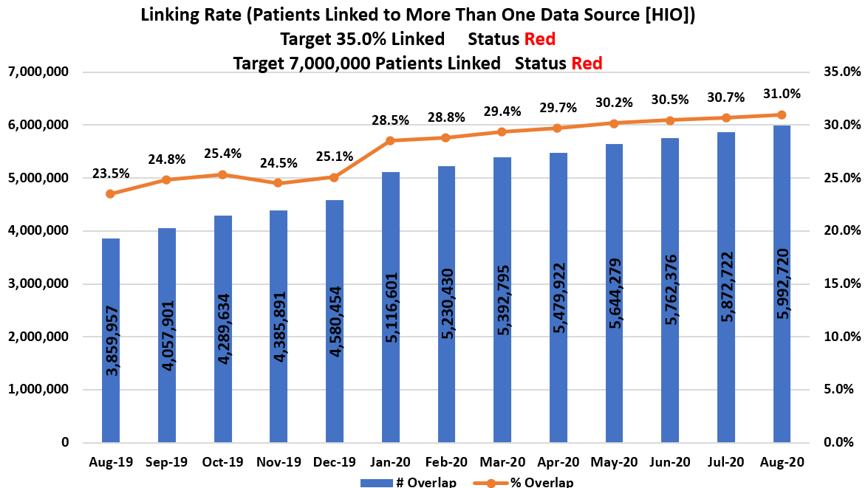
P3N Linking Rate

Slide 14
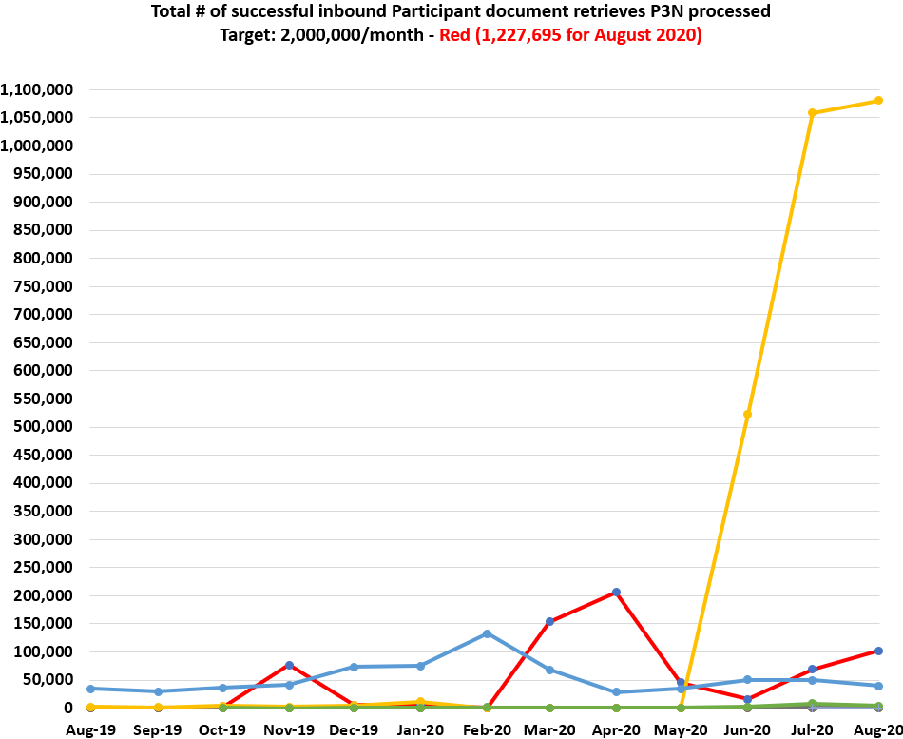
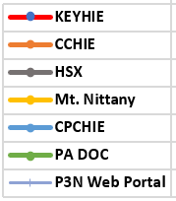
P3N Document Retrieves

Slide 15
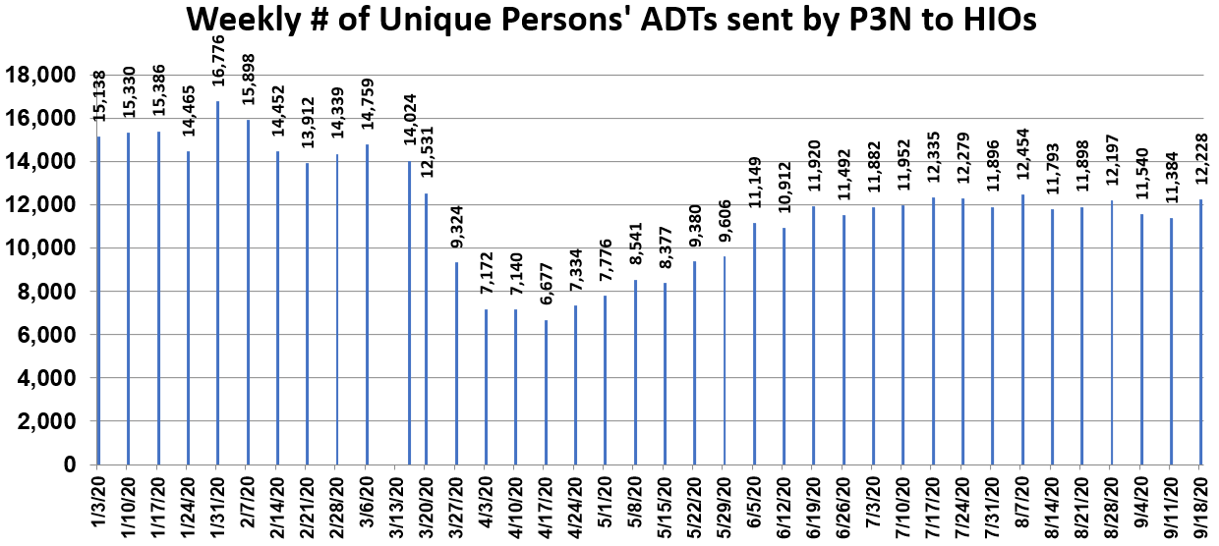
P3N ADT Service Activity

Slide 16

Public Education on HIE
Taping of Episode 2 postponed from 11/16/2020 due to COVID resurgence. Episode 1 can be streamed at: https://vimeo.com/444076673/d9edc587df

Slide 17
Interagency Health Reform Council
Purpose: The IHRC will evaluate the potential alignment of Commonwealth health care payment and delivery systems to provide efficient, whole-person health care that also contains costs, reduces disparities, and achieves better health outcomes for Pennsylvanians.
Responsibilities: Evaluate and recommend policies to align and integrate Commonwealth programs and activities related to health and health care.
Deliverable: The IHRC shall submit a report to the Governor no later than December 31, 2020, that includes proposals for the development and implementation of health care reform and identifies all policy and legislative changes needed to effectuate the Council’s proposals.
PA eHealth is leading the Leverage Health Information Exchange (HIE) Workstream Support Team, which includes members from the Department of Human Services, Aging, Drug and Alcohol Programs, and the Office of Long-Term Living.

Slide 18
Allegheny County Health Department: ESPnet Updates & Chronic Conditions Among Medicaid Recipients
Pennsylvania eHealth Partnership Advisory Board Meeting
LuAnn Brink, PhD, Chief Epidemiologist and Deputy Director
Lynda Jones, MPH, Epidemiologist
November 13, 2020

Slide 19
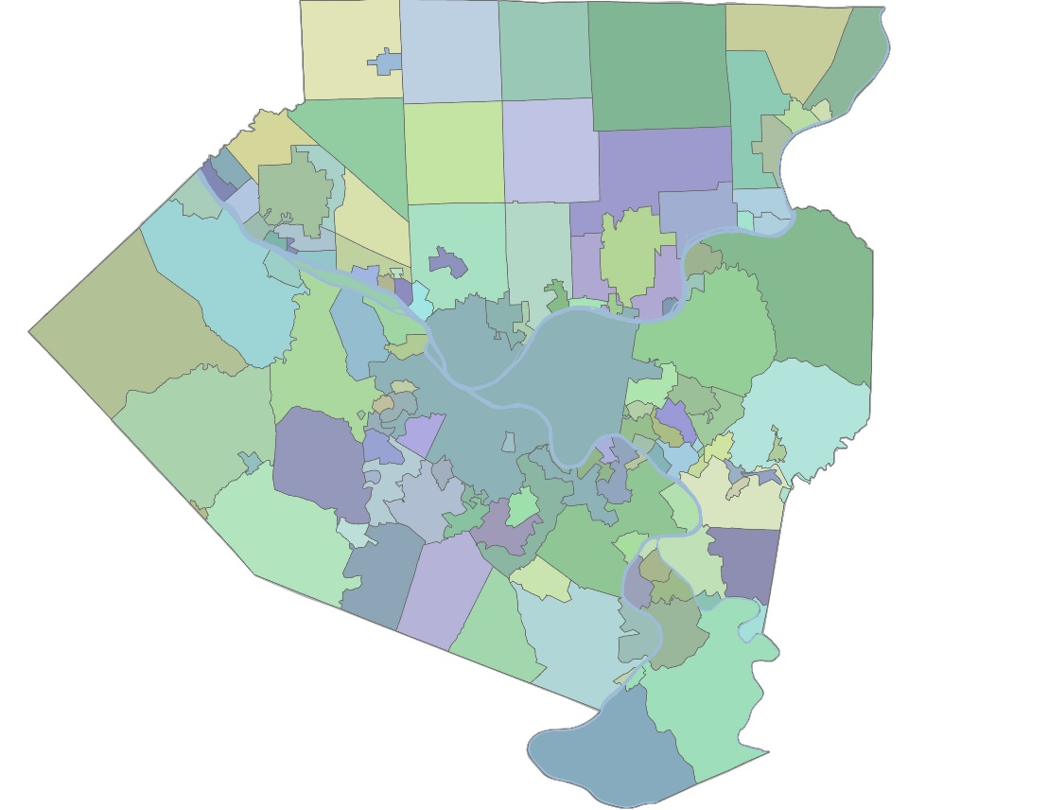
Allegheny County, PA
130 municipalities with > 1.2 million residents
Characteristic | Allegheny County | United States
White | 80% | 77%
Black | 13% | 13%
Hispanic | 2% | 18%
Foreign Born | 6% | 14%
Age 65+ | 19% | 16%
Percent Poverty | 12% | 13%
Insured (19-64) | 95% | 88%
Data Source: American Community Survey, 2018 1-year and 5-year estimates

Slide 20
Chronic Diseases and Associated Risk Factors, 2016; Survey Data
*
*2015-2016 data
Source: Allegheny County Health Survey (ACHS), BRFSS retrieved from EDDIE and CDC
Notes:
The purpose of this slide is to demonstrate burden of chronic disease and risk factors in AC, why we need more timely and detailed data
Bridging previous state to current state of data

Slide 21

Public Health Chronic Disease Surveillance Data
deaths
hospitalizations
ED visits
prescriptions
Urgent care visits
PCP visits
Blood pressure measurements
Cholesterol measurements

Slide 22

Automating Chronic Disease Surveillance for Public Health Practice
diagnoses
Electronic health records (EHR) include visits to PCPs, specialists, urgent care, EDs, and Hospitals
lab results
medications
Chronic Disease Epidemiology
electronic case reports or aggregate summaries
vital signs
demographics
Adapted from JAMIA 2009;16:18-24
Am J Pub Health 2012;102:S325–S332

Slide 23
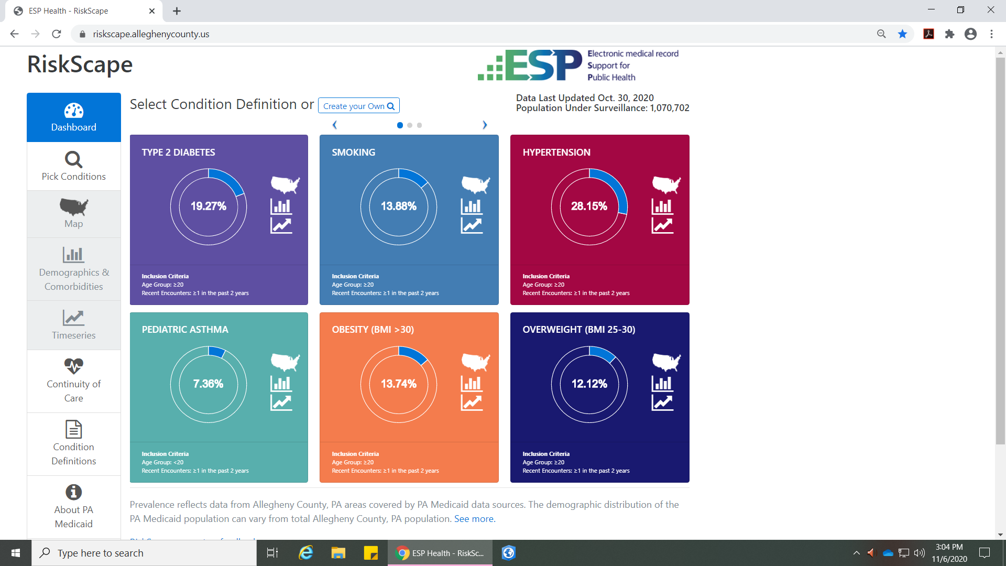
RiskScape Dashboard
Notes:
Includes all payers; counts too low for Medicaid only

Slide 24
Limitations of Survey Data
County-level only
Sample size
  Variability, subgroup comparisons
Self-report
Precise data up to 5 years apart
Notes:
- Why we need EHR data
- Our ACHS (and hopefully our oversample) have sufficient sample, but these were 5 years apart; unprecise data available yearly from PADOH (underpowered at county level)

Slide 25
Why EHR Data?
Objective, detailed information related to cardiovascular risk
  Provides clinical measures rather than self-report
All individuals from participating health systems
Census tract and zip code
Monthly updates
Data difficult to capture in other sources simultaneously (medications, pre-diabetes and HTN, behaviors, payer)
Unique data only in EHR (not in claims or survey datasets)
Captures data for children and adolescents
Notes:
We can mention limitations of EHR data but leaving them out of the deck because we want to focus on strengths

Slide 26
EHR Uses for ACHD
Surveillance
  Changes over time overall, by subgroup, location
Inform programming
  Which communities and populations have highest burden of risk factors (primary prevention)
  Which communities and populations have highest burden of uncontrolled diabetes and HTN (secondary prevention)
Determine associations
  What is the relationship between risk factors/prevalence/control status and community factors in Allegheny County?

Slide 27
Timeline ACHD/ESPNet
Milestone | Expected Schedule
ESP installation and setup process specified for all Clinical Data partners. BAAs and DUAs completed as required | 30 April, 2019
Systems tested and ready for installation | 31 May, 2019
ESP installed at AHN and UPMC ETL running, 2 years of data loaded and nightly updates configured | 30 June, 2019
All disease detection algorithms installed at AHN and UPMC and configured, Hypertension and Diabetes disease conditions validated | 31 July, 2019
Release PMN system for investigational use. | 31 Aug, 2019
Release RiskScape system for investigational use. | 31 Aug, 2019
Provide support and training until end of contract period | 30 Sept, 2019
Begin data validation | 20 Jan 2020
Assessing concordance of definitions for HTN and DM2 using medical records | 30 Apr 2020
Results indicate 100% concordance for HTN and sensitivity and specificity for DM2 = 92%, 99% respectively | 31 May 2020
Introduction to NACDD/MENDS | 30 Jun 20
February 2019 held calls with health systems to gain agreement to participate
9/30/19 Interface up and operational

Slide 28
Results
Surveillance using RiskScape
Diabetes and HTN Queries

Slide 29
RiskScape for Surveillance
Visualizes HTN and diabetes by geography, race, age, gender, payer
Many inclusion criteria – demographic, comorbidities, labs, BP, Rx
  E.g. smoking, pregnancy, BMI, LDL, A1C, triglycerides, insulin, Metformin
Can modify definition of encounters – who we want to capture
  ≥ 1 in the past 1 or 2 years
  ≥ 2 in the past 1 or 2 years
Trends over time
  Data updated monthly
Notes:
- The purpose of this slide is to demonstrate that while RiskScape is structured, there is a lot of flexibility and information to access
We are limited to the structure of RiskScape for surveillance; when we want something that is currently not structured in RiskScape we either have to (1) work with Commonwealth Informatics to build out Riskscape or (2) switch to the SQL code queries answered by individual health systems through PopMedNet
We can modify definition of encounters but this is meant for a wide range of conditions; given our definitions for diabetes and htn we can only modify to 2+ in the past 1 or 2 years, since these definitions require 2 encounters. But this is useful if/when we add a condition like asthma

Slide 30
Definitions
Condition | Criteria
Type 2 Diabetes | At least one of following: HbA1c > 6.5% Fasting glucose > 126 mg/dL Prescription for insulin outside pregnancy or other diabetes medication Diagnosis code(s) on two or more encounters Does not meet criteria for T1DM
Hypertension | Either one of following: SBP ≥ 140 or DBP ≥ 90 or both on 2 or more occasions within a one year period Diagnosis code for HTN and prescription for at least 1 antihypertensive medication within 1 year of diagnosis code

Slide 31
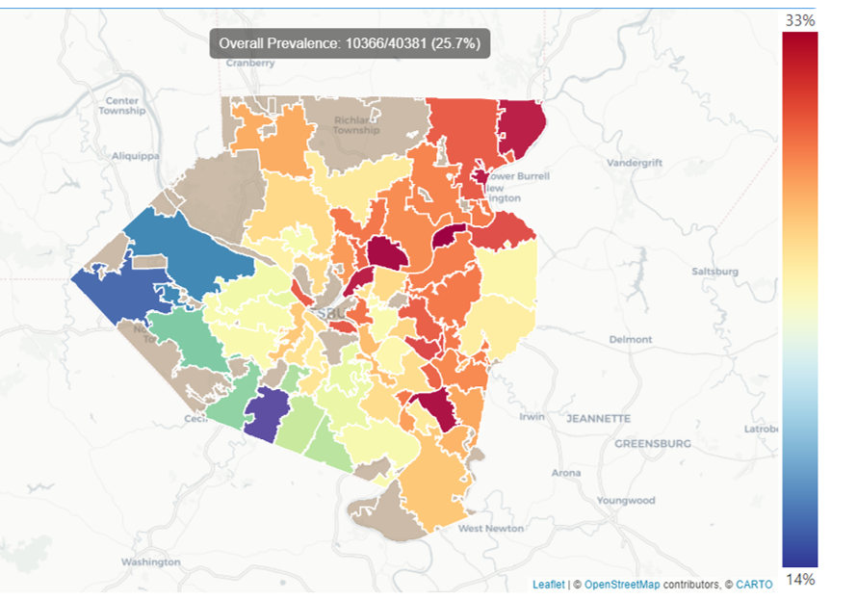
Hypertension – Medicaid Recipients
Notes:
Prevalence by payer

Slide 32
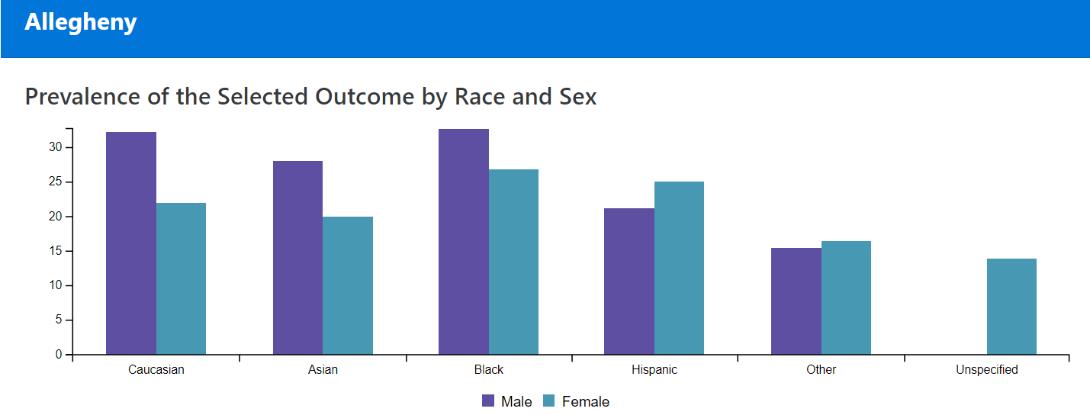
Hypertension – Medicaid Recipients
Notes:
Prevalence by payer

Slide 33
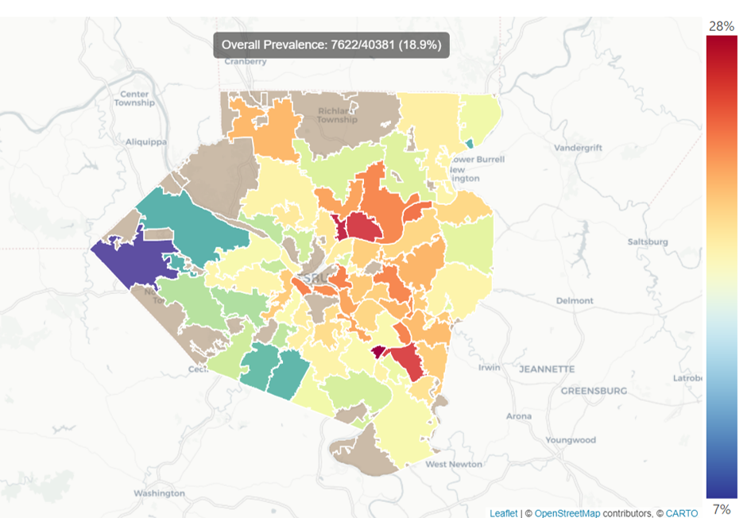
Diabetes – Medicaid Recipients
Notes:
Prevalence by payer

Slide 34
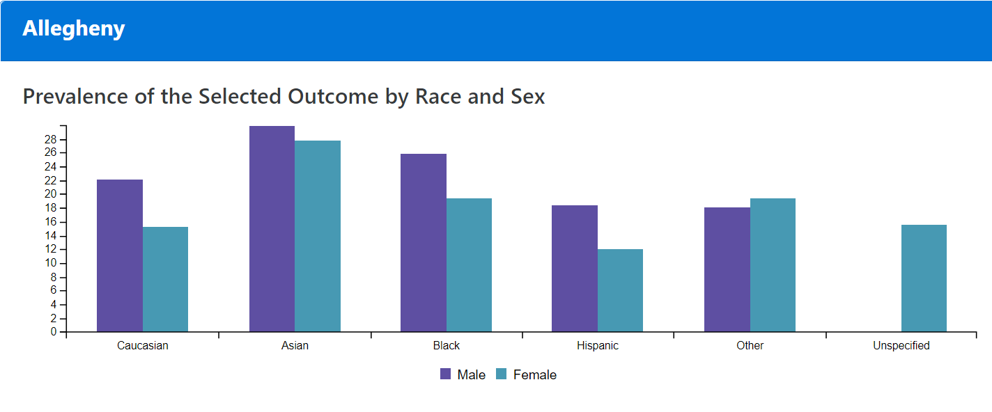
Diabetes – Medicaid Recipients
Notes:
Prevalence by payer

Slide 35
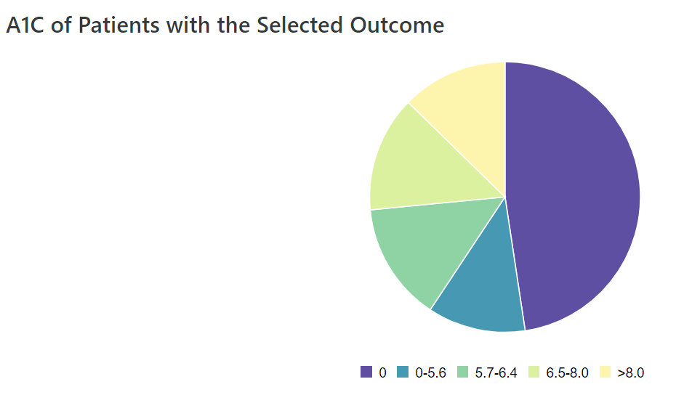
A1C Among Diabetes Patients With Medicaid
> 8,000 Medicaid patients in RiskScape
Approximately 13% of Medicaid recipients with diabetes have an A1C > 8%
Notes:
Prevalence by payer

Slide 36
PopMedNet for Query Submission
Direct submission of SQL queries to UPMC and AHN
More customized than RiskScape
Health systems review, approve, and return aggregate data where cell counts are ≥ 5
Currently using PopMedNet to answer diabetes/HTN questions related to:
  Control status
  Risk factor distribution (with and without diabetes/HTN)
  pregnancy
Stratifying all queries by demographic variables and payer to understand opportunities for intervention
Notes:
- Overview of our queries since we don’t have the results for all of them yet
- We’re starting simple to refine our questions since there is a lot of time and effort needed to complete queries and for health systems to check and respond to queries

Slide 37
PopMedNet Example – Hypertension Control Among Medicaid Recipients
10,366/40381 (25.7%) of Medicaid Recipients have HTN
43% of Medicaid recipients with HTN have uncontrolled HTN
Control status varies by race and age
48% of Black Medicaid recipients with HTN have uncontrolled HTN compared to 39% of white Medicaid recipients
Notes:
Our queries are returned in a way that we can only look at 2 variables at a time; payer is one of the variables
Because of this, we can only look at Medicaid*Race or Medicaid*Age; we can’t look at Medicaid*Race*Age because this would be a 3-way table which are currently not included in our queries (but hopefully will be in the future)
65+ is an age group, but the definition of control status only applies to age 70; this can be mentioned verbally
Uncontrolled BP is SBP≥140 or DBP≥90 among those with HTN

Slide 38
Queries Currently Building to Answer…
Which communities and populations have the greatest burden of risk factors among residents with and without diabetes/HTN?
Among those with a diagnosis, which communities and populations have greatest burden of uncontrolled diabetes/HTN?
What is the distribution of risk factors among pregnant females (18-44)?
What is the relationship between community characteristics and diabetes/HTN rates?
Notes:
More detailed info related to queries
A major delay occurred with these because queries with multiple variables take longer to run on the server and it has maxed out at about 2 hours without completing queries
Bob has been working to create work-arounds to break down the queries but still be able to match each to an ID
Time consuming so we don’t have as much data to share as we would like, but will have lots of data when this issue is figured out

Slide 39
Challenges
Experiences with health systems compared to Massachusetts
Customizing RiskScape
Issues with health systems monthly updates to RiskScape
More complex PopMedNet queries
  Server times out after 2 hours
  Longer queries take > 2 hours and required development of 2 stage query submission tool

Slide 40
Next Steps
Report key findings
Disseminate and identify program opportunities
Use for surveillance and evaluation
Continue to work with AHN and UPMC on data sharing
Continue to work with Commonwealth Informatics on RiskScape dashboard and PopMedNet queries
Join the CDC-funded National Association of Chronic Disease Directors (NACDD) MENDS (Multi-state EHR-based Network for Disease Surveillance) project
  Financing opportunity and learning community to connect with other health departments using EHR data

Slide 41
COVID-19 and HIE
  Meghna Patel
  Deputy Secretary for Health Innovation
  Pennsylvania Department of Health

Slide 42
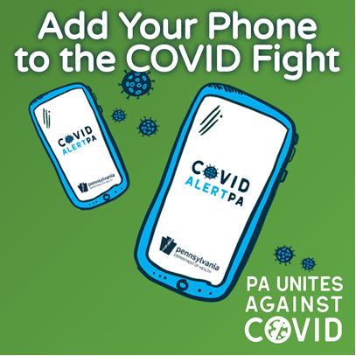
COVID Alert PA app
When it comes to COVID-19, we all must do our part to
stop the spread. An easy way to do your part is by
downloading the COVID Alert PA app.
The COVID Alert PA app notifies you if you have had a potential exposure to someone who has tested positive for COVID-19. The app works by using anonymous Bluetooth technology that identifies other devices with the app in your proximity. When an app user who was near you reports they have a positive COVID-19 diagnosis, you may receive an alert, depending on the date, how long you were exposed and how close you were to the other person. It does not track your location or store your personal information.
The app also includes an interactive COVID-19 symptom checker, updates on the latest public health data about COVID-19 in PA and advice for what to do if you have a potential exposure to COVID-19.

Slide 43
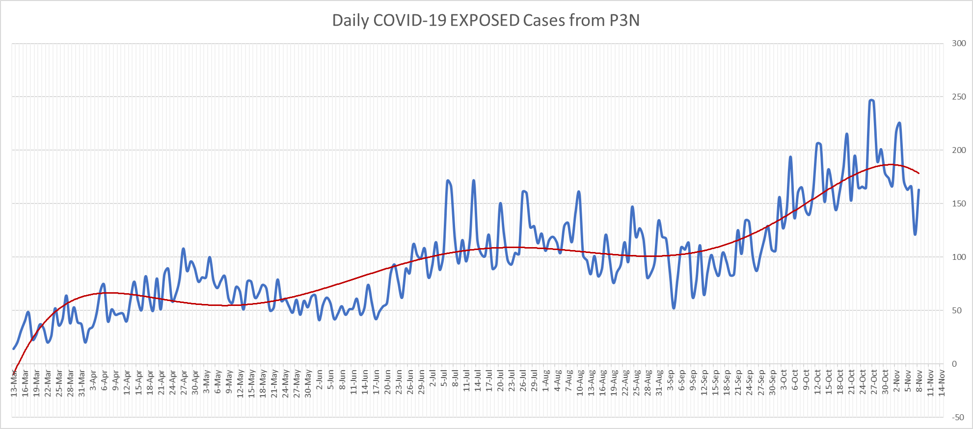
P3N ADT COVID-19 Surveillance

Slide 44
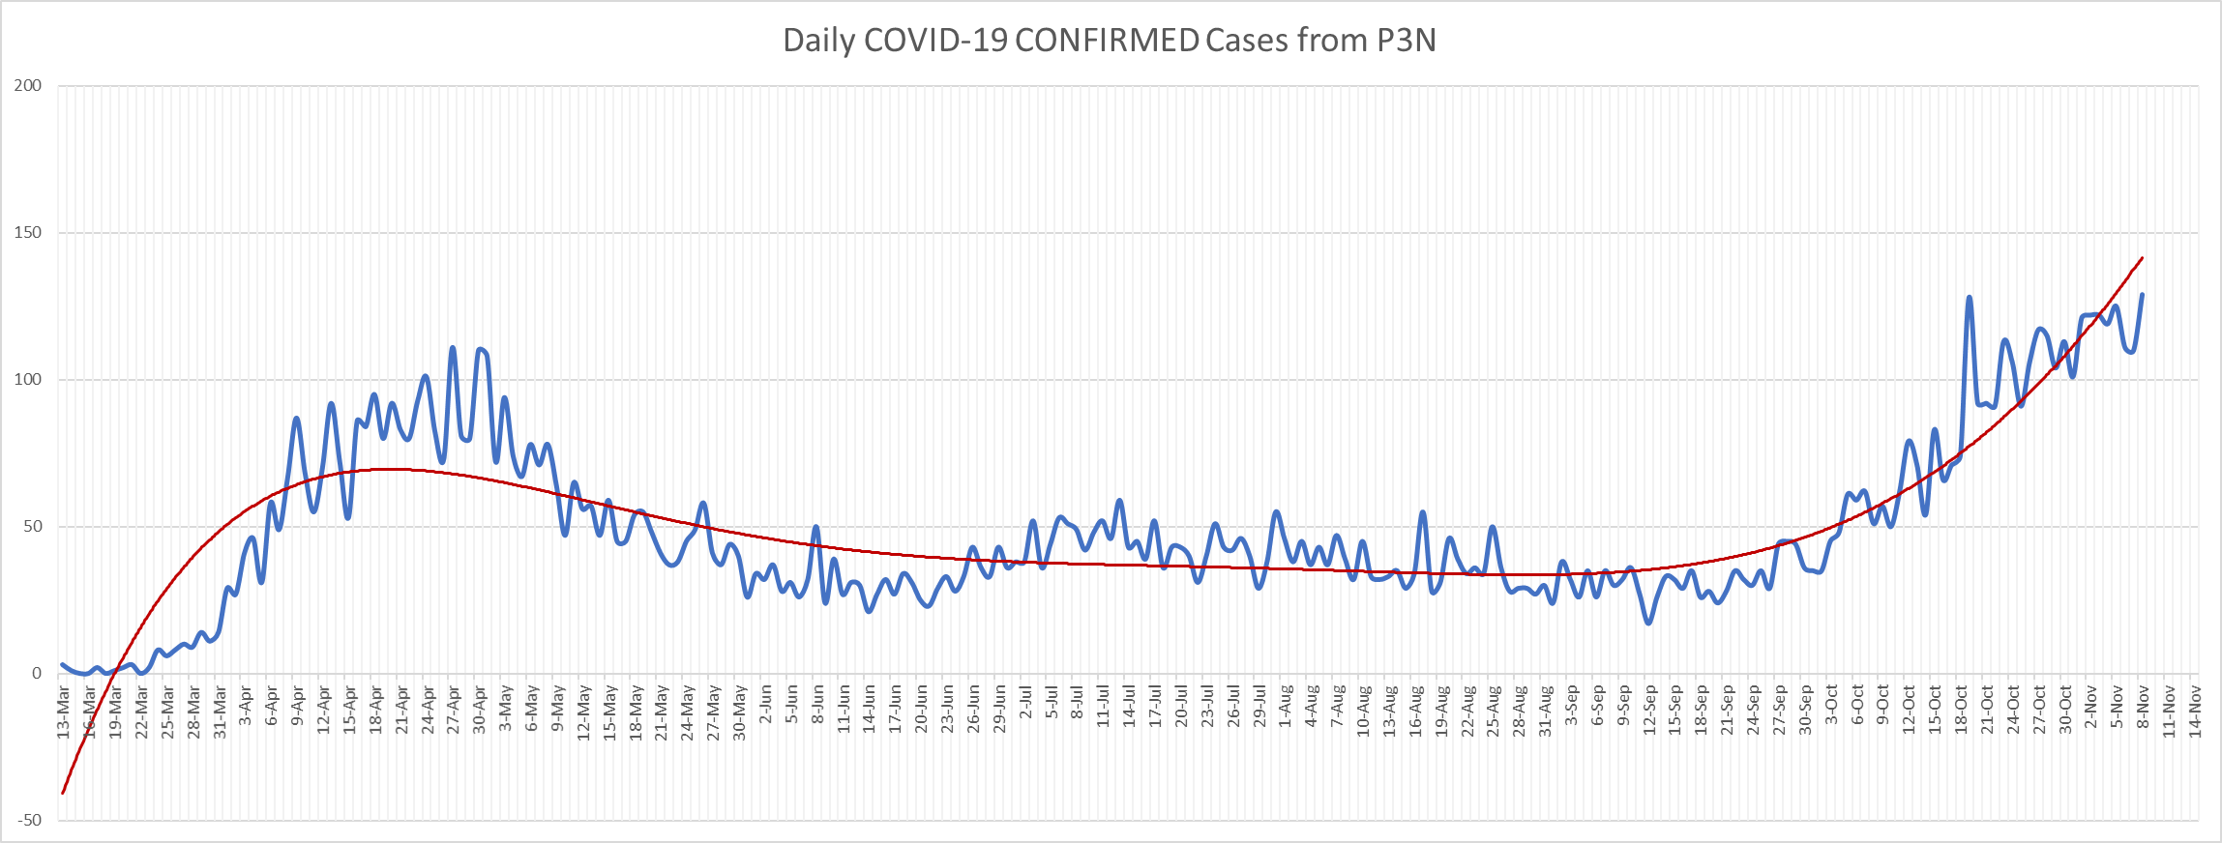
P3N ADT COVID-19 Surveillance

Slide 45
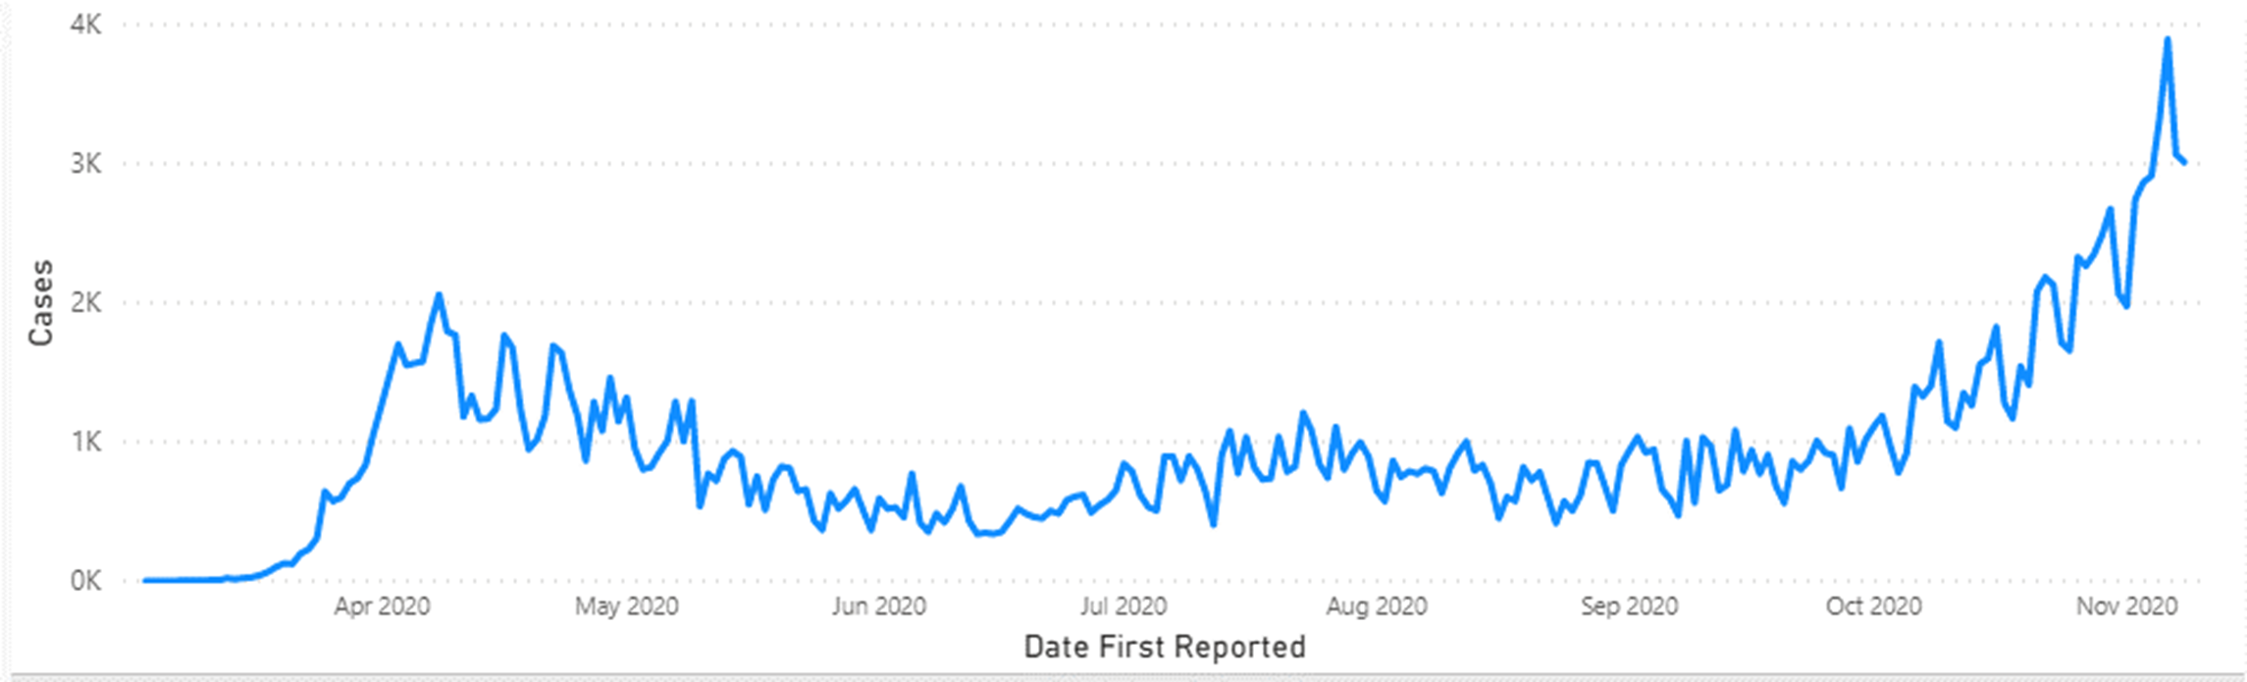
DOH COVID-19 Cases
FOR COMPARISIN WITH DEPT. OF HEALTH CORONAVIRUS (COVID-19) WEBSITE
https://www.health.pa.gov/topics/disease/coronavirus/Pages/Coronavirus.aspx
November 8, 2020 - 12:00 p.m. Update

Slide 46
HIE Trust Community Committee
  Keith Cromwell
  Program Manager
  Central PA Connect Health Information Exchange

Slide 47
HIE Trust Community Committee
Chairperson:
  Kimberly A. Chaundy, Sr. Director HIE & Interoperability, KeyHIE
HIE Trust Community Committee Meeting Summaries:
  HIETCC Meeting Agenda, October 14, 2020
  HIETCC Meeting Minutes, September 9, 2020
  HIETCC Meeting Minutes, August 5, 2020
Next HIE Trust Community Committee Meeting:
  November 18, 2020

Slide 48
HIE Trust Community Committee
Topics covered/discussions w/continued focus on:
HITECH – FFY 2020 and 2021 Projects
Interstate Data Sharing – CRISP Connectivity
Discrete Documents
  Sharing Discrete Clinical Documents Across P3N
  Transparency of HIO Member Submissions to Clinical Data Repository
  Normalization of Document Naming Conventions
PDMP – Onboarding to RxCheck PDMP through Public Health Gateway
Encounter Notification – P3N ADT Service Inpatient Expansion
Care Coordination – Office of Long-Term Living Explained Payer Data Needs
Super Protected Data – Code Set Updated
COVID-19 – Coronavirus Related Activity
P3N Certification Package – Annual Review Completed with no Changes
Electronic Case Reporting – Registry Development

Slide 49
Mount Nittany Exchange Overview
  Doug Carroll
  Director of Information Services
  Mount Nittany Health

Slide 50
PA eHealth Draft Annual Report Review
  Christy Stermer
  Program and Fiscal Manager
  Pennsylvania eHealth Partnership Program
  Office of Medical Assistance Programs
  Pennsylvania Department of Human Services

Slide 51
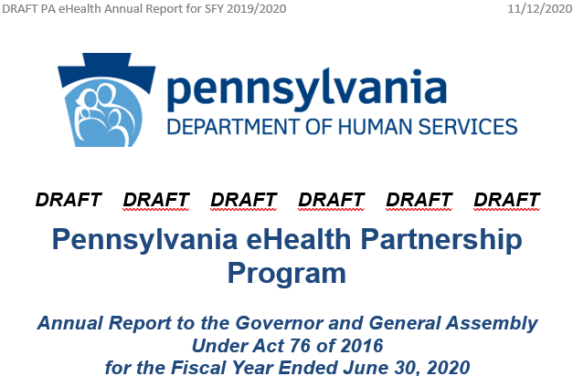
Draft Annual Report

Slide 52
Draft Letter from the Secretary
  Fiscal Year 2019-2020 was marked by the COVID-19 Public Health Emergency, which provided unique opportunities to leverage the investments Pennsylvania has made in regional and statewide health information. Beginning in March 2020, PA eHealth began facilitating weekly meetings of the five Pennsylvania Patient and Provider Network (P3N) Certified Health Information Organizations (HIOs) to learn from each other’s experiences and to respond to data calls from the Pennsylvania Department of Health (DOH). The five HIOs agreed to allow PA eHealth to use the P3N Encounter Notification Service (ENS) data for daily COVID-19 reports of exposed and confirmed COVID-19 cases to DOH. In order to speed up the reporting of COVID-19 test results to DOH, many additional providers onboarded to the Public Health Gateway (PHG) for Electronic Lab Reporting through their HIO.

Slide 53
Draft Letter from the Secretary (cont.)
  During this year we added the Pennsylvania Department of Corrections to the P3N and Medical Assistance Fee-For-Service Case Managers began accessing the P3N for immediate access to health records of their clients. PA eHealth also made great progress toward enriching services offered by the statewide health information exchange (HIE). DHS leveraged managed care contracts, value-based payment programs, and federal Health Information Technology for Economic and Clinical Health Act (HITECH) funding to substantially increase provider and payer participation in HIE in Pennsylvania.
  This report provides a summary of PA eHealth’s activities and accomplishments, a summary of receipts and expenditures, a list of contracts entered, and a summary of reportable breaches.

Slide 54
1. Leveraging state services and resources
PA eHealth supported production connections to four Department of Health public health registries and one Department of Human Services (DHS) registry.
PA eHealth onboarded 3 HIOs to the Prescription Drug Monitoring Program (PDMP) through the Public Health Gateway (PHG) and Lancaster General Health began using RxCheck PDMP gateway.
PA eHealth continued work with IBM in developing a robust provider directory leveraging data from DHS, Department of Health (DOH), Department of Aging (PDA), Department of Drug and Alcohol Programs (DDAP), Department of State (DOS) and the Centers for Medicare and Medicaid Services (CMS).

Slide 55
2. Expanding coverage area of exchange
In September 2019, PA eHealth completed onboarding the Pennsylvania Department of Corrections’ (DOC) electronic health record (EHR) system, which covers all 25 state correctional institutions, to the P3N.
DHS awarded $4.45 million in HIE Onboarding Grants to connect 62 inpatient (including 52 nursing homes) and 53 ambulatory providers to P3N Certified HIOs.

Slide 56
3. Increasing bi-directional access to PHG
DHS awarded $65,000 to HIOs to support their efforts to connect their member organizations (MOs) to public health registries through PHG.
In the last week of June 2020, DOH processed more than 50,000 PA-SIIS messages through the PHG and more than 140,000 total DOH PHG messages were processed that week.
All five P3N Certified HIOs achieved production status with one or more PHG registries and all five have production connections to the Electronic Lab Registry (eLR).
Thirty HIO MOs are reporting the results of COVID-19 tests to eLR through the PHG.
PA eHealth also provided funding to DOH to support ongoing development of the PHG and registries, including Electronic Case Reporting (eCR).

Slide 57
4. Improving data quality through analytics
Worked with the National Center for Quality Assurance and P3N HIOs to explore certification strategies to leverage their clinical data repositories for payer members’ clinical quality measure analytics to replace or supplement paper chart reviews.
Provided all HIO demographic data fill-rate reports to HIOs on a monthly basis and provided a weekly report to each HIO that identifies individual patient registrations with missing demographic information.
Patient matching or linking has steadily increased from 21.6% in June 2019 to 30.5% in June 2020.

Slide 58
5. Enhancing the types of data exchanged
PA eHealth used the P3N ENS data for daily COVID-19 reports of exposed and confirmed COVID-19 cases to DOH.
Three of the P3N Certified HIOs began sharing real-time inpatient (IP) ADT information with the P3N in addition to emergency department (ED) ADTs so that a patient’s care team can be alerted to the patient’s ED and IP encounter even if the patient is in a different HIO.
Began collecting opioid use disorder (OUD) Continuity of Care Documents (CCD) in the DHS electronic clinical quality measure (eCQM) registry for select Medicaid OUD ED encounters.
Three P3N HIOs began sharing discrete clinical documents in response to P3N queries.
The new P3N Advance Directive Registry went into production in June 2020 to provide a statewide centralized registry available to healthcare providers in Pennsylvania.
Awarded funding to the Allegheny County Health Department (ACHD) for open-source population analytics and visualization software…

Slide 59
6. Updating the certification program
The P3N HIE Trust Community Committee reviewed the P3N HIO Certification Package and added a new Downtime Notification Policy effective January 1, 2020.
HIETCC also adjusted HIO insurance requirements to align with current insurance industry practices and added new P3N services.
PA eHealth worked with DHS, the five HIOs, and DOC to update the coding used to prevent super-protected information from being shared across the P3N.

Slide 60
7. Offering expanded system access
Medicaid FFS Case Managers began using the P3N Portal to improve the timeliness and completeness of their care plans for new and vulnerable enrollees.
PA eHealth has been in discussions with the DOH Women Infant and Children (WIC) Program to provide their pediatric nutritionists with access to the P3N Portal to support a new telehealth model.
PA eHealth awarded onboarding grant funding for the Department of Aging’s PACE Program to connect to a P3N Certified HIO.

Slide 61
8. Facilitating inter-state exchange
PA eHealth engaged in discussions with Maryland, West Virginia, and Delaware on options for alerting a patient’s home care team when the patient crosses state boundaries for health care services.
Secured a no-cost contract change request with IBM to onboard the Chesapeake Regional Information System for our Patients (CRISP) to the P3N ADT Service.

Slide 62
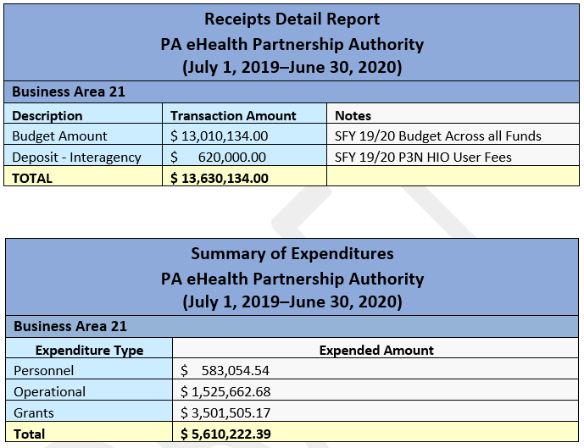
Summary of Receipts and Expenditures

Slide 63
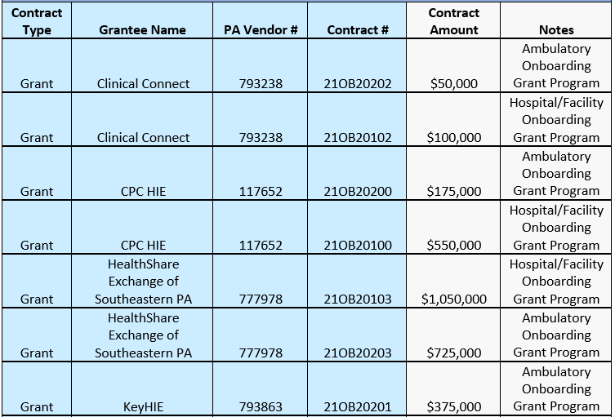
List of Contracts

Slide 64
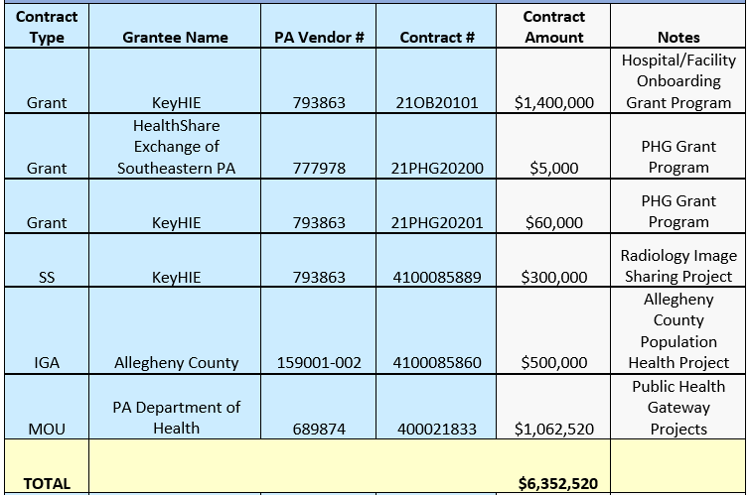
List of Contracts (cont.)

Slide 65
Reportable Security Breaches
The Pennsylvania Patient and Provider Network (P3N) experienced no reportable security breaches in 2019-2020.

Slide 66
Advisory Board Vice Chair Election
Pennsylvania eHealth Partnership Advisory Board Bylaws
  Section 4. Vice Chairperson.
  The Advisory Board members shall annually elect, by a majority vote of the members, a vice chairperson from among the appointed members of the Advisory Board, who shall serve as acting Chairperson in the absence of the Chairperson or if there is a vacancy in said Chairpersonship.
Vice Chairperson election to be held during the November 13, 2020 Advisory Board Meeting for Calendar Year 2021.
Current Vice Chair, Mr. Paul McGuire, accepted his nomination during the August 14, 2020 Advisory Board Meeting.
Nominations for Vice Chairperson are open until the election.

Slide 67
2021 Advisory Board Meeting Dates
  Friday, February 12, 2021 – Skype Meeting from 10 a.m. - 12 noon
  Friday, May 7, 2021 – H&W Building, Room 327 from 10 a.m. - 2 p.m.
  Friday, August 6, 2021 – H&W Building, Room 327 from 10 a.m. - 2 p.m.
  Friday, November 5, 2021 – H&W Building, Room 327 from 10 a.m. - 2 p.m.

Slide 68
Public Comment
  Name of submitter for written comment submission acknowledged by chair
  Verbal comment (3 minutes per commenter)
For further information:
http://dhs.pa.gov/ehealth
PA eHealth Partnership Advisory Board:
https://www.dhs.pa.gov/providers/Providers/Pages/Health%20Information%20Technology/eHealth-Advisory-Board.aspx
P3N HIO Certification Package:
https://www.dhs.pa.gov/providers/Providers/Pages/Health%20Information%20Technology/HIO-Connection.aspx
P3N Certified Health Information Organizations (HIO) Information:
https://www.dhs.pa.gov/providers/Providers/Documents/Choose%20your%20HIO.pdf

