Slide 1
CRISIS 101
A LIHEAP Vendor’s Guide to Submitting Crisis Claims through PROMISe™ LIHEAP 2019/20 Season
1

Slide 2
Crisis dates and data entry
The Crisis component of LIHEAP is available for households who are in a home heating emergency during the LIHEAP Season from:
Friday, November 1, 2019 – Friday, April 10, 2020
Fuel deliveries or utility termination resolutions that are paid in whole or in part with LIHEAP Crisis funds must be data-entered by vendors into a claim management system called PROMISe™ to initiate payment.
NOTE: When an emergency is resolved with a combination of LIHEAP Cash and Crisis grants, vendors will identify any credits (such as the LIHEAP Cash grant) by writing them on the documentation and subtracting the credits from the total delivery or termination. Submit the difference in PROMISe™ to be paid with Crisis funds. Do not prepare separate delivery tickets associated with the Cash and Crisis grants as we want to ensure that the customer received the lowest price based on the total quantity delivered.

Slide 3
Benefit amounts
The amount of a Crisis pledge is based on the minimum amount needed to resolve the crisis. For deliverable fuels, the amount needed to resolve the crisis is defined as the amount of fuel needed to fill the tank as long as the cost does not exceed the season maximum. For utilities, it is the minimum amount needed to prevent termination. The 2019/20 season maximum for Crisis is $600 per household.
A household may receive multiple Crisis authorizations during the season, but the total amount of all Crisis grants issued for the season may not exceed $600.
Each time a Crisis is authorized for a solid/liquid fuel, the CAO will pledge an ‘up to’ amount.
A Crisis Authorization # is good for a one time delivery, pickup or utility-shutoff situation.
Crisis claims must be submitted in the exact dollar amount, not rounded. (i.e., if fuel was delivered for $598.97, the claim should be submitted for exactly that amount, not $600).
NOTE: Do NOT initiate a claim in PROMISe before making the delivery!

Slide 4
PROMISe™ Log On and Password
To process LIHEAP Crisis claims in PROMISe™, a vendor designates a primary PROMISe user. This user must register in PROMISe™ using the 13-digit Vendor ID and establish a password. See Desk Guide in PROMISe.
Users with access to more than one Vendor ID or service location must set up log on/passwords at each location.
The primary PROMISe user may set up alternate users to access LIHEAP Vouchers and process Crisis claims. See Desk Guide in PROMISe.
For help with Password Resets call 1-800-248-2152
Crisis Claims must be entered in PROMISe™ on a computer using Internet Explorer at the web address: http://LIHEAP.dpw.state.pa.us
NOTE: The PROMISe website does not support data entry using Mozilla Firefox or Google Chrome.

Slide 5
Crisis Authorizations
The County Assistance Office (CAO) must contact the vendor to authorize a Crisis grant before fuel is delivered or picked up.
Fuel deliveries or fuel pickup made prior to CAO approval will not be paid.
Vendors can help their LIHEAP customers who are on automatic delivery. Let the customer know the date of an upcoming delivery so the customer can contact the CAO to make a request for LIHEAP Crisis. The CAO must contact the vendor to provide a Crisis Authorization Number (#) before the delivery is made.
NOTE: The Authorization number must be 10-digits long and typically start with a zero.
Every approval will be given an ‘up to’ amount and a Crisis Authorization #.
The Authorization number can be seen in PROMISe™ the day after the CAO processes it. The CAO may also be able to provide the vendor with the Crisis Auth #.
NOTE: Contact the LIHEAP Vendor Unit at 1-877-537-9517 if you cannot locate the Auth # in PROMISe
After making a delivery or crediting a customer’s utility account, the vendor must file a Crisis claim via data entry in PROMISe™ and then provide documentation in order to be paid. Documentation can be uploaded on the PROMISe website or faxed or mailed with a system- generated LIHEAP cover sheet.

Slide 6
Accessing PROMISe™
Access PROMISe Via Website http://LIHEAP.dpw.state.pa.us

Slide 7
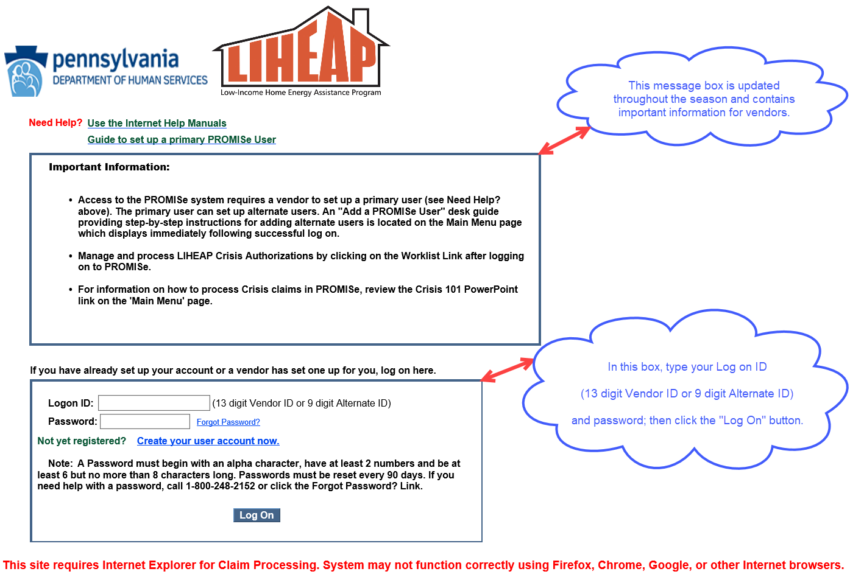
Log On Screen

Slide 8
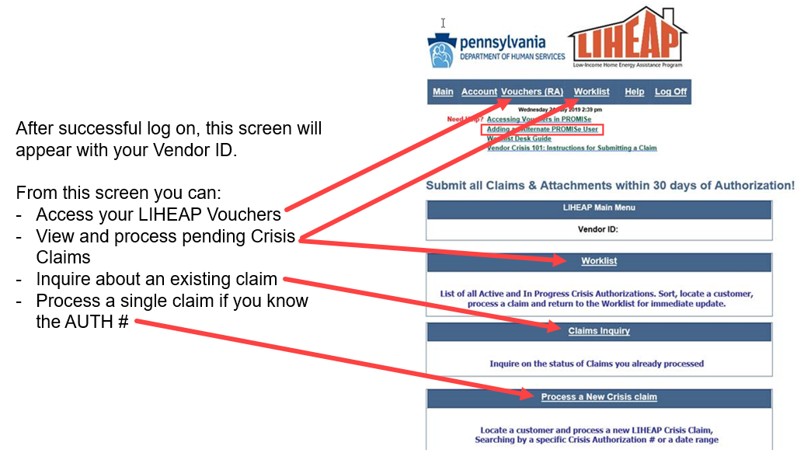
PROMISe™ Main Menu Screen Features:

Slide 9
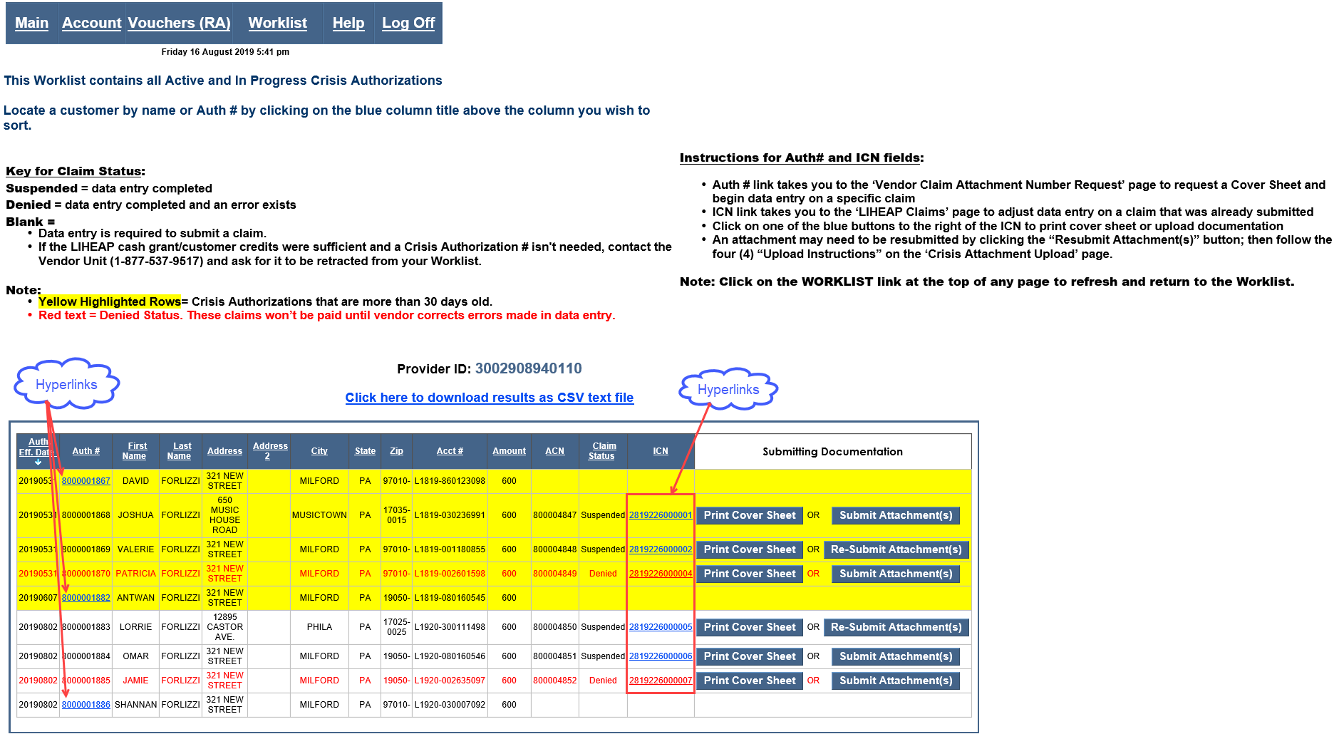
Using the Worklist
The Worklist is a user-friendly tool to process LIHEAP Crisis claims. Sort the Worklist by clicking a column heading above the blue task bar. Navigate the Worklist via hyperlink to process a claim and then return to a refreshed Worklist to locate and process another LIHEAP Crisis claim. When data entry and documentation meet in the claim system, the claim goes to PAID status and drops off your Worklist. See Worklist Desk Guide on the Main Menu.

Slide 10
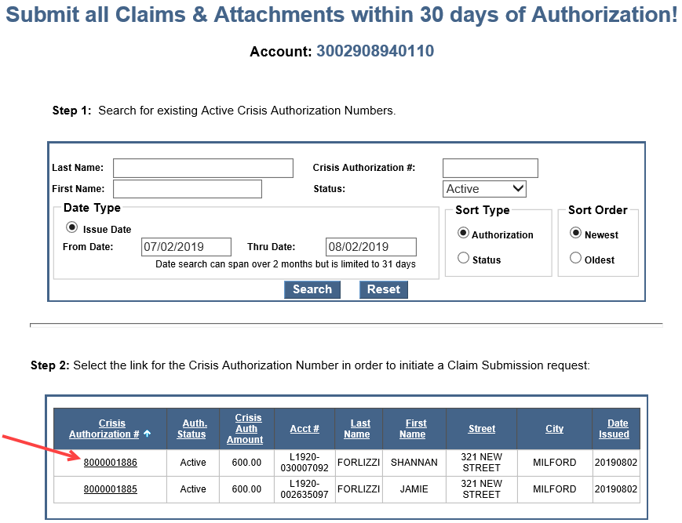
The Express Claim Processing Box
The Express Claim Processing box is still available if you want to process just one claim.
Use one of these search criteria:
Crisis Authorization Number and
“Active” status.
First name, last name, 30-day date range and “Active” status.
30-day date range and “Active” status.
When a result is displayed, click the link on the Crisis Authorization # for the customer whose claim you want to process.

Slide 11
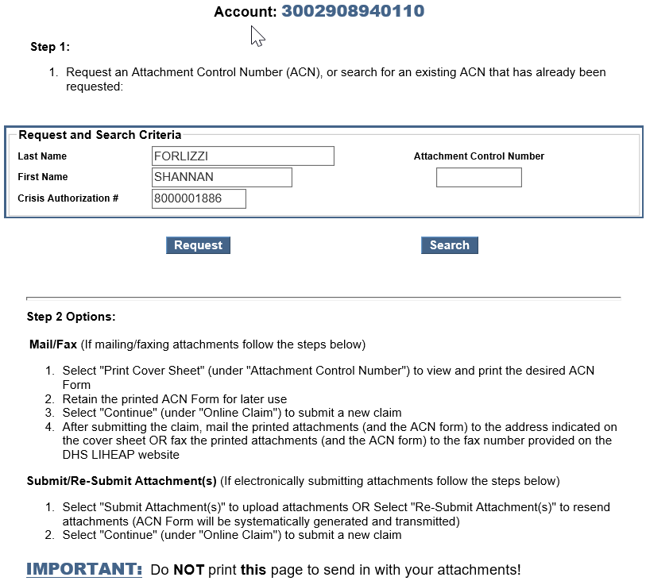
Attachment Control Number
Request an Attachment Control Number (ACN) or search for an existing ACN.
IMPORTANT:
An ACN may only be requested one (1) time per authorization.
After an ACN has been requested, subsequent activity on this page must be with the search button.

Slide 12
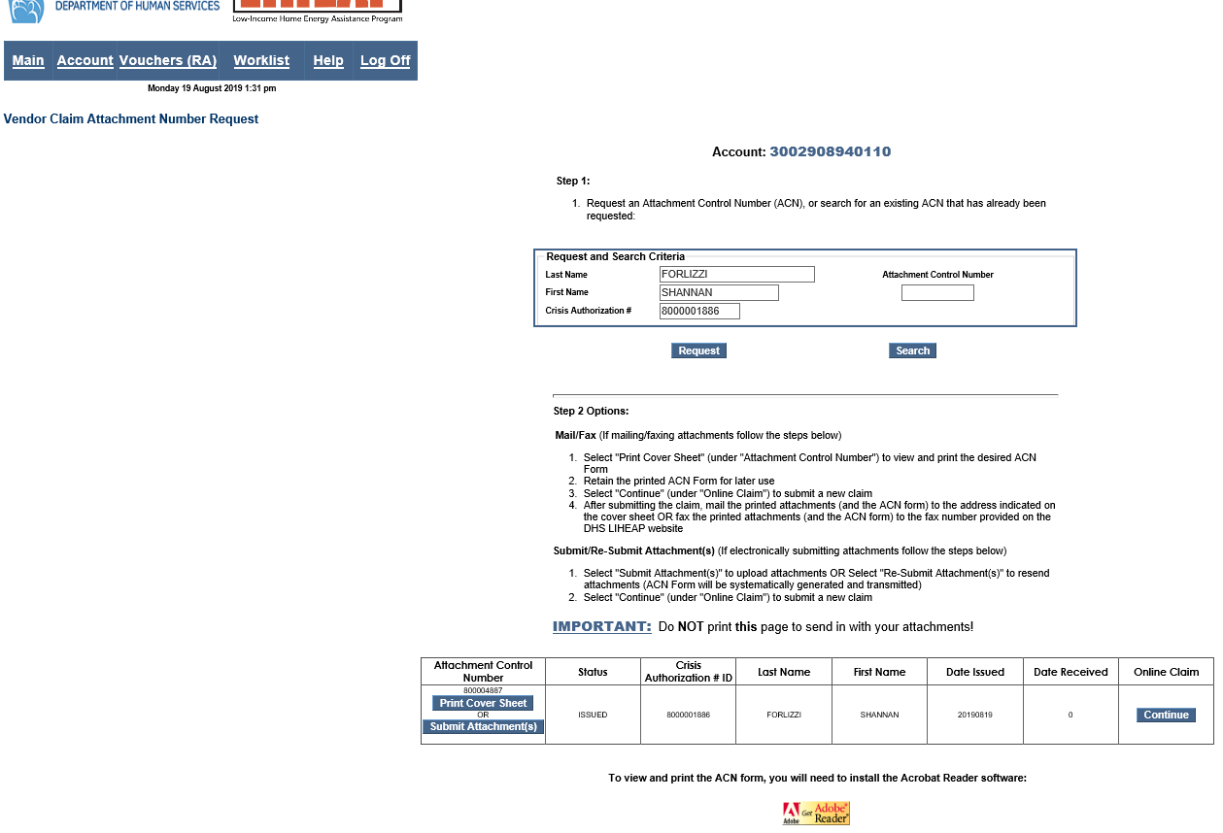
Providing documentation
The customer’s last name on documentation must be the SAME as the recipient last name displayed in PROMISe (including spelling) or the claim won’t be paid. If the last names do not match exactly (including spelling), be sure to write either the recipient’s last name OR the ACN OR all 10 digits of the Crisis Auth # on the documentation.
Requesting an ACN gives you the option to print the LIHEAP Cover Sheet or Upload documentation.
Only print the cover sheet if you plan to mail or fax documentation associated with this customer’s Crisis Authorization Number.
Attaching documentation via Upload does not require a cover sheet.
NOTE: If you receive LIHEAP Vouchers via SeGOV (MOVEiT), you have the option to upload Crisis claims through this process.

Slide 13
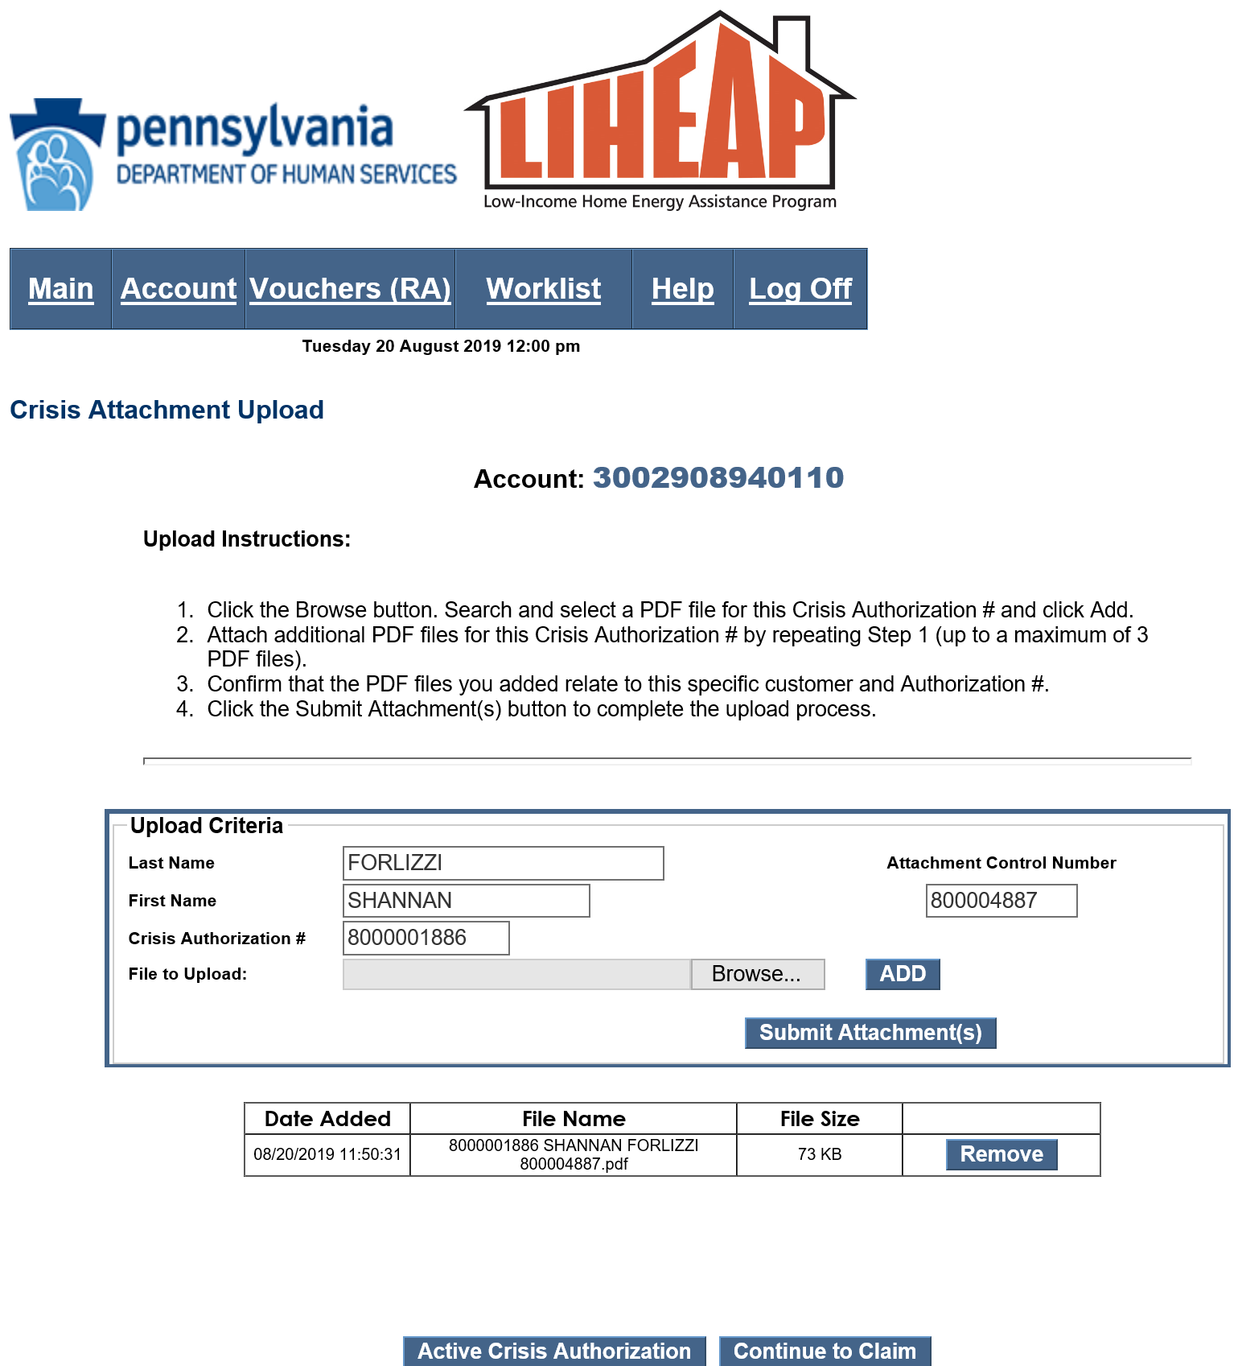
Uploading documentation into PROMISe
Uploading allows you to completely process a claim with one effort without having to send documentation by fax or mail.
Follow these steps to Upload documents:
Scan and store delivery tickets/utility bills into a current season file folder on your computer or flash drive. Name the PDF file by the Authorization number and name of the customer receiving the Crisis benefit.
Example: 123123123MaryJones.pdf
Locate files(s) on your computer or flash drive and add PDF files one at a time (up to 3 PDF files) by clicking the ADD button. Each file name must be unique.
Review files that appear under the Upload Criteria
box to verify that the files you added are correct.
Click the Submit Attachment(s) For Processing button to complete the upload process.
The message “Successfully Uploaded attachments” will appear in red to let you know they were submitted.
Click the “Continue to Claim: button to navigate to the Claim Submission page. Skip to Slide 16

Slide 14
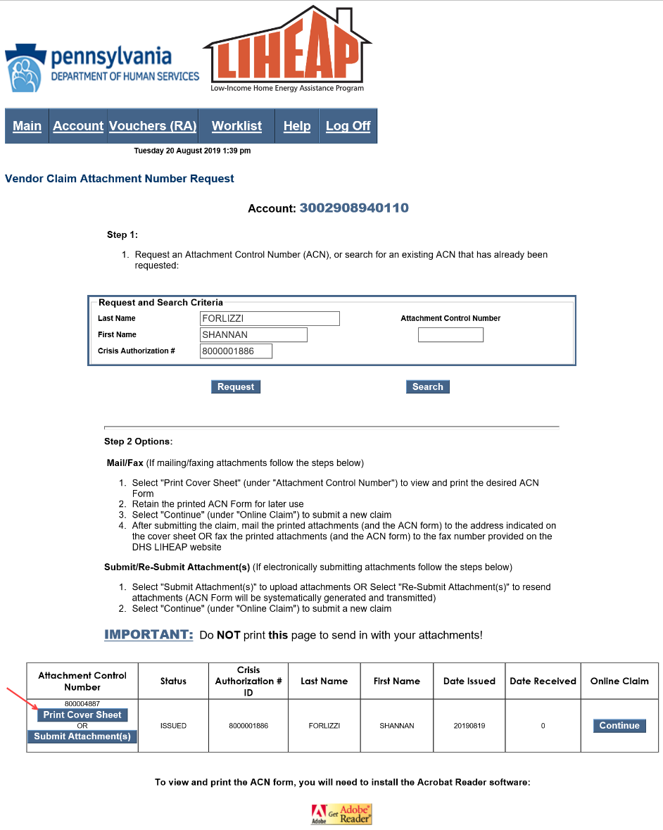
Sending documentation by mail or fax
You must click “Print Cover Sheet” if you plan to fax or mail the documentation for a Crisis Authorization. The Upload function does not require a coversheet.
PROMISe fax lines are dedicated to the Crisis claims attachment processing only. ONLY fax PROMISe cover sheets and trip tickets/termination notices. The PROMISe cover sheet must always be the first page, immediately followed by the corresponding trip ticket. Multiple claims can be sent in one fax transmission up to 30 pages. NEVER include your company’s fax cover sheet.
PROMISe™ Fax:
• 717-207-7994 or
• 717-207-7997
PROMISe™ Mail:
DHS – LIHEAP Crisis Claims
PO Box 69028
Harrisburg, PA 17106

Slide 15
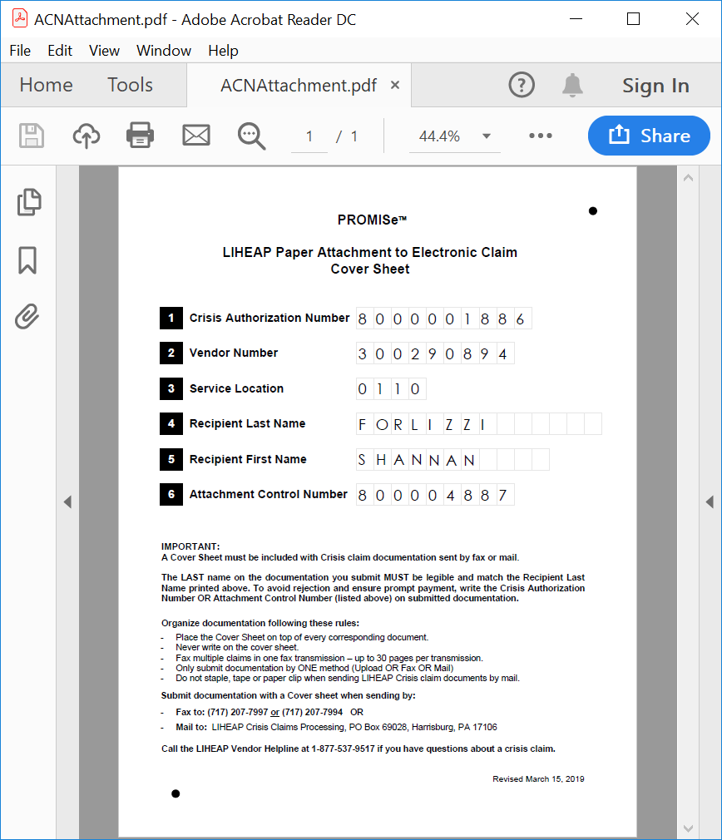
Manually Submitting Verification
Click ‘Print Cover Sheet’ will display the LIHEAP Cover Sheet specific to the customer’s Crisis Auth #. This form must accompany documentation submitted by mail or fax.
The LIHEAP Cover Sheet is system- completed with the recipient’s name and numbers appearing in blocks.
If the blocks are not pre-populated, ensure that your Adobe Reader is updated. If the problem continues, contact the LIHEAP Vendor Unit.
IMPORTANT: Never write on the cover sheet.
REMEMBER: the last name on your documentation must be exactly the same as the last name on the LIHEAP Cover sheet. If it is not, write the last name or ACN or 10-digit Auth # on the documentation.

Slide 16
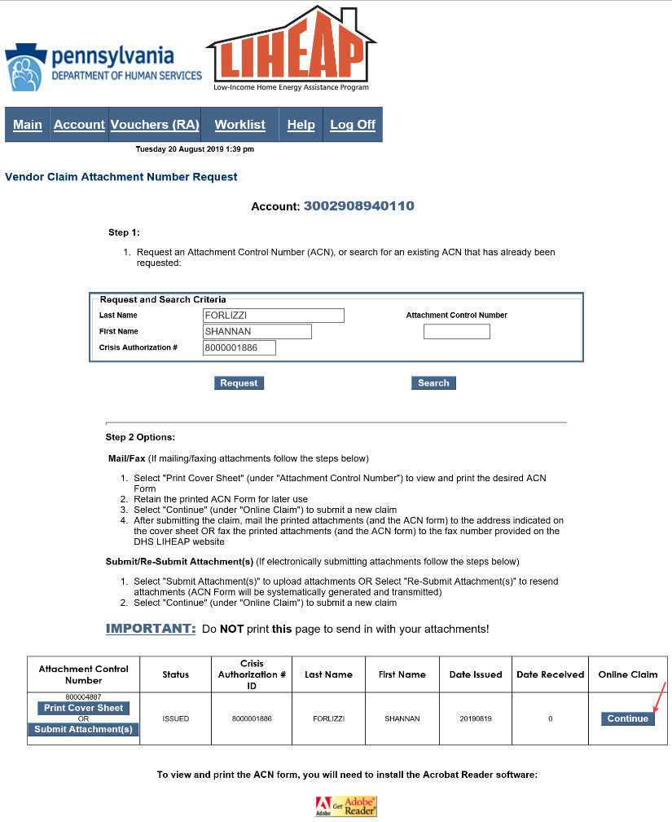
Continue to Claim Submission
After printing the LIHEAP Cover Sheet you return to this page. Click Continue.

Slide 17
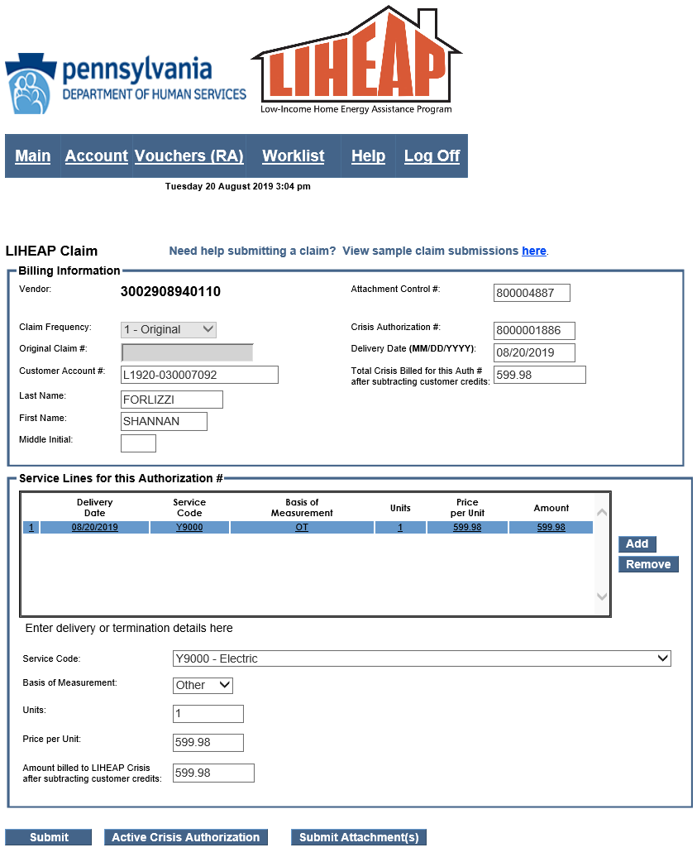
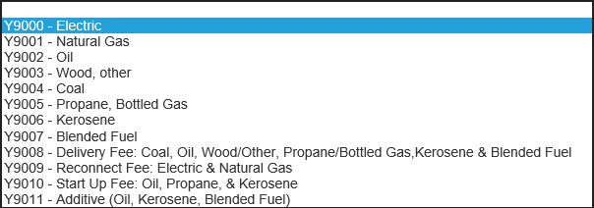
Submitting a Crisis claim
Complete this screen by adding service codes to explain cost of the delivery/ termination.
At this time, customer credits are not recorded in PROMISe. Customer credits must be evaluated, however, and subtracted from the total amount of the delivery or termination. The subtraction must be shown on the documentation that is sent in for that Auth #. The amount entered on PROMISe is ONLY the amount you wish to be paid in Crisis funds.
PLEASE NOTE:
Select Service line for heating type
Verify that the customer’s name matches the account number listed.
You can correct the “Customer Account #” If you do, the correct number will convey and be displayed on the payment voucher.
Do not round up or enter more $ than was delivered minus the cash grant.
The total amount billed in PROMISe to be paid in LIHEAP Crisis funds may not exceed the season limit.

Slide 18
Submitting a Crisis claim
Click the submit button after completing all fields on the claim submission page.
This message should appear.

Slide 19
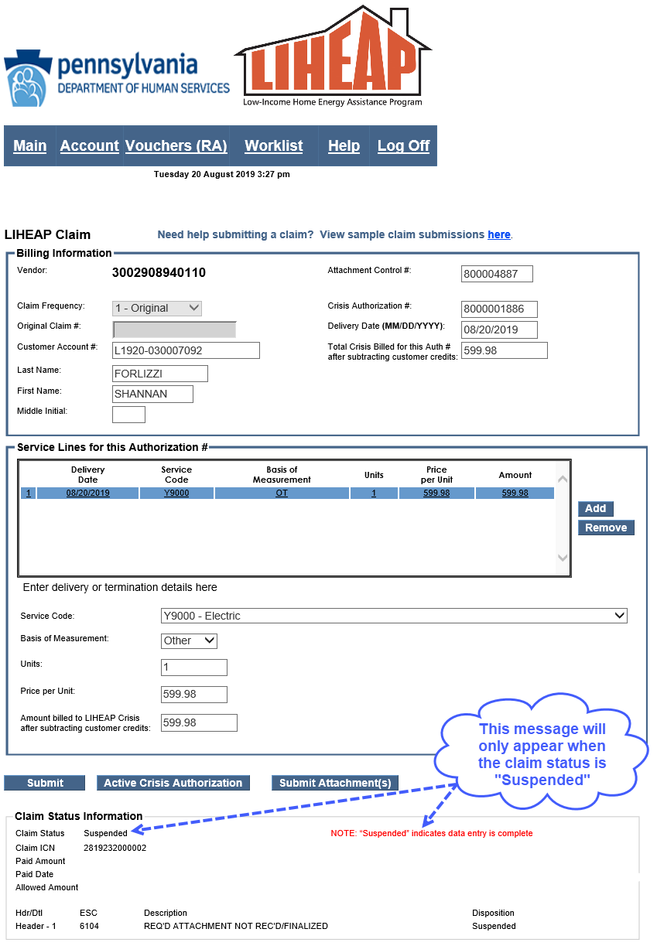
Submitting a Crisis claim
This screen will be displayed.
Upon successful data entry, the Claim status should state “Suspended.”
Payments for Crisis Claims submitted with uploaded documents will typically be paid by Treasury within 3-4 weeks.
If the Claim Status does not say “Suspended”, review your data entry for errors. Contact the LIHEAP Vendor Helpline at 877-537-9517.
If you want to submit a claim for another Crisis Authorization, return to the Worklist by clicking the link in the blue task bar at the top of the screen.

Slide 20
Need Additional Information?
Help with PROMISe password Resets: 1-800-248-2152
Desk Guides that explain how to access payment vouchers, how to use the Worklist, and how to add an alternate PROMISe user are all located on the PROMISe main menu page
The LIHEAP Vendor Website contains valuable information:
http://www.dhs.pa.gov/provider/informationforliheapvendors
Contact the LIHEAP Vendor Helpline by phone or email Monday – Friday from 8:00 – 4:00
Phone: 1-877-537-9517 Email: RA-LIHEAPVendors@pa.gov

