Slide 1
Financial Management Services (FMS) Stakeholder Meeting FMS Vendor Transition for Self-Directed Services
Community HealthChoices
April 1, 2022

Slide 2
Agenda
FMS Transition
Presented by your Community HealthChoices MCOs: AmeriHealth Caritas PA CHC, Keystone First CHC, PA Health & Wellness, Inc., UPMC
AND Tempus Unlimited
Transition Information
Tempus Call Center
EVV Training
Questions

Slide 3
Transition Information

Slide 4
Tempus Transition Packets
Transition Packet Statistics
70% of CLE packets and 61% of DCW packets were returned
Transition packets were re-mailed to all individuals who have not returned their packet
Transition packets mailed to new CLEs and DCWs who recently became active
If you have not received a transition packet, contact Tempus
Transition Packet Communication
Tempus communication to CLEs and DCWs:
Transition packet received and processed
Transition packet has not been received and was re-mailed
Transition packet mailed
Tempus is contacting CLEs with transition packets received and needing corrections

Slide 5
Tempus Transition Packets
Alternate Languages
For transition packet language translation needs, please contact Tempus
Contact Tempus at: 1-844-983-6787 or email PAFMS@tempusunlimited.org
If you have not received a packet or want to check if your packet has been received:
Contact Tempus at: 1-844-983-6787 or email PAFMS@tempusunlimited.org
Contact your Service Coordinator

Slide 6
Tempus Transition Timeline Extension
EVV enrollment (“Welcome!”) emails scheduled to go out starting March 28.
New Enrollments with Tempus will begin around May 7, 2022
Time Entry
First day for Payroll Schedule A to submit time to Tempus is June 5
First day for Payroll Schedule B to submit time to Tempus is June 12
How is this extension being communicated to CLEs and DCWs?
Broadcast by email, text and voice message
Letters were sent to CLEs
Notification on the Tempus PA website and on MCO websites
Service Coordinators are aware of extension and communicating to Participants

Slide 7
Payroll Timeline
Tempus will issue checks on or after July 1, 2022
Payroll schedules for participants will remain the same
Participants on Schedule A with PPL
Services beginning with pay period 6/5–6/18/2022 will be submitted to Tempus
Payment date 7/1/2022
The payroll period of 6/19-7/2/2022 will be paid on 7/8/2022
Check dates will be every 2 weeks thereafter (7/22; 8/5; 8/19; etc.)
Participants on Schedule B with PPL
Services beginning with pay period 6/12–6/25/2022 will be submitted to Tempus
Payment date 7/1/2022
Check dates will be every 2 weeks thereafter (7/15; 7/29; 8/12; etc.)

Slide 8
Tempus Call Center

Slide 9
Tempus Call Center
Tempus call back feature is now live in the call center
Tempus is continuing to hire and train staff
Average time in queue is below 5 minutes
Goal is to maintain below 2-minute average queue time
Eventual goal is 85% of calls answered in 30 seconds or less

Slide 10
EVV Training

Slide 11
Timesheet Submission & Approval Process
Every CLE and DCW will need to use Electronic Visit Verification (EVV) to submit timesheets
Tempus EVV process changes include:
New app to clock in and clock out
New process for DCWs to review and submit time to CLE for approval
New approval process for CLEs
New phone system (“IVR”) option for DCWs and CLEs to record and approve time
Every Common Law Employer and Direct Care Worker will need to be trained on the EVV system!

Slide 12
Timesheet Submission & Approval Process
Important information regarding Tempus user accounts:
All CLEs and DCWs must have a unique email address
CLEs and DCWs must provide an email address
How to provide email address
Visit https://pa.tempusunlimited.org/ and click on the email survey link, answer the questions, and submit the form
How to obtain an email address
“How to” videos explaining how to get free email accounts with Google, Microsoft and Yahoo! on Tempus website
What happens if you don’t have internet or unable to use email:
You can use the phone system to clock time and approve time
The phone system is called “IVR”. IVR stands for Interactive Voice Response
CLEs can use IVR to approve time – this can be done from any phone
DCWs must use the Participant’s land-line in order to use IVR for time entry
You will receive a document with information on how to use IVR

Slide 13
Timesheet Submission & Approval Process
Tempus began to host multiple training sessions for CLEs and DCWs on January 10, 2022.
Training is conducted through:
Online WebEx Sessions
In-person Sessions will be scheduled closer to the new “go live”
Training Videos are posted on the Tempus website
How-to Guides are posted on the Tempus website
Training topics include:
How to obtain a user account to access the Tempus EVV app and Tempus portal
How to download and use the Tempus EVV app to clock in and clock out
How to use the Tempus portal to submit time worked, edit a shift and create a manual entry
How to use Tempus phone system to clock in and clock out
How to approve or reject a shift
How to use the Tempus portal to view timesheet and payment information

Slide 14
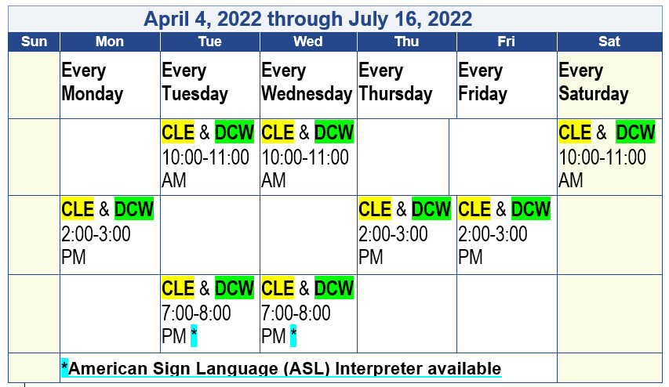
Timesheet Submission & Approval Process
Tempus is hosting 60-minute Online WebEx sessions through 7/16/2022 for CLEs and DCWs to learn how to submit and approve time worked.
Login Information included in the monthly communication to CLEs and posted to the Tempus website at https://pa.tempusunlimited.org/.

Slide 15
Questions?

