Slide 1
OLTL Updates
LTSS Sub-MAAC Meeting
August 13, 2019

Slide 2
Agenda
Transportation
DMVA Workgroups
Community HealthChoices Waiver Renewal
Home and Community-Based Services (HCBS) Settings Final Rule

Slide 3
Transportation in Phase 3 of CHC

Slide 4
Transportation in Phase 3 of CHC
Transportation Summit Takeaways
Evaluate potential areas for innovation to support the informal transportation supports currently being provided by direct care workers.
Evaluate potential flexibilities of the waiver service definitions.
Continue to facilitate discussion to ensure MCOs, providers, and other stakeholders understand the various transportation resources offered through Commonwealth programs.
Increase communication to service coordinators regarding the role of the transportation brokers in CHC.

Slide 5
Department of Military and Veteran’s Affairs (DMVA) Workgroups

Slide 6
DMVA Workgroups
Physical Health Services
Financial Issues
Home and Community-Based Services
Facility-Based Services
Behavioral Health
Veteran Homelessness
Incarceration and Hard to Place Cases
Regulations

Slide 7
CHC Waiver Renewal

Slide 8
CHC 1915(c) Waiver Renewal
Timeline
The current waiver expires June 30, 2020.
The waiver will be renewed early with minimal changes with an effective date of January 1, 2020.
A more comprehensive amendment will be completed with a January 1, 2021 effective date.
Why renew early?
To align the waiver with the calendar year as opposed to the fiscal year.
The CHC Agreement and CHC rates are currently aligned to the calendar year.

Slide 9
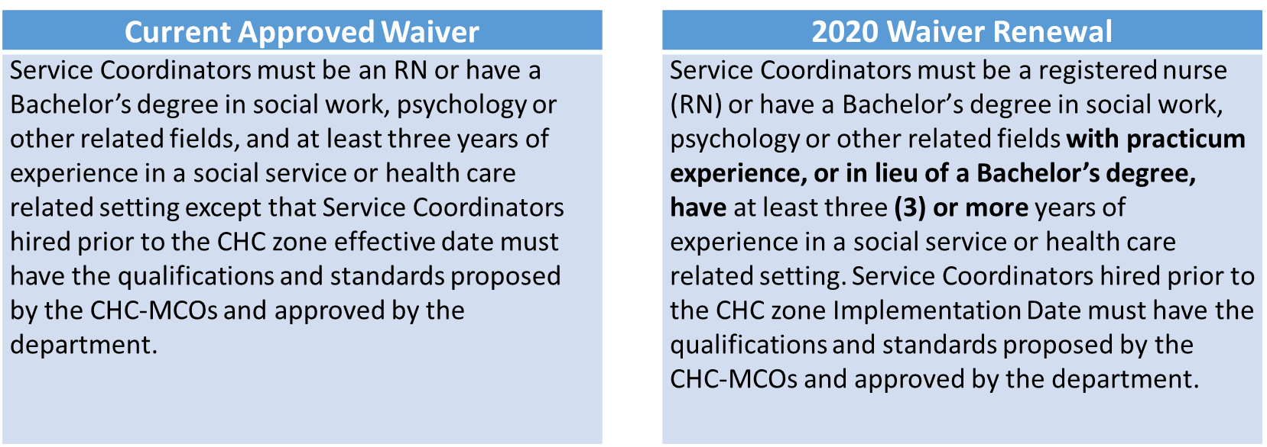
Substantive Changes Being Proposed
Qualifications for Service Coordinators

Slide 10
Substantive Changes Being Proposed
Qualifications for Service Coordinator Supervisors
Current Approved Waiver |  | 2020 Waiver Renewal
Service Coordinator supervisors must be an RN or have a PA licensed social worker or PA licensed mental health professional with at least three years of relevant experience except that Service Coordinator Supervisors hired prior to the effective date who do not a have a license, 1) must obtain a license within their first year under the new CHC contract in their zone or 2) must have the qualifications and standards proposed by the CHC-MCOs and approved by the department. |  | Service Coordinator supervisors must be an RN or have a Master’s degree in social work or in a human services or healthcare field and three (3) years of relevant experience with a commitment to obtain either a Pennsylvania social work or mental health professional license within one year of hire. Service Coordinator supervisors hired prior to the CHC zone Implementation Date (who do not a have a license) must either: 1) obtain a license within their first year under the new CHC contract in their zone, or 2) have the qualifications and standards proposed by the CHC-MCOs and approved by the department.

Slide 11
Substantive Changes Being Proposed
Emergency Back-Up Plan
Must be included in the Person-Centered Service Plan
Service Definitions for Job Finding, Job Coaching, Employment Skills Development, Career Assessment and Benefits Counseling
Add language that Office of Vocational Rehabilitation (OVR) services are considered to not be available if OVR has not made an eligibility determination within 120 days.
Add language to address when employment services can be provided through the CHC waiver when OVR is operating under a closed order of selection (waiting list).
A participant who has been referred to OVR but does not have an approved Individualized Plan for Employment (IPE) may receive CHC employment-related services.
A participant who has not been referred to OVR may receive CHC employment-related services without a referral to OVR.

Slide 12
Substantive Changes Being Proposed
Service Definition for Residential Habilitation
Modify the number of hours that are defined as a day unit from a minimum of 12 hours to a minimum of 8 hours. This will allow providers to bill for a day if the participant is receiving Residential Habilitation for at least 8 hours in a 24 hour period.
Comprehensive Needs Reassessments
Add to the trigger events for when a CHC-MCO must complete reassessment:
If a CHC MCO identifies that a participant has not been receiving services for 5 or more days, and if the suspension of services was not pre-planned, then the CHC-MCO must communicate with the participant to determine the reason for the service suspension within 24 hours.
After communicating with the participant, if the participant’s health status or needs have changed, then the CHC-MCO must conduct a comprehensive needs reassessment within fourteen (14) days of identifying the issue.

Slide 13
Public Notice and Comment
A Public Notice will be published in the Pennsylvania Bulletin in mid August 2019.
A public comment period for written comments will be open for 30 days after publication of the notice.
Comments from today’s presentation about the CHC waiver renewal, please send to the Department’s resource account: RA-waiverstandard@pa.gov
Use ''CHC Waiver Renewal'' in the subject line.

Slide 14
OBRA Amendment

Slide 15
OBRA Amendment
Will be effective January 1, 2020.
Service Definitions for Job Finding, Job Coaching, Employment Skills Development, Career Assessment and Benefits Counseling will be updated to contain the same language regarding the availability of OVR services as is proposed in the CHC waiver renewal.
Service Definition for Residential Habilitation will be updated to define a day unit as a minimum of 8 hours, identical to the proposed change in the CHC waiver renewal.
A Public Notice will be published in the Pennsylvania Bulletin in late August 2019.
A public comment period for written comments will be open for 30 days after publication of the notice.

Slide 16
HCBS Settings Final Rule

Slide 17
HCBS Settings Final Rule
Initial compliance bulletin (#59-16-14) was issued December 26, 2016.
Draft Heightened Scrutiny bulletin was sent for stakeholder feedback to LTSS SubMAAC on July 15, 2019 and comments were due July 29, 2019.
OLTL appreciates the comments received and will adopt stronger language relating to the on-site reviews.
OLTL will include language on how stakeholders may submit a setting for heightened scrutiny review.

Slide 18
HCBS Settings Final Rule
As part of the Heightened Scrutiny process, OLTL will request stakeholder comment on sites to submit to CMS, and looks forward to comments from this committee on the compliance of those sites.
OLTL will be putting forward sites for Heightened Scrutiny review that are considered out of compliance with the Final Rule but meet the spirit of the rule in many other ways.
OLTL will be working with those providers and stakeholders to compile evidence that demonstrates compliance.

Slide 19
HCBS Settings Final Rule
To date, OLTL has collected the following information:
144 Settings have been assessed and reviewed.
40 sites were found to be in compliance.
51 providers have an approved Corrective Action Plan.
53 sites will receive a Corrective Action Plan.
130 sites were seen and are pending a review by a panel.
Sites reviewed include: Adult Day, Employment Services, Residential Habilitation, and Structured Day.

