Slide 1
Enrollment Updates and Data Review
LTSS Sub-MAAC Meeting
August 14, 2018

Slide 2
Aging Waiver Enrollment Volumes
Aging Waiver New Enrollment Volumes
Month | 2014 | 2015 | 2016 | 2017 | 2018
January | 346 | 474 | 477 | 774 | 867
February | 256 | 463 | 681 | 882 | 946
March | 589 | 628 | 946 | 1,003 | 1,094
April | 573 | 533 | 856 | 942 | 1,138
May | 389 | 402 | 814 | 893 | 1,170
June | 526 | 545 | 857 | 742 | 1,159
July | 484 | 644 | 285 | 789 | 992
August | 498 | 873 | 495 | 1,038
September | 611 | 749 | 538 | 868
October | 594 | 654 | 730 | 1,090
November | 409 | 492 | 867 | 919
December | 483 | 556 | 1,207 | 839
Average | 480 | 584 | 729 | 898 | 1,043
Total | 5,758 | 7,013 | 8,753 | 10,779 | 5,215

Slide 3
Average Number of Day in Enrollment Status

Slide 4
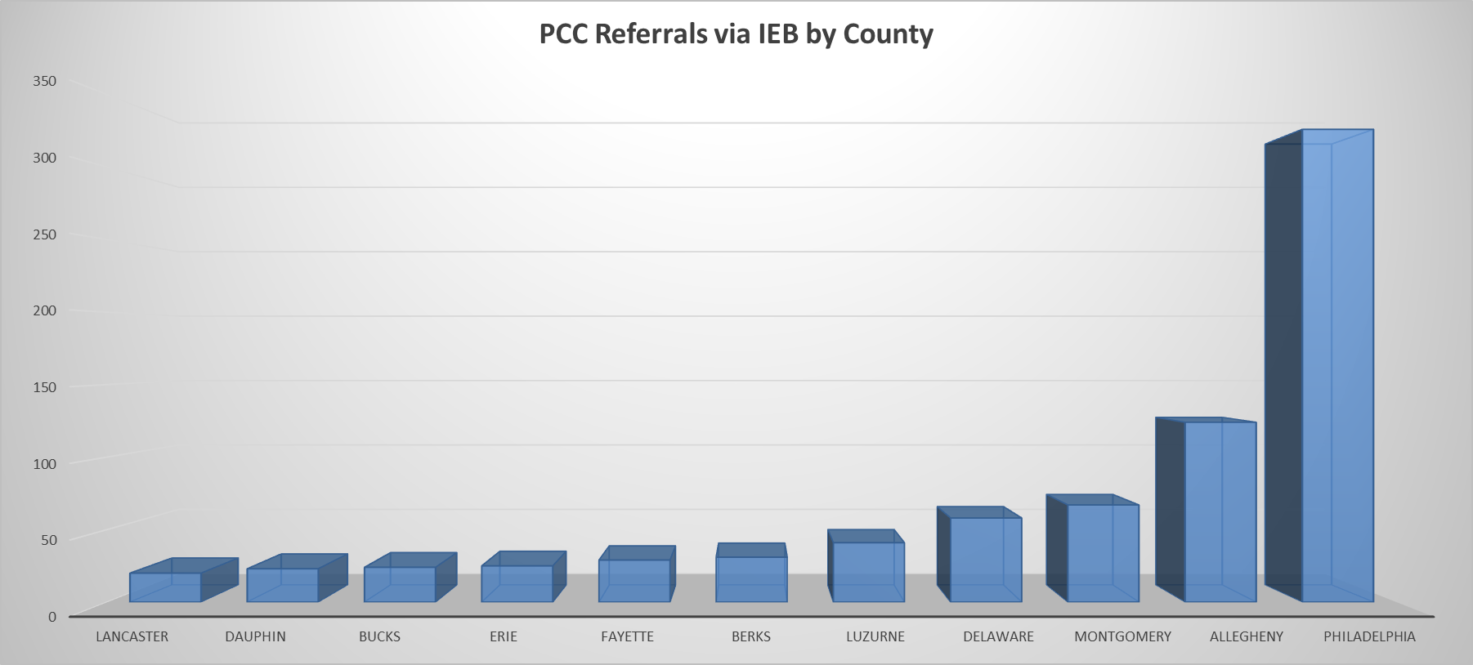
ADRC Involvement in the Application Process
Data Period: January 2017 through March 2018

Slide 5
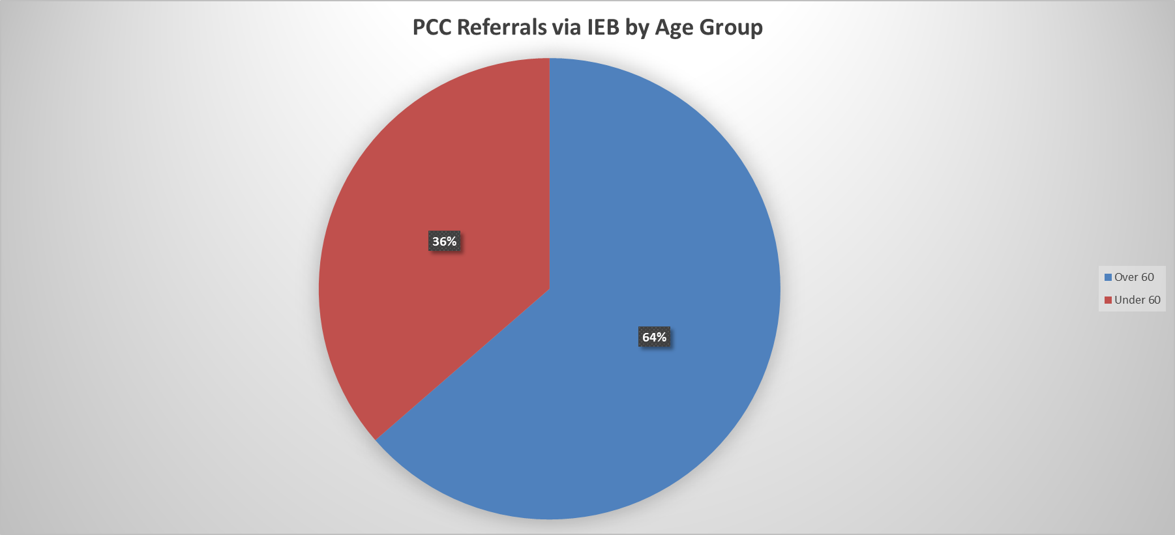
ADRC Involvement in the Application Process

Slide 6
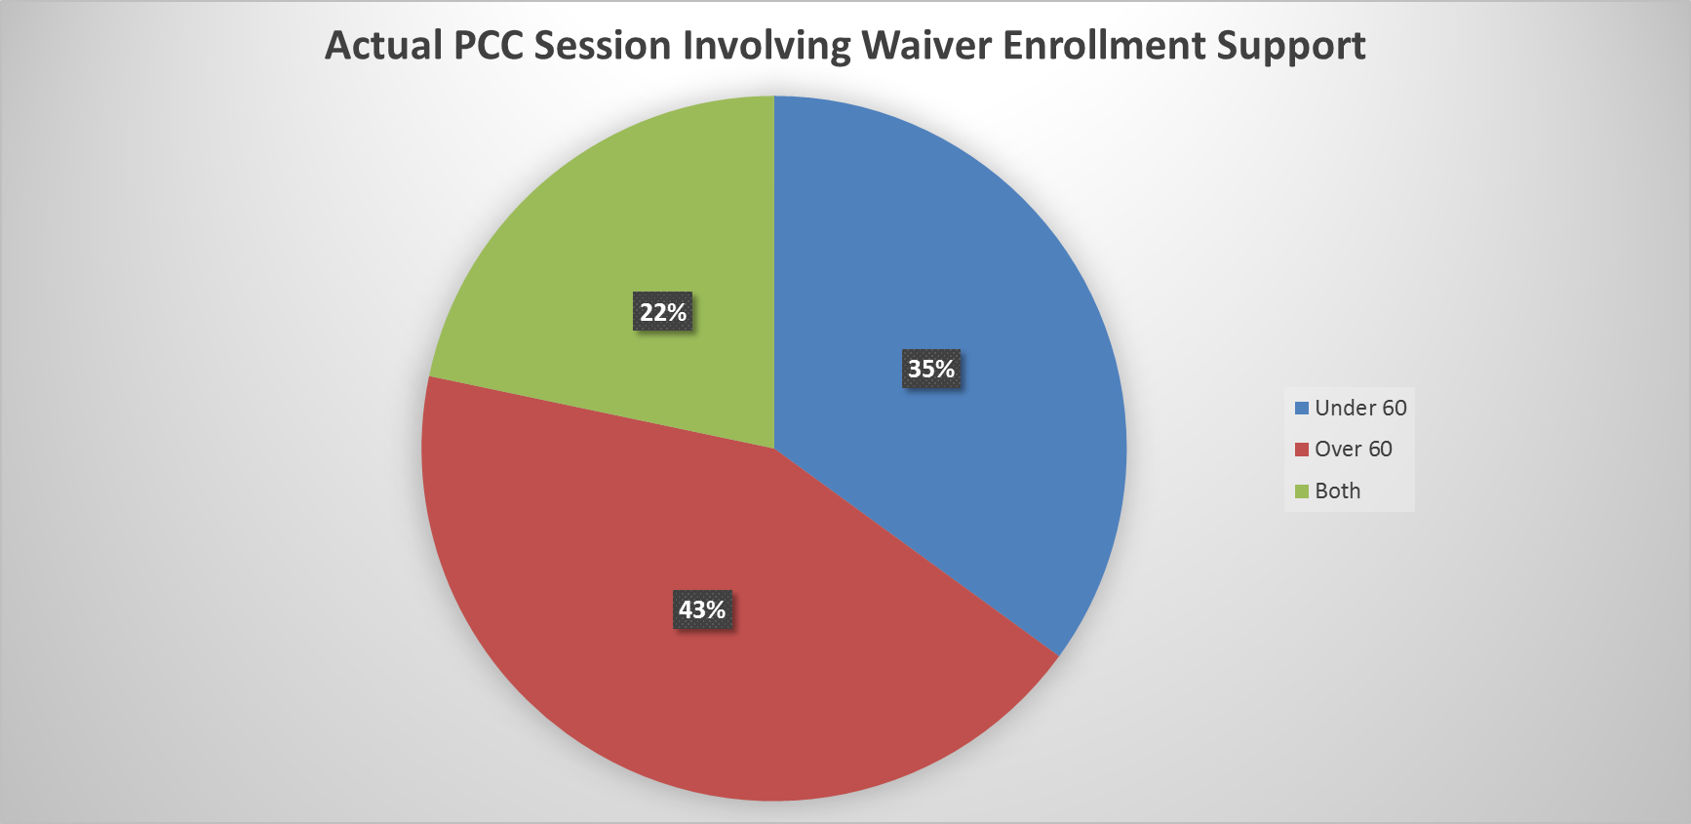
ADRC Involvement in the Application Process
“Both” refers to individuals who have are over the age of 60 and have a disability. This is an unduplicated representation.

Slide 7
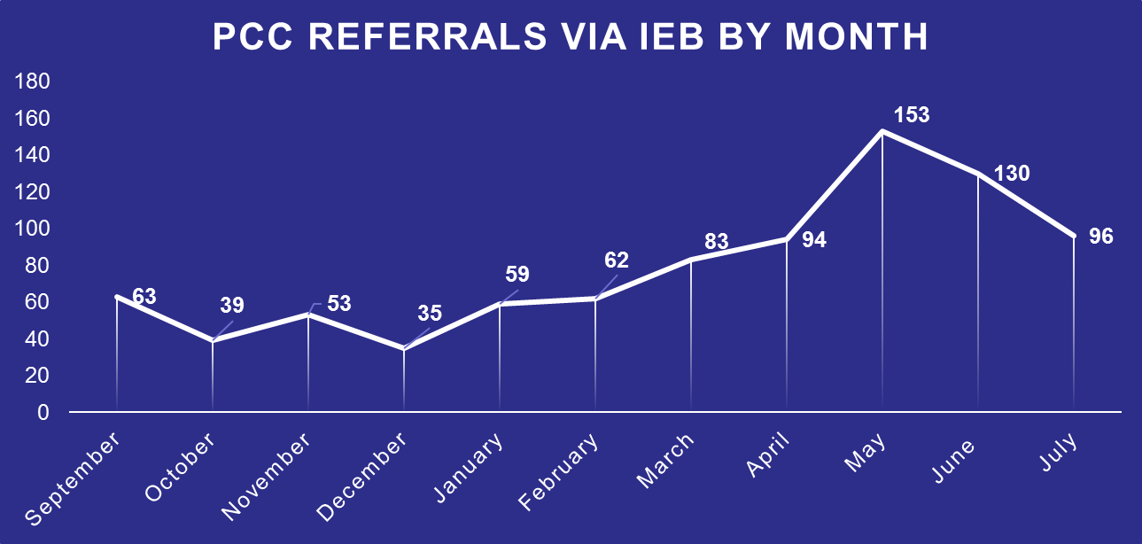
ADRC Involvement in the Application Process
The reason for the increase since December is unknown to the ADRO. However, the trend continues, with 143 referrals in May.

Slide 8
Current IEB Report – All Waivers
All unduplicated applications in process this quarter
Total unduplicated applications completed this quarter
Total unduplicated applications completed during the quarter in 90 days
Total unduplicated applications completed during the quarter and over 90 days, but with excuse of a delayed enrollment
Using the above fields = (row 3 + row 4)/ row 2
Average to complete excluding excused applications
Note: Reapplications removed

Slide 9
Current IEB Report
All unduplicated applications in process this quarter
Total unduplicated applications completed this quarter
Total unduplicated applications completed during the quarter in 90 days
Total unduplicated applications completed during the quarter and over 90 days, but with excuse of a delayed enrollment
Using the above fields = (row 3 + row 4)/ row 2
Average to complete excluding excused applications
Note: Reapplications removed

Slide 10
IEB Issues
Application Processing Timelines
  For applications that closed during the 1st quarter of 2018
    App Begin to Enrollment/Denial – 58 days
    From Referral to Enrollment/Denial – 74 days

Slide 11
Consumer Authorized for Services – Monthly
Chart for the 2nd, 3rd and 4th Quarters of SFY 2017-18
Active Consumers eligible for services at any time in the month:
FFS Waiver/Act 150/LIFE Program | 17-Oct | 17-Nov | 17-Dec | 18-Jan | 18-Feb | 18-Mar | 18-Apr | 18-May | 18-Jun
Act 150 | 1,543 | 1,536 | 1,520 | 1,471 | 1,471 | 1,473 | 1,474 | 1,467 | 1,453
Aging | 37,368 | 37,791 | 38,197 | 33,377 | 33,560 | 33,763 | 33,813 | 33,767 | 34,395
Attendant Care | 16,552 | 16,713 | 16,911 | 15,560 | 15,652 | 15,639 | 15,581 | 15,607 | 15,836
COMMCARE | 306 | 227 | 198
Independence | 16,574 | 16,837 | 16,983 | 13,785 | 13,889 | 13,983 | 14,027 | 14,058 | 14,183
LIFE | 5,908 | 5,959 | 5,988 | 6,022 | 6,047 | 6,102 | 6,131 | 6,083 | 6,488
OBRA | 1,481 | 1,496 | 1,495 | 1,101 | 1,105 | 1,109 | 1,111 | 1,109 | 1,113
Total FFS Waiver/ACT 150/LIFE Consumers | 79,732 | 80,559 | 81,292 | 71,316 | 71,724 | 72,069 | 72,137 | 72,091 | 73,468
FFS Long Term Care | 17-Oct | 17-Nov | 17-Dec | 18-Jan | 18-Feb | 18-Mar | 18-Apr | 18-May | 18-Jun
County Nursing Facility | 5,911 | 5,858 | 5,770 | 4,341 | 4,250 | 4,185 | 4,053 | 3,935 | 3,862
Hospice Care in a Nursing Facility | 39 | 40 | 39 | 26 | 25 | 26 | 23 | 22 | 25
Private Nursing Facility | 53,163 | 52,946 | 52,520 | 42,004 | 41,161 | 40,284 | 38,708 | 37,320 | 36,666
Total LTC Consumers | 59,113 | 58,844 | 58,329 | 46,371 | 45,436 | 44,495 | 42,784 | 41,277 | 40,553
Managed Care (Community Health Choices) | 17-Oct | 17-Nov | 17-Dec | 18-Jan | 18-Feb | 18-Mar | 18-Apr | 18-May | 18-Jun
CHC-HCBS Duals |  |  |  | 8,182 | 8,215 | 8,324 | 8,398 | 8,518 | 8,669
CHC-HCBS Non Duals |  |  |  | 2,727 | 2,744 | 2,772 | 2,832 | 2,891 | 2,893
CHC-LTC Duals |  |  |  | 10,133 | 10,034 | 10,127 | 10,079 | 10,092 | 10,240
CHC-LTC Non Duals |  |  |  | 889 | 904 | 913 | 921 | 923 | 870
CHC-NFI |  |  |  | 57,861 | 57,823 | 57,726 | 57,484 | 57,450 | 57,387
Total Managed Care Consumers | 0 | 0 | 0 | 79,792 | 79,720 | 79,862 | 79,714 | 79,874 | 80,059
NOTES:
•The data source for enrollment changed to CIS from HCSIS because of the 1/1/2018 CHC implementation. At that time Aging, Attendant Care and Independence waiver participant activity in the Southwest Region ceased in HCSIS. Phase 2 in the Southeast region is scheduled to start 1/1/2019.
•Consumers eligible for services count if active at any time during the period.
•The most recent activity date determines what record to choose if more than one activity occurs within the month.
•Consumers counted only in CHC if they appear in both FFS and Managed Care during the month.
Notes:
Note: The three categories A, B and C cannot be reconciled. (It can be done however because the members did not understand why the numbers didn’t add up. I reconciled every month when the program first started in July 2015 but the process was cumbersome, tedious and time-consuming so the need to reconcile was dropped as an issue.
The most recent month is the only calculated table column. All others are “hold overs” and “unaltered”. The numbers for prior months would be quite different otherwise.
The enrollment data uses the standard definition of an enrolled person:
Funding Source Name(s)
'ACT 150', 'Aging', 'Attendant Care', 'COMMCARE', 'Independence', 'OBRA'
In waiver/Act 150 anytime in period
[Waiver Eligibility Begin Date] <=?Report end date? [Waiver Eligibility End Date] is null or [Waiver Eligibility End Date] >?Report start date?
Newly enrolled in period
[Waiver Eligibility Begin Date] between ?Report start date? and ?Report end date?
“Disenrolled” in period
[Waiver Eligibility End Date] between ?Report start date? and ?Report end date?
Transfers: For September 2017 the only transfers were from Attendant Care to Independence and COMMCARE to Independence.
Facility Fact table data identifies any participant with a change to her or his service plan in the current month as indicated.

Slide 12
Employment
Note: This is the total number of waiver/program participants employed Data Source: eDW CIS Employment and Income Report
Notes:
This CIS custom report provides employment and income information for waiver recipients.
The report matches MCI information from the CIS and waiver Data for a given month.
The report also includes the recipient’s waiver and enrollment as well as the employment and income details.
The categories identify by waiver the number of participants with CIS employment data.
The table does not include the “Sheltered workshop” and “Room and board” employment categories.

Slide 13
NHT and MFP Transitions
Month | NHT02 Service Deliveries Count | Number of those who were also MFP * | Participants who were MFP only ** | % NHT Transitions who also had MFP
2017
July | 101 | 16 | 25 | 15.8%
August | 93 | 8 | 19 | 8.6%
September | 95 | 19 | 20 | 20.0%
October | 106 | 15 | 27 | 14.2%
November | 81 | 11 | 21 | 13.6%
December | 75 | 11 | 16 | 14.7%
2018
January | 104 | 11 | 25 | 10.6%
February | 89 | 9 | 16 | 10.1%
March | 75 | 7 | 18 | 9.3%
April | 116 | 14 | 5 | 12.1%
May | 130 | 7 | 20 | 5.4%
June | 61 | 1 | 9 | 1.6%
TOTAL for Period | 1126 | 129 | 221 | 11.5%
* Based on MFP anytime around NHT completion
** Based on MFP Facility Begin Date
Notes:
% NHT Transitions who also had MFP data for the last three months looks low. This is due to using two data sources to capture the data and therefore a maturation process will lead to higher percentages over time.

