Slide 1






CBO Training Module 4:
Financial Planning Workshop
June 17, 2021
Notes:
Nora

Slide 2
Training Session #4
  Two concurrent options today:
  Plenary Session and Panel Discussions will feature CBO, MCO, and provider organization representatives talking about their own experiences developing these partnerships, featuring examples in the area of food security and housing. Register at: https://attendee.gotowebinar.com/register/2793971610639341836
  CBO Financial Planning Model Breakout Session where interested representatives of CBOs’ budget and finance departments can spend time reviewing the CBO Financial Planning Model and participating in a discussion about the financial implications of a CBO contract with an MCO or provider organizations. Register at: https://attendee.gotowebinar.com/register/3714480547338020111

Slide 3
Presenters
Mike Bonetto, PhD, Member of Pennsylvania TA team, healthcare strategic planning and policy
Dan Vizzini, Policy Analyst and Financial Modeler, Center for Evidence-based Policy

Slide 4
BUILDING PARTNERSHIPS
Training Resources
All training sessions are being recorded. These recordings, the slides, and tools will be posted on the DHS website at https://www.dhs.pa.gov/HealthInnovation/Pages/Health-Innovations-Resources.aspx

Slide 5

Virtual Training Etiquette
Due to the large number of attendees:
We will mute all lines during the presentation
Please use the question feature to ask questions
Be sure to ask for clarification when needed
Image Source. Ellicom

Slide 6
Commonly-Used Acronyms
CBO: community-based organization
DHS: Department of Human Services
MCO: managed care organization
RAHCs: Regional Accountable Health Councils
SDoH: social determinants of health
VBP: value-based purchasing

Slide 7
Agenda
Framing Questions
Touring the Planning Tool
Live Modeling Exercise
Questions and Comments

Slide 8
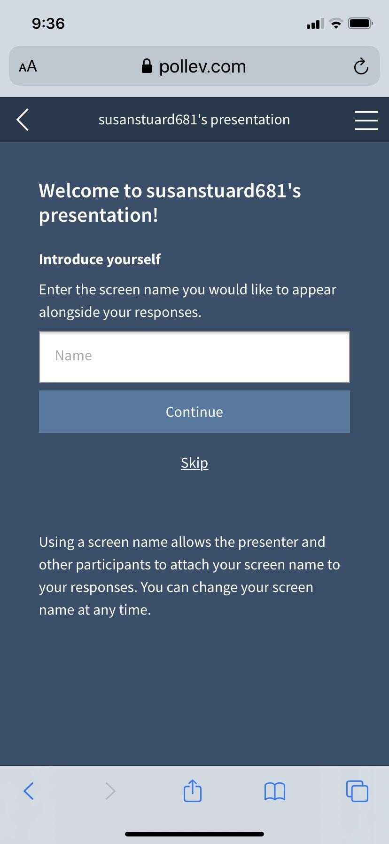
Electronic Voting Instructions
Poll Everywhere
Navigate to the link PollEv.com/cebpohsu925 and wait for the question prompts on your screen or text CEBPOHSU925 to 22333 once to join
You should be able to click on link inserted into the chat feature
If you wish to be anonymous, select the skip option when prompted to enter your name
Your device will automatically advance you to the active poll
Results will appear on the screen upon entry submission; you are allowed to change your responses if you wish

Slide 9
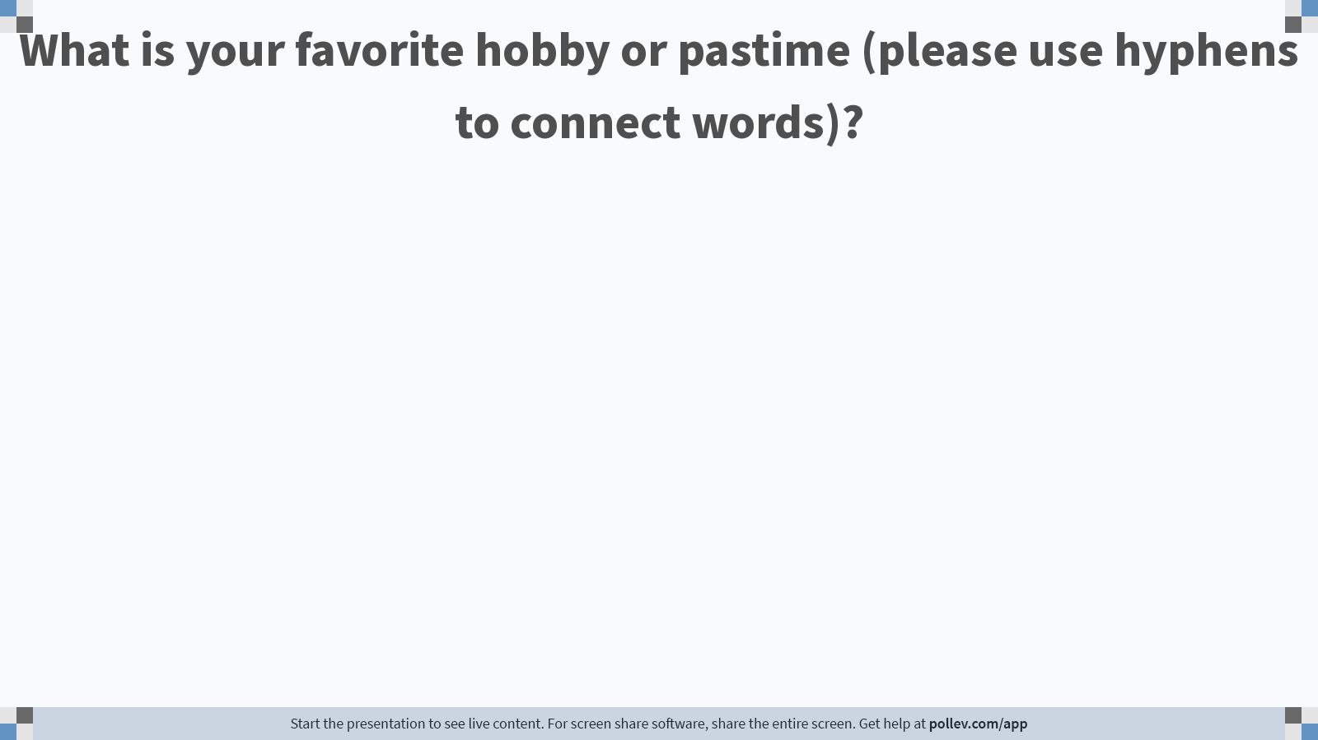
Notes:
Poll Title: Do not modify the notes in this section to avoid tampering with the Poll Everywhere activity.
More info at polleverywhere.com/support
What is your favorite hobby or pastime (please use hyphens to connect words)?
https://www.polleverywhere.com/free_text_polls/DKmhYnWUINHmsulCJgpDH

Slide 10
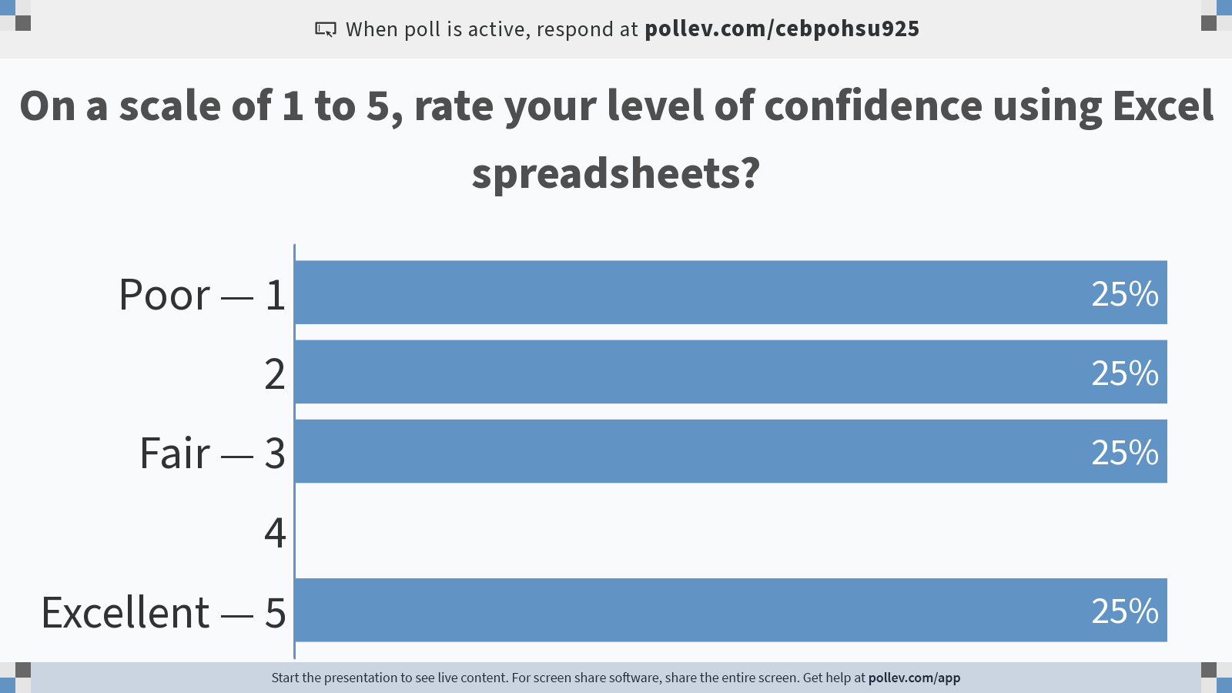
Notes:
Poll Title: Do not modify the notes in this section to avoid tampering with the Poll Everywhere activity.
More info at polleverywhere.com/support
On a scale of 1 to 5, rate your level of confidence using Excel spreadsheets?
https://www.polleverywhere.com/multiple_choice_polls/2daw6DQELvbv4vpPXPzkb?flow=Default&onscreen=persist

Slide 11
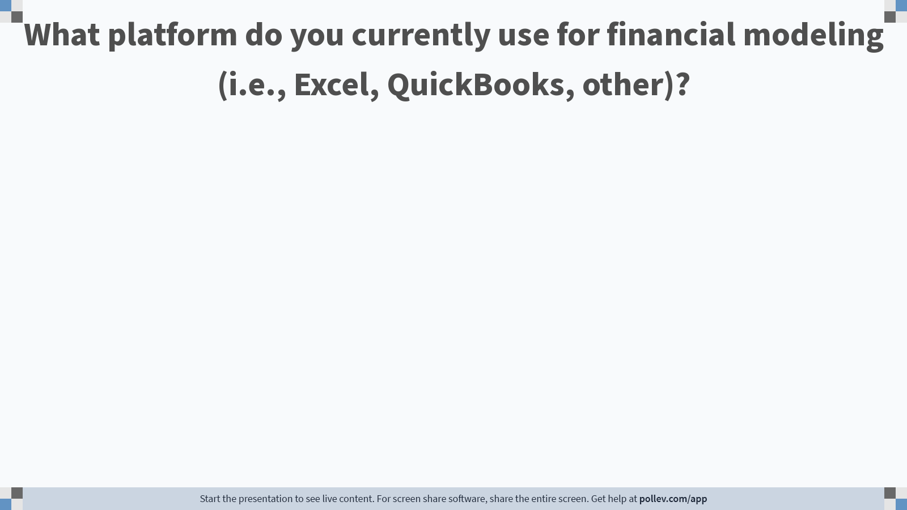
Notes:
Poll Title: Do not modify the notes in this section to avoid tampering with the Poll Everywhere activity.
More info at polleverywhere.com/support
What platform do you currently use for financial modeling (i.e., Excel, QuickBooks, other)?
https://www.polleverywhere.com/free_text_polls/RY0Njodvr7eTsS2qup1Fv

Slide 12
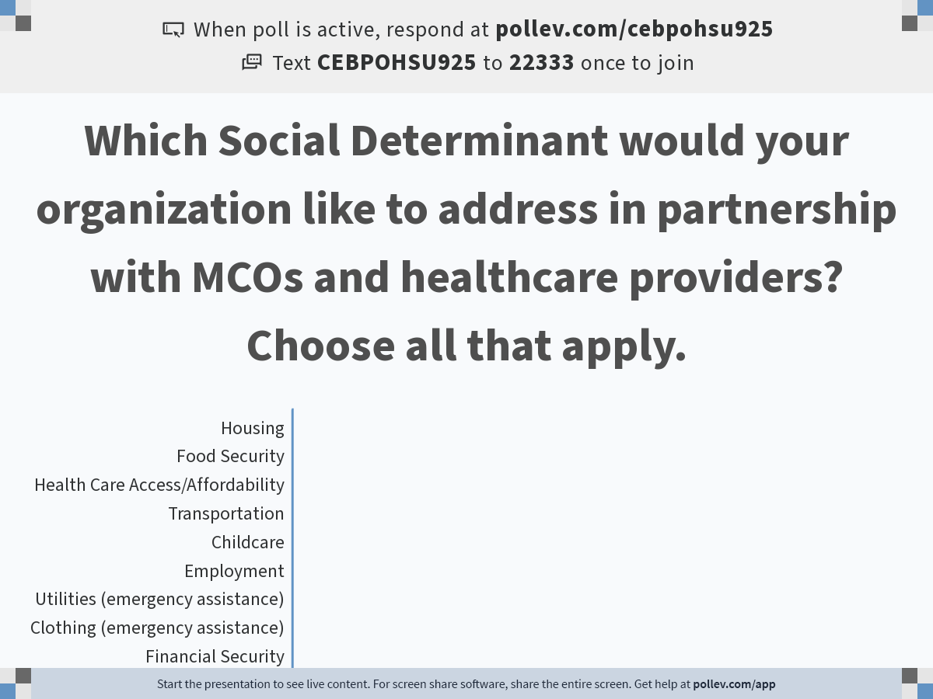
Notes:
Do not modify the notes in this section to avoid tampering with the Poll Everywhere activity.
More info at polleverywhere.com/support
Which Social Determinant would your organization like to address in partnership with MCOs and healthcare providers? Choose all that apply.
https://www.polleverywhere.com/multiple_choice_polls/4WZZlYocyHs2t0CBGJYLa?flow=Default&onscreen=persist

Slide 13
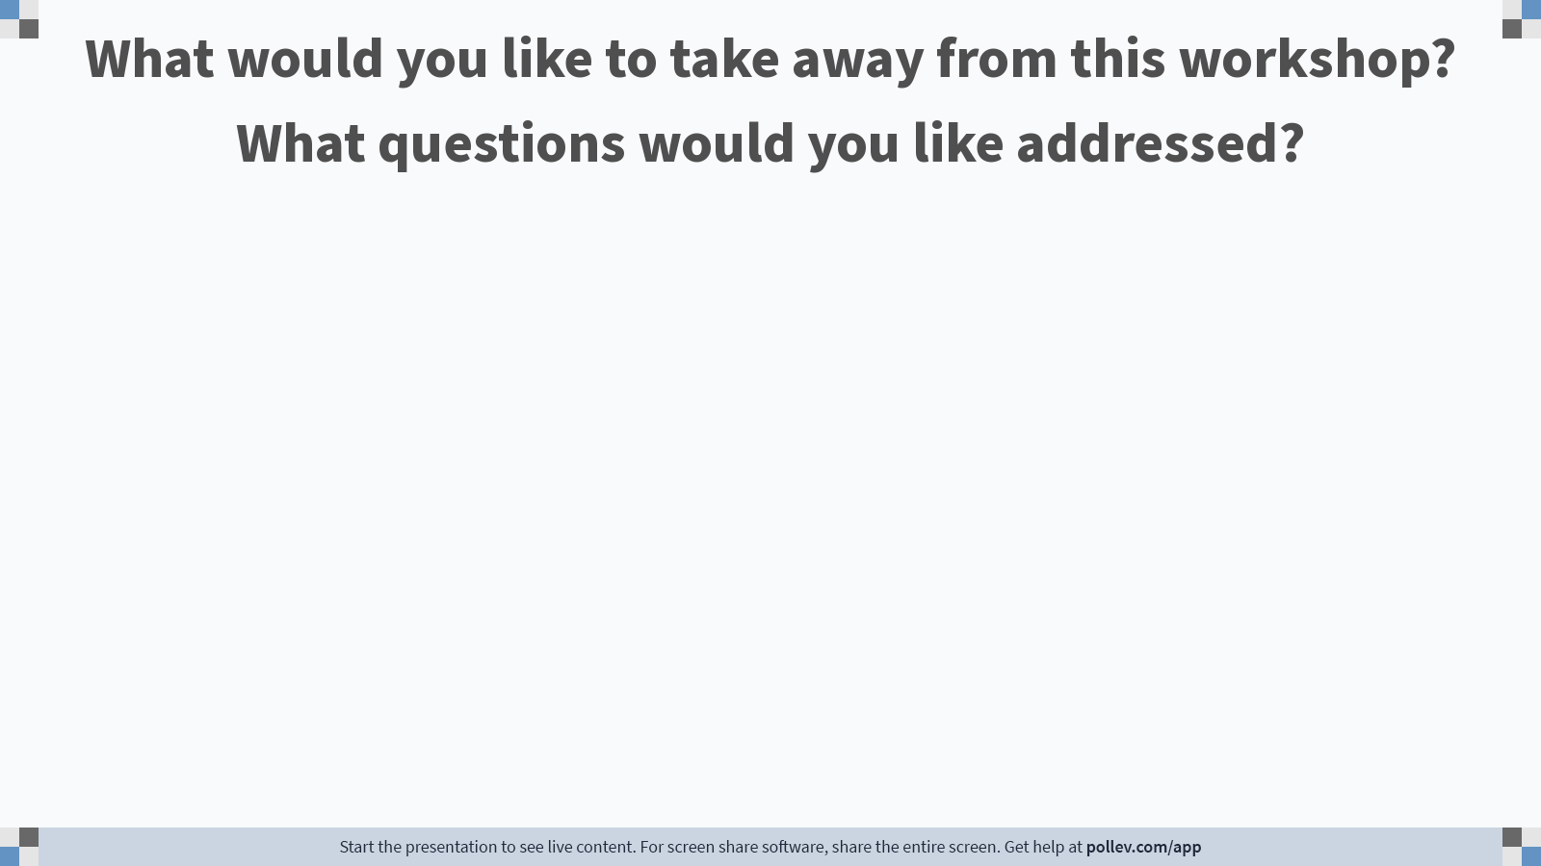
Notes:
Poll Title: Do not modify the notes in this section to avoid tampering with the Poll Everywhere activity.
More info at polleverywhere.com/support
What would you like to take away from this workshop? What questions would you like addressed?
https://www.polleverywhere.com/free_text_polls/WevzSVtI7ZkRnuJWq4aPr

Slide 14
CBO Financial Planning Tool
Taking the Tour

Slide 15
CBO Financial Planning Tool - Overview
Results Summary
Control Panel
Results Tables

Slide 16
CBO Financial Planning Tool – Control Panel
Service Metrics
Performance Metrics
Program Requirements
Program Resources
Contract Drivers

Slide 17
CBO Financial Planning Tool – Results Tables
Program Requirements
Program Resources
Contract Earnings

Slide 18
CBO Financial Planning Tool – Results Tables
Overall Finances
Contract Earnings - Alternative 1
Contract Earnings - Alternative 2

Slide 19
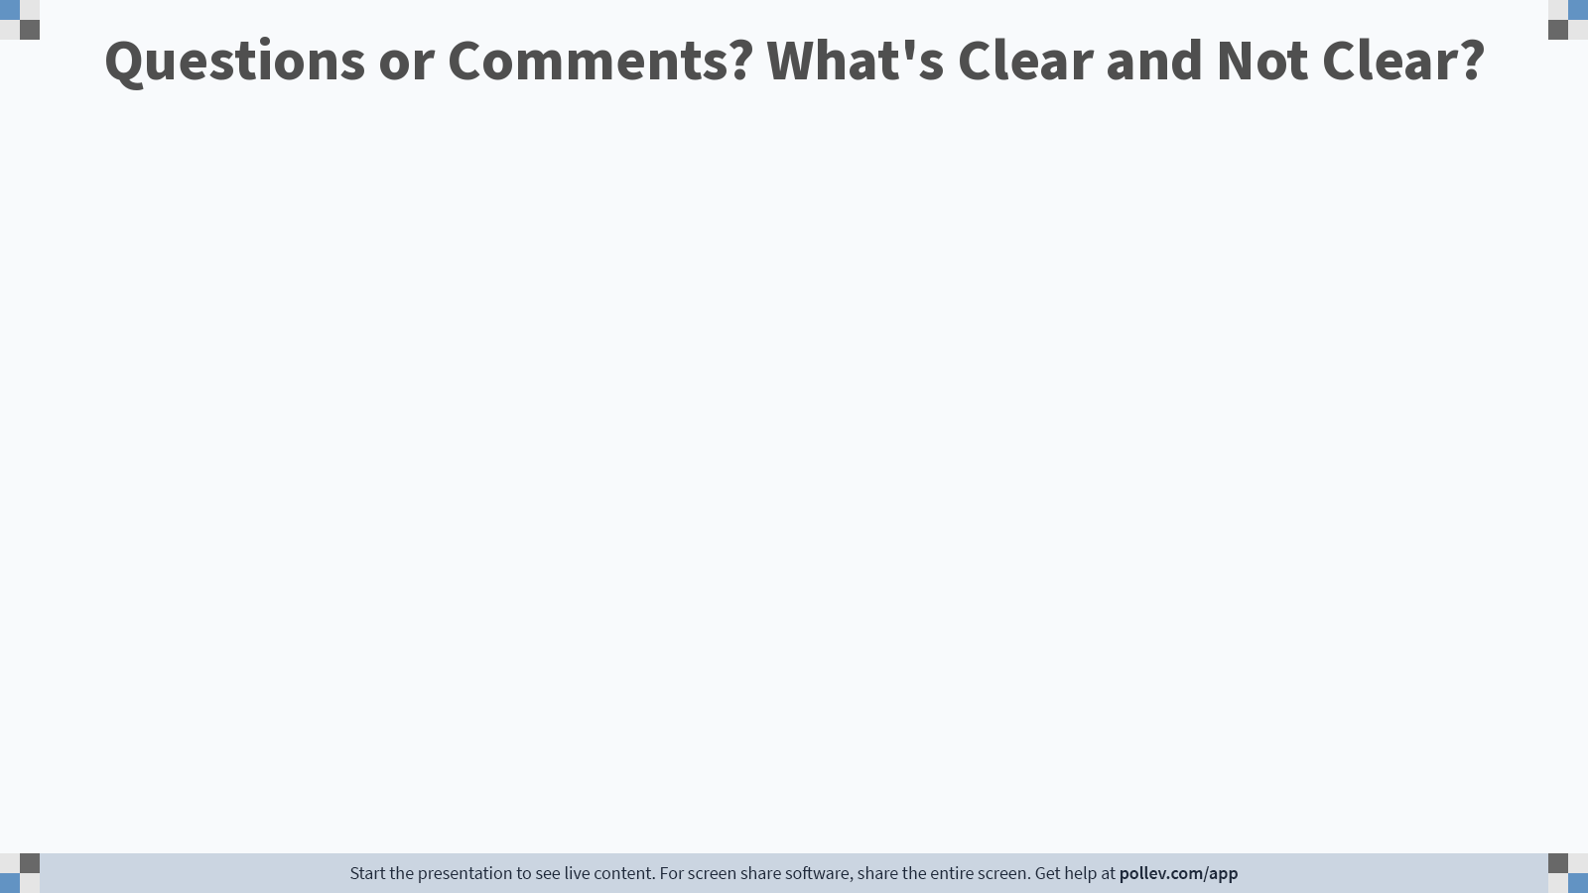
Notes:
Poll Title: Do not modify the notes in this section to avoid tampering with the Poll Everywhere activity.
More info at polleverywhere.com/support
Questions or Comments? What's Clear and Not Clear?
https://www.polleverywhere.com/free_text_polls/oSmJLryqIOQz7ofi0BTgs

Slide 20
CBO Financial Planning Tool
Live Modeling Exercise

Slide 21
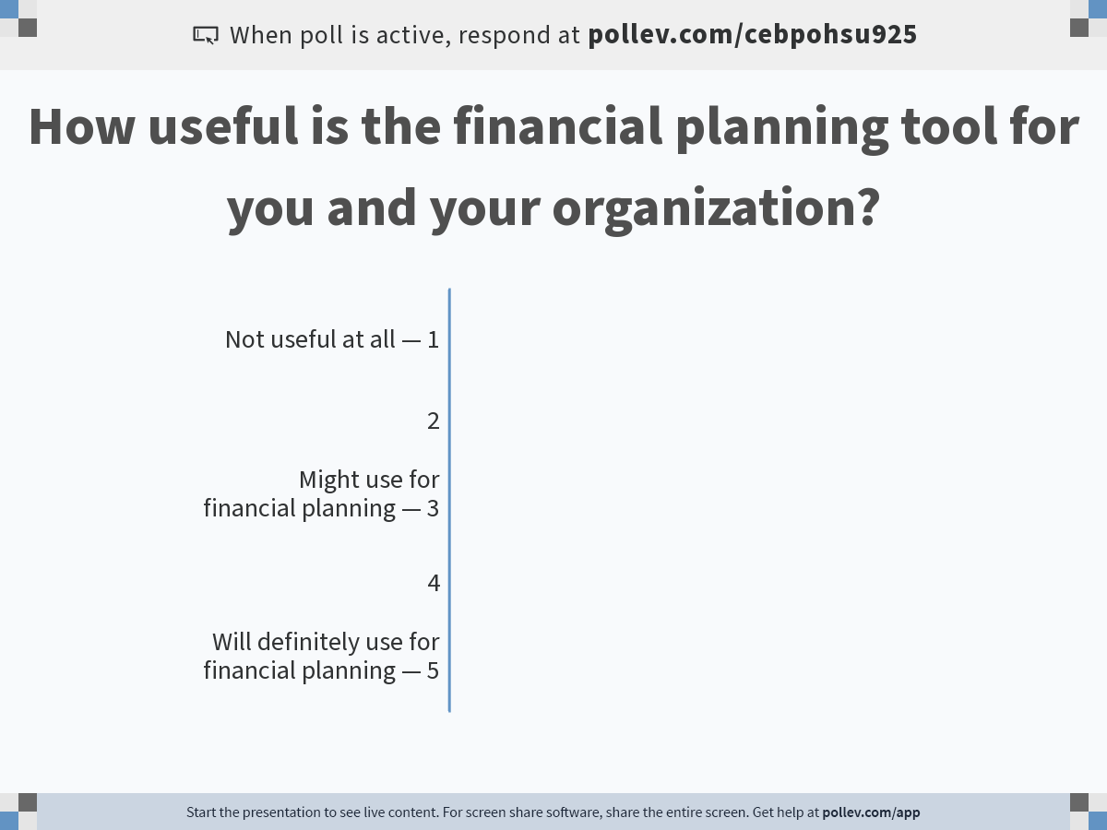
Notes:
Do not modify the notes in this section to avoid tampering with the Poll Everywhere activity.
More info at polleverywhere.com/support
How useful is the financial planning tool for you and your organization?
https://www.polleverywhere.com/multiple_choice_polls/UDa1Nvt5on3H1jqZrVrZ9?flow=Default&onscreen=persist

Slide 22
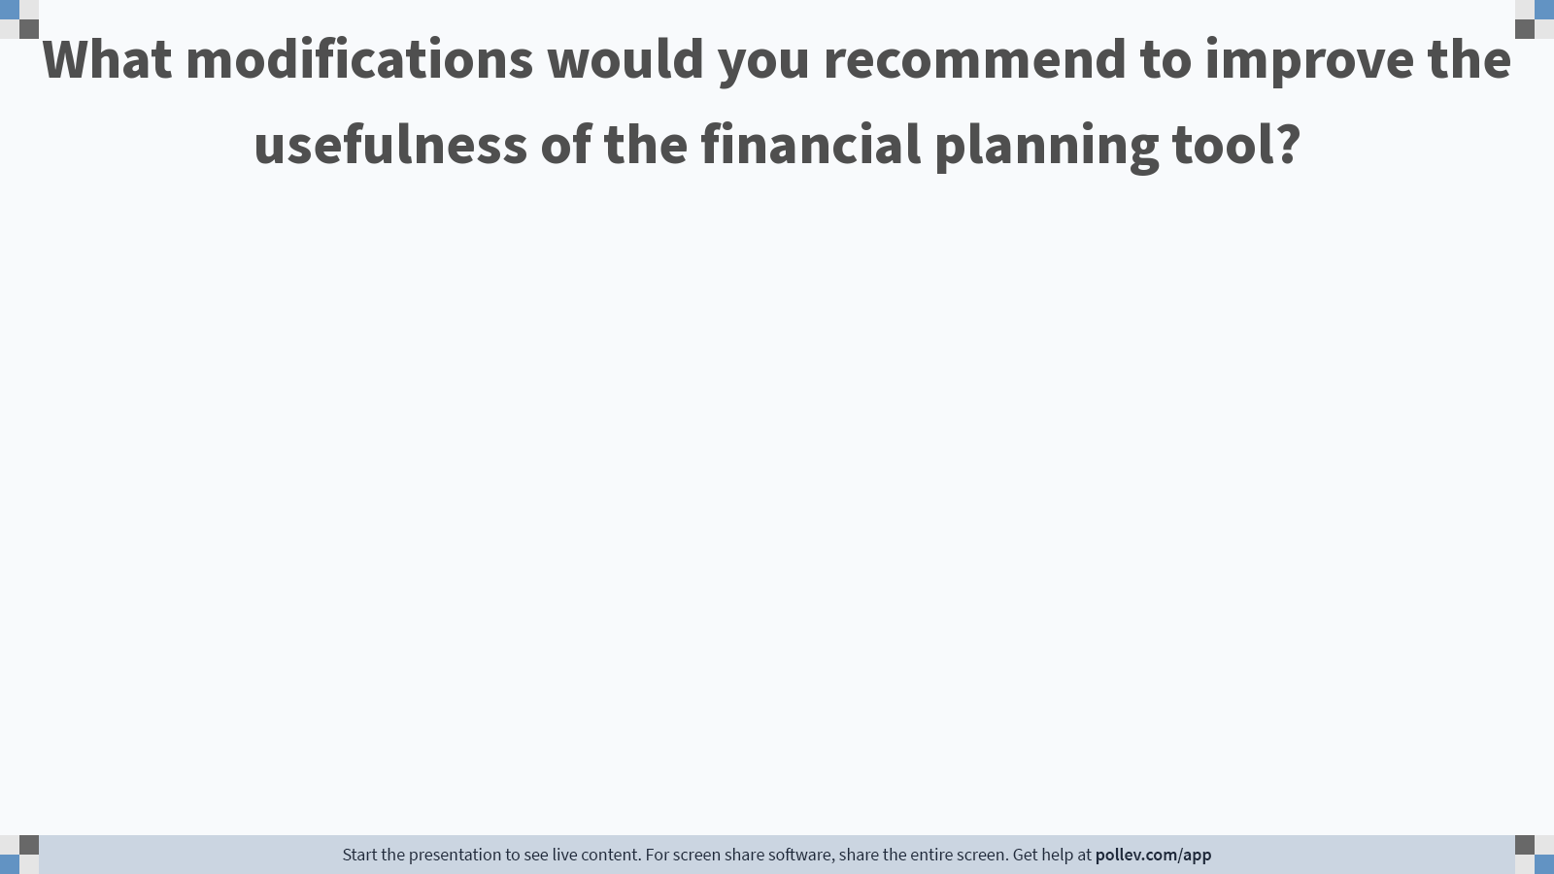
Notes:
Poll Title: Do not modify the notes in this section to avoid tampering with the Poll Everywhere activity.
More info at polleverywhere.com/support
What modifications would you recommend to improve the usefulness of the financial planning tool?
https://www.polleverywhere.com/free_text_polls/D6TaYrPw2hJmKTMB5X8In

Slide 23
Questions and Comments
CBO Financial Planning Tool

Slide 24
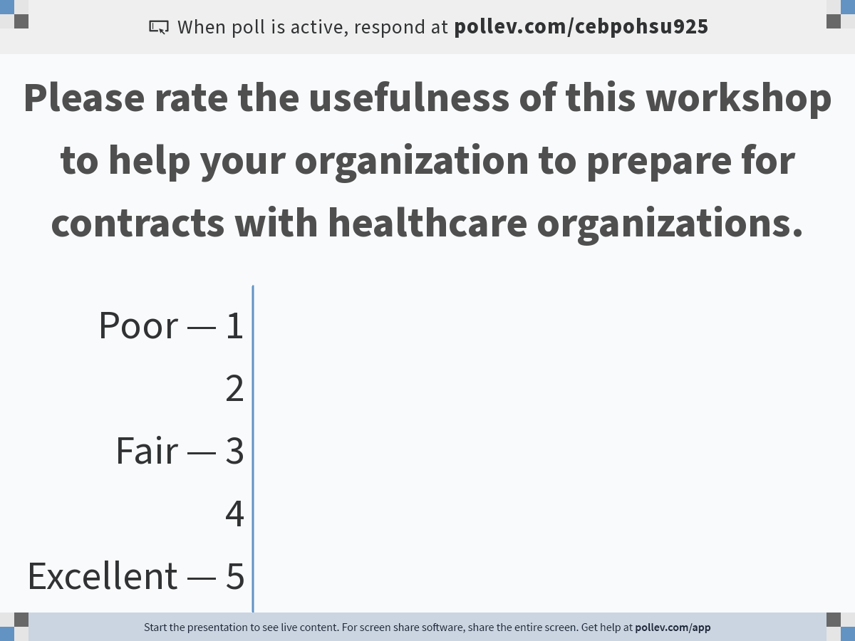
Notes:
Do not modify the notes in this section to avoid tampering with the Poll Everywhere activity.
More info at polleverywhere.com/support
Please rate the usefulness of this workshop to help your organization to prepare for contracts with healthcare organizations.
https://www.polleverywhere.com/multiple_choice_polls/A5VzJrEOMrFK7fE6IuBzE?flow=Default&onscreen=persist

Slide 25
Thank You for Your Participation

