Slide 1



Hospital-Based and
Physical Health Providers Overview
PHASE THREE PROVIDER SUMMIT
Jill I Vovakes
Larry Appel, MD
Office of Long-Term Living
Department of Human Services
MAY/JUNE 2019

Slide 2

MEDICAID HOME AND COMMUNITY-BASED WAIVERS
  Allows States to spend federal dollars for home and community-based (HCBS) services for those who would otherwise qualify for MA-funded institutional care.
  Currently, the Office of Long Term Living (OLTL) manages four HCBS waivers which serve discreet target populations.
  *Aging Waiver *Independence Waiver
  *Attendant Care Waiver OBRA Waiver
  Pennsylvania is moving to a Managed Long-Term Services and Supports (MLTSS) delivery system.
  These *three waivers will be consolidated into one new waiver called Community HealthChoices or CHC.

Slide 3
WHAT IS COMMUNITY HEALTHCHOICES (CHC)?
A Medicaid managed care program that will include physical health benefits and long-term services and supports (LTSS). The program is referenced to nationally as a managed long-term services and supports program (MLTSS).
WHO IS PART OF CHC?
Individuals who are 21 years of age or older and dually eligible for Medicare and Medicaid.
Individuals who are 21 years of age or older and eligible for Medicaid (LTSS) because they need the level of care provided by a nursing facility.
  This care may be provided in the home, community, or nursing facility.
  Individuals currently enrolled in the LIFE Program will not be enrolled in CHC unless they expressly select to transition from LIFE to a CHC managed care organization (MCO).

Slide 4
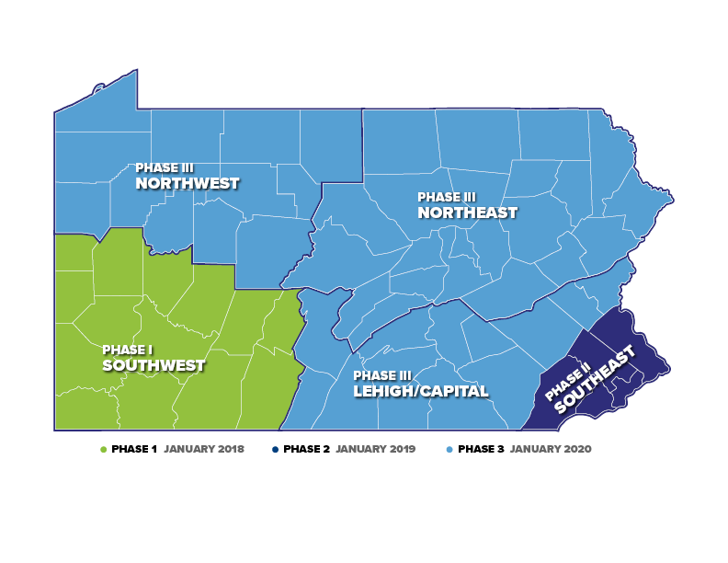
IMPLEMENTATION HIGHLIGHTS
WHEN DOES COMMUNITY HEALTHCHOICES (CHC) BEGIN?
CHC will be phased in across the state using the five geographic HealthChoices zones. The implementation date for the Phase 3 regions is January 2020.
Prior to implementation of CHC in each
region, providers should expect to
receive detailed communications from
the Department of Human Services
informing them of actions needed to
be taken in order to continue providing
services under this new model.

Slide 5
CHC PHASE 3 POPULATION
10%
14,609
Duals in Waivers
16%
23,323
Duals in Nursing Facilities
70%
99,887
NFI Duals
143,004
CHC POPULATION
3%
4,089
Non-duals in Waivers
13%
IN WAIVERS
17%
IN NURSING FACILITIES
96%
DUAL-ELIGIBLE
1%
1,096
Non-duals in Nursing Facilities

Slide 6
PHASE 3 ZONES: LEHIGH/CAPITAL
16%
10,861
Duals in Nursing Facilities
10%
6,269
Duals in Waivers
70%
46,411
NFI Duals
3%
1,996
Non-duals in Waivers
66,044
CHC POPULATION
LEHIGH/CAPITAL COUNTIES:
Adams, Berks, Cumberland,
Dauphin, Franklin, Fulton,
Huntingdon, Lancaster, Lebanon, Lehigh, Northampton, Perry, York
1%
507
Non-Duals in Nursing Facilities

Slide 7
PHASE 3 ZONES: NORTHWEST
15%
4,053
Duals in Nursing Facilities
13%
3,671
Duals in Waivers
68%
18,737
NFI Duals
4%
1,080
Non-duals in Waivers
27,730
CHC POPULATION
NORTHWEST COUNTIES:
Cameron, Clarion, Clearfield, Crawford, Elk, Erie, Forest, Jefferson, McKean, Mercer, Potter, Venango, Warren
<1%
189
Non-Duals in Nursing Facilities

Slide 8
PHASE 3 ZONES: NORTHEAST
17%
8,397
Duals in Nursing Facilities
9%
4,664
Duals in Waivers
71%
34,727
NFI Duals
2%
1,007
Non-duals in Waivers
49,195
CHC POPULATION
NORTHEAST COUNTIES:
Bradford, Carbon, Centre, Clinton, Columbia, Juniata, Lackawanna,
Luzerne, Lycoming, Mifflin, Monroe, Montour, Northumberland, Pike, Schuylkill, Snyder, Sullivan, Susquehanna, Tioga, Union, Wayne, Wyoming
1%
400
Non-Duals in Nursing Facilities

Slide 9
HEALTHCHOICES vs.
COMMUNITY HEALTHCHOICES
HEALTHCHOICES
Providers enroll as Medicaid providers
COMMUNITY HEALTHCHOICES
Providers enroll as Medicaid providers
Providers contract with managed care organizations (MCOs)
Providers bill MCOs
Physical Health Adult Benefit Package
Coordinate behavioral health services
Providers contract with MCOs
Providers bill MCOs
Physical Health Adult Benefit Package
Coordinate behavioral health services
Dual-eligible coverage
Long-term services and supports

Slide 10
CONTINUITY OF CARE
MIRRORS HEALTHCHOICES FOR PHYSICAL HEALTH
MCOs are required to comply with continuity of care requirements outlined in MA Bulletin 99-03-13.
Providers must check the Eligibility Verification System (EVS) prior to providing any service to an eligible Medical Assistance participant.
If the provider learns, through EVS or otherwise, that a participant has an approved fee-for-service (FFS) authorization and has enrolled in a MCO, providers must call the MCO and notify them of the prior authorized services about to be performed.
Participants may keep their existing providers for the 60-day continuity of care period after
CHC implementation for physical health services.
The commonwealth will conduct ongoing monitoring to ensure the MCOs maintain provider networks that enable participants choice of provider for needed services.

Slide 11
CONTINUITY OF CARE
LONG-TERM SERVICES AND SUPPORTS (LTSS) CONTINUITY OF CARE – FIRST 180 DAYS
MCOs are required to contract with all willing and qualified existing LTSS providers for 180 days after CHC implementation.
Participants may keep their existing LTSS providers, including service coordinators, for the 180-day continuity of care period after CHC implementation.
A participant who resides in a nursing facility on the implementation date will be able to stay in their nursing facility as long as they need that level of care, unless they choose to move.

Slide 12
PROVIDER PROGRAM INFORMATION
LTSS CONTINUITY OF CARE – FIRST 180 DAYS
All CHC-MCO network providers must be enrolled with Medicaid and must be credentialed by and contracted with a CHC-MCO to receive reimbursement for services provided to a participant.
The Medicaid enrollment process verifies that a provider meets Medicaid enrollment requirements.
CHC-MCO network providers must be enrolled in Medicaid for all types of services they wish to provide under CHC.
To meet necessary accreditation standards, CHC-MCOs must go through a similar process. This process has additional requirements related to the approval process, time limits for how long information can be used in verifying providers, and requires direct verification of provider information.
Providers must agree to contractual terms and meet CHC-MCO participation requirements.
CHC-MCOs will determine best practices and quality standards to support their programs.
CHC-MCOs are currently actively contracting with providers in the Southeast region.
Providers are encouraged to engage with the CHC-MCOs now to assure continuity of care for participants.

Slide 13
PROVIDER PROGRAM INFORMATION
HOW ARE PROVIDERS PAID FOR SERVICES?
Providers must bill the appropriate CHC-MCO to receive reimbursement for services
after January 1, 2020.
Each CHC-MCO will have their own claim system.
CHC-MCOs are required to train providers on claims submission, any electronic visit verification system, other software systems such as their service coordination system, as well as many other aspects of CHC.
Providers will have the opportunity to participate in claims testing with the CHC-MCOs through the readiness review process as needed.

Slide 14
PROVIDER PROGRAM INFORMATION
HOW CAN A PROVIDER IDENTIFY A PARTICIPANT’S CHC PLAN?
The Access card is not going away.
The current EVS will identify CHC participants and their CHC-MCO.
The EVS methods, inquiry, and response formats will not change with CHC implementation.
EVS will display the CHC-MCO plan code information, along with the consumer’s primary care physician, if available.
All other existing waiver benefit packages and HealthChoices managed care responses remain unchanged.

Slide 15
COVERED SERVICES
FOR ALL PARTICIPANTS:
Physical health services
All participants will receive the Adult Benefit Package, which is the same package they receive today.
This includes services such as:
  Primary care physician
  Specialist services
  Please note: Medicare coverage will not change.

Slide 16
COVERED SERVICES
FOR ALL PARTICIPANTS:
Behavioral health services
All participants will receive behavioral health services through the Behavioral Health HealthChoices MCOs.
This is new for Aging Waiver participants and nursing facility residents, who receive behavioral health services through fee-for-service.
Services available to participants include but are not limited to:
  Inpatient Psychiatric Hospital
  Inpatient Drug and Alcohol Detox and Rehabilitation
  Psychiatric Partial Hospitalization
  Outpatient Psychiatric Clinic
  Drug and Alcohol Outpatient Clinic

Slide 17
COVERED SERVICES
Transportation Services:
All CHC participants have access to emergency and non-emergency medical transportation.
Participants will continue to use the Medical Assistance Transportation Program (MATP) for non-emergency medical transportation to and from medical appointments.
  Participants residing in nursing facilities are the exception.
  Nursing facilities will continue to coordinate transportation for their residents.
Nursing facility clinically eligible (NFCE) participants also have access to non-medical transportation. Non-medical transportation can include:
  Transportation to community activities, religious services, employment and volunteering, and other activities or LTSS services as specified in the Participant’s Person-Centered Service Plan (PCSP).
  This service is offered in addition to medical transportation services and shall not replace them.
  These services may include the purchase of tickets or tokens to secure transportation for a participant.
CHC Transportation Provider Workshops will be held on May 16th in Kutztown, May 23rd in Bradford, and June 7th in Bloomsburg.

Slide 18
COVERED SERVICES
FOR PARTICIPANTS WHO QUALIFY FOR LTSS:
Home and community-based long-term services and supports including:
Long-term services and supports in a nursing facility
Participant-directed services will continue as they exist today.
  Adult Daily Living
  Assistive Technology
  Behavior Therapy
  Benefits Counseling
  Career Assessment
  Cognitive Rehabilitation Therapy
  Community Integration
  Community Transition Services
  Counseling Services
  Employment Skills Development
  Financial Management Services
  Home Adaptations
  Home Health Aid Services
  Home Delivered Meals
  Non-Medical Transportation
  Nursing
  Nutritional Consultation
  Occupational Therapy
  Personal Assistance Services
  Personal Emergency Response System (PERS)
  Pest Eradication
  Physical Therapy
  Job Coaching
  Job Finding
  Residential Habilitation
  Respite
  Specialized Medical Equipment
  and Supplies
  Speech and Language Therapy
  Telecare
  Vehicle Modifications

Slide 19
ELIGIBILITY CRITERIA
Clinically Eligible
Must meet the specified level of care
Must be re-determined annually
Financially Eligible
Income – income may not exceed 300% of the Federal poverty guidelines
Assets/Resources – assets less than $2,000 (with a $6,000 disregard)
Program Eligible (target group)
Most Waivers will have targeted, participant specific, eligibility requirements, for example specific disabilities or ages

Slide 20
NURSING FACILITY CLINICALLY ELIGIBLE (NFCE)
NFCE is defined by the following:
The individual has an illness, injury, disability or medical condition diagnosed by a physician; and
As a result of that diagnosed illness, injury, disability or medical condition, the individual requires care and services above the level of room and board; and
A physician certifies that the individual is NFCE; and
The needed care and services are either:
skilled nursing or rehabilitation services as specified by the Medicare Program in 42 CFR §§ 409.31(a), 409.31 (b)(1) and (3), and 409.32 through 409.35; or
health-related care and services that may not be as inherently complex as skilled nursing or rehabilitation services, but which are needed and provided on a regular basis in the context of planned program of health care and management and were previously available only through institutional facilities.

Slide 21
PHYSICIAN’S CERTIFICATION FORM
Notes:
Discussion Points:
Form must be signed by the physician (MD or DO) and include their license number or it is considered incomplete. Need to be returned to the IEB as soon as possible or the application will be delayed.
NFCE vs. ICF/ORC
The person has a diagnosis of an Other Related Condition (ORC)—a severe, chronic disability—other than a mental illness or an intellectual disability—that manifested before age 22, is likely to continue indefinitely, results in the impairment of either general intellectual functioning or adaptive behavior, and results in substantial functional limitations in at least three of these areas: self-care, understanding and use of language, learning, mobility, self-direction, and capacity for independent living, and
Requires active treatment—a continuous program that aggressively, consistently gives specialized and generic training, treatment, health services and related services; that focuses on the client acquiring behaviors necessary to function with as much self-determination and independence as possible; and that aims to prevent or slow regression or loss of current optimal functional status.
Short-term (<180 days) vs. Long-term (>180 days)

Slide 22
PHYSICIAN’S CERTIFICATION FORM
http://www.dhs.pa.gov/cs/groups/webcontent/documents/bulletin_admin/c_285786.pdf

Slide 23
ELIGIBILITY PROCESS
The applicant contacts the Independent Enrollment Broker (IEB).
The IEB makes referral to the local Area Agency on Aging for the clinical assessment and assists the participant with obtaining the Physician’s Certification (PC) form.
The applicant’s physician completes the physician certification form and returns the form to the IEB.
The IEB also facilitates the financial eligibility process at the local County Assistance Office.
Once eligibility has been established, the applicant chooses a Service Coordinator who works with the participant to develop an individualized service plan and choose providers to deliver the services.

Slide 24
ON-GOING SERVICES
The individualized service plan is based on a comprehensive assessment conducted with the participant by the MCO’s Service Coordinator.
The participant chooses the providers to deliver services and the Service Coordinator is responsible for notifying the provider of the type, scope, amount, duration and frequency of the service.
Physician’s are not required to “prescribe” services with the exception of Home Health services, specialized medical equipment and supplies, nutritional consultation, and assistive technology.
If the participant’s needs change, the MCO’s Service Coordinator will conduct another needs assessment to identify additional unmet needs and necessary revisions to the service plan.

Slide 25
PROVIDER PROGRAM INFORMATION
WHAT ARE THE OBJECTIVES OF SERVICE COORDINATION FOR CHC?
Service coordination is an administrative function of the CHC-MCOs.
Every participant receiving LTSS will choose a service coordinator.
The service coordinator will coordinate Medicare, LTSS, and physical and behavioral health services.
They will also assist in accessing, locating and coordinating needed covered services and non-covered services such as social, housing, educational and other services and supports.
The service coordinator will also facilitate the person-centered planning team.
Each participant will have a person-centered planning team that includes their doctors, service providers, and natural supports.

Slide 26
COORDINATION WITH MEDICARE
Promoting improved coordination between Medicare and Medicaid is a key goal of CHC. Better coordination between these two payers can improve participant experience and outcomes.
  Dually eligible participants will continue to have all of the Medicare options they have today, including Original Medicare and Medicare Advantage managed care plans.
  The implementation of CHC will not change the services that are covered by Medicare.
  All CHC-MCOs are required to offer a companion Dual Eligible Special Needs Plans, also known as D-SNPs to its dually eligible participants. D-SNPs are a type of Medicare Advantage plan that coordinates Medicare and Medicaid services.

Slide 27
COORDINATION WITH MEDICARE
Medicare will continue to be the primary payor for any service covered by Medicare. Providers will continue to bill Medicare for eligible services prior to billing Medicaid. All Medicaid bills for participants will be submitted to the participant’s CHC-MCO, including bills that are submitted after Medicare has denied or paid part of a claim.
Participants must have access to Medicare services from the Medicare provider of his or her choice. Participants will be able to keep their Medicare PCP even if they are not enrolled with the CHC-MCO. The CHC-MCO is responsible to pay any Medicare co-insurance and deductible amount, whether or not the Medicare provider is included in the CHC-MCO’s provider network.
Providers cannot bill dually eligible participants for Medicare cost- sharing when Medicare or Medicaid do not cover the entire amount billed for a service delivered.
Providers should still check EVS to confirm participant eligibility, their CHC MCO, and any other coverage a participant might have

Slide 28
PROVIDER PROGRAM INFORMATION
HOW IS CRITICAL INCIDENT REPORTING HANDLED?
Providers must report in accordance with applicable requirements.
CHC-MCOs and their network providers and subcontractors must report critical events or incidents via the Department’s Enterprise Incident Management System (EIM).
Using the Department’s Enterprise Incident Management System, the CHC-MCOs must investigate critical events or incidents reported by network providers and subcontractors and report the outcomes of these investigations.
Providers should check with the MCOs about their procedures for critical incident reporting.

Slide 29
PROVIDER PROGRAM INFORMATION
WHAT MEASURES WILL BE USED TO MEASURE QUALITY?
NATIONAL
Healthcare Effectiveness Data & Information Set (HEDIS)(Adults)
STATE
LTSS Community-based services
LAUNCH INDICATORS
Key data points provided frequently during launch
CMS Adult Core
CMS Nursing Facility
Consumer Assessment of Healthcare Providers & Systems (CAHPS)
CMS Medicare measures for dually eligible, special needs plans
Service coordination and care coordination
Grievances, appeals, and critical incidents
Rebalancing
CHC HCBS Waiver assurances
Focus on:
Continuity of services
LTSS provider participation

Slide 30
PARTICIPANTS
WHAT CAN PROVIDERS DO TO ASSIST PARTICIPANTS?
Encourage them participate in CHC Third Thursday webinars to learn more about CHC.
Encourage them to participate in stakeholder engagements.
Ask them to read any CHC-related information by the Department.
Encourage them to participate in upcoming educational sessions hosted by the Department.
Encourage them to select a CHC-MCO by the date identified by the Department.
Encourage them to subscribe to the CHC listserv.

Slide 31
PARTICIPANTS
WILL PARTICIPANTS BE ABLE TO USE THE OLTL HOTLINE?
Participants should work with their CHC-MCO to address concerns.
The CHC-MCOs will have complaint and grievance processes and will support the
Medicaid fair hearing process.
The participant hotline will still be available for unresolved issues with MCOs.

Slide 32
COMMUNICATIONS
WHAT SHOULD MY ORGANIZATION DO TO PREPARE?
Participate in CHC Third Thursday webinars to learn more about CHC.
Participate in stakeholder engagements.
Read and share within your organization any CHC-related information sent to you by the Department.
Participate in upcoming educational sessions hosted by the Department.
Contact CHC-MCOs to discuss contracting.

Slide 33

www.HealthChoices.pa.gov

Slide 34
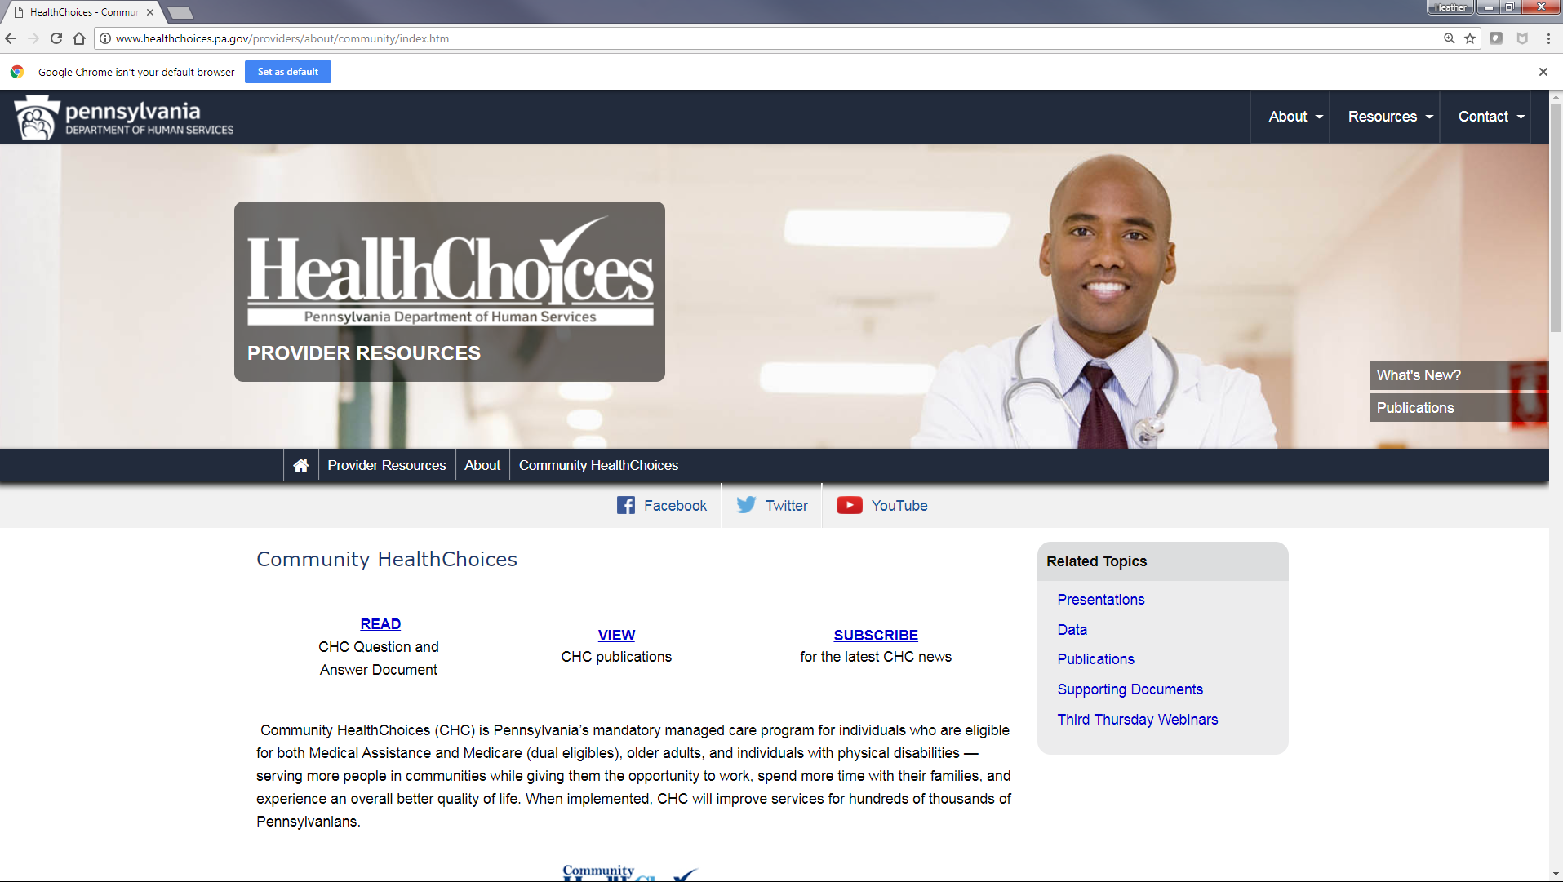

Slide 35
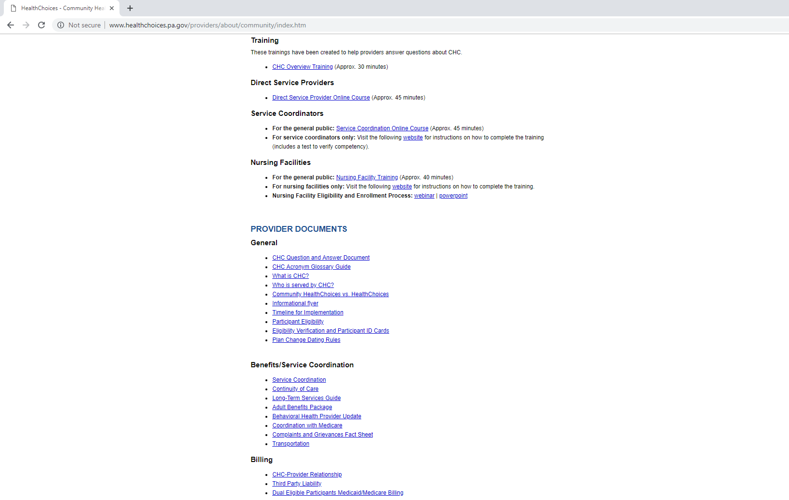

Slide 36

PROVIDERS
Bi-weekly email blasts on specific topics
  Examples: Billing, Service Coordination,
  Medicare, HealthChoices vs. CHC,
  Continuity of Care
Provider narrated training segments
Provider events in local areas to meet with
MCOs and gain information about CHC

Slide 37
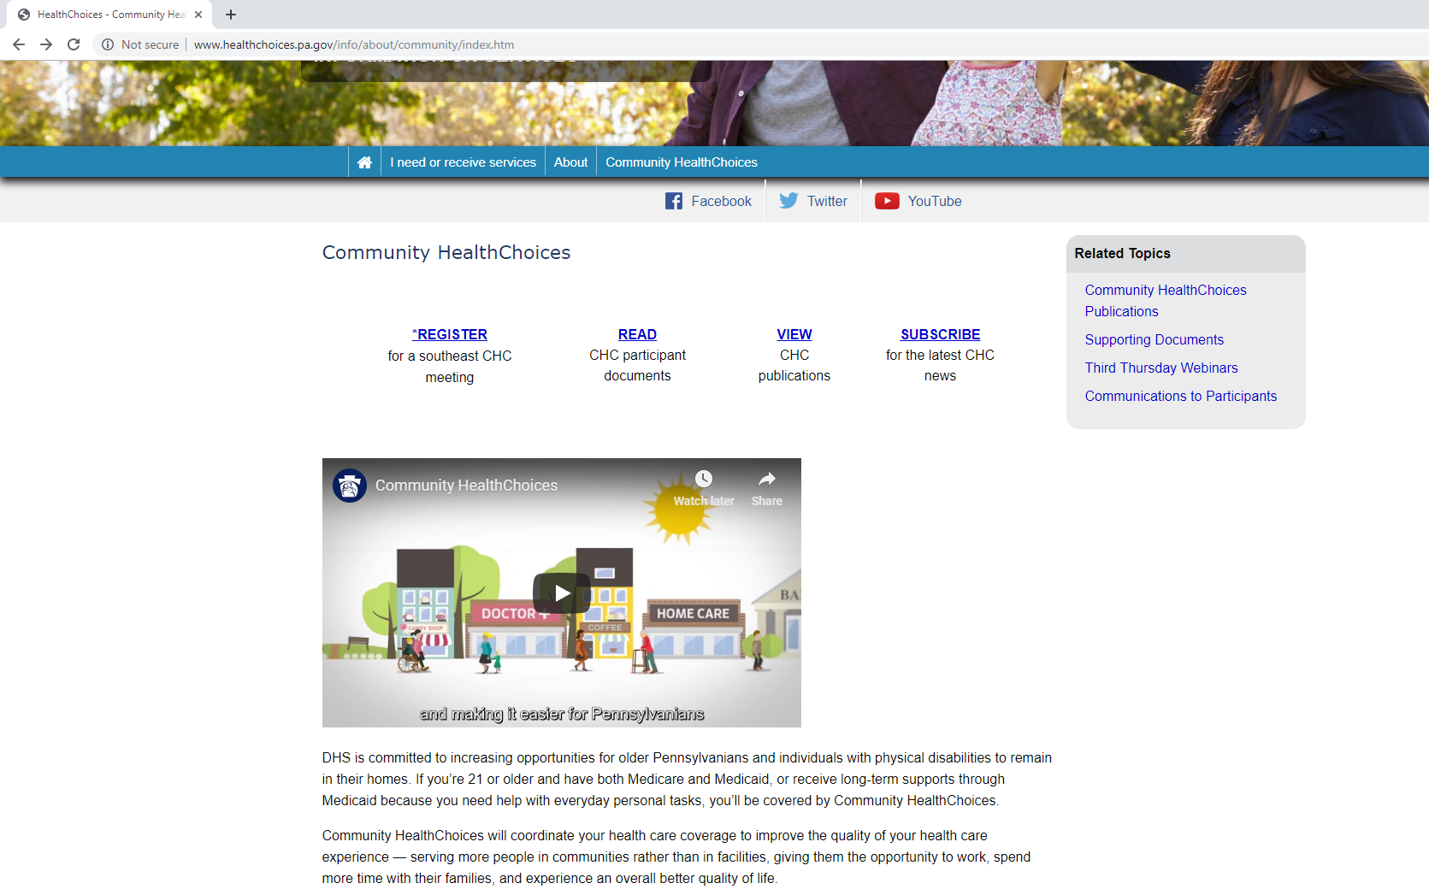

Slide 38
PARTICIPANTS
AWARENESS FLYER
  Mailed five months prior to implementation. Phase Three: July 2019
AGING WELL EVENTS
  Participants will receive invitations for events in their area. Phase Three: August 2019
PRE-TRANSITION NOTICES AND ENROLLMENT PACKET
  Mailed four months prior to implementation. Phase Three: August 2019
SERVICE COORDINATORS
  Will reach out to their participants to inform them about CHC. Phase Three: August 2019
NURSING FACILITIES
  Discussions about CHC will occur with their residents. Phase Three: August 2019

Slide 39


MANAGED CARE ORGANIZATIONS
The selected offerors were announced on August 30, 2016.
www.AmerihealthCaritasCHC.com
www.PAHealthWellness.com
www.upmchealthplan.com/chc

Slide 40
RESOURCE INFORMATION
CHC LISTSERV // STAY INFORMED: http://listserv.dpw.state.pa.us/oltl-community-healthchoices.html
COMMUNITY HEALTHCHOICES WEBSITE: www.healthchoices.pa.gov
MLTSS SUBMAAC WEBSITE: www.dhs.pa.gov/communitypartners/informationforadvocatesandstakeholders/mltss
EMAIL COMMENTS TO: RA-PWCHC@pa.gov
  OLTL PROVIDER LINE: 1-800-932-0939
  OLTL PARTICIPANT LINE: 1-800-757-5042
  INDEPENDENT ENROLLMENT BROKER: 1-844-824-3655 or (TTY 1-833-254-0690)
  or visit www.enrollchc.com

Slide 41

QUESTIONS

