Slide 1
FMS Vendor Transition for Self-Directed Services
Community HealthChoices
September 3, 2021

Slide 2
Agenda
Today: FMS Transition
Presented by your CHC MCOs—AmeriHealth Caritas, Keystone First, PHW, & UPMC—
and Tempus Unlimited
Introducing your Tempus Team
Tempus at-a-Glance
Key Milestones ​
​
Communication Plan
What to expect during Transition
Frequently asked Questions
2

Slide 3
Introducing your Tempus Team
3

Slide 4
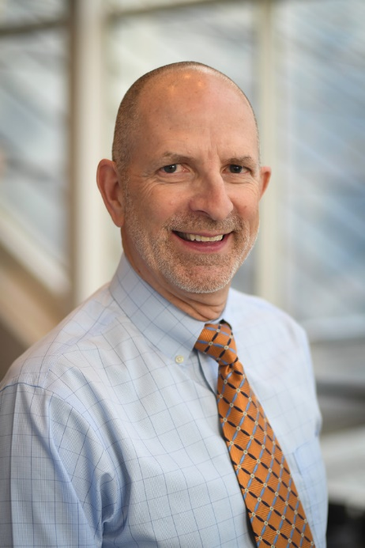
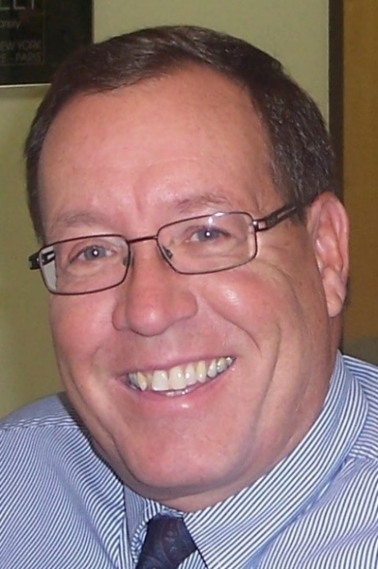
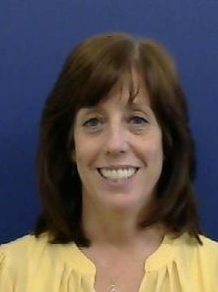
Tempus Unlimited Team
LARRY SPENCER
CEO and FI Director
22+ years as Director of F/EA Services
20 years as Tempus Unlimited CFO
9 years as Tempus Unlimited CEO
Applied Self-Direction Steering Committee Member
Commitment to Self-Direction
LAURA FRATICELLI
Assistant FI Director
11+ years as management at Tempus Unlimited
19+ years F/EA work at Tempus Unlimited
Applied Self-Direction Steering Committee Member
DAVID RIDDLE
VP of Operations/Assistant FI Director
8 years providing leadership and managing service delivery in FMS
20+ years prior experience in management and business relationship roles
Oversees integration and delivery of FMS services
LINDA ANDRADE
Director of Community Services
24+ years experience directing community service programs
16+ years participating as a stakeholder, providing leadership and managing service delivery to community based MassHealth Long Term Services and Supports Services.
Notes:
Steve

Slide 5
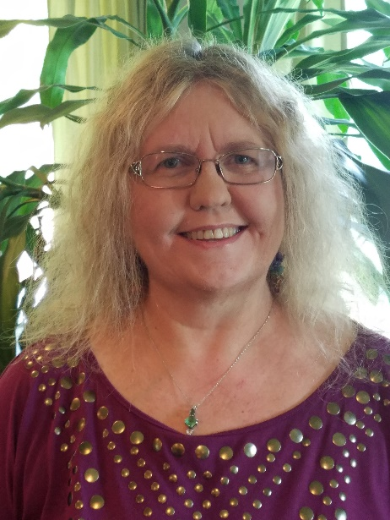
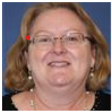
Tempus Unlimited Team
TERRI REESER
Manager, PA Program
14 years in management positions providing F/EA Services in PA OLTL and PA ODP programs
9 years as manager with Public Partnerships LLC in PA programs
20+ years of prior management experience
MARGARET BARRETT-HALL
Compliance and Quality Assurance Manager
ASQ Certified Manager of Quality/Organizational Excellence
CCB Certified in Health Care Compliance (CHC) & Certified in Health Care Privacy Compliance (CHPC)
9 years F/EA work at Tempus Unlimited
10 years prior work in Managed Care
Notes:
Steve

Slide 6
Tempus At a Glance

Slide 7
Tempus Unlimited exists to provide a continuum of community-based services that support the efforts of children and adults with disabilities to live as independently as possible in the least restrictive environment
MISSION
Facts
Non-profit organization
One of the largest Fiscal/Employer Agents in the country
Tempus board members and staff with disabilities bring lived experience to Tempus services
10+ years experience working in Managed Care
Coming soon: three Pennsylvania offices
Headquarters in Massachusetts

Slide 8
Tempus Approach
Set-up for Participants, common law employers (CLEs), and DCWs is quick and easy
Pay is on-time and accurate: daily processing of completed bi-weekly payrolls with reconciliations
Real people on the phone that help in real-time – first call resolution
Integrated, Participant-focused service delivery
Navigation of software and tools is simple
Training is proactive and flexible to meet the individual’s need
Notes:
Currently do payroll for 35,000 self-directing Participants and over 60,000 DCWs
Highlight real people on the phones

Slide 9
Key Milestones

Slide 10
Key Milestones
Transfer existing Participant, Common Law Employer and DCW data to Tempus
Hold information sessions for all stakeholders
Ensure Participants, common law employers and DCWs can easily access information and assistance from Tempus
Train Participants, common law employers and DCWs on new application for EVV and Self-Service tools
EVV requirements do not change
Collect and update required paperwork from Participants, common law employers and DCWs
Test, test, test to ensure payments will be smooth, accurate and on-time
Notes:
Make clear that EVV requirements do not change

Slide 11
Key Milestones to Launch April 2022
JUNE - JULY
AUGUST - SEPTEMBER
SEPTEMBER - DECEMBER
JANUARY - MARCH
APRIL 2022
Go Live
Existing payroll schedules remain
All EVV time recorded with new FMS entity
Payments made by new FMS entity
Announce new VF/EA FMS entity
Configure Test Environments
Extensive project planning
Develop data migration specifications
Transition & Communications
Information sessions begin
Stakeholder Meetings
Data migration from incumbent
Contact Participants and DCWs regarding certain paperwork
Training & Go-Live
EVV and Self-Service Tools Training for Participants, CLEs, DCWs
Participants, CLEs, DCWs sign needed forms
Ongoing Information Sessions
Ongoing Stakeholder Meetings
Regular written and other communication
Start EVV transactions in Tempus’ system/app
Timesheet Entry to begin starting March prior to the April go-live
Communications
Share timelines, key dates and contact information with stakeholders
Establish information websites
Data migration coordination

Slide 12
Communication Plan

Slide 13
Communication Workflow
In-Person Information Sessions
Monthly Updates
Information Webinars
Announcement
Information Site
Introductory Webinars
Training Webinars
In-Person Training Sessions
Notes:
Laura

Slide 14
What to Expect during Transition

Slide 15
What to Expect during Transition
Introductory emails and letters from Tempus
Common Law Employers will receive pre-populated transition packets from Tempus late-October
Participant/Common Law Employer Transition Packet
Direct Care Worker Transition Packet
Complete and return packets to Tempus within 2-weeks of receipt
Attend Tempus Training Sessions
WebEx
In-Persons
Introduction to Tempus EVV timesheet submission and approval process
Introduction to Tempus Enrollment Process
Notes:
Make clear that EVV requirements do not change

Slide 16
NEW! Informational Website
Website address: https://pa.tempusunlimited.org and this can be one of your primary sources of information
Check Frequently: Information and updates from the MCOs and from Tempus will be posted to the Documentation section
Webinars and In-person sessions: Soon we’ll post the schedules for important webinars and in-person sessions to assist you with paperwork and to answer questions
The FAQs will be updated as we provide more information to Participants, Common Law Employers, and Direct Care Workers
Notes:
Make clear that EVV requirements do not change

Slide 17
Frequently Asked Questions

Slide 18
Frequently Asked Questions
When does this change go into effect?
Tempus Unlimited will become your F/EA effective April 1, 2022.
Is PPL no longer my F/EA?
PPL is still your F/EA and will be until the transition to Tempus is completed April 1, 2022.
After April 1, 2022, Tempus will be your F/EA
Will there be any interruptions to my services?
You will continue to receive your services as authorized with no interruptions from this transition process.
Will my DCW(s) still get paid on time?
There will be no changes to the current pay schedule with PPL and DCWs will experience no interruptions in their regularly scheduled payroll from this transition process.

Slide 19
Frequently Asked Questions
Will we still be submitting our time the same way using PPL’s Time4Care mobile app?
You will still submit your time using PPL’s Time4Care mobile app until mid-March 2022.
Time submission will move to the new EVV system/app in March 2022. We will share more information on exact dates to stop using that tool.
What if I need to hire a new DCW between now and April 1, 2022?
You will follow the same processes you have been with PPL. There will be no interruption to the DCW hiring process from this transition.
Are there any changes that are in effect now? How will I know what is changing and when those changes go into effect?
Nothing in your service delivery has changed, and nothing will change in the services you receive except as the result of a reassessment.
In the upcoming weeks and months, additional information will be coming from OLTL, your MCO, and Tempus Unlimited about this transition.
No changes will take place before they have been communicated to you.

Slide 20
Frequently Asked Questions
What will change?
Your services will remain the same. Those are not changing unless it’s the result of a reassessment. What will change is that you will begin working with Tempus Unlimited in mid-March 2022 instead of PPL. They will support you as your F/EA and provide the same type of services you have been receiving from PPL.
There will be some changes in terms of to whom you communicate about your service delivery and how you communicate with them such as different phone numbers, fax numbers, e-mails, and websites.
The Portals and Web Apps you use for logging, submitting, reviewing, and editing time worked will be different, but payroll schedules will remain the same.
The EVV app will be all new and easier to use for Direct Care Workers and Common-Law Employers
What should I expect from this transition?
First and foremost, you should expect clear communication that occurs frequently. E-Mails, mailings, information site updates, as well as information sessions will all be regularly occurring during the transition.
You should also expect an inclusive and collaborative approach to the transition plan, with easy accessibility to both staff and resources throughout the processes.

Slide 21
Frequently Asked Questions
What do I have to do to get ready for this transition?
Today, there is nothing you need to do other than watch your email and stay in touch with your Service Coordinator to learn about upcoming activities
In the future, CLEs and DCWs will need to complete new tax forms and participate in systems training
Who do I contact / where do I go if I have more questions?
You can reach your MCO by contacting your Service Coordinator listed on your Service Plan
You can reach OLTL at 1-800-932-0939
You may also go to the Tempus Unlimited website for up-to-date information and resources at pa.tempusunlimited.org
Check Frequently: Information and updates from the MCOs and from Tempus will be posted to the Documentation section
Webinars and In-person sessions: Soon we’ll post the schedules for important webinars and in-person sessions to assist you with paperwork and to answer questions
The FAQs will be updated as we provide more information to Participants, Common Law Employers, and Direct Care Workers

Slide 22
Questions?

