Slide 1
Financial Management Services (FMS) Stakeholder Meeting FMS Vendor Transition for Self-Directed Services
Community HealthChoices
February 4, 2022

Slide 2
Agenda
FMS Transition
Presented by your Community HealthChoices MCOs: AmeriHealth Caritas PA CHC, Keystone First CHC, PA Health & Wellness, Inc., UPMC
AND Tempus Unlimited
Transition of Financial Management Services
Information Sessions
Payroll
EVV Training
What’s New
Tempus Website
Questions

Slide 3
Transition of Financial Management Services

Slide 4
Sharing the News!
How communications are being provided
Monthly letters from each MCO August and September
Monthly letters from Tempus since October
Monthly Stakeholder meetings started in June
Service Coordinators including information on transition in touch base discussions
Frontline calling and texting campaign to DCWs
PPL including messages on EVV app, portal, messaging system and in envelope stuffers
MCOs partnering with PHLP (Pennsylvania Health Law Project) with talking points and requests to guide participants to the correct place with questions
Common Law Employer and Direct Care Worker Transition Packet mailing in November and ongoing for new enrollments

Slide 5
Sharing the News!
How communications are being provided
Tempus Call-in/Online WebEx Transition Information Sessions held in November and December
Tempus hosted In-Person Transition Sessions in December
General Question & Answer Call-in/Online WebEx Sessions starting in January through transition
Tempus EVV Training started in January

Slide 6
Transition Packets for Common Law Employers and Direct Care Workers
Tempus mailed pre-populated Transition Packets with information received from Public Partnerships LLC.
Packets mailed to the Common Law Employer’s address on file.
Participant/Common Law Employer Transition Packets include:
Cover Letter
CLE Enrollment Checklist
Common Law Employer Agreement *
IRS Form 2678 - Employer/Payer Appointment of Agent *
Tempus Notice of Privacy Practices
* Sign and Return; Requires signature of the CLE
Direct Care Worker Transition Packet sent for EACH of your DCWs. Packets include:
Cover Letter
DCW Enrollment Checklist
Direct Care Worker Agreement **
Direct Care Worker Information and Acknowledgement Form **
** Sign and Return; Requires signature of both the CLE and the DCW

Slide 7
Transition Packet Mailing
Initial CLE and DCW transition packets mailed by end of November 2021
Packets mailed to “active” or “good to go” CLEs and DCWs based on information provided by PPL.
Packets returned to Tempus as undeliverable are being researched to make sure everyone gets a packet who should receive a packet.
Some packets were mailed to Participants who transferred to Agency Model and no longer using self-directed services.
Tempus and CHC-MCOs are going through the list to remove those not using self-directed services.
As new Participants and DCWs complete the enrollment process with PPL, Tempus will mail transition packets when notified of an “active” or “good to go” status through regular updates provided by PPL.
Participants who did not receive a transition packet for themselves or an active DCW, should complete a packet request on the Tempus website at https://pa.tempusunlimited.org or email Tempus at PAFMS@tempusunlimited.org or call 1-844-9TEMPUS (1-844-983-6787).

Slide 8
Preparing for What’s Ahead
Tracking of packets to ensure individualized outreach for no response or corrections needed
Pre-populated forms – easy to complete
Low percentage of corrections – doing individual outreach for corrections
MCOs socializing information for all participants throughout organizations
MCOs preparing internally with staff training and education, as well as team updates

Slide 9
Transition Progress – Packets
Transition Packet Statistics
48% of CLE packets and 40% of DCW packets were returned
Tempus planning to re-mail transition packets to all individuals who have not returned their packet
Transition packet requests can be submitted on the Tempus website
During EVV training sessions, CLEs and DCWs reminded to return their packet
Transition Packets returned that are incomplete
Tempus is identifying categories of issues and doing targeted communication that includes text, email and phone messages
Transition Packets need to be returned and complete prior to first payroll check on April 1, 2022

Slide 10
Transition Progress – Call Center
Call Center Stats and Activity
Dedicated Pennsylvania toll-free phone line
Average wait time is 6 minutes as of yesterday (2/3/2022)
Staffing Plan for Call Center
Hiring of call center staff is ongoing
Professional trainer hired to decrease training time for new hires
Developing tiers of support for Customer Relations Department
How is Tempus managing call backs and responses to emails
Auto call back feature will be implemented February 4
Most call backs made by Customer Relations staff after 4:30 pm when inbound calls end
Emails are reviewed and routed to the appropriate department for a response

Slide 11
Transition Progress – Call Center
Tempus anticipates call volume will spike March 6 and again on March 13 when time needs to be submitted to Tempus
Expect incoming calls from individuals who didn’t return a packet or attend EVV training
Tempus plan to assist CLEs and DCWs
Dedicated group to handle EVV questions
Additional Q&A sessions for non-EVV questions
“How to” Guides on how to submit and approve time worked will be posted to Tempus website
Recording of EVV Training sessions will be posted to the Tempus website soon
Scheduled EVV sessions will continue through end of March
Telephony option available

Slide 12
Information Sessions

Slide 13
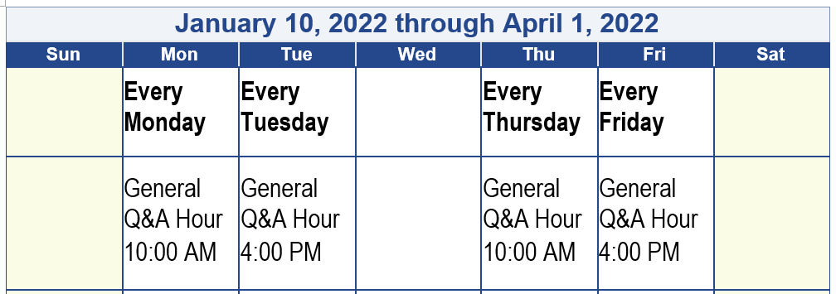
Call-in and Online Information Sessions
Tempus will host one hour Question and Answer Call-in and Online WebEx sessions through the transition to answer general questions from Participants, CLEs and DCWs.
Login Information included in the monthly communication and posted to the Tempus website at https://pa.tempusunlimited.org/.
Please note: These are NOT EVV training sessions.

Slide 14
Payroll

Slide 15
Payroll Timeline
Tempus will issue payroll checks starting April 1, 2022
Payroll schedules for Participants will remain the same
Participants on Schedule B with PPL
Services beginning with pay period 3/6–3/19/2022 will be submitted to Tempus
Payment date 4/1/2022
The payroll period of 3/20-4/2/2022 will be paid on 4/8/2022
Check dates will be every 2 weeks thereafter (4/22; 5/6; 5/20; etc.)
Participants on Schedule A with PPL
Services beginning with pay period 3/13–3/26/2022 will be submitted to Tempus
Payment date 4/1/2022
Check dates will be every 2 weeks thereafter (4/15; 4/29; 5/13; etc.)

Slide 16
EVV Timesheet Submission and Approval Process Training

Slide 17
Timesheet Submission & Approval Process
Electronic Visit Verification (EVV) requirements do not change. Changes to process include:
New app to clock in and clock out
New process for DCWs to review and submit time to CLE for approval
New approval process for CLEs
New phone system option for DCWs and CLEs to record and approve time
Important information regarding Tempus user accounts:
All CLEs and DCWs must have a unique email address
CLEs and DCWs will need to provide Tempus their email address
To provide email address to Tempus, visit https://pa.tempusunlimited.org/ and click on the email survey link, answer the questions, and submit the form
“How to” videos explaining how to get free email accounts with Google, Microsoft and Yahoo! on Tempus website
Every Common Law Employer and Direct Care Worker will need to be trained.

Slide 18
Timesheet Submission & Approval Process
Beginning January 10, 2022, Tempus began to host multiple training sessions for CLEs and DCWs.
Training will be conducted through:
Online WebEx Sessions
In-person Sessions
How-to Guides and Training Videos will be posted to the Tempus website
Training topics include:
How to download and use the Tempus EVV app to clock in and clock out
How to use the Tempus portal to submit time worked, edit a shift and create a manual entry
How to use Tempus phone system to clock in and clock out
How to approve or reject a shift
How to use the Tempus portal to view timesheet and payment information
How to obtain a user account to access the Tempus EVV app and Tempus portal

Slide 19
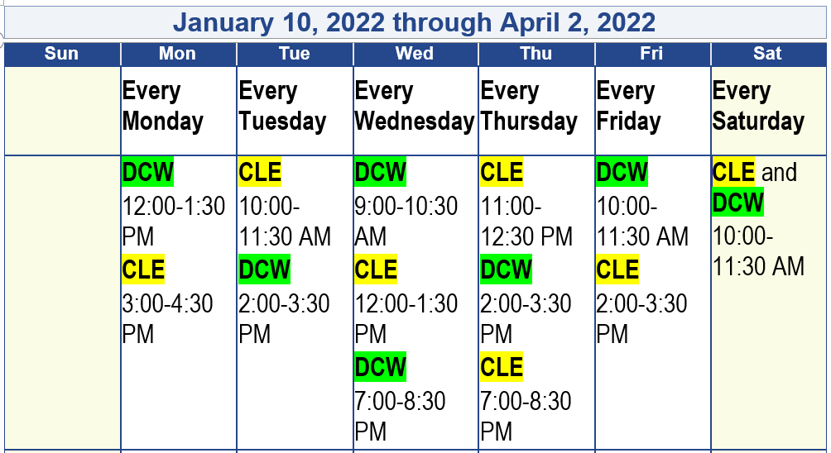
Timesheet Submission & Approval Process
Tempus will host 90 minute Online WebEx sessions from 1/10/2022 through 4/2/2022 for CLEs and DCWs to learn how to submit and approve time worked.
Login Information included in the monthly communication to CLEs and posted to the Tempus website at https://pa.tempusunlimited.org/.

Slide 20
What’s New

Slide 21
What’s new with Tempus
DCWs will have three payment options to receive their paycheck
Direct Deposit
Paper Check
New – U.S. Bank Debit Card option
Tempus will assist with DCW enrollment for the Debit Card
Call center call back feature
Enhanced Training for Direct Care Workers
The direct care workforce has a challenging job
Considerable skill level is needed to provide direct care
Advances skills and knowledge
It advances productivity and performance
Training develops work ethics, relationships, and safety
It standardizes work processes while recognizing unique nature of each participant
It boosts morale and improves worker satisfaction
Participants will feel impact of elevated service

Slide 22
Tempus Website

Slide 23
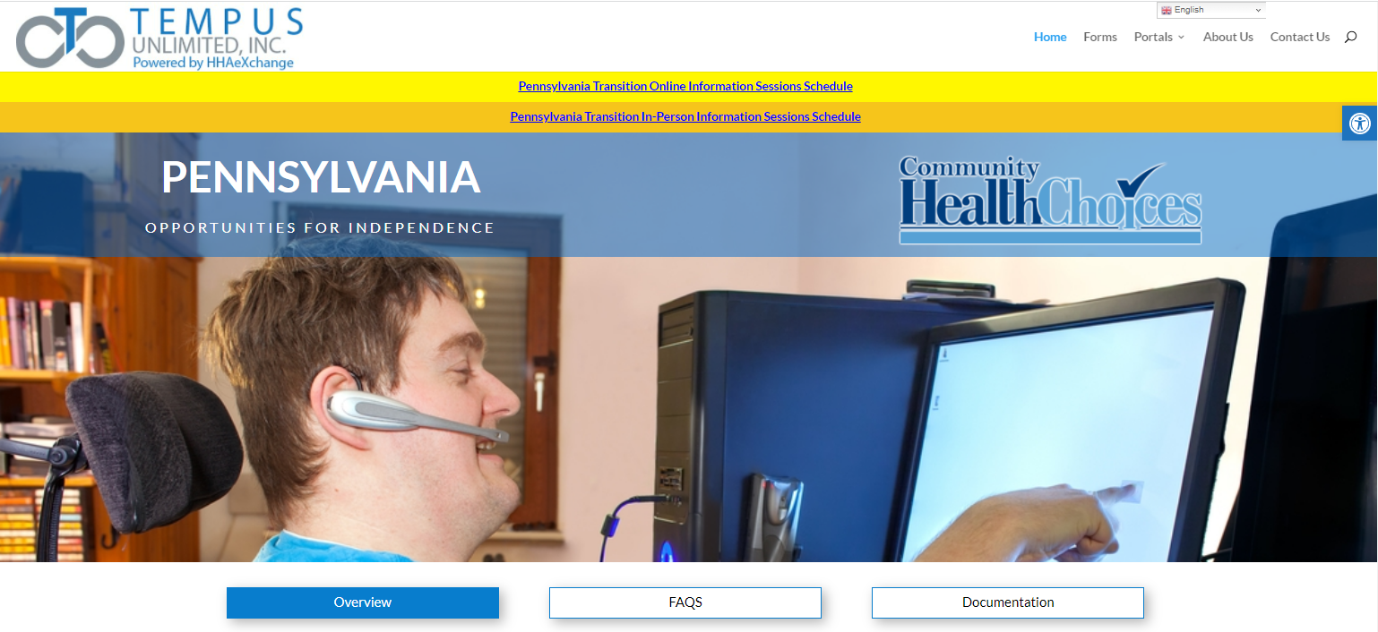
Tempus Informational Website
Website address: https://pa.tempusunlimited.org
This is your best source of information
Check Frequently: Information and updates from the CHC-MCOs and from Tempus will be posted to the Documentation section
Webinars and In-person sessions: Schedule posted with important webinars and in-person sessions to assist you with submitting and approving time worked
The FAQs will be updated as we provide more information to Participants, Common Law Employers, and Direct Care Workers

Slide 24
Pennsylvania In-State Hiring Initiative
Tempus is hiring remote and in-office staff for Pennsylvania
Tempus is opening three offices in Pennsylvania
Pittsburgh Area
Central Pennsylvania
Philadelphia area
Individuals with lived experience or an understanding of self-direction would be valuable
Please check the Tempus website frequently for job openings:
Website: https://tempusunlimited.org

Slide 25
Questions?

